Slide 1

Before starting RE for today , please try to log in to ‘Twinkle Go’!

Slide 2
Twinkle Go!
Let’s Have a Go!
Please could you try to log in to ‘Twinkle Go’ for extra resources.
If you are unable to access the resources there are still some on the school website.
I would like to use this site for extra ,interactive PPTs and files that are too large to upload onto the school website.
The login details should be in the email sent to you yesterday, if not let me know and I’ll resend it.
If you personalise passwords, please keep these details as I will not have a record of the changes you have made.
Please let me know how you get on and if you now have access.
Step by step instructions are on the next slide.

Slide 3
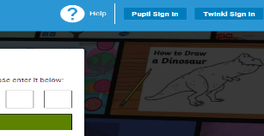

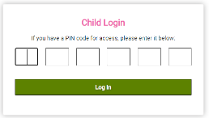
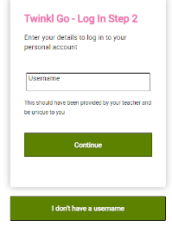

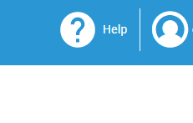
TWINKLE GO
Follow the instructions to have access to Twinkle Go
Follow this link:
https://www.twinkl.co.uk/go
Select the ‘Pupil Sign In’ button in the top, right hand corner
Enter the PIN code: ZV2730
(This will change when I add resources or topics)
Now fill in the Username and password e-mailed to you.
This is your account. Click on the account icon to see resources shared.

Slide 4

Why is The Mosque important to Muslims?
Below are a selection of video clips to watch as well as a PPT in the folder before you complete the activity sheet.
Kaisan visits a London Mosque
https://www.bbc.co.uk/teach/class-clips-video/religious-education-ks2-my-life-my-religion-east-london-mosque/zmctvk7
Kaisan demonstrates ‘Wudu’ –washing ritual
https://www.bbc.co.uk/teach/class-clips-video/religious-education-ks2-my-life-my-religion-washing-ritual-wudu/zvmrwty
If you login in to Twinkle Go, you will find: Looking around a Mosque ( potos)
Places of Worship PPT (photos)
Places Of Worship ( inside a Mosque)
Islam ( interactive PPT)
Twinkle Go-PIN:
ZV2730

Slide 5
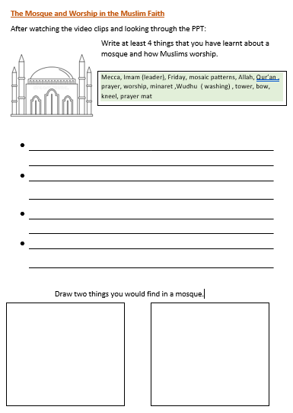
Complete the activity sheet.
write in full sentences
use neat handwriting
use detail and colour
in your drawings

Slide 6

Follow the link for Today’s Worship
In the Whole School Folder

