Slide 1


Slide 2

This week we are going to take a look at verbs and verbs ending in ‘ing’.

Slide 3

A verb is often known as a doing word
I like to call it an action word.
A verb is a word that describes the action in a sentence.
For example
I play football.
We eat lasagne for tea.
They sit at their desks to work.

Slide 4

By adding ‘ing’ to verbs we can show that something is happening or has happened.
For example
The dog is barking.
The child was writing their homework.
I am swimming in the pool.
We were running to the forest.

Slide 5
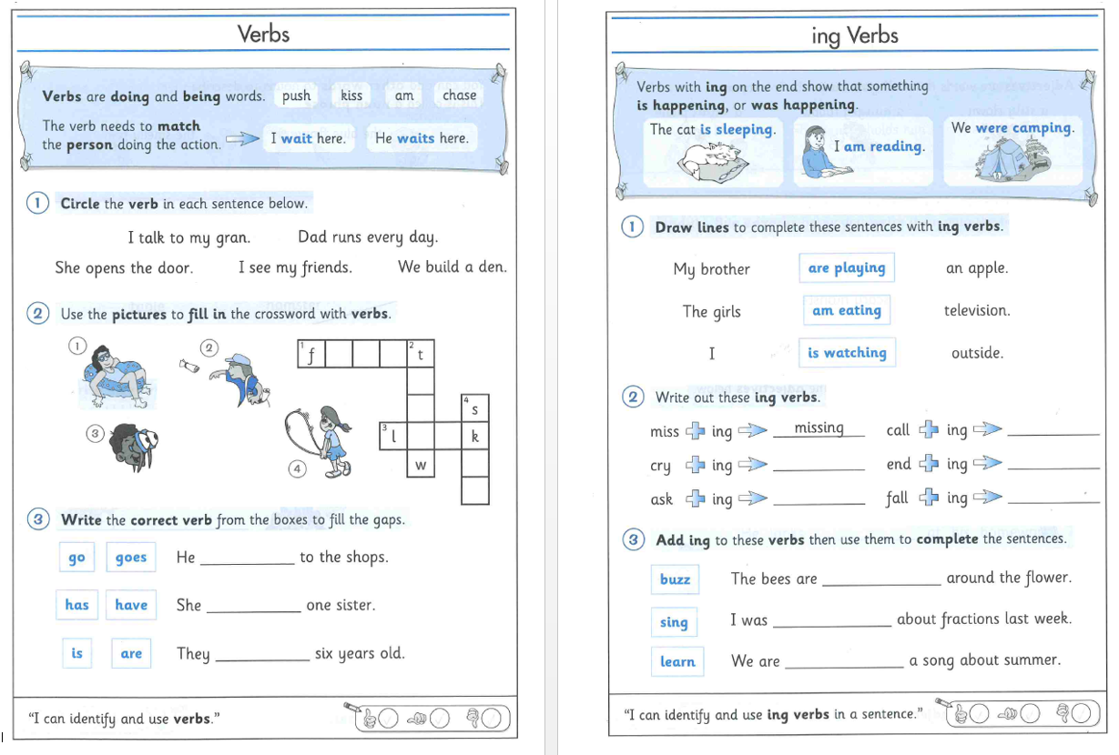
Can you complete the worksheets on verbs and ‘ing’ verbs.
After you have completed it can you write your own sentences and underline the verbs or ‘ing’ verbs.
If you are unable to print the worksheet, completing it on a separate book or paper will be great.

