Slide 1

Digital Literacy
This term we will be following the BBC Bitesize computing curriculum.
We will be using both KS1 and KS2 lessons where appropriate for Year 3.
Each short lesson contains games, interactive programmes or video clips to help you understand the topic.
As the lessons are short we may cover two in one session.
This week we will be looking at:
Lesson 1: What is the Internet?
There is a video clip to watch.
https://www.bbc.co.uk/bitesize/topics/zymykqt/articles/zgwnsbk
Lesson2: How can you use the internet?
There is an interactive activity.
https://www.bbc.co.uk/bitesize/topics/zymykqt/articles/zgqfyrd

Slide 2
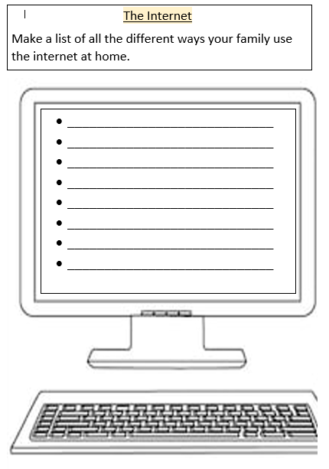

Slide 3
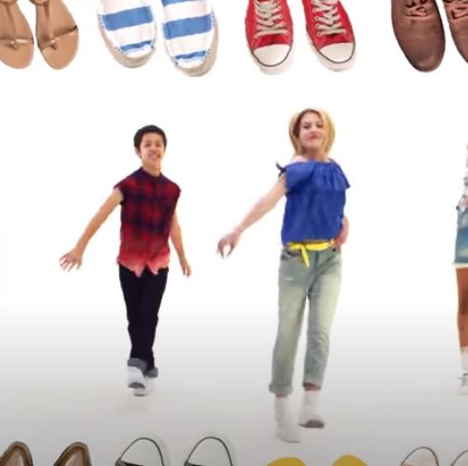
https://www.youtube.com/watch?v=lJPvEs8qpQc
Go Noodle
Get Up and Dance!
Footloose:
Can’t Stop the Feeling
https://www.youtube.com/watch?v=KhfkYzUwYFk

Slide 4

Follow the link for Today’s Worship
This can be found in the
‘Whole School’ folder.

