Slide 1


Slide 2
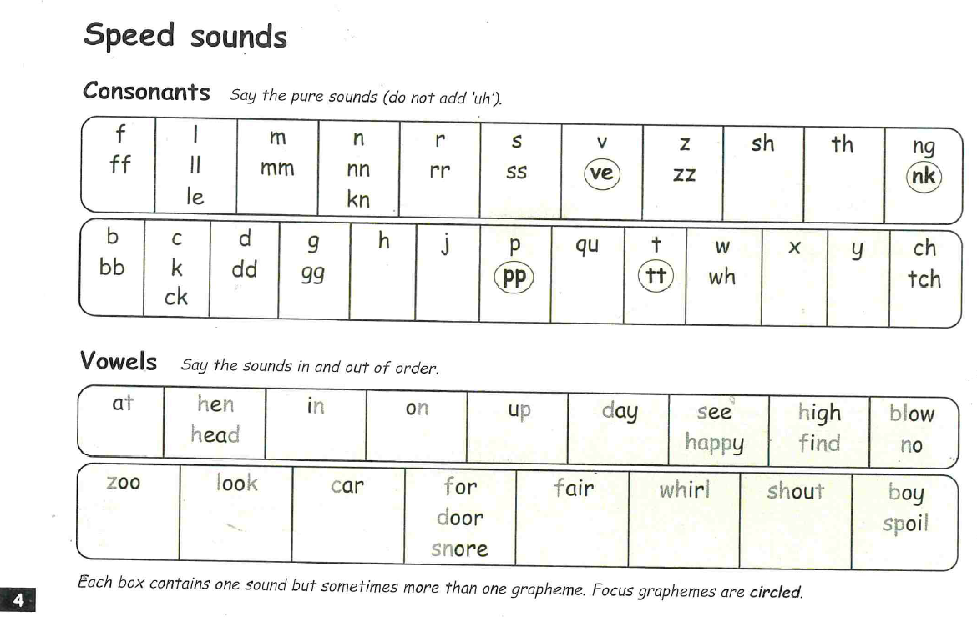

Slide 3
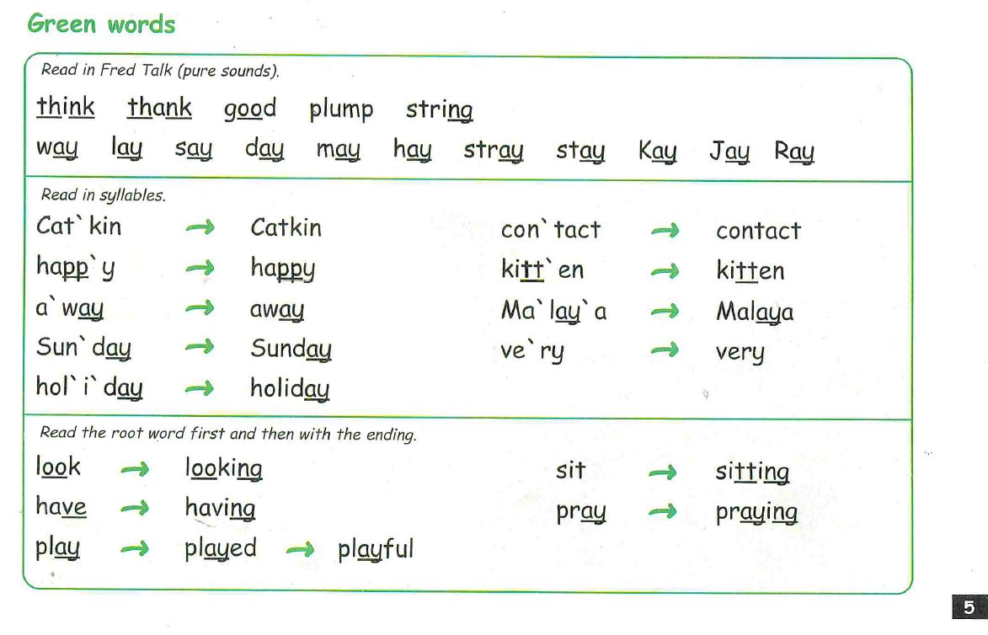

Slide 4
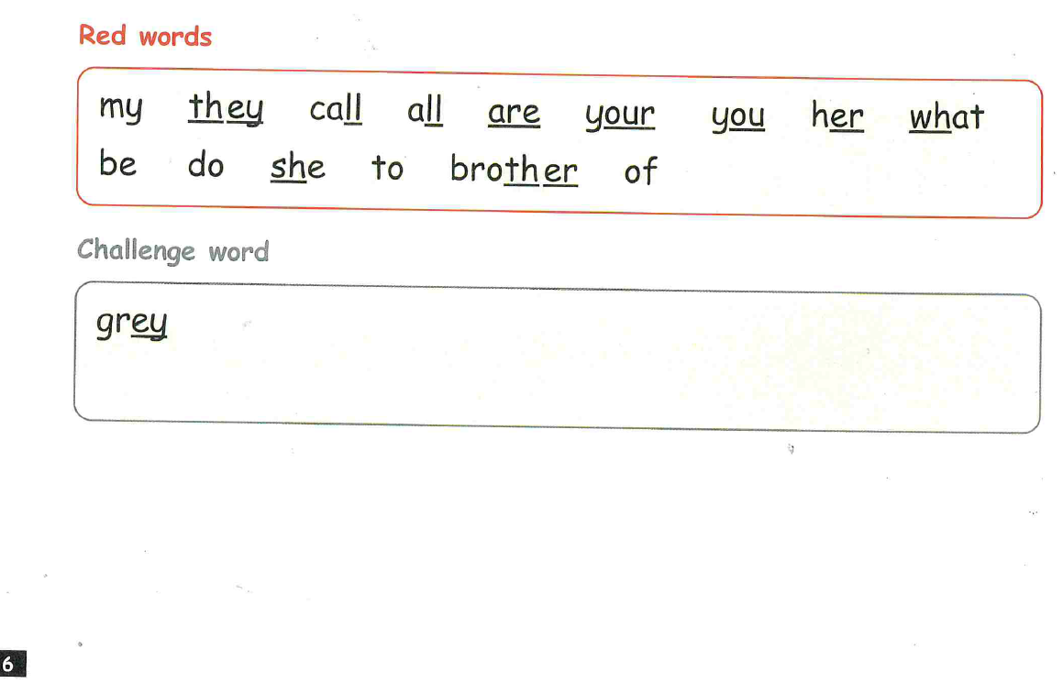

Slide 5
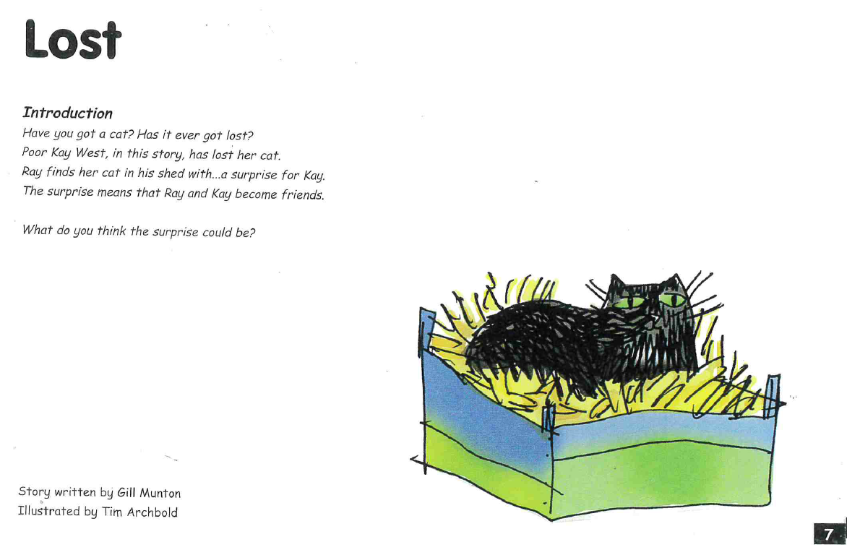

Slide 6
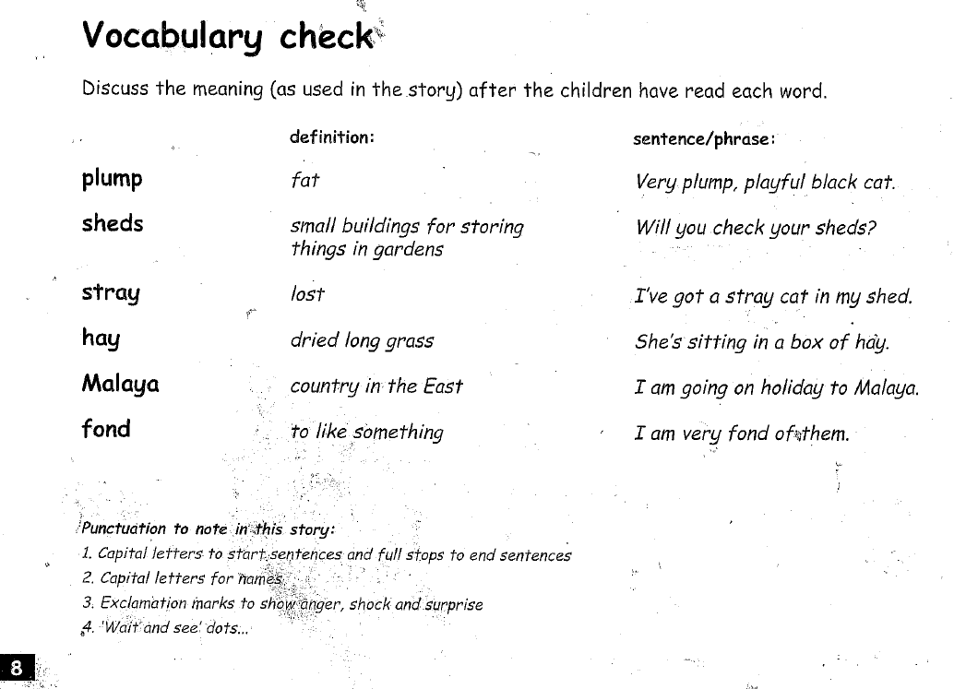

Slide 7
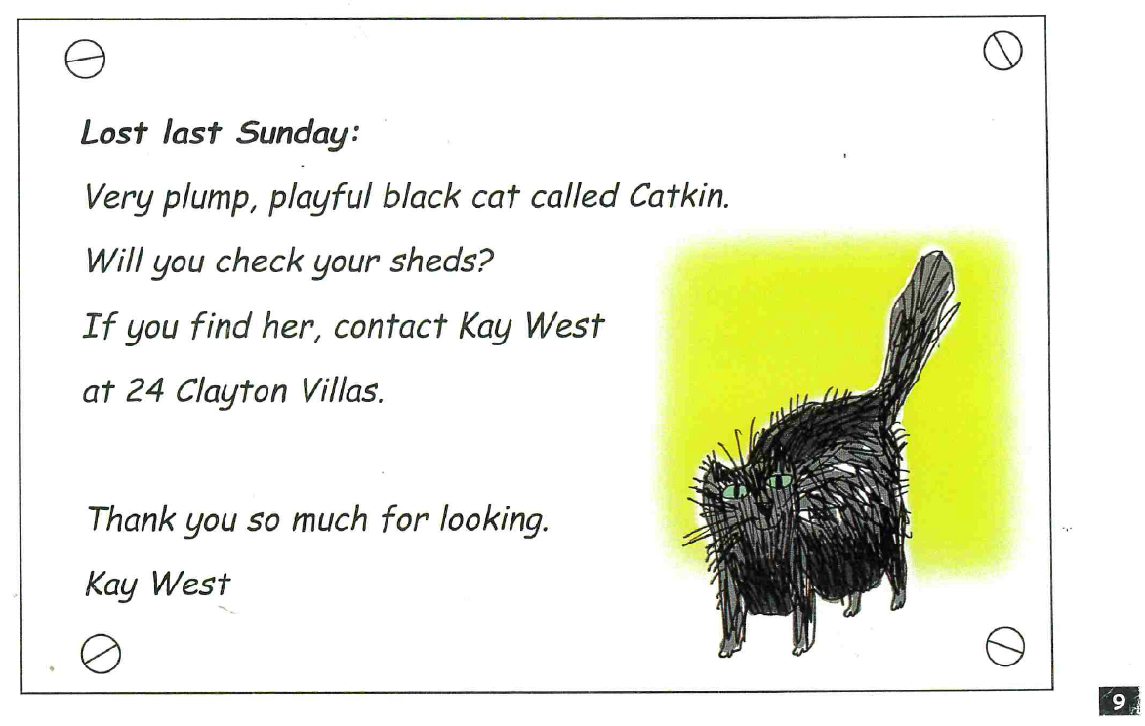

Slide 8
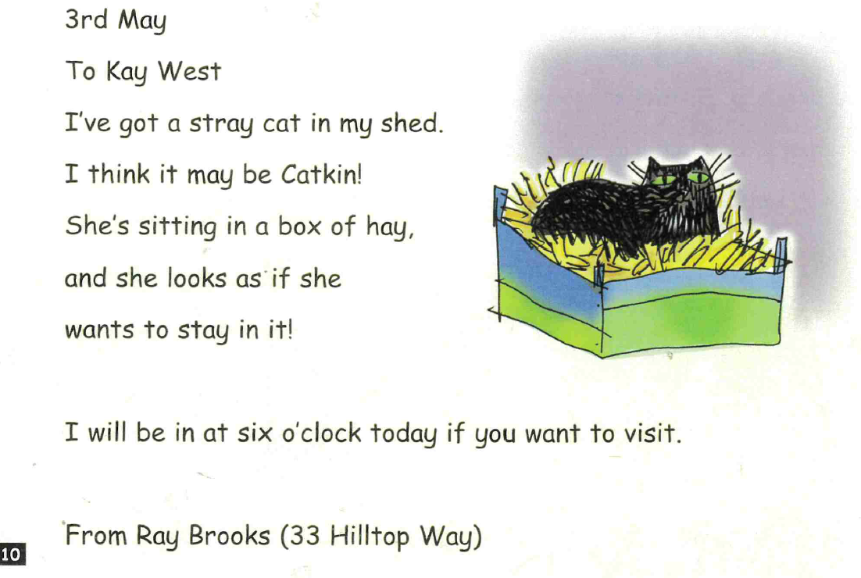

Slide 9
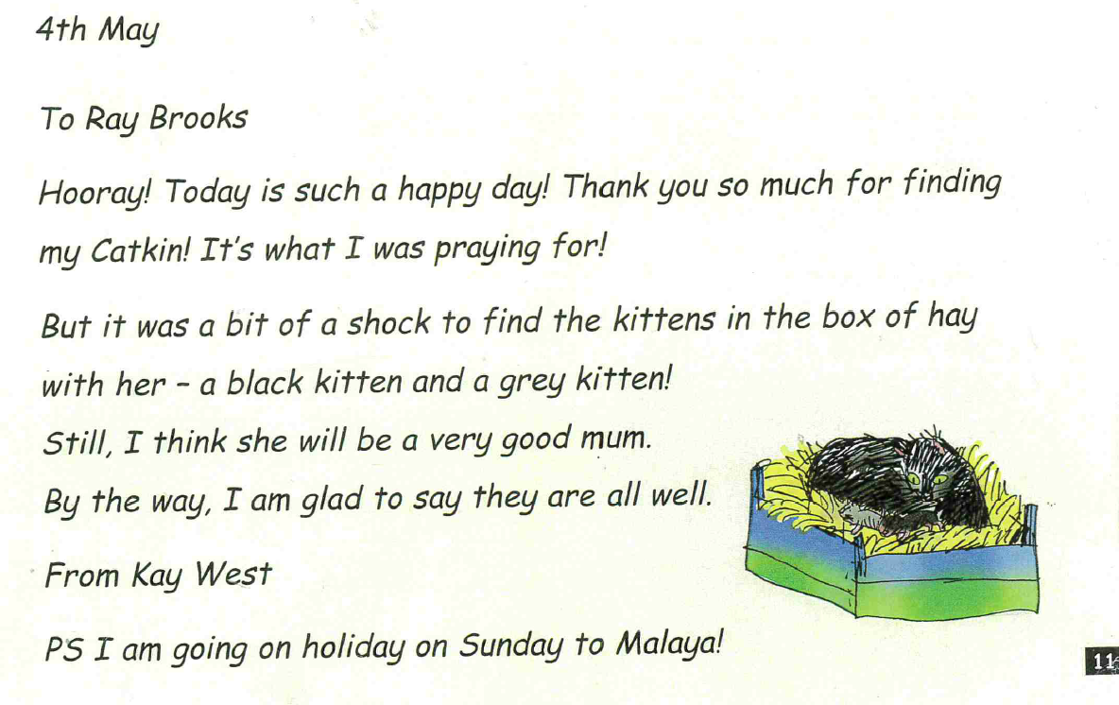

Slide 10
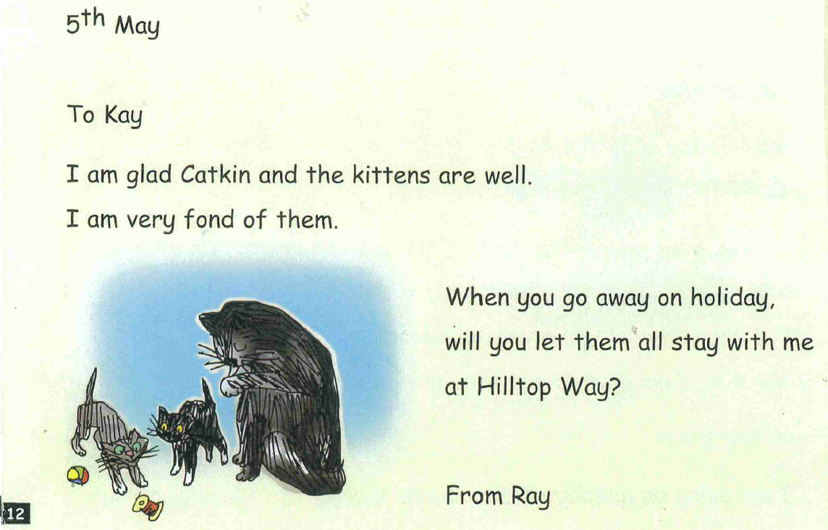

Slide 11
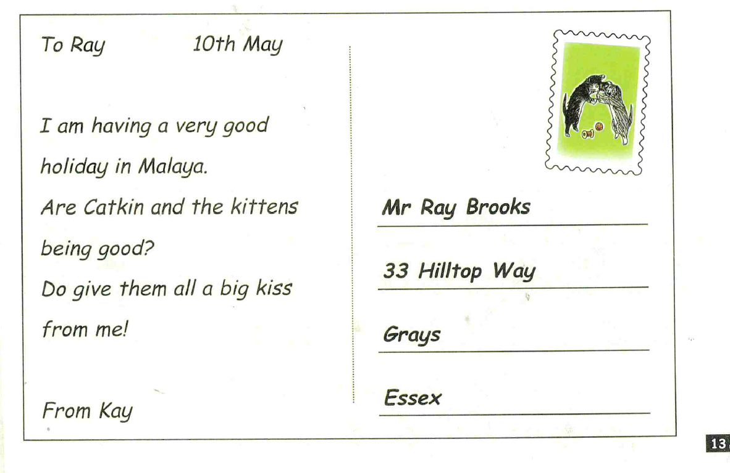

Slide 12
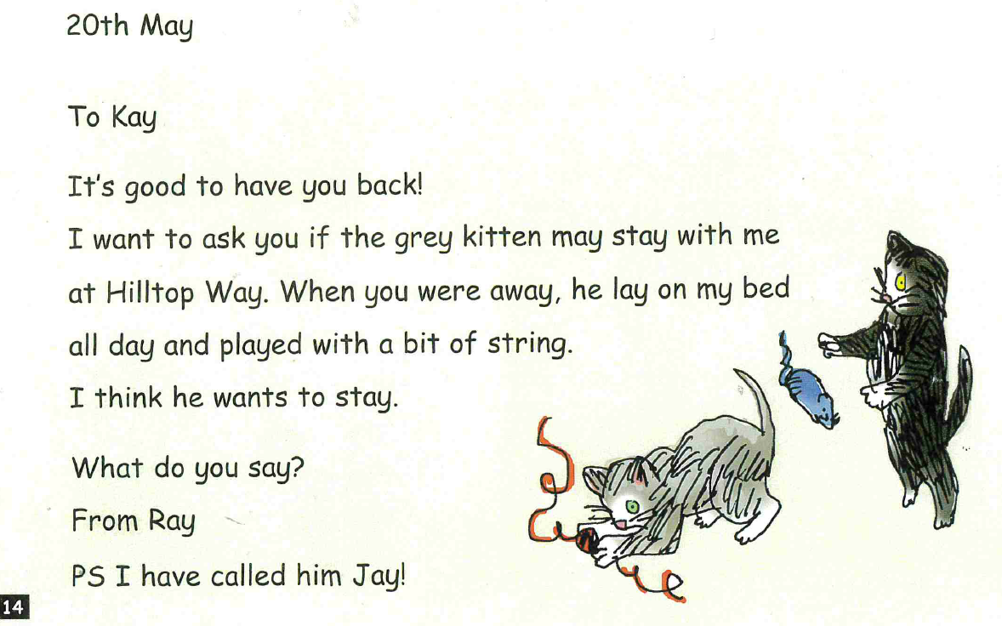

Slide 13
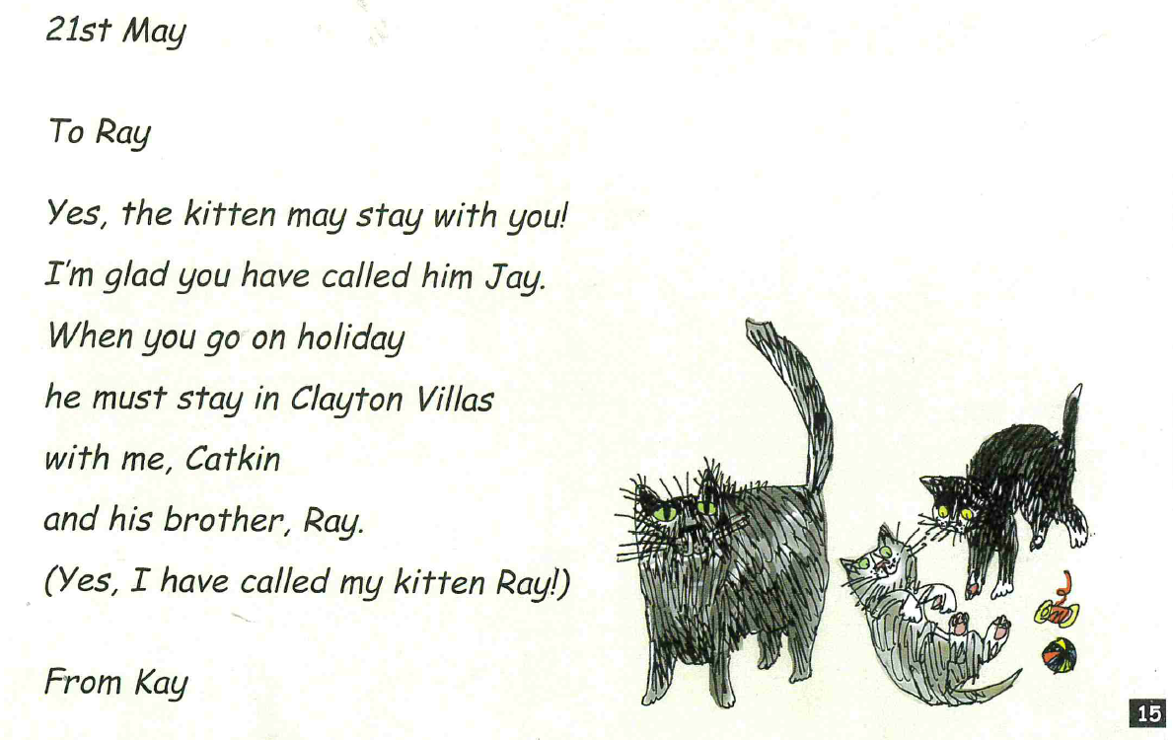

Slide 14
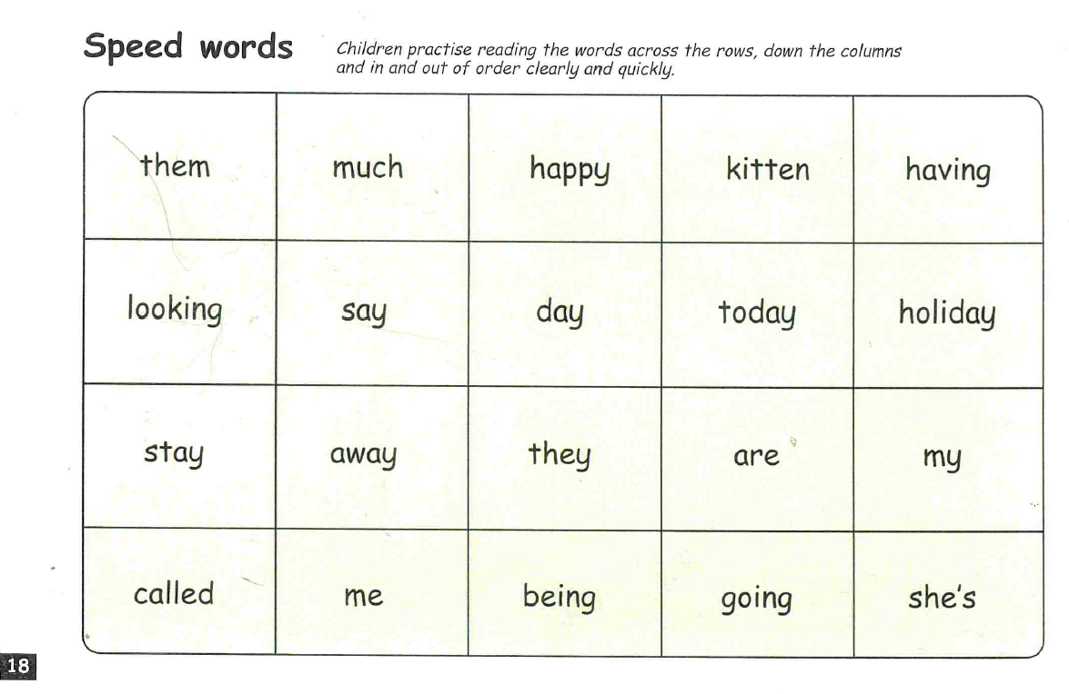

Slide 15



Edit a Sentence
2. Build a Sentence
The worksheet can be found on website or follow the PowerPoint and
write in a book or on handwriting paper.

Slide 16
Edit a sentence
Can you rewrite the below sentence for me please correcting all the mistakes. The correct sentence is on the following slide. No peaking until you have finished!
There are 2 capital letters missing
2 spelling mistakes
2 full stops missing
he lay on my bed all day he playd with a bit of strig
Then mark it using the correct sentence on the next slide.

Slide 17
He lay on my bed all day. He played with a bit of string.

Slide 18

Build a sentence
Your word for today is - mischief
What does it mean? Can you find out?
Your job is to write a really creative sentence using this power word.
Can you include:
‘wow’ vocabulary
Add a conjunction to extend your sentence – and, or, but, so, if, because, when, that
Remember the 3 golden rules – capital letters, full stops and your sentence must make sense
Don’t forget to use your headphones to say your sentence out loud before writing it down.
E.g. Catkin’s kittens was full of mischief leaping and bouncing on Ray’s bed.

Slide 19


