Slide 1


Slide 2
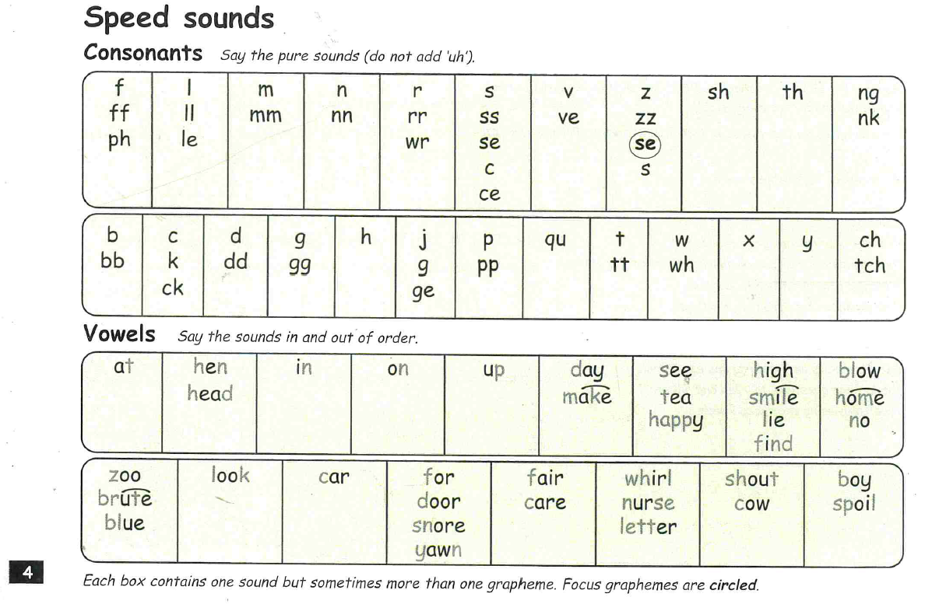

Slide 3
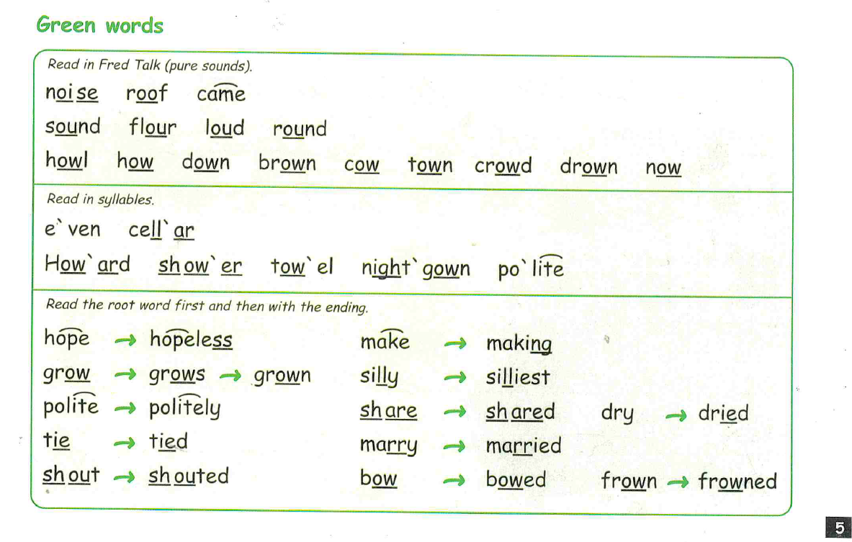

Slide 4
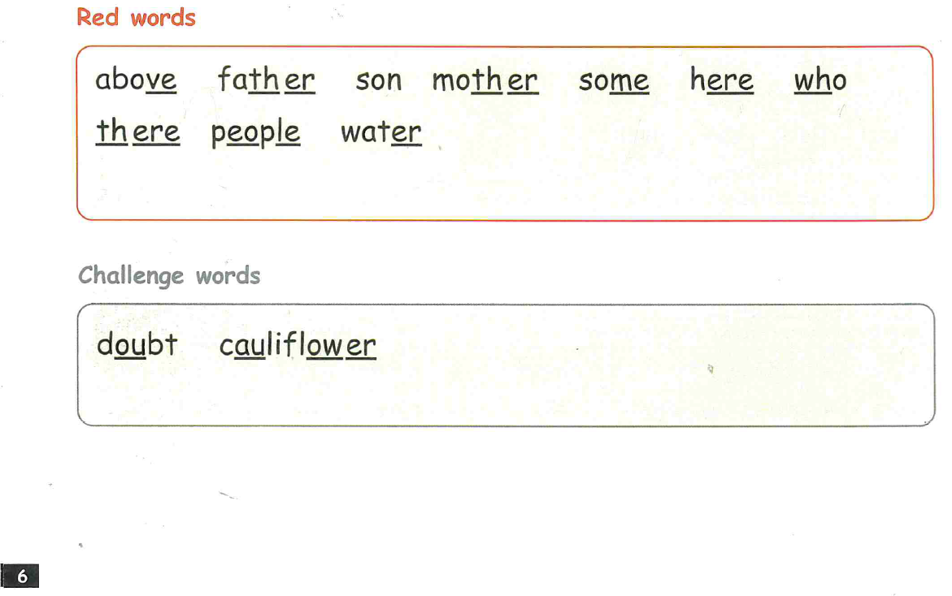

Slide 5
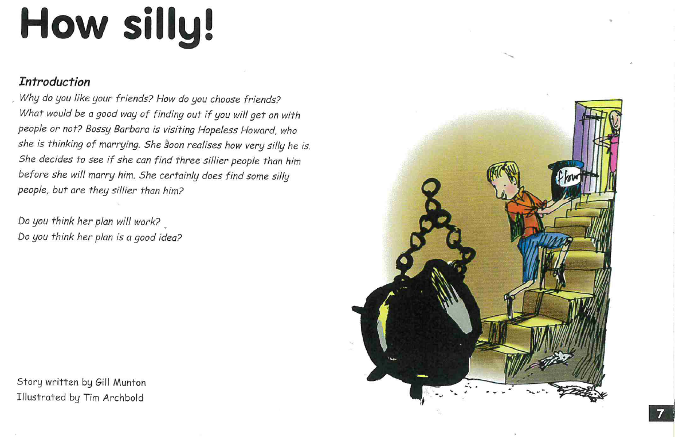

Slide 6
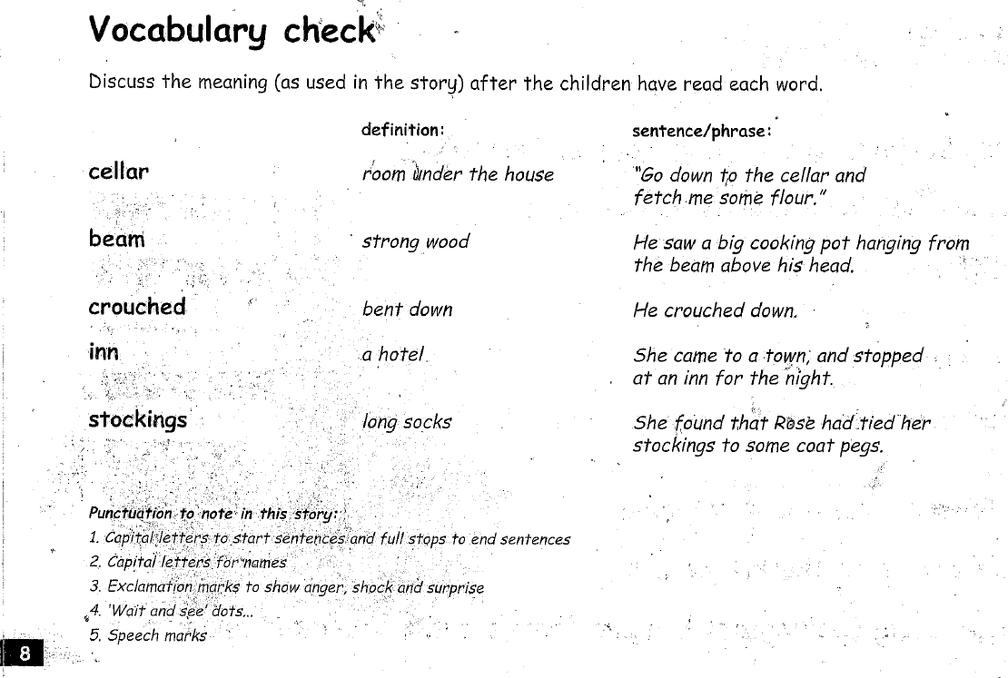

Slide 7
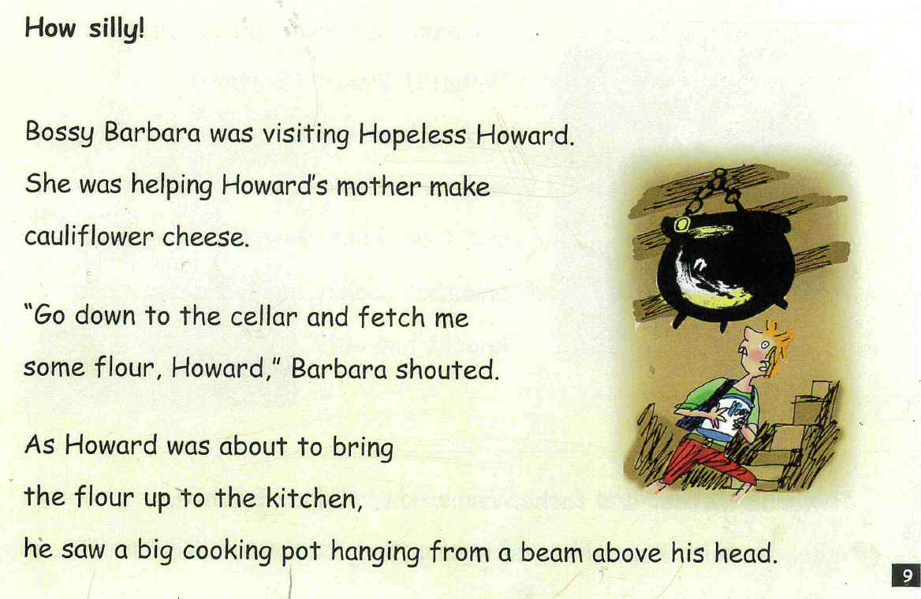

Slide 8
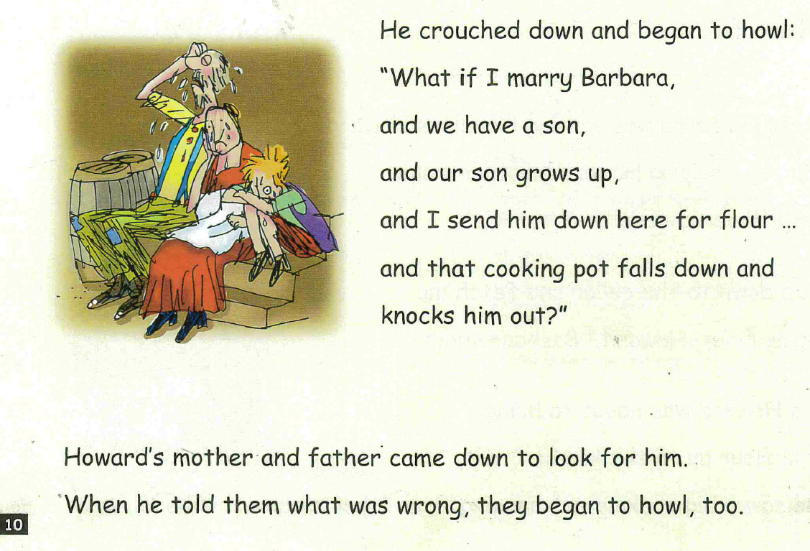

Slide 9
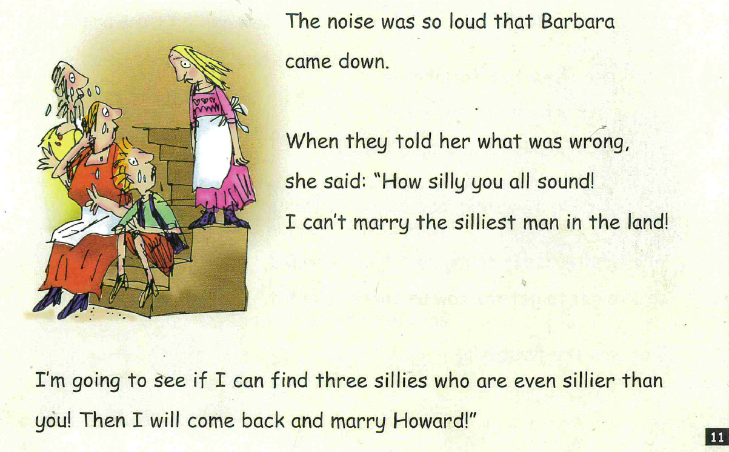

Slide 10
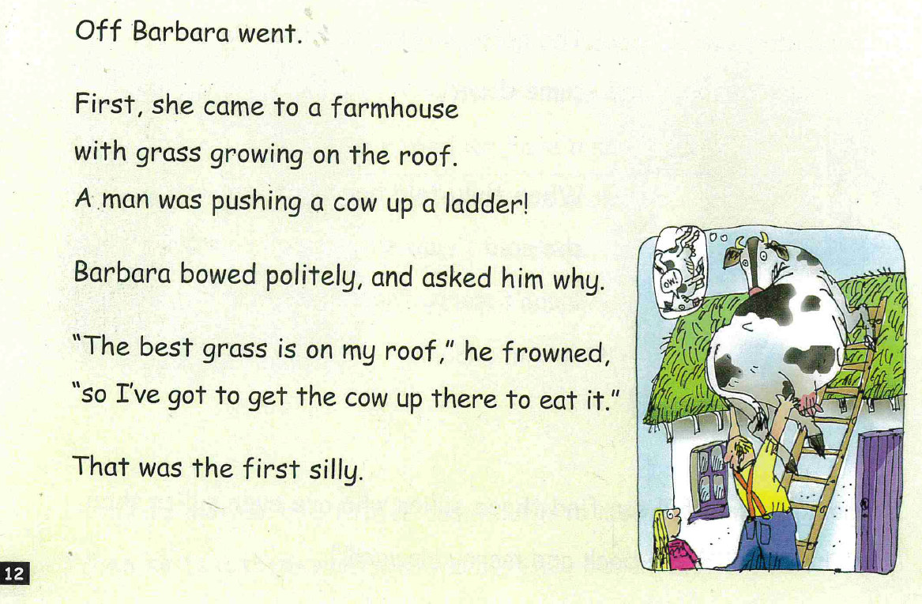

Slide 11
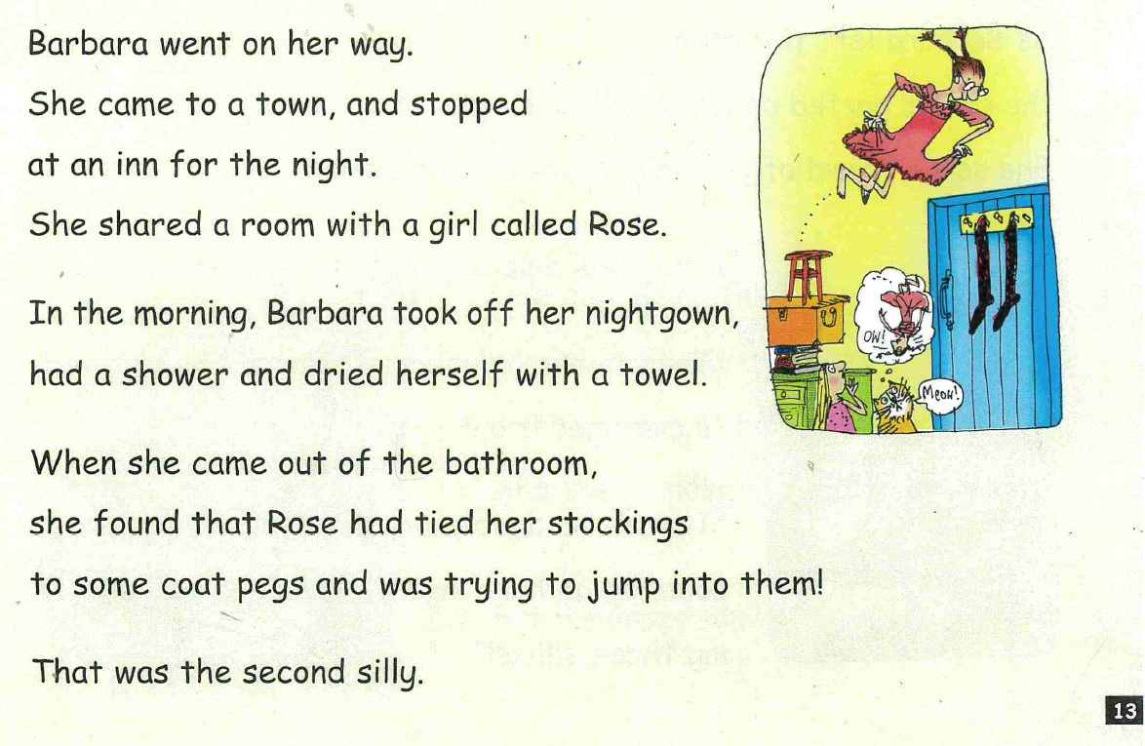

Slide 12
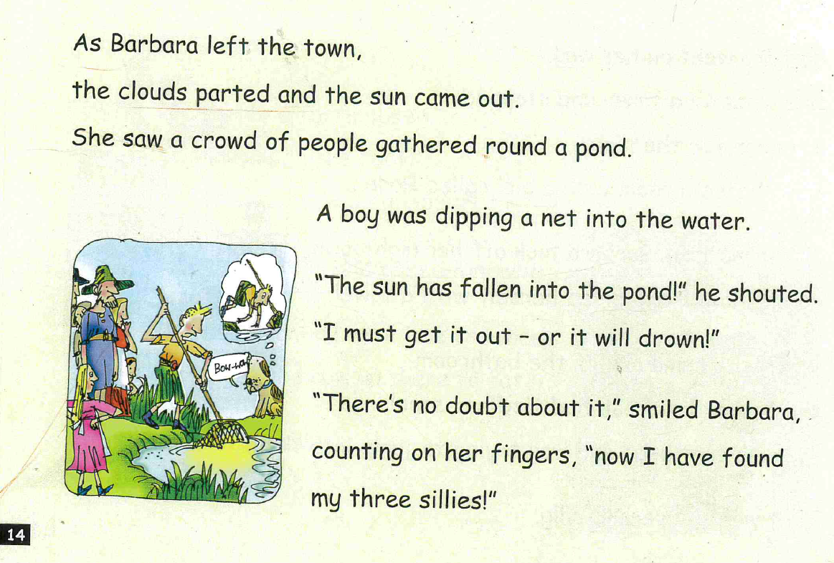

Slide 13
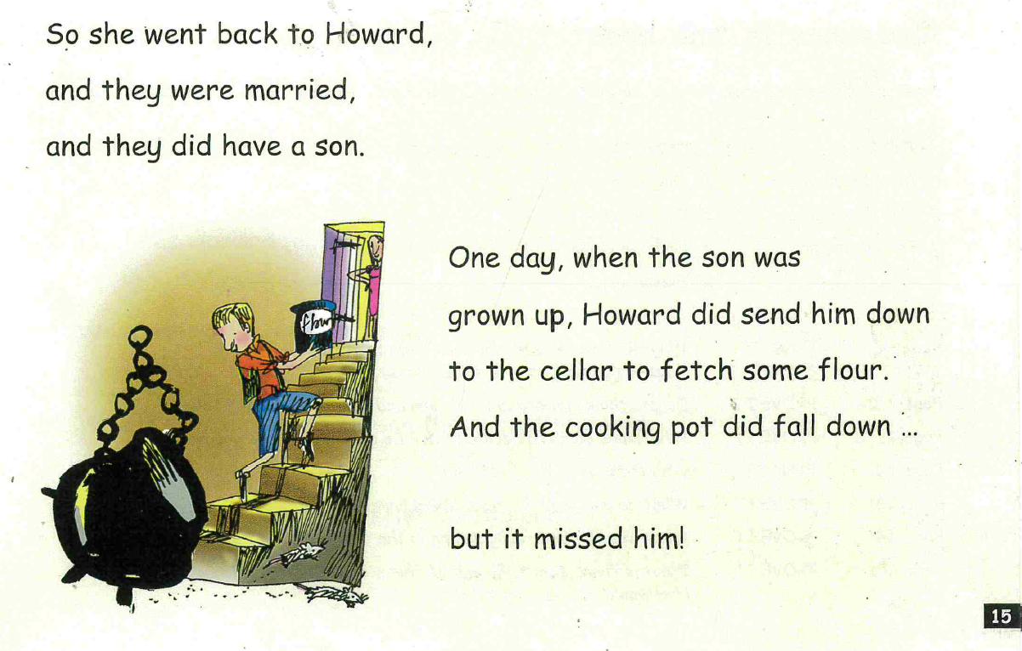

Slide 14
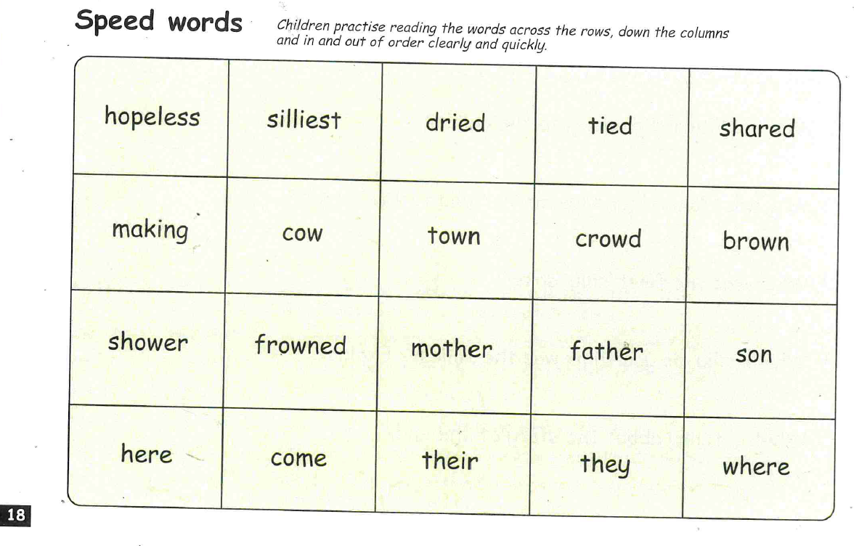

Slide 15

Reading Comprehension
Questions for the reading comprehension can be found on the website.

Slide 16


Remember to write in full sentences – here is an example…
Why did the boat sink?
The boat sank because the basket was too heavy for the boat to carry. ✓
Too heavy. ✗

Slide 17


