Slide 1
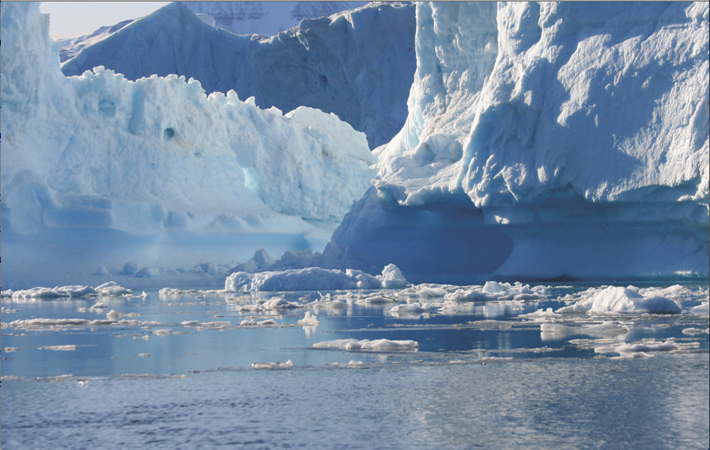
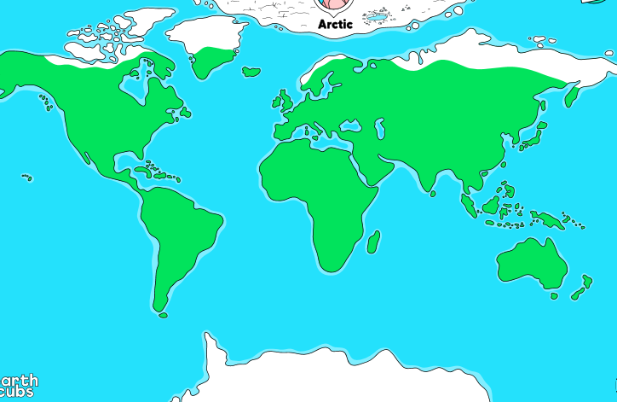
The Arctic
Remember that the Arctic is found in the far North (top) of our earth. The North Pole is located in the Arctic.

Slide 2
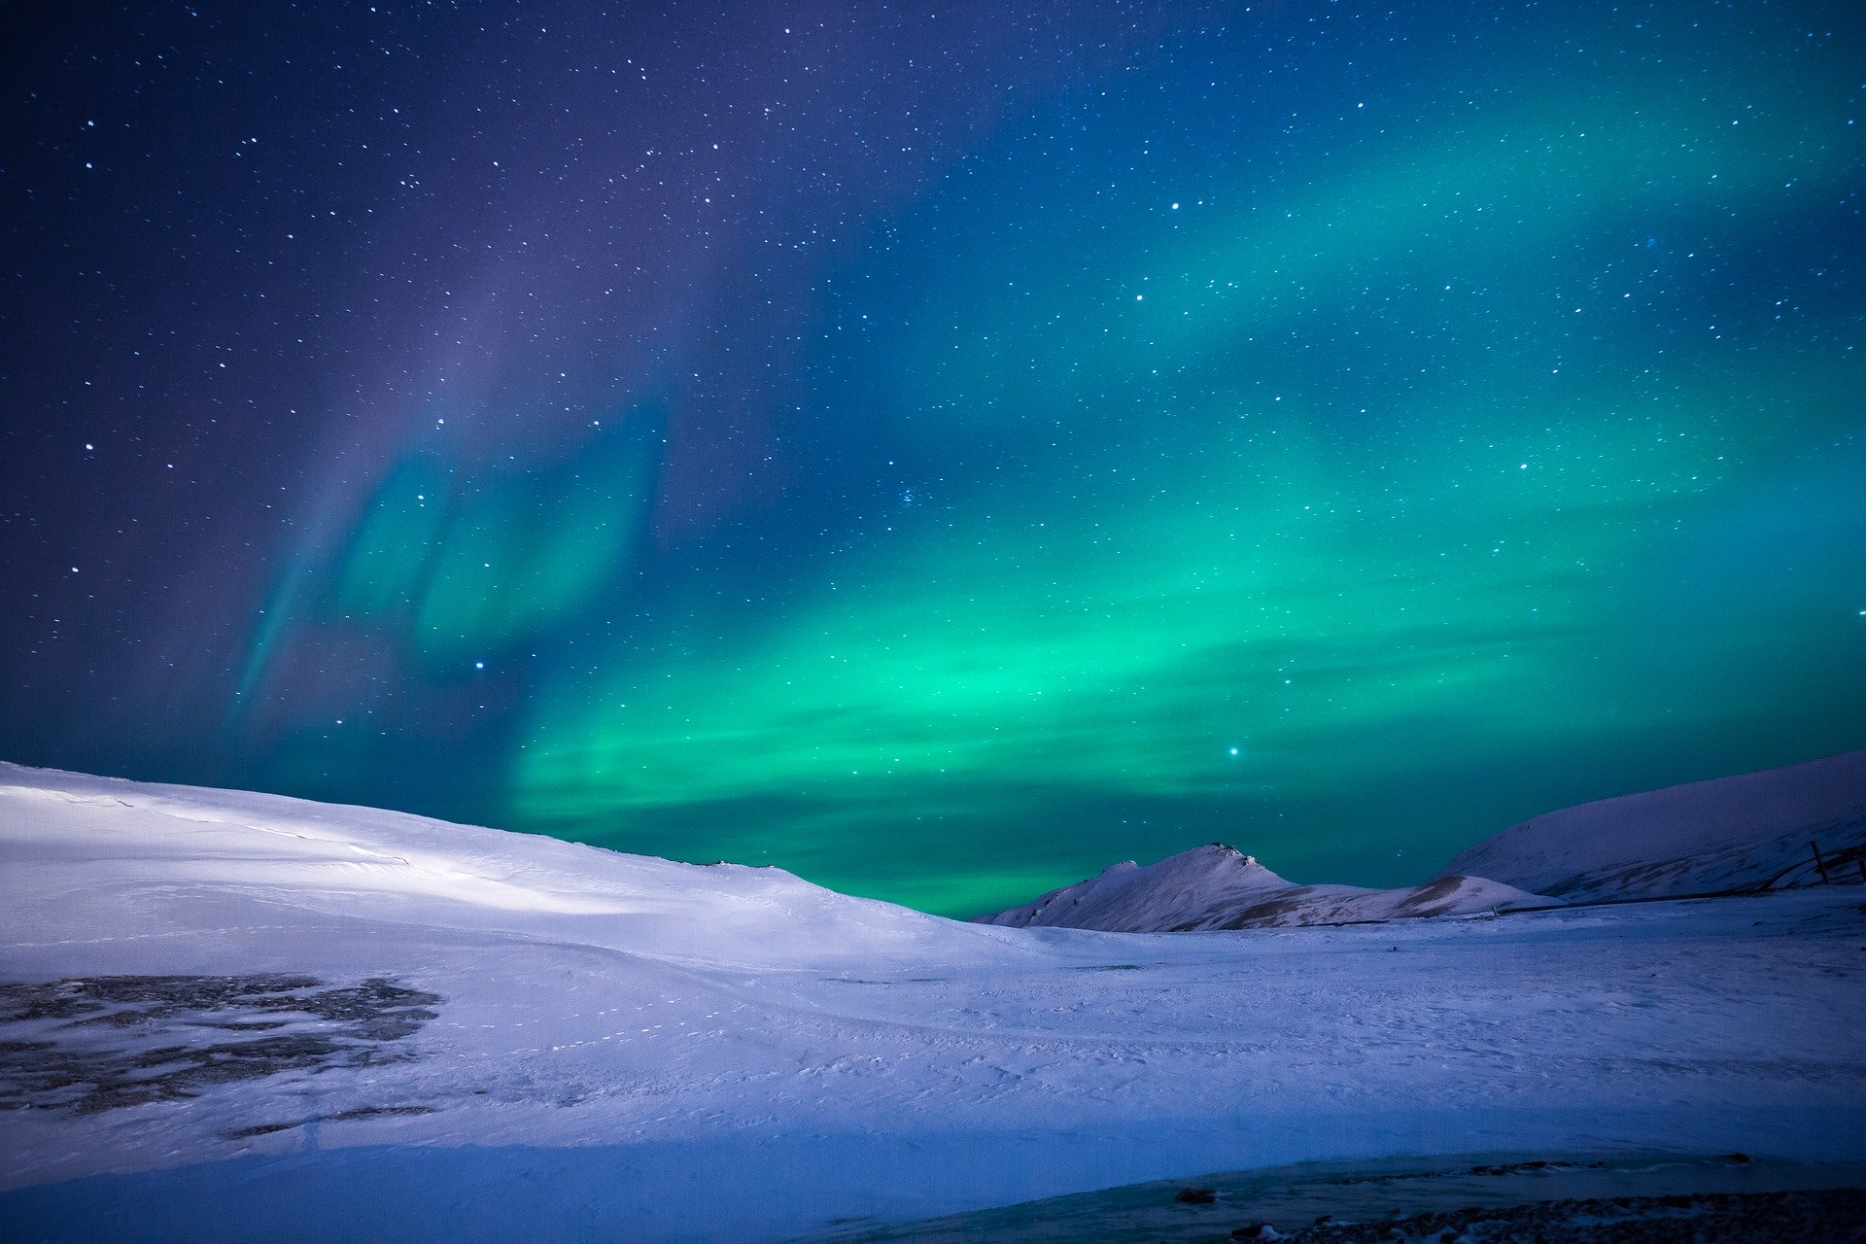
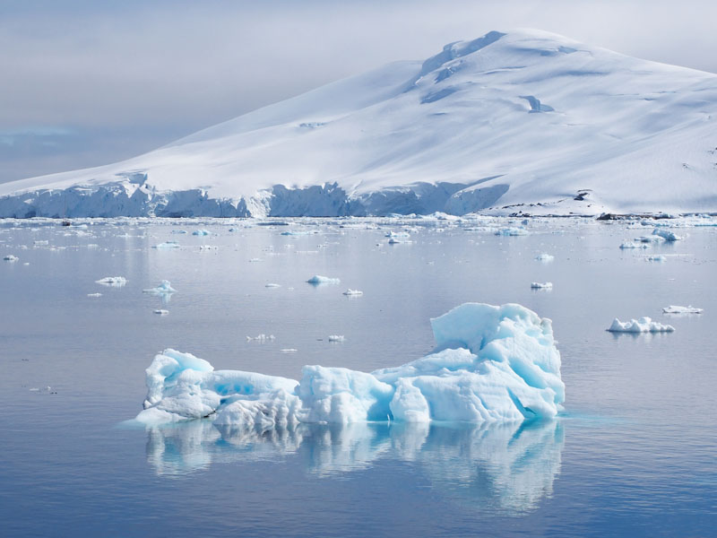
Topic
What can you see in these two pictures? Think about the landscape and colours.

Slide 3
The Arctic
What can you see in these pictures? Think about the landscape and colours.

Slide 4
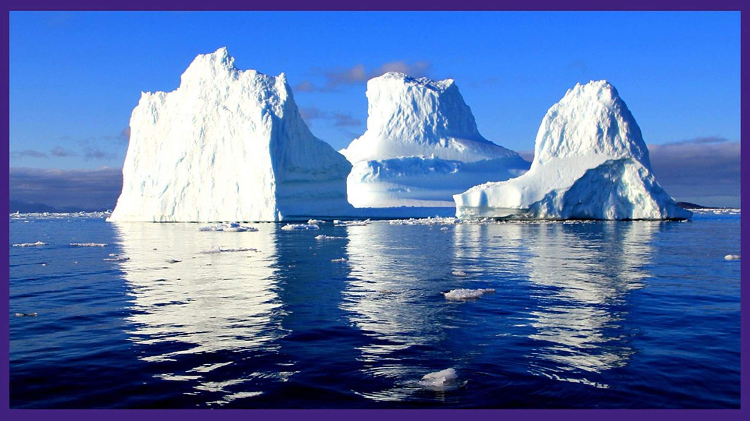
The Arctic

Slide 5
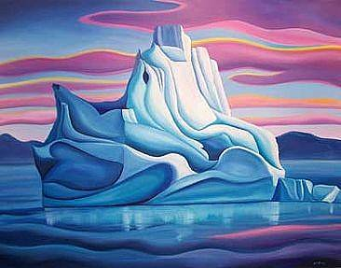
The Arctic
I would like you to use the Power Point on Linda Lang, the Polar artist, that is in Tuesday’s file. Read through the slides and follow the instructions to produce your own piece of Arctic artwork.

