Slide 1

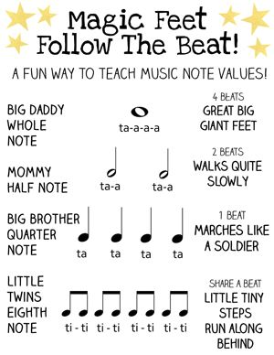
Music
Click on the link below and follow the lesson .
Your task after watching is to create your own rhythm and write it down for me to clap.
https://classroom.thenational.academy/lessons/understanding-pulse-and-rhythm-chj3cr?activity=video&step=1
When creating your rhythm remember the value of the notes.

Slide 2
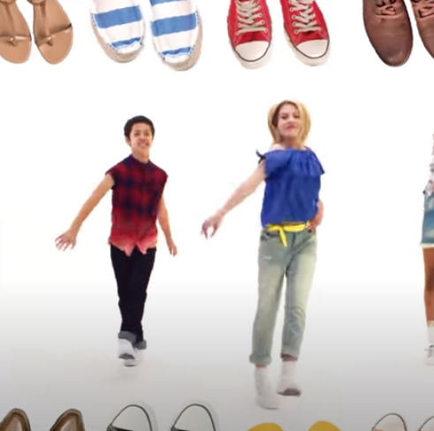
https://www.youtube.com/watch?v=lJPvEs8qpQc
Go Noodle
Get Up and Dance!

Slide 3

Follow the link for Today’s Worship
This can be found in the
‘Whole School’ folder.

