Slide 1


Slide 2
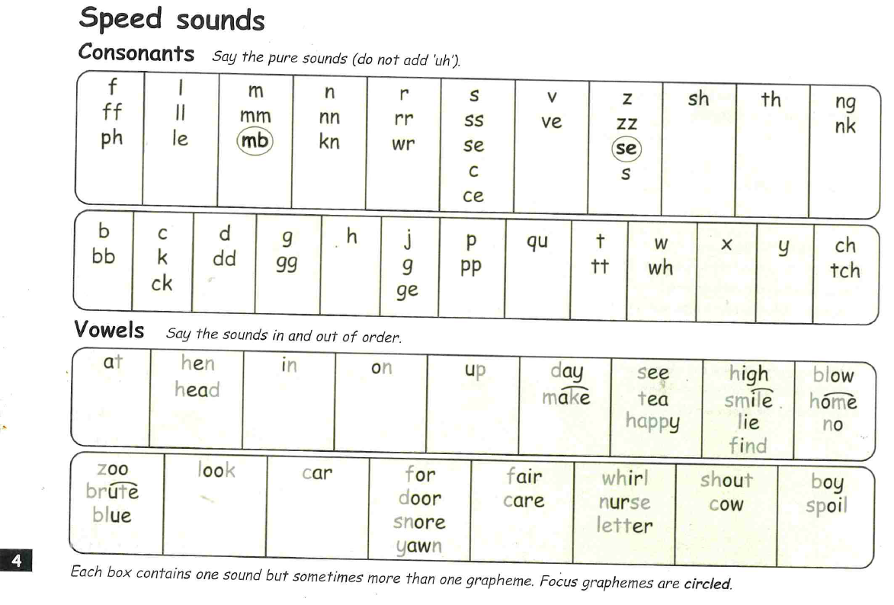

Slide 3
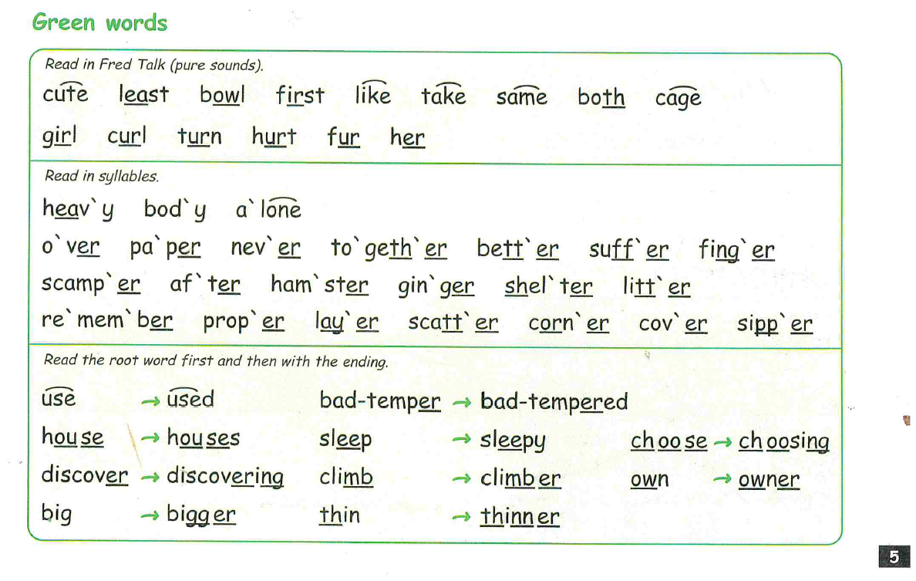

Slide 4
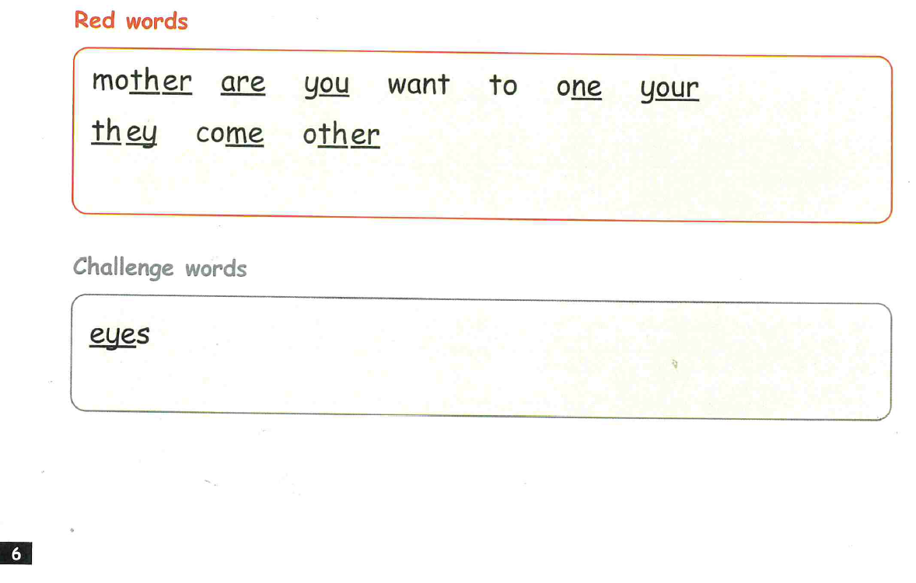

Slide 5
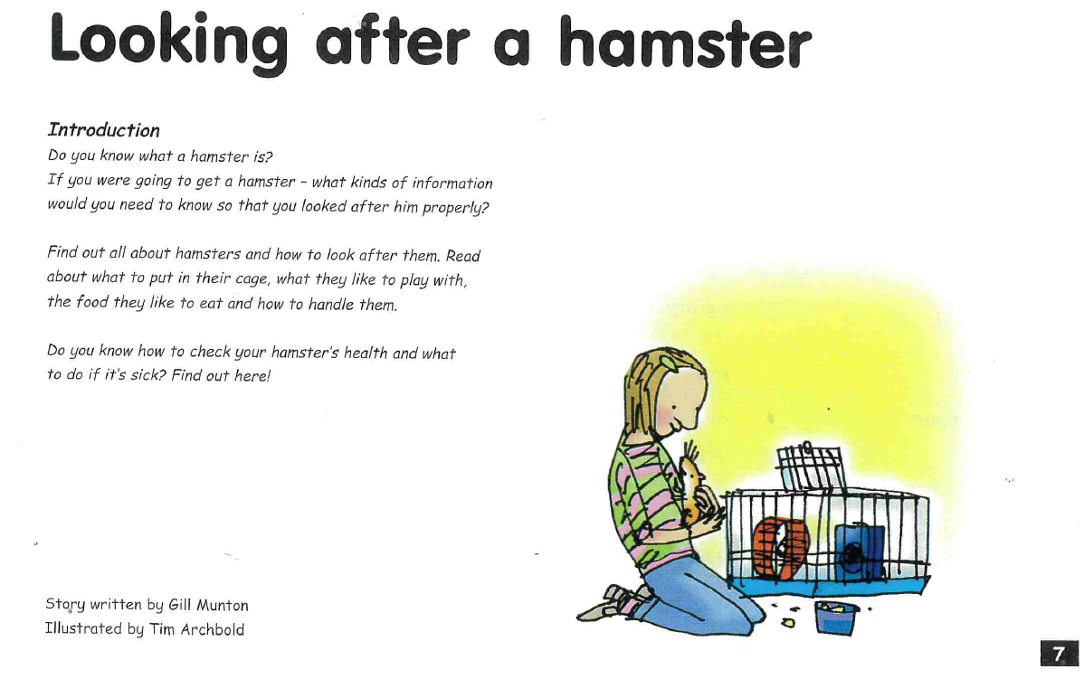

Slide 6
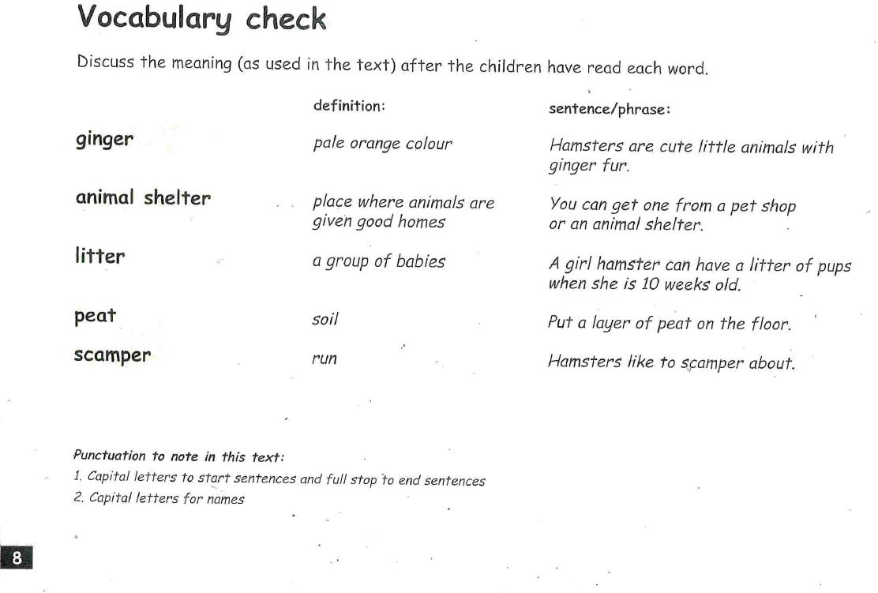

Slide 7
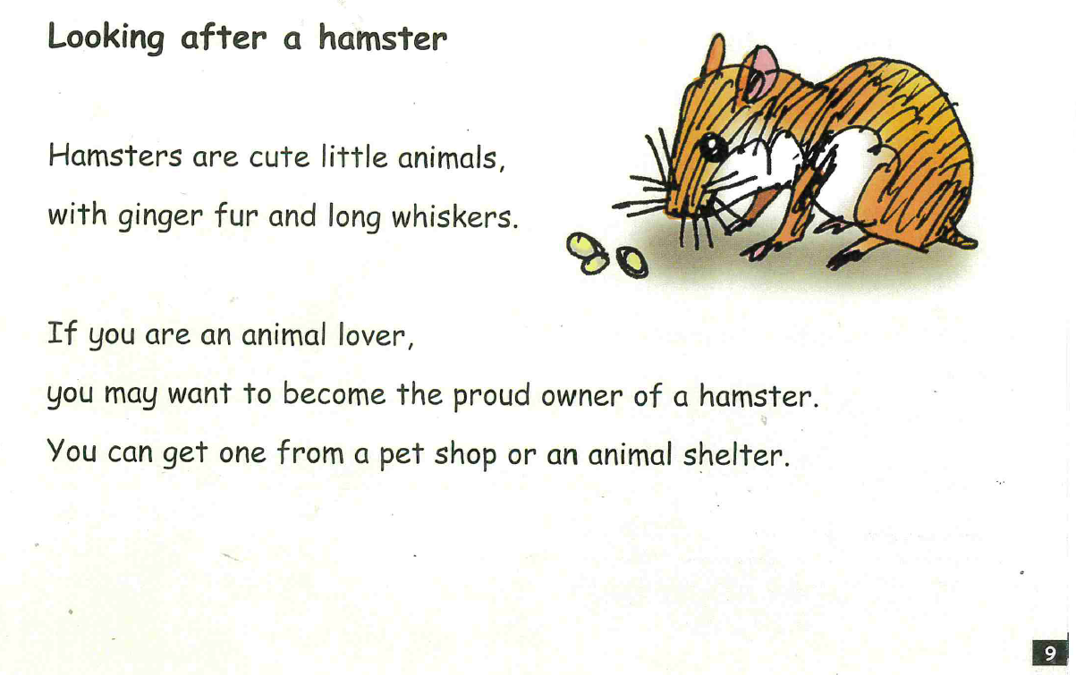

Slide 8
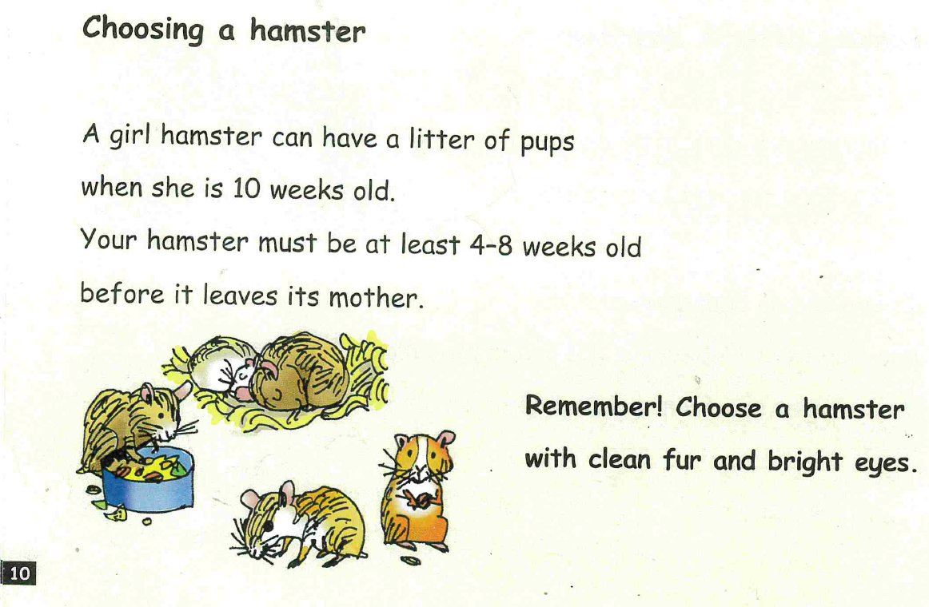

Slide 9
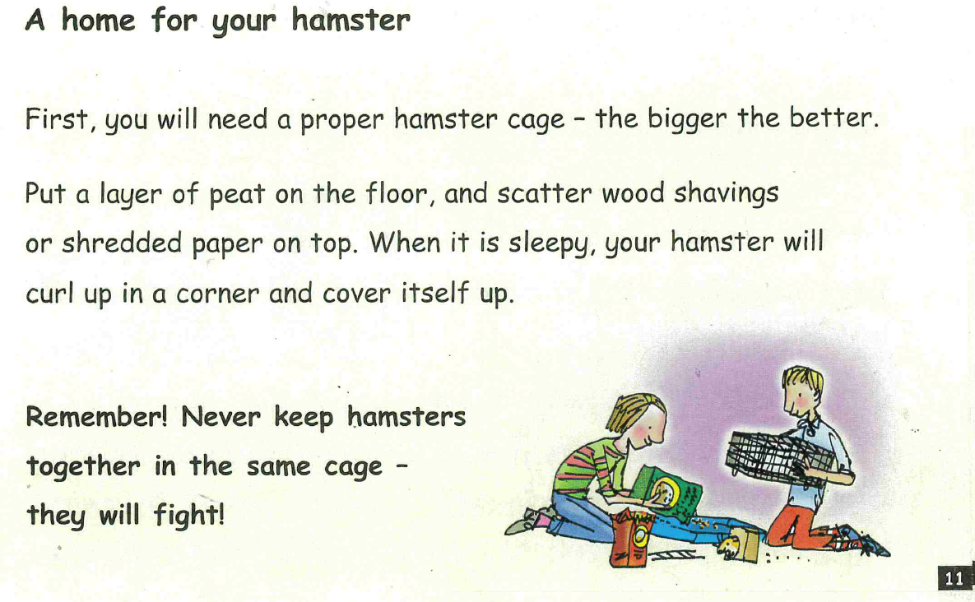

Slide 10
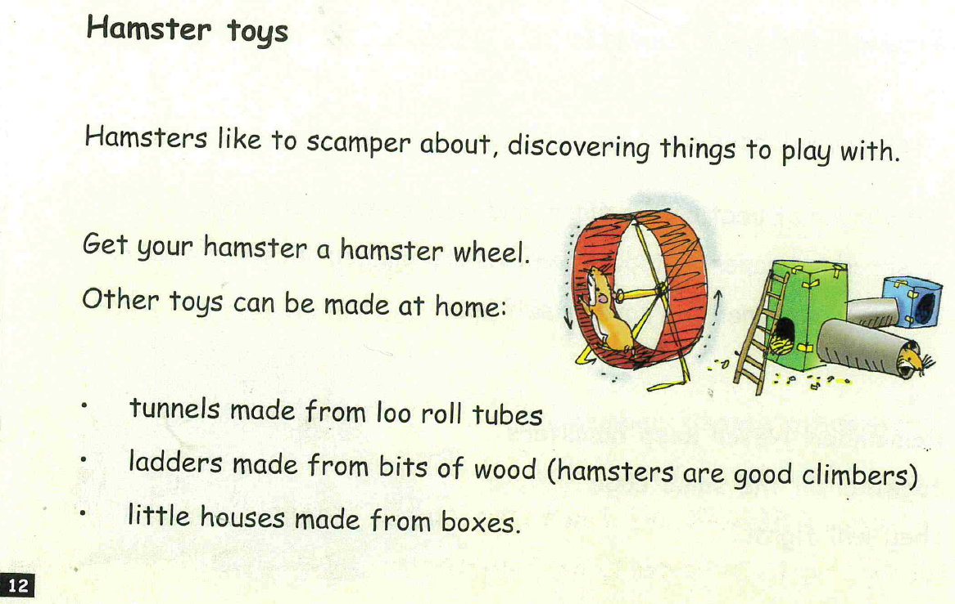

Slide 11
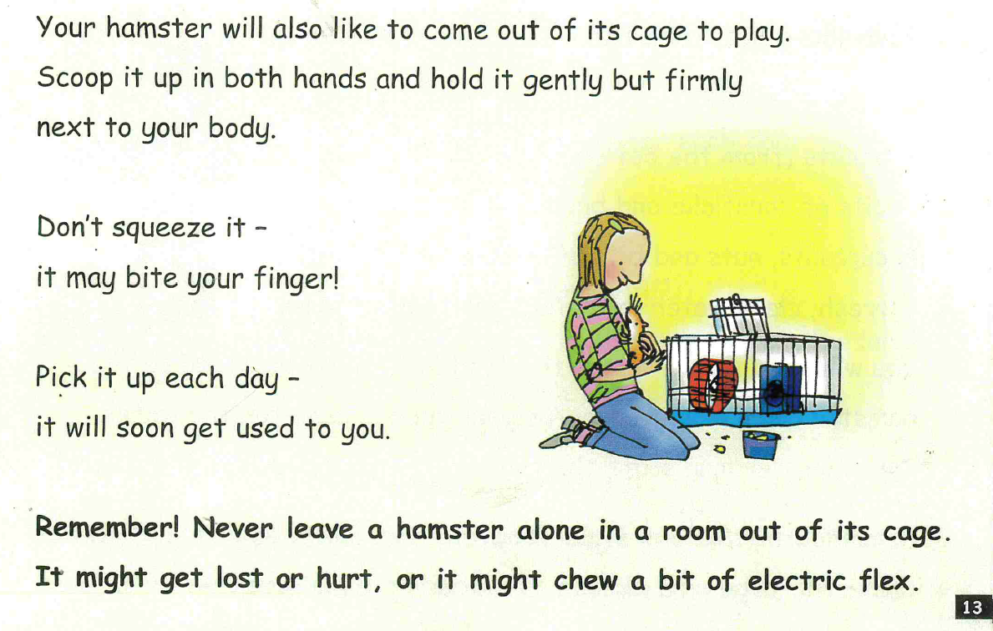

Slide 12
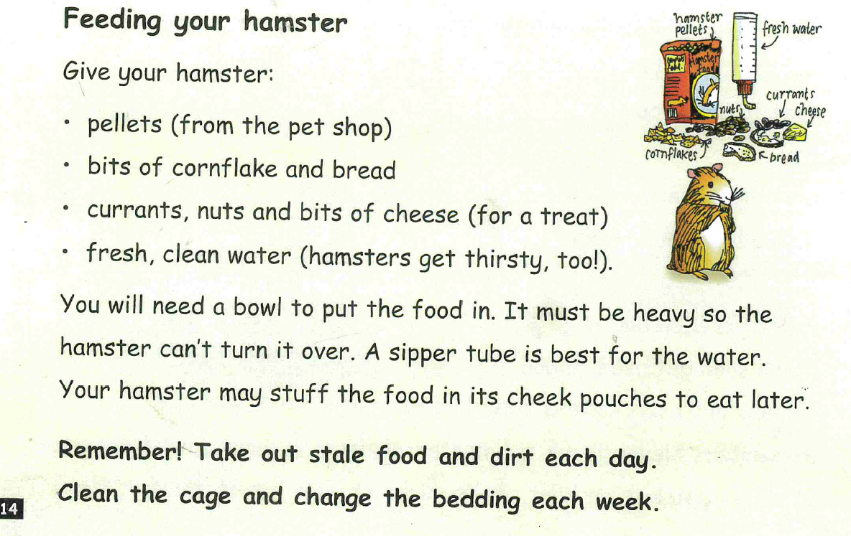

Slide 13
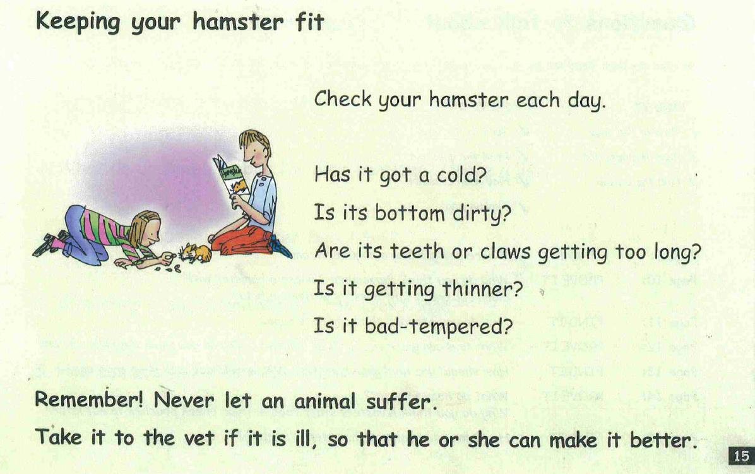

Slide 14
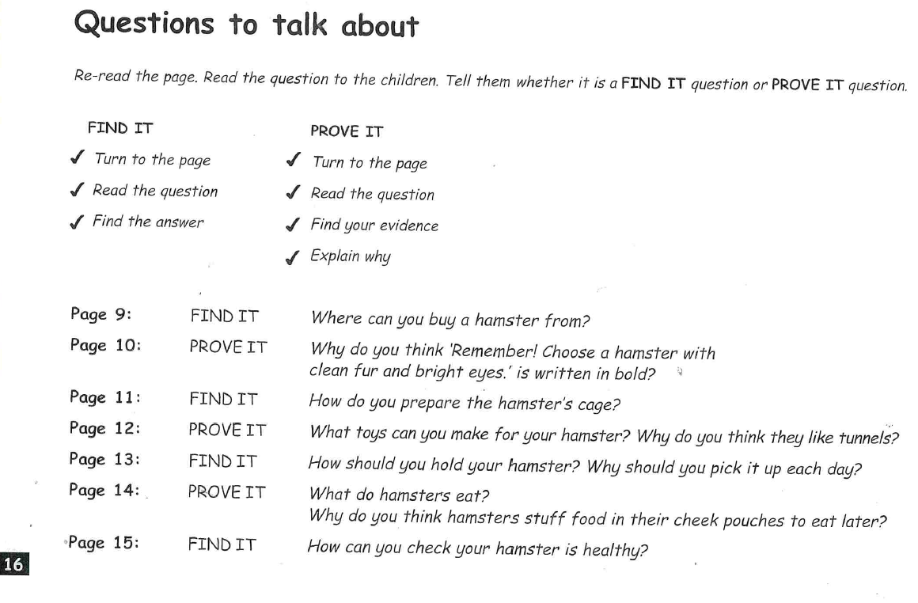

Slide 15
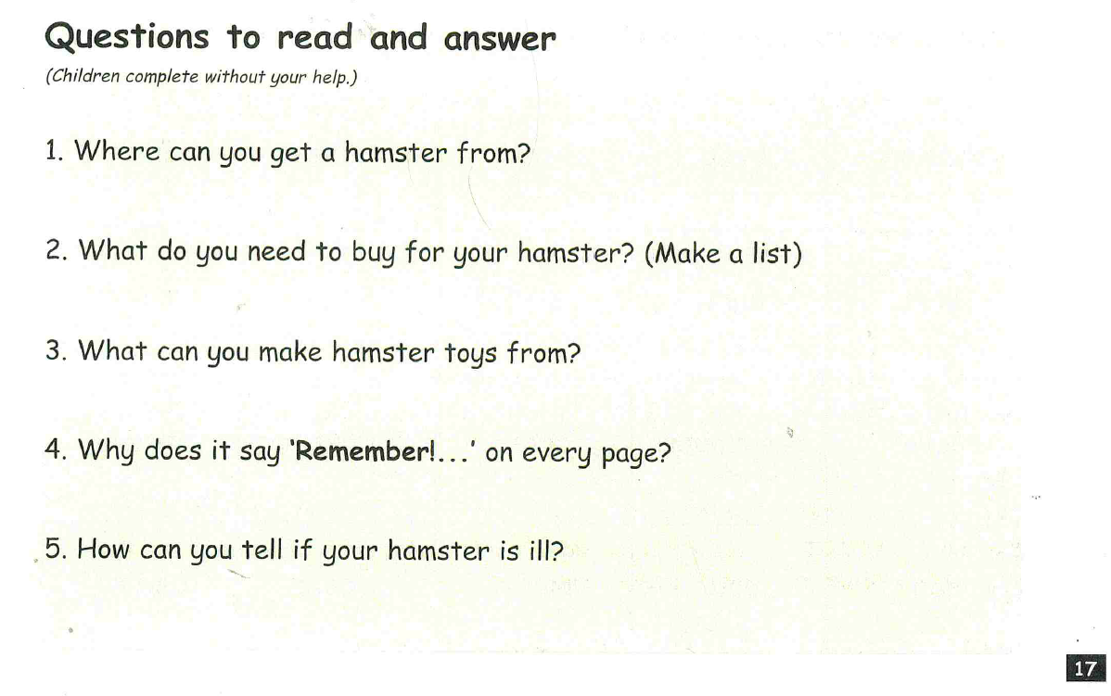

Slide 16
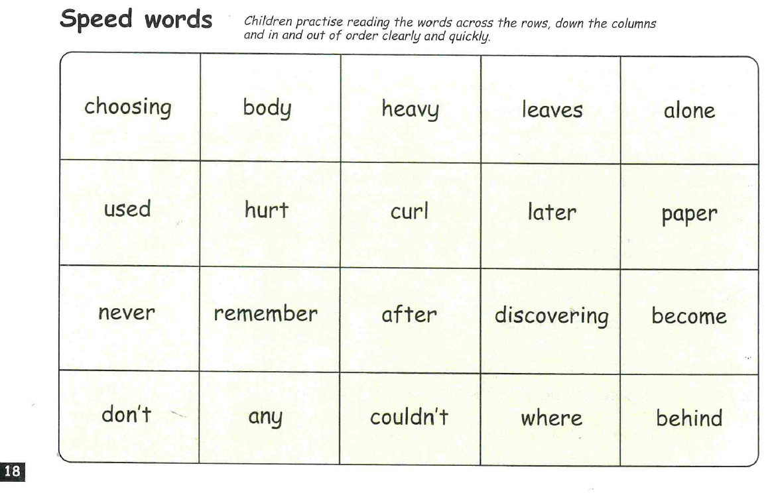

Slide 17



Edit a Sentence
2. Build a Sentence
The worksheet can be found on website or follow the PowerPoint and
write in a book or on handwriting paper.

Slide 18
Edit a sentence
Can you rewrite the below sentence for me please correcting all the mistakes. The correct sentence is on the following slide. No peaking until you have finished!
There are 2 capital letters missing
2 spelling mistakes
2 full stops missing
never let an anmal suffu take it to the vet if it is ill, so that he or she can make it better
Then mark it using the correct sentence on the next slide.

Slide 19
Never let an animal suffer. Take it to the vet if it is ill, so that he or she can make it better.

Slide 20

Build a sentence
Your word for today is - clamber
What does it mean? Can you find out?
Your job is to write a really creative sentence using this power word.
Can you include:
‘wow’ vocabulary
Add a conjunction to extend your sentence – and, or, but, so, if, because, when, that
Remember the 3 golden rules – capital letters, full stops and your sentence must make sense
Don’t forget to use your headphones to say your sentence out loud before writing it down.
E.g. I clambered over the high gate because it was locked and there was no other way into the field.

Slide 21


