Slide 1
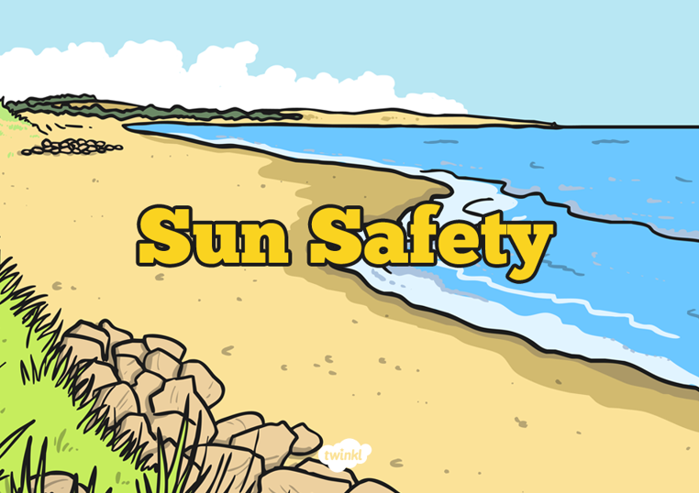
Safety in the Sun
Although we are not seeing much of the sun at the moment, it is important to know how to protect yourself from the sun. The sun is a vital source of light and warmth but can also be very dangerous.
I would like you to create a poster advertising how to keep safe in the sun and how to protect yourself. You will need:
A4 sheet of blank paper
Pencils, felt tips and crayons
Now watch the video clip and look at the PPT to get ideas and information that is important for your poster.
https://www.bbc.co.uk/cbeebies/watch/sun-safety-for-kids

Slide 2
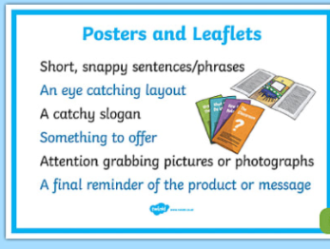
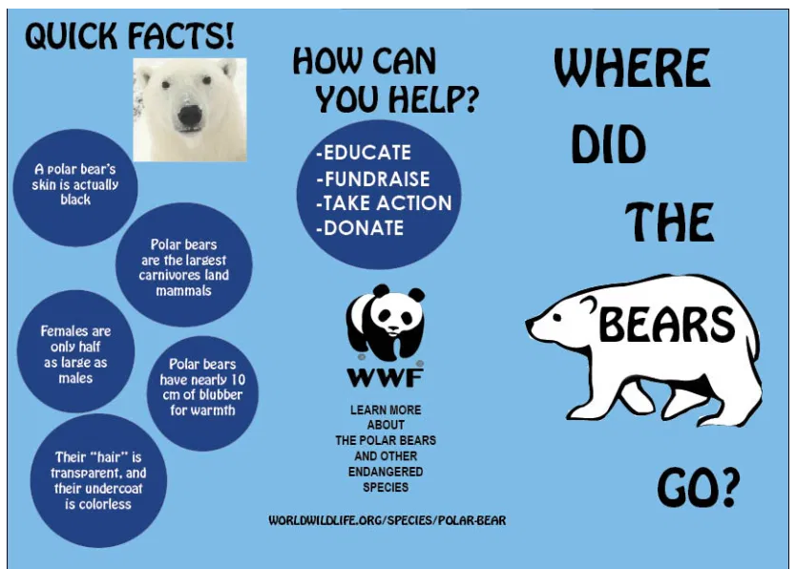
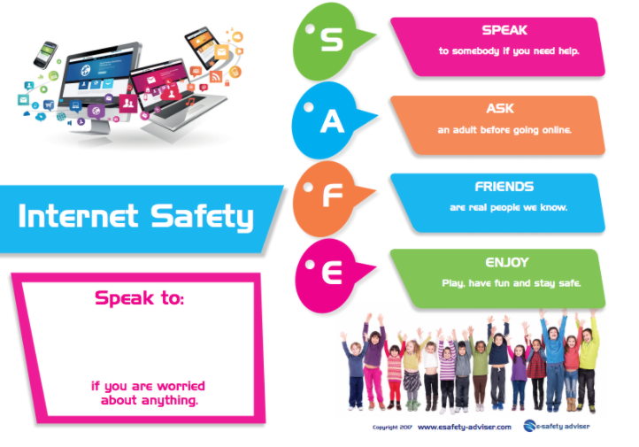
Tips For Designing a Poster
It needs to be clear, well organised and planned
have clear headings and slogans
Include pictures
Have a border around your page
Have bold, neat printing

Slide 3

Follow the link for Today’s Worship
This can be found in the
‘Whole School’ folder.

