Slide 1
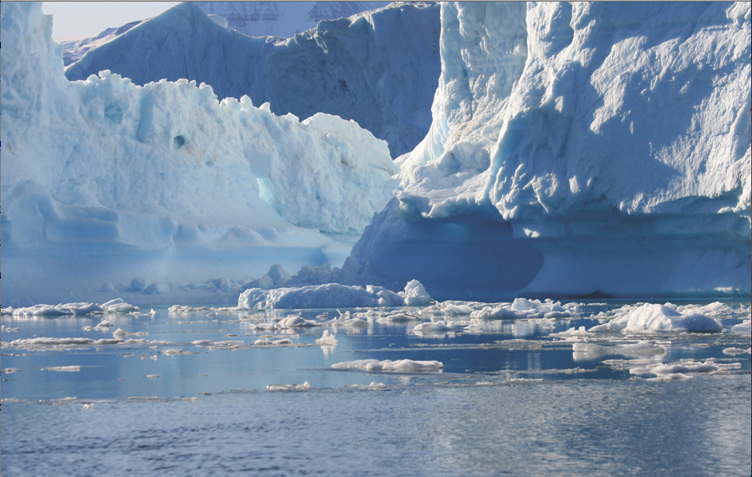
Topic
(Topic work will go at back of your
purple book. Can an adult draw a line at
the top for the date and another for the title?)
Listen to the following story
https://www.youtube.com/watch?v=LYK8ERKPnNM
This week we are looking at two questions:
Where is the Arctic?
What is it like there?

Slide 2
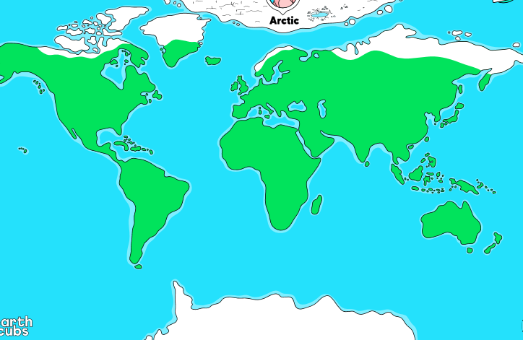
The Arctic
The Arctic is found in the far North (top) of our earth. The North Pole is located in the Arctic.

Slide 3
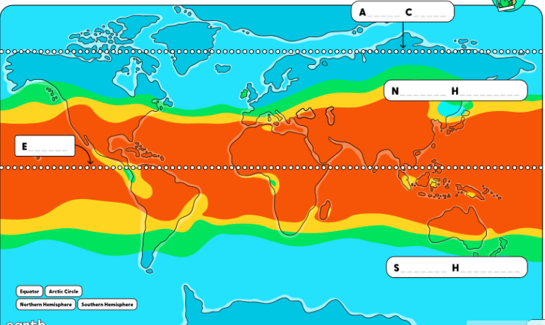
The Arctic
On this world map you can see climatic bands. Around the middle of the earth (the equator) it is hot and the further you go towards the north and south (North and South Pole), the colder it gets.

Slide 4
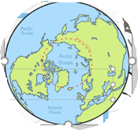
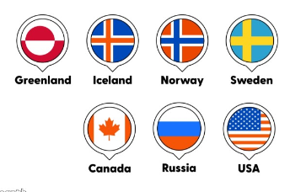
The Arctic
The dotted red line is an imaginary line around the top of our earth. This marks the Arctic Circle.
The countries that are inside
the circle are parts of
Canada, Greenland, Norway,
Sweden, Finland, Russia,
USA (Alaska) and Iceland.

Slide 5
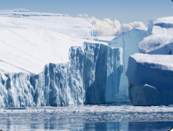
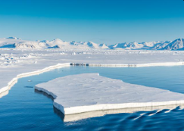
The Arctic
These are pictures of a Polar Habitat in the Arctic.
- What can you see?
- What words can you use to describe the Arctic?
- Why is there a lot of white?

Slide 6
The Arctic
The Arctic has very few plants because it is very cold .
The ice acts as the land.
There are icebergs in the Arctic Ocean which surrounds the Arctic.
Icebergs are pieces of ice that have broken off and are floating in the Ocean.

Slide 7
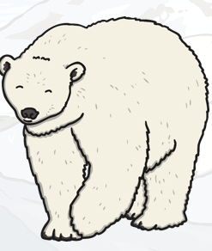
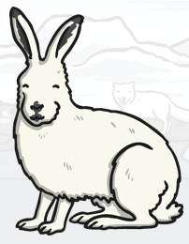
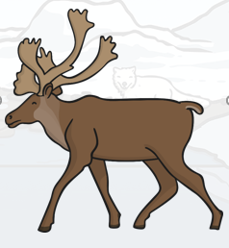
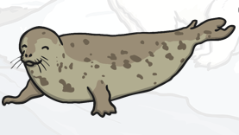
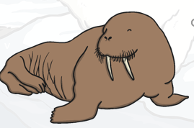
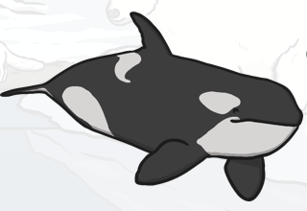
The Arctic
There are many different animals that live in the Arctic including:
walrus seal
Polar Arctic reindeer
bear hare orca whale

Slide 8
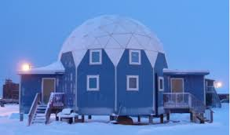
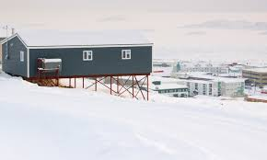
The Arctic
People (Inuits) live in the Arctic in houses that are built up off the ground. This stops the people
from getting snowed in for weeks at a time. Also
it is easier for them to keep their houses warm.

Slide 9
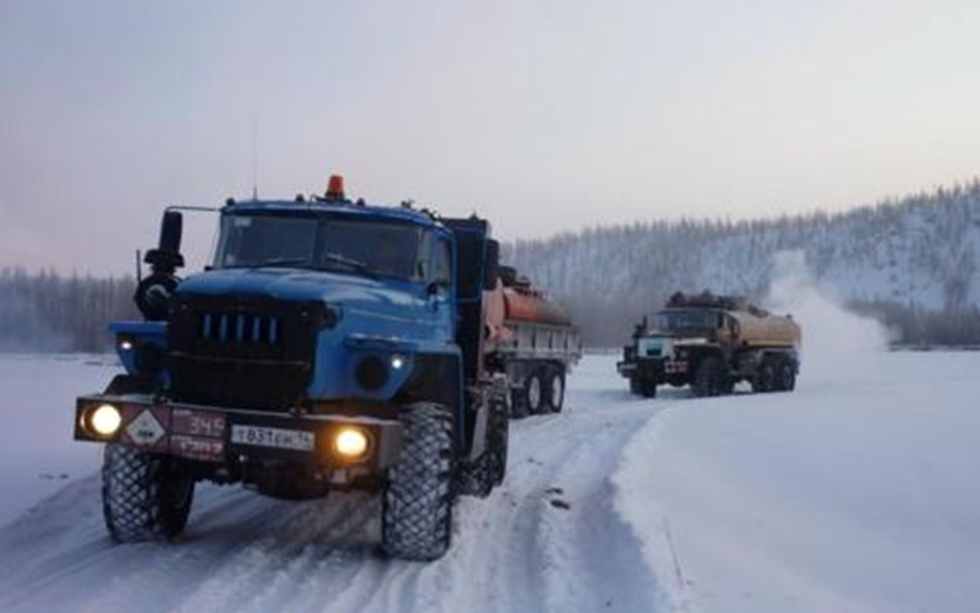
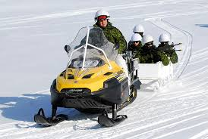
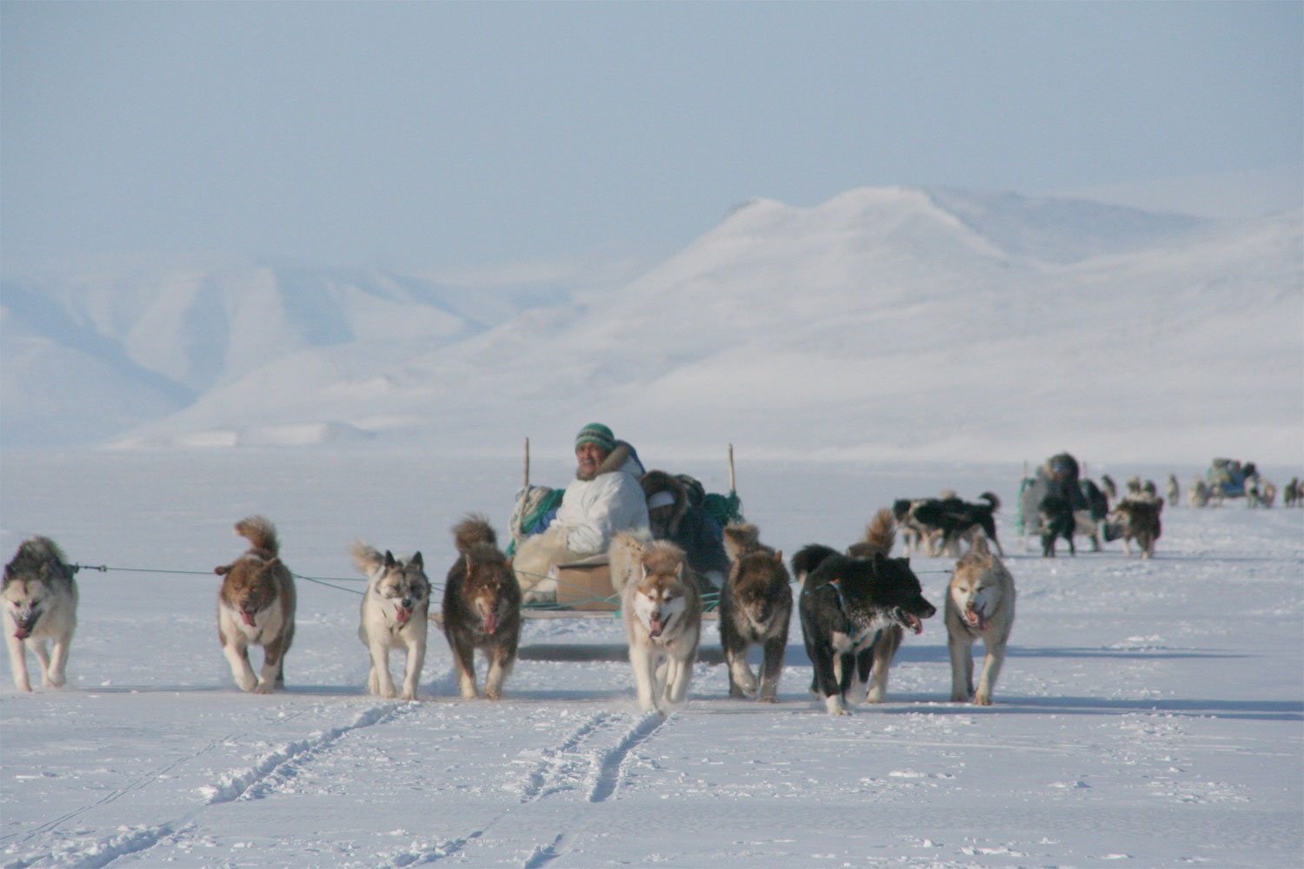
The Arctic
Some people use vehicles with special snow tyres to travel from place to place. Others use snow mobiles or even sleds that are pulled by dogs to skim across the snow and ice.

Slide 10
The Arctic
As plants don’t grow, they have to hunt and fish for their food. When fishing, they have to break a hole in the ice to get to the water and then put a fishing line through the hole and wait to catch the fish.

Slide 11
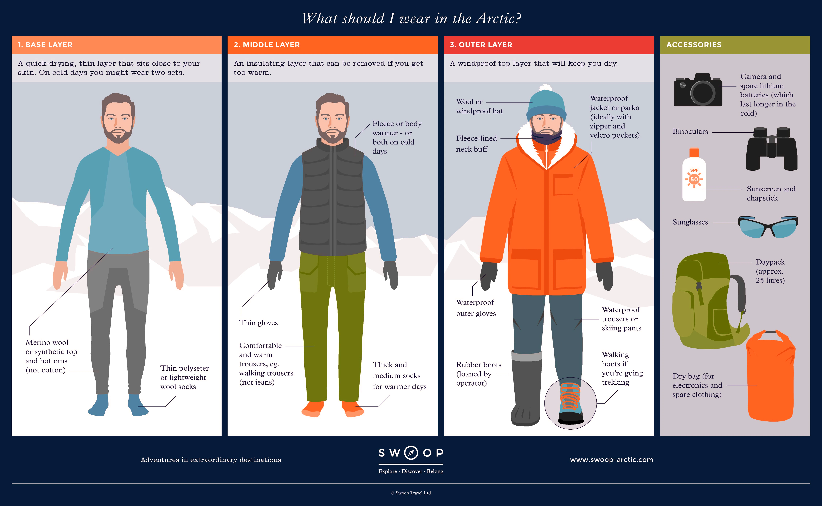
The Arctic
As it is so cold, it is important to wear gloves, hats, boots and lots of thin layers of clothing to keep you warm.

Slide 12
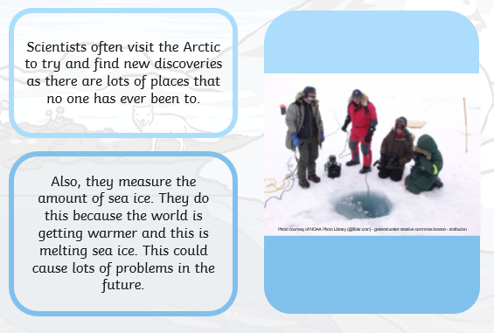
The Arctic
Now watch https://www.youtube.com/watch?v=b-9xDztBhzE

Slide 13
The Arctic
In the back of your purple book write the date
Tuesday 19th January
and title
The Arctic

Slide 14
The Arctic
I would like you to draw and label a picture about what you have found out about the Arctic. Or you could make an information page about the Arctic.
I am looking forward to seeing what you have produced.

Slide 15

Most importantly encourage your child to read a suitable book to you. Later on it would be great if you could read a bedtime story to them.
Please remember to send an email containing the work that they have done to teacher@kingslandengland.hereford.sch.uk

Slide 16

Worship Time with:
Mr. Debenham

