Slide 1
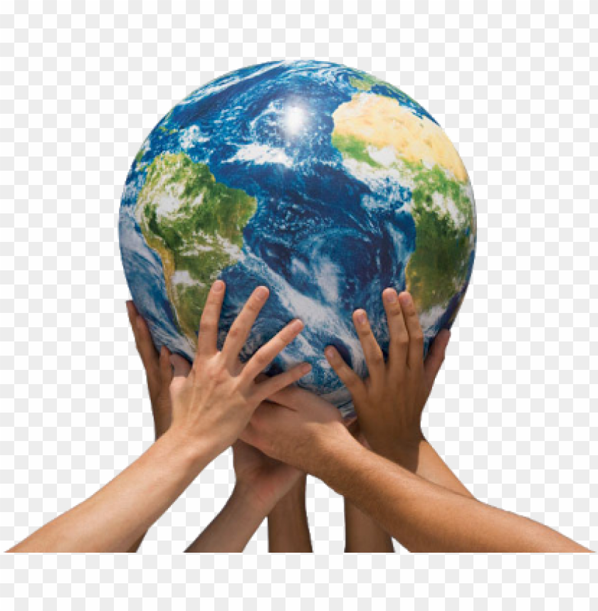
Our Environment and Climate Change
Watch the following video clip before going through the PPT in the folder.
https://www.bbc.co.uk/programmes/p075tsy2
https://www.bbc.co.uk/bitesize/topics/zp22pv4/articles/z2md82p

Slide 2

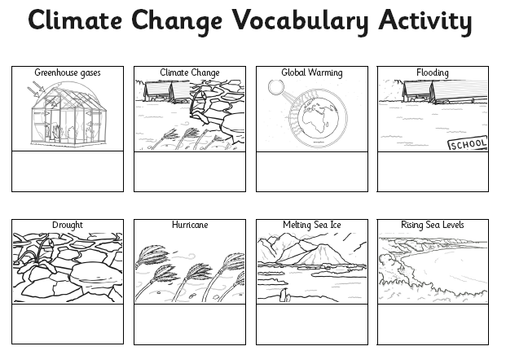
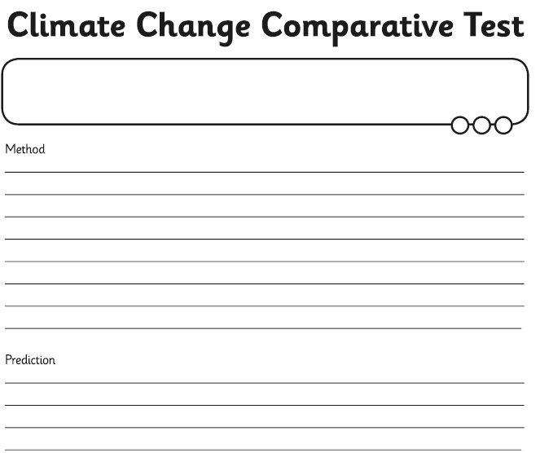
Our Environment and Climate Change
In the folder you will find a PPT explaining what is happening to our environment.
Use the sheet to match the labelled picture with the explanation.
There is an experiment you may want to try and a sheet to record on.

Slide 3

Follow the link for Today’s Worship
Live on TEAMS with
Mr Debenham

