Slide 1


Slide 2
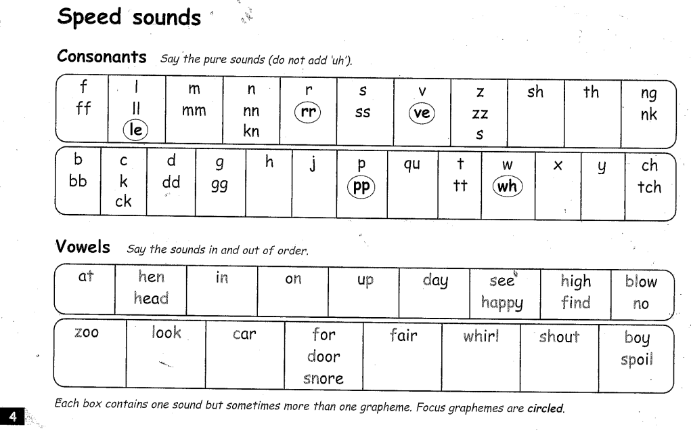

Slide 3
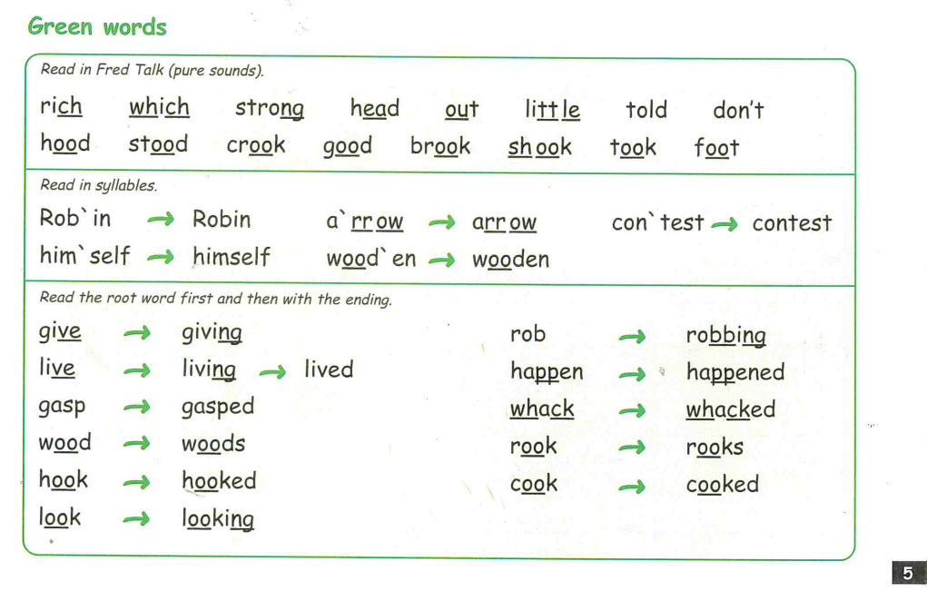

Slide 4
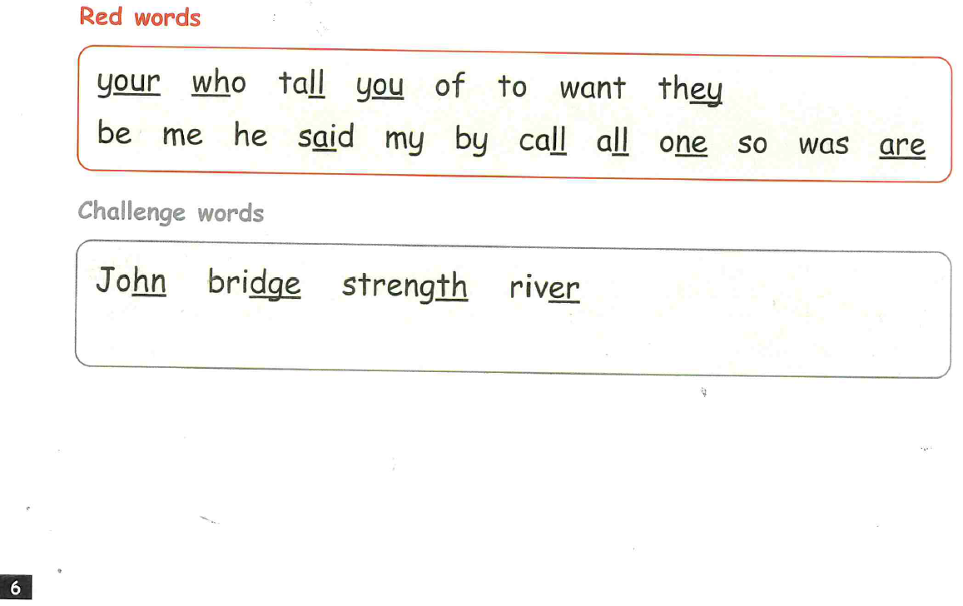

Slide 5
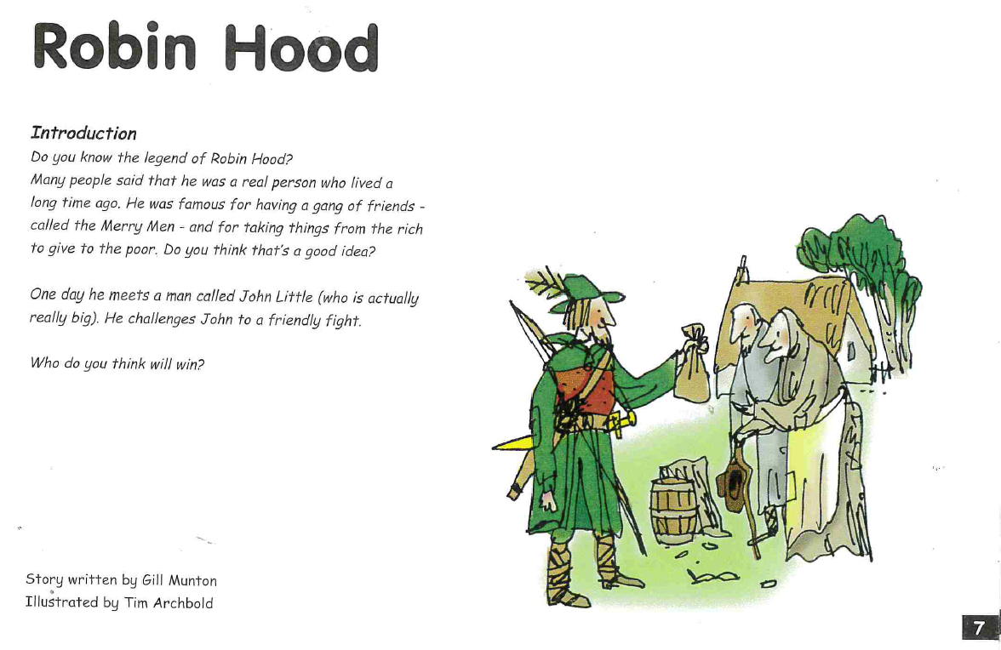

Slide 6
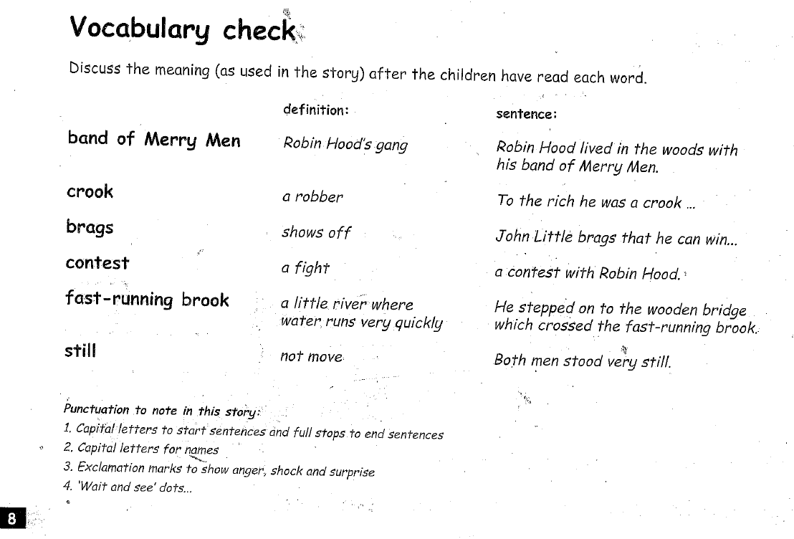

Slide 7
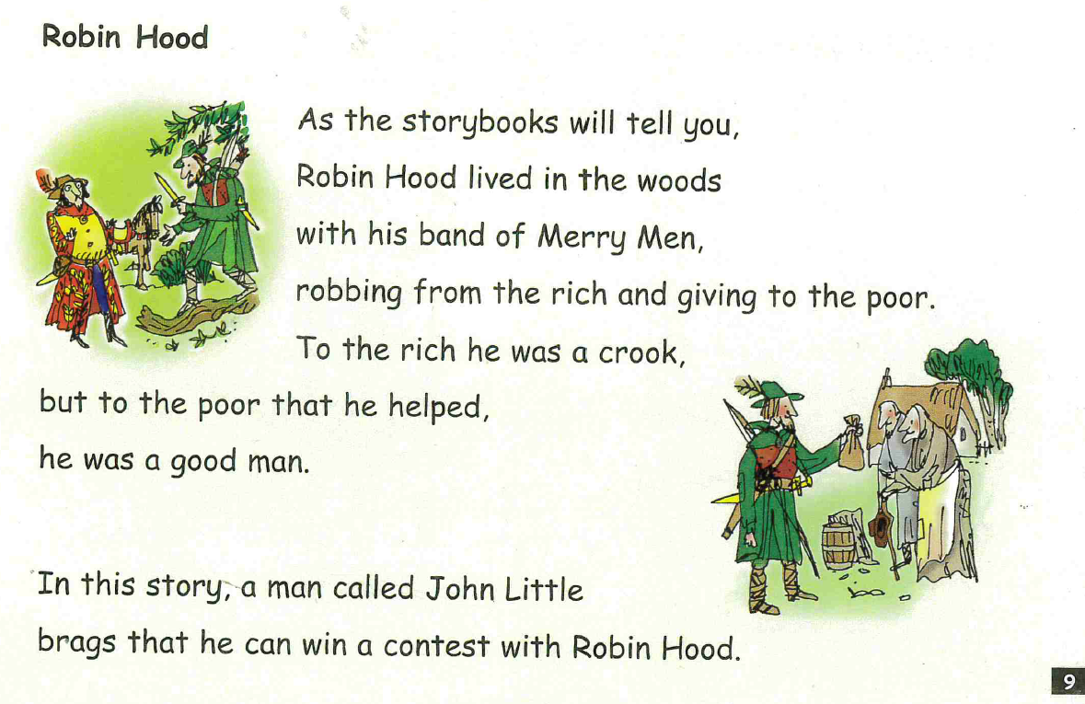

Slide 8
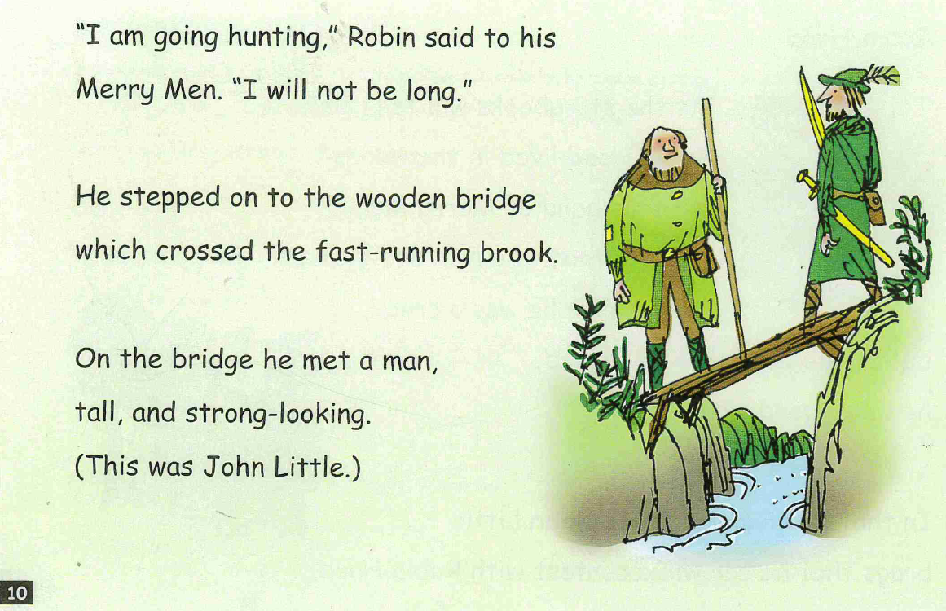

Slide 9
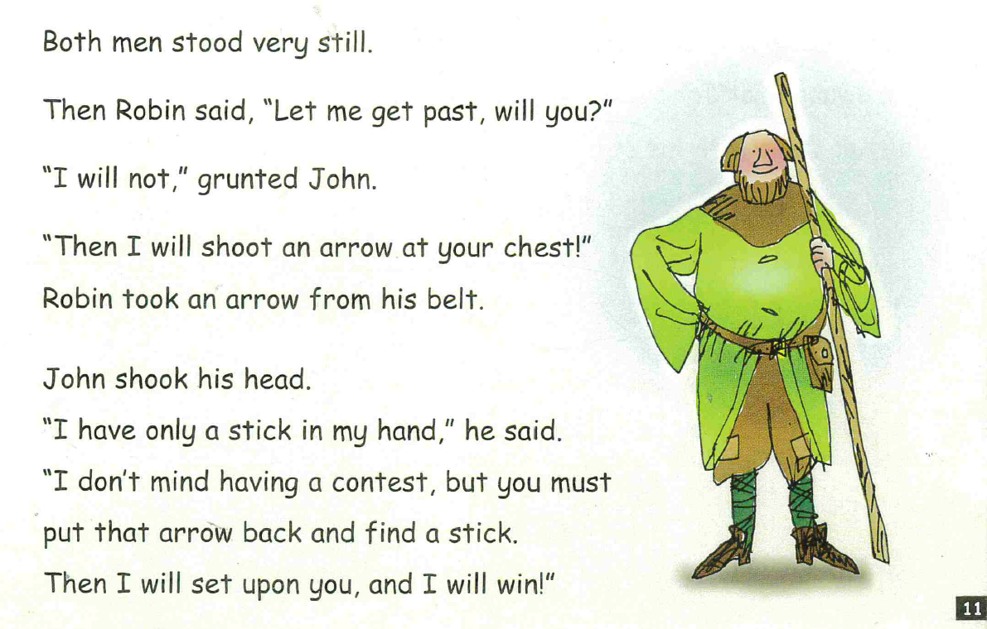

Slide 10
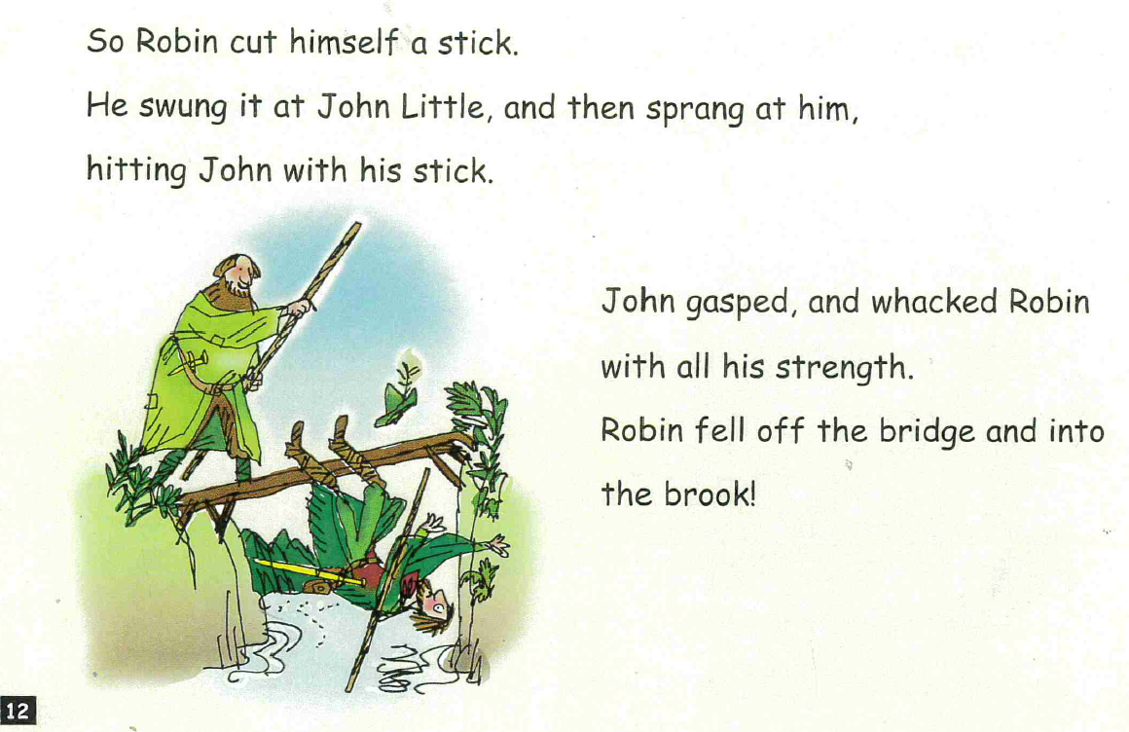

Slide 11
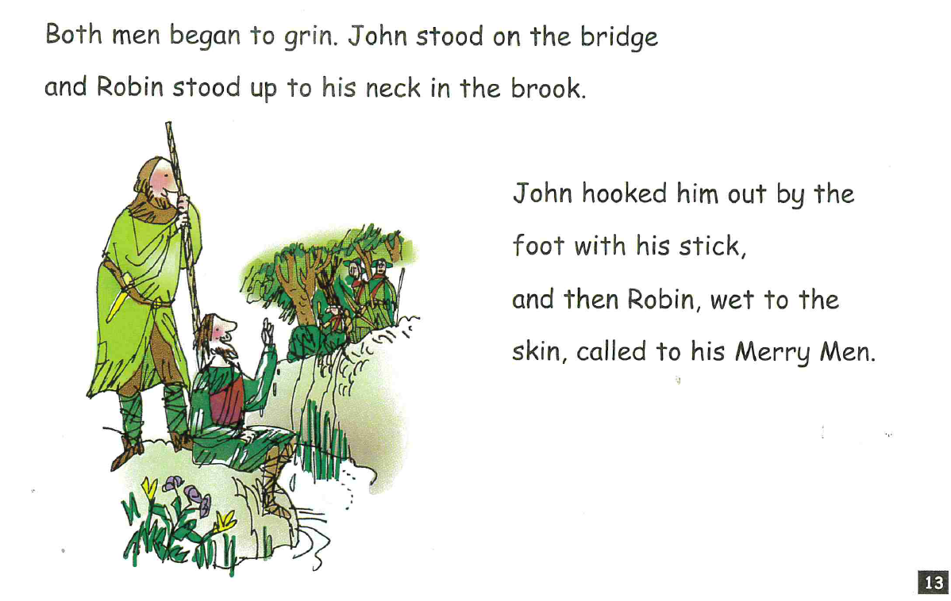

Slide 12
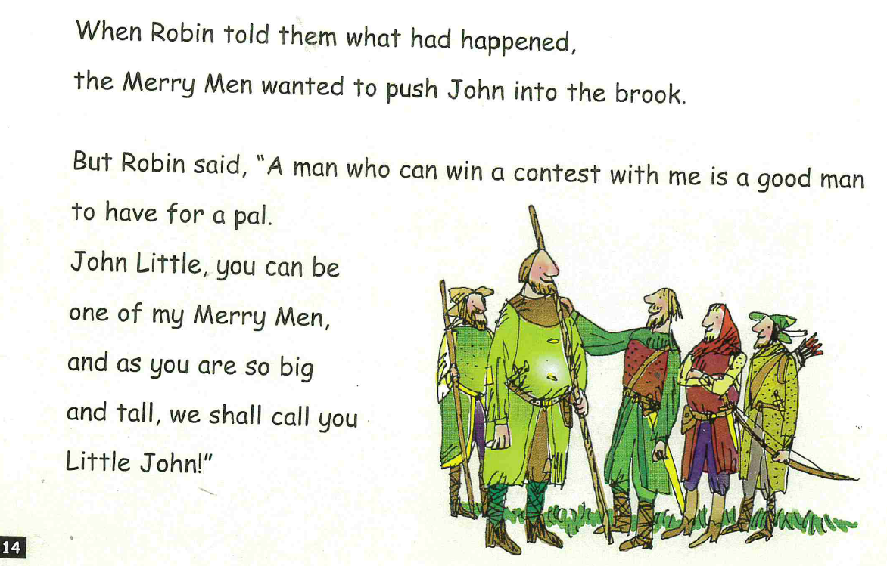

Slide 13
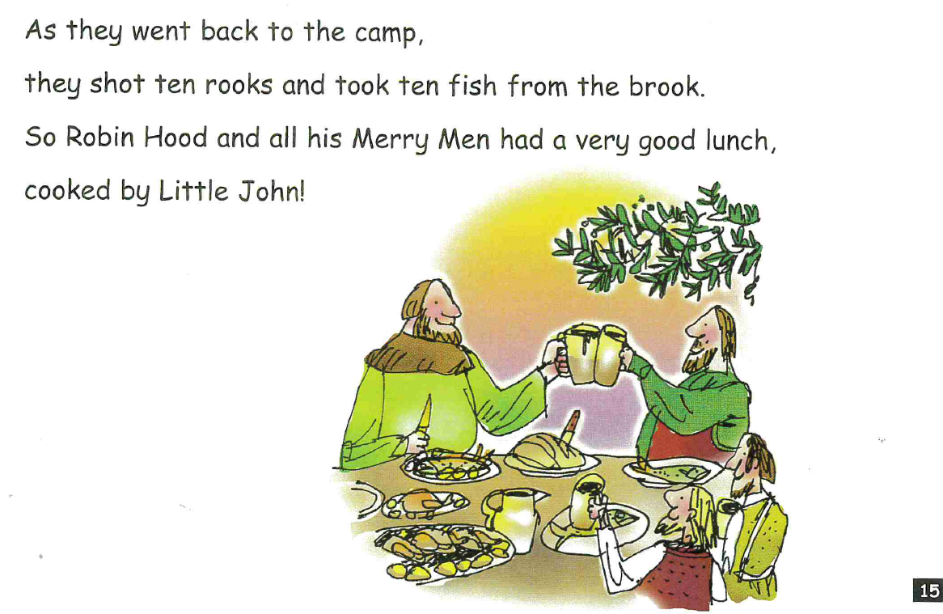

Slide 14
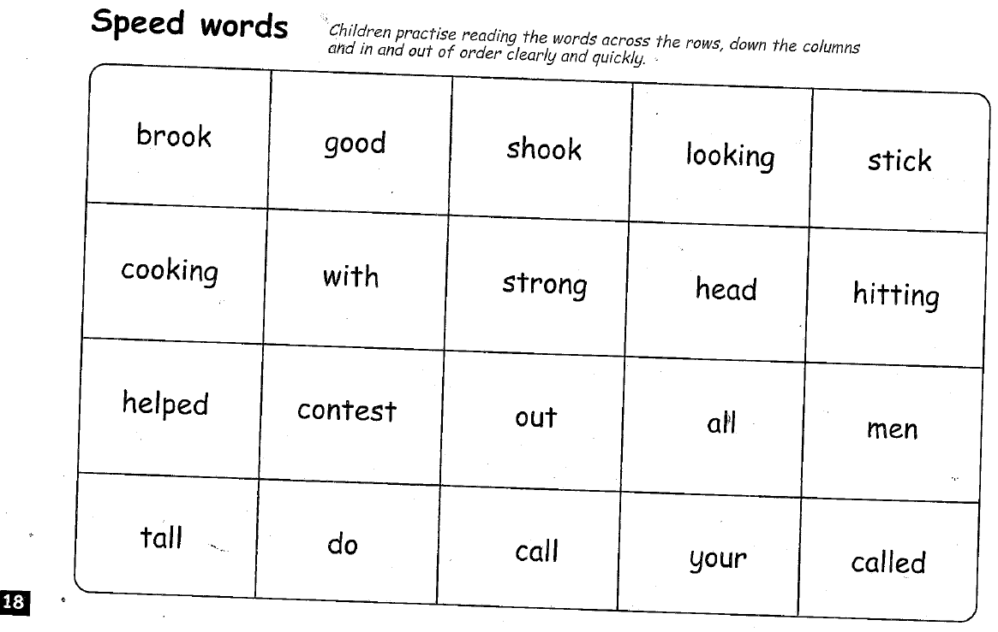

Slide 15

Hold a Sentence
When you click the speaker button I will say a sentence for you. Please listen to the sentence twice and then write it down as neat as you possibly can trying to get all the words in the right order and with the correct punctuation. When you have done that please flick to the next slide and the sentence will be there ready for you to check your work.
If the sound clip does not work can you ask a parent to read the sentence on the next slide to you please. No peeking first!

Slide 16
They took ten fish from the brook.

Slide 17
Hold a Sentence 2
Press the speaker below for the second hold a sentence and write it exactly as I’ve said it with a capital letter and punctuation at the end.
If the sound clip does not work can you ask a parent to read the sentence on the next slide to you please. No peeking first!

Slide 18
They cooked a very good lunch.

Slide 19


