Slide 1

The Qur’ an
Follow the links and learn about the Qur’an before doing the worksheet.
https://www.bbc.co.uk/bitesize/clips/z6d2hyc
https://www.bbc.co.uk/bitesize/clips/zrn34wx
https://www.bbc.co.uk/teach/class-clips-video/religious-education-ks2-my-life-my-religion-the-quran/z4p8mfr

Slide 2
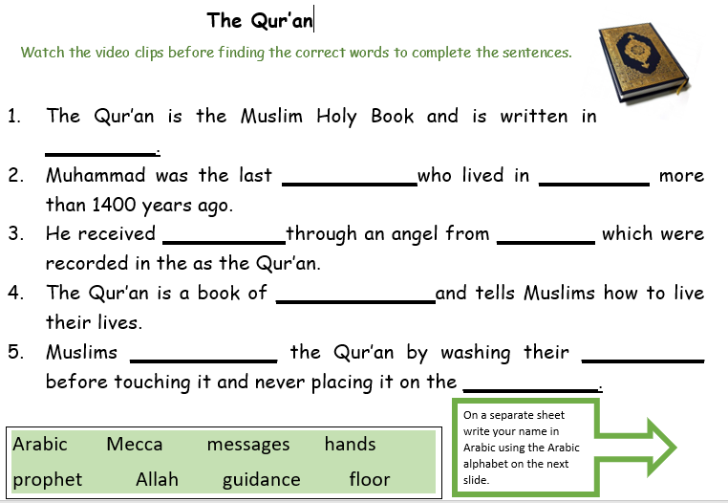
The Qur’ an
Watch the three video clips and think about why the Qur’an is important to Muslims.
Once you have finished watching and listening , complete the sentences by filling in the
correct word from the vocabulary box.
Using the Arabic alphabet , write your name in Arabic .

Slide 3
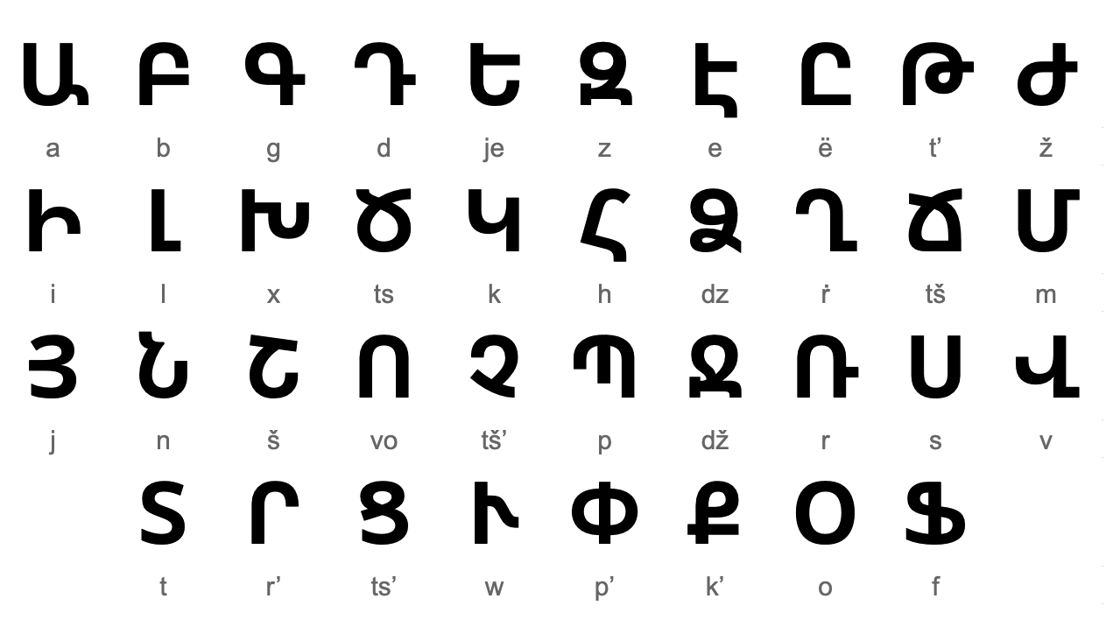

Slide 4

Follow the link for Today’s Worship
In the Whole School Folder

