Slide 1

Religious Education
Today we are continuing our topic on Islam.
Last week you all agreed that people matter more than things.
We know that GOD is most important for both Christians, Jews but today you are also going to find out that God is most important for Muslims (people who follow Islam).

Slide 2
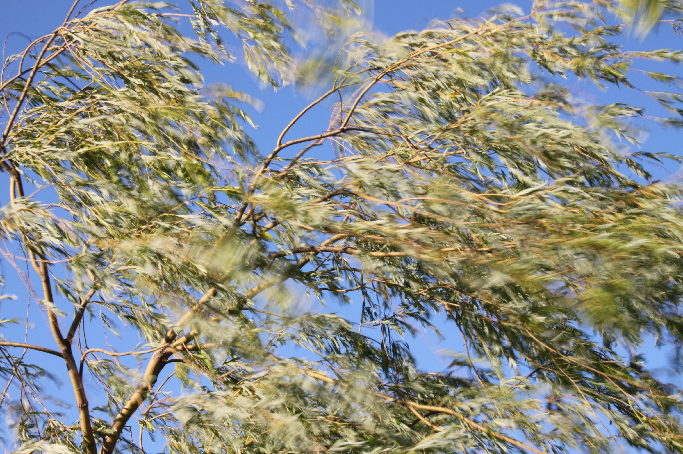

Religious Education
What is making the leaves on this tree move?
Can you see the wind?
What does this represent?
Can you see love?
We can’t see it but know that it exists.

Slide 3

Religious Education
What is inside this balloon?
Can we see it?
We can’t see the air but it doesn’t mean that there is nothing there.

Slide 4
Religious Education
Muslims believe that the world would
not function without God. A bit like the
balloon would not inflate without air.
Even though people can’t see God, some people think that the world would not be the place that it is without God.
This Photo by Unknown Author is licensed under CC BY-NC-ND

Slide 5
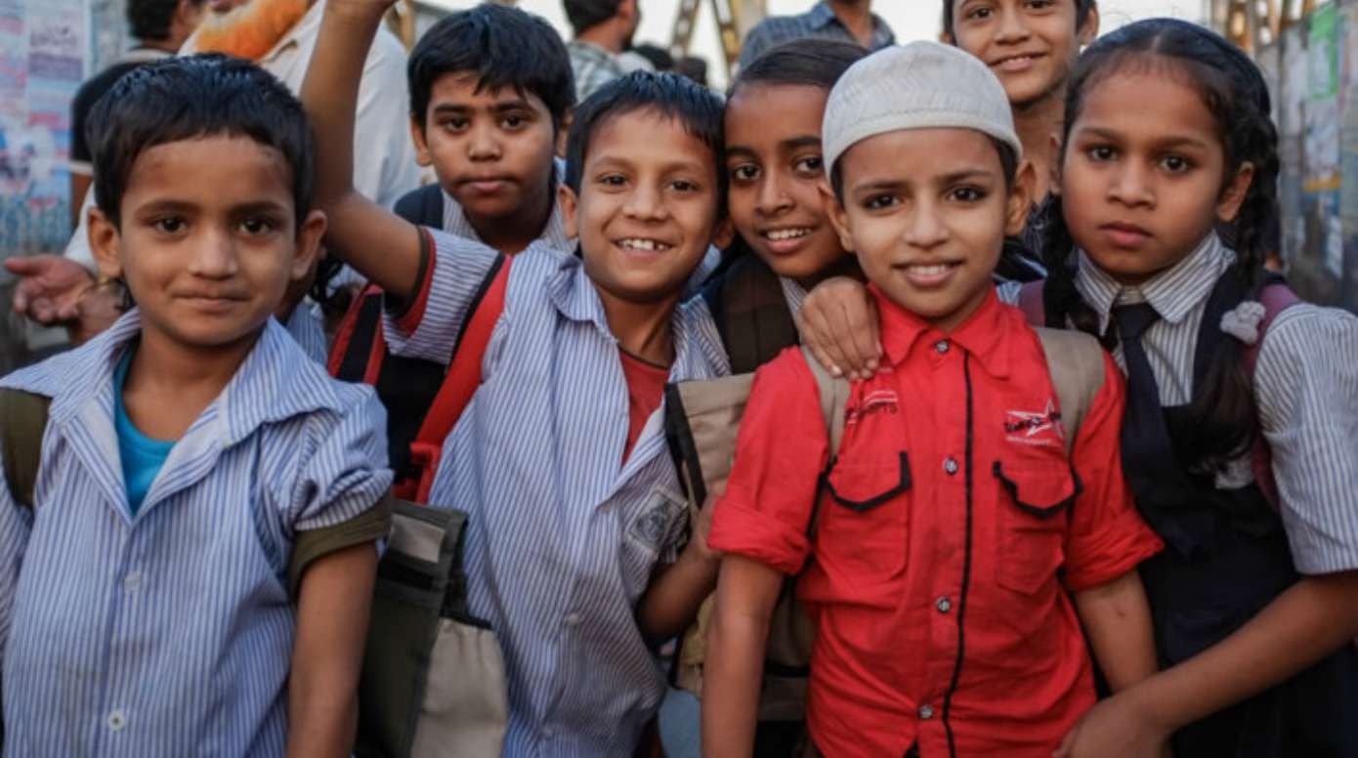
Religious Education
These children are Muslim children.
They are similar to us.
They enjoy things we enjoy,
They like/get upset like we
do.
There are about 360 Muslims living in Hereford.
This Photo by Unknown Author is licensed under CC BY-SA

Slide 6
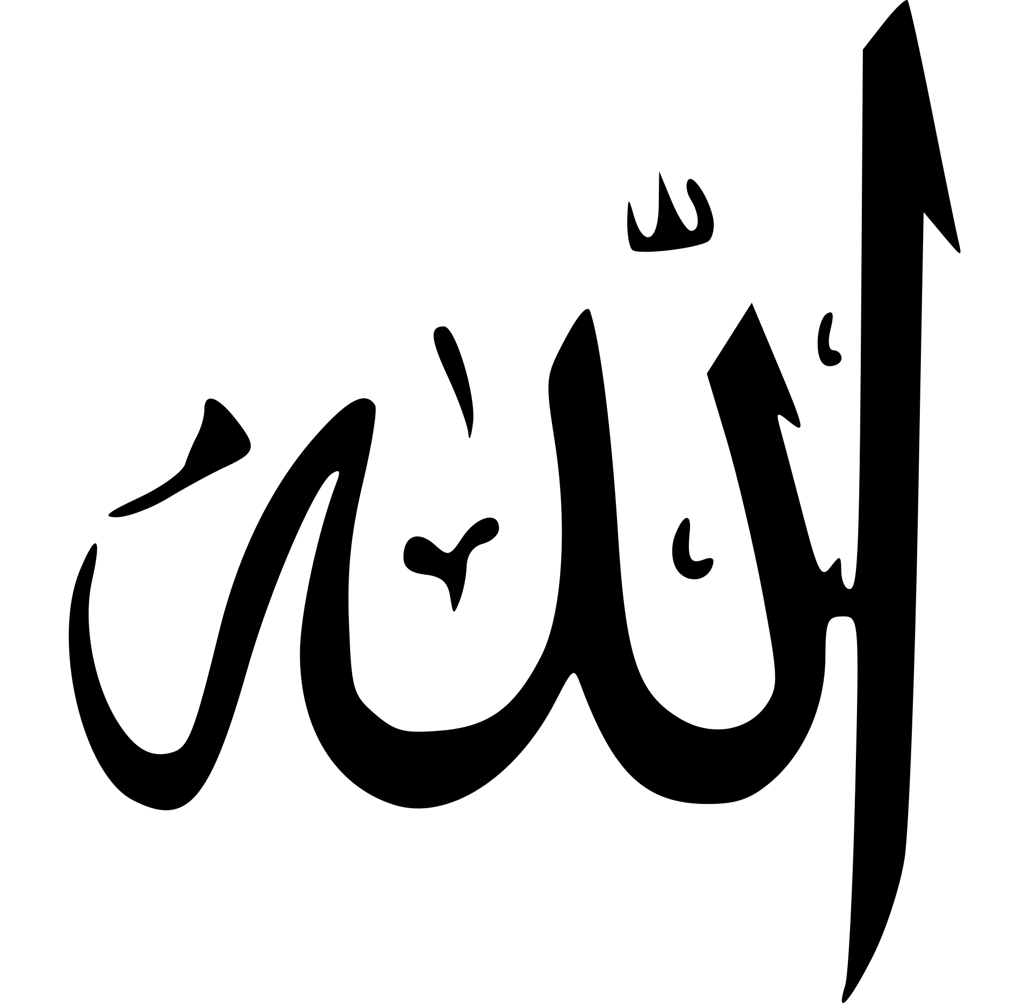
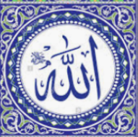
Religious Education
Muslims believe in one God, Allah, who is all powerful.
The Muslim word for God in Arabic is
Allah .
Muslim people are not allowed to draw Allah so always write the word.

Slide 7
Religious Education
Can you think about: Where you think you could find God? What is God like?
In the back of your purple books, write the date Monday 18th January and title God.
Draw, colour in or paint a picture of where you think that you would find God (There are some ideas on the next slide).

Slide 8
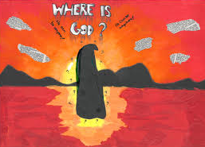
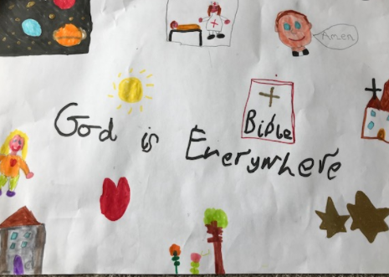
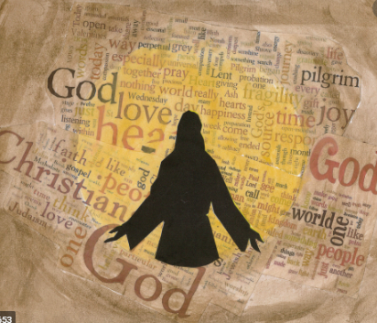
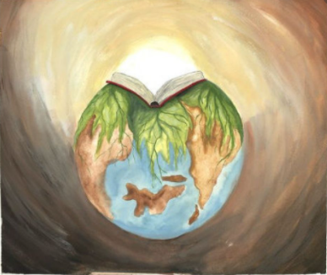
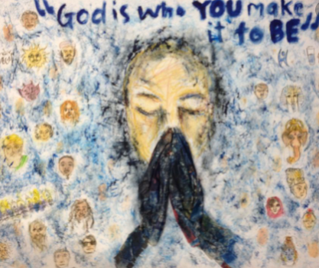
Religious Education
https://www.youtube.com/watch?v=DhRuKt5b0y0

Slide 9

Worship Time with:
Rev. Julie

