Slide 1
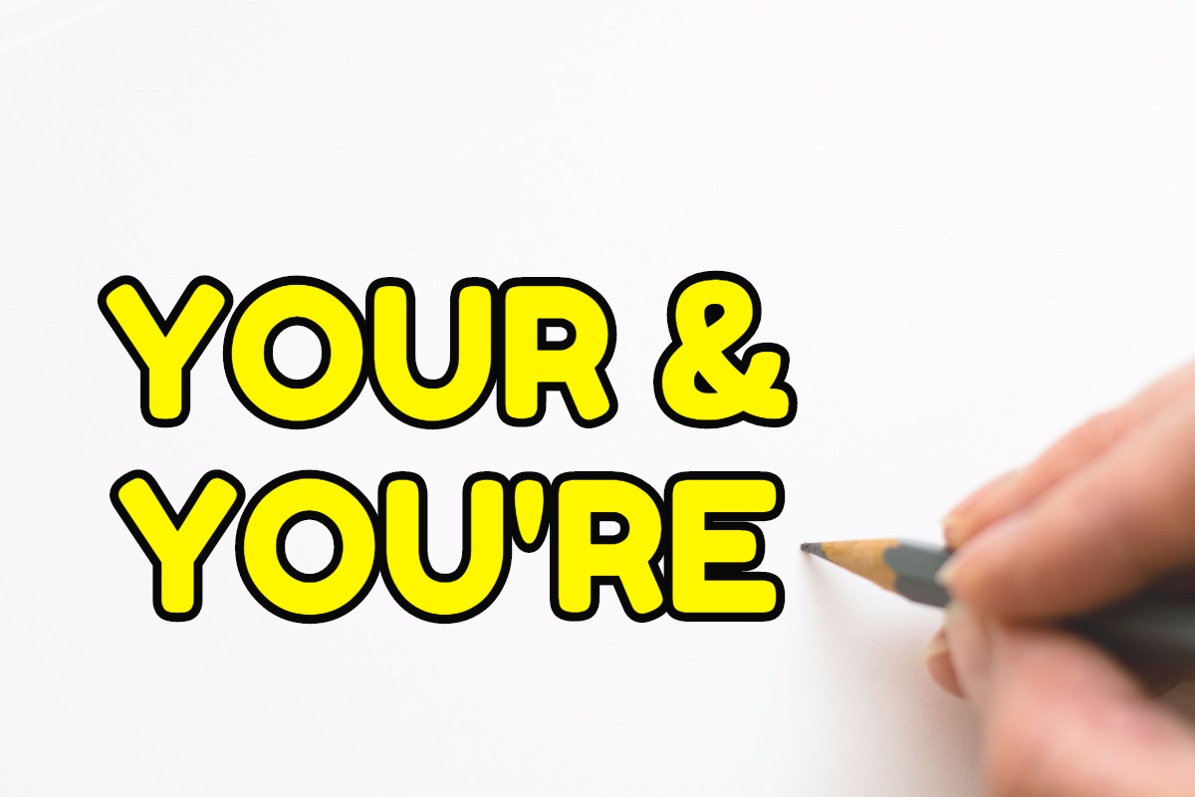

Slide 2
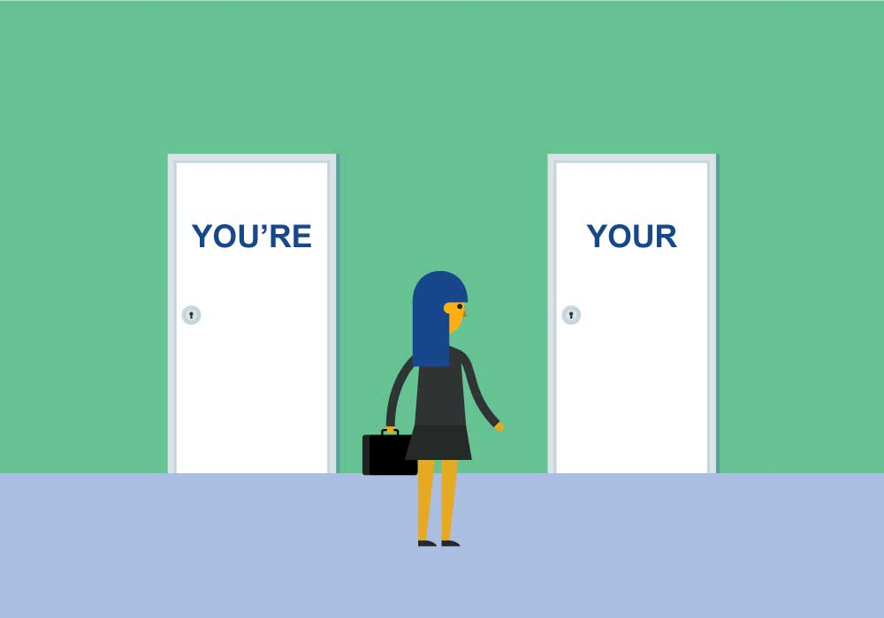
What does your and you’re mean?
Have and think and see what you come up with.
The answer is on the following page.

Slide 3
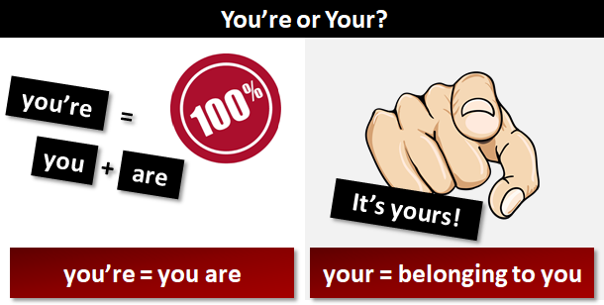
You’re is a contraction. This means it is two words joined into one word. The ‘ (apostrophe) replaces the letters which have been squeezed out. The two words are you are.

Slide 4
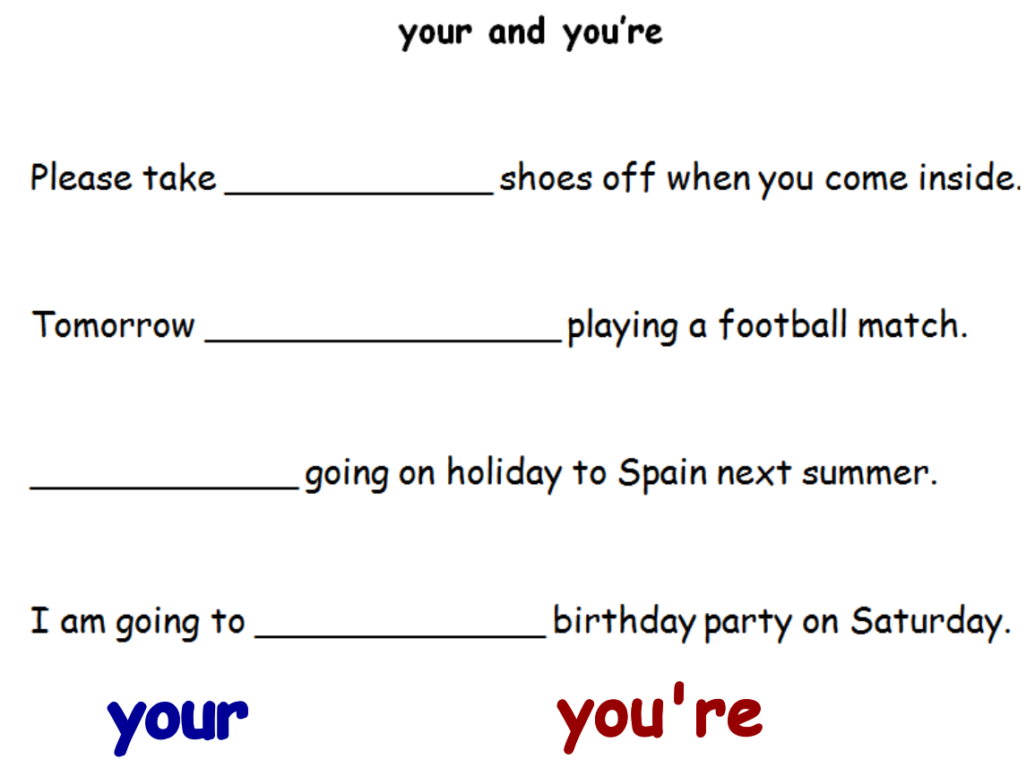
Have a practice, which your or you’re would you use?

Slide 5


