Slide 1
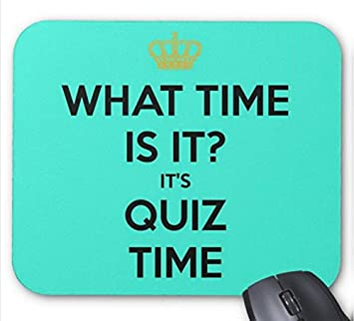
Spelling Quiz!

Slide 2

Now is the chance for us to quiz you on how well you have remembered your sounds.
(click on the button to hear the spelling)
1.
2.
3.
4.
5.
Answers are on the next page.
(If the sound clips do not work you will need a parent to tell you the spellings on the next page. No peeking!)

Slide 3
How many did you get right?
1. today
2. train
3. take
4. holiday
5. paid

