Slide 1
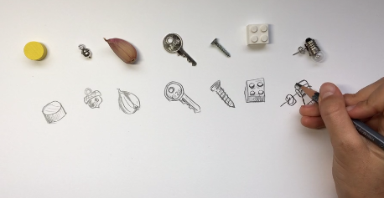
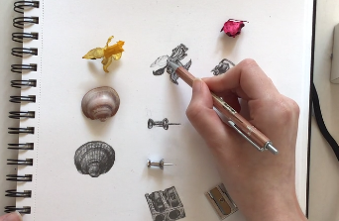
ART
You will need:
Plain paper
Pencil
A few small objects from around your house
Some calm background music
https://www.ramsgateartsprimaryschool.co.uk/blog/?pid=9&nid=23&storyid=5634
After watching the video, choose a few small objects to sketch.

Slide 2

Follow the link for Today’s Worship
This can be found in the
‘Whole School’ folder.

