Slide 1


Slide 2
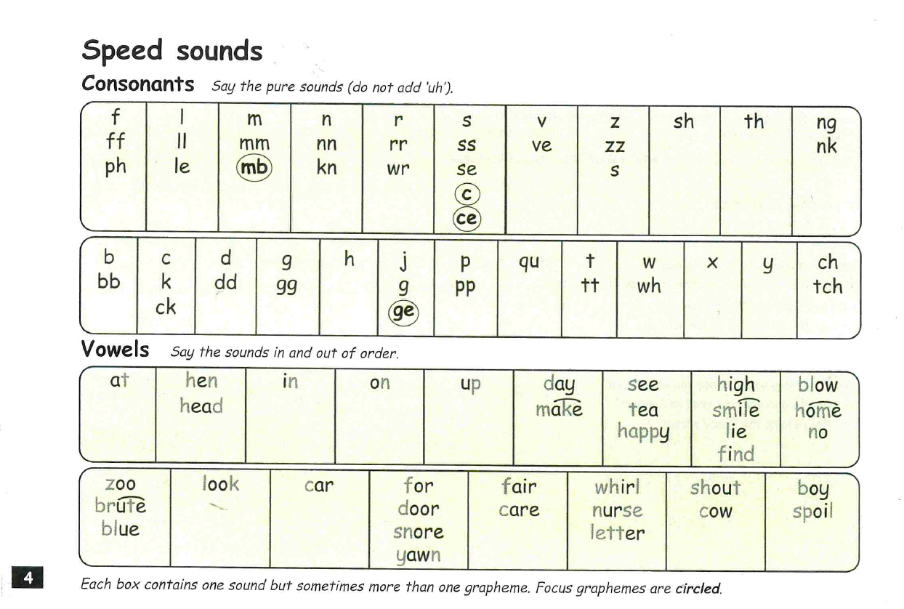

Slide 3
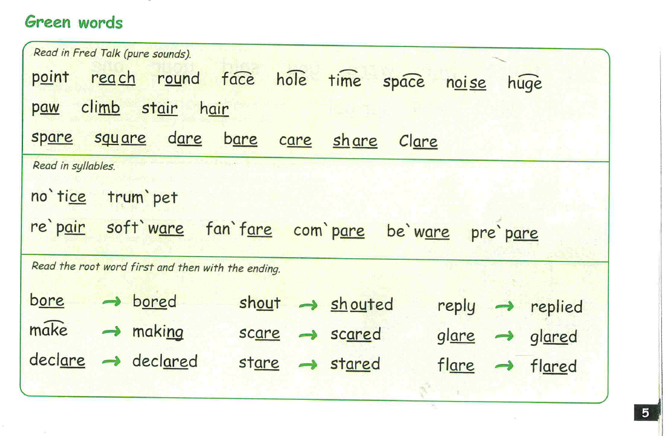

Slide 4
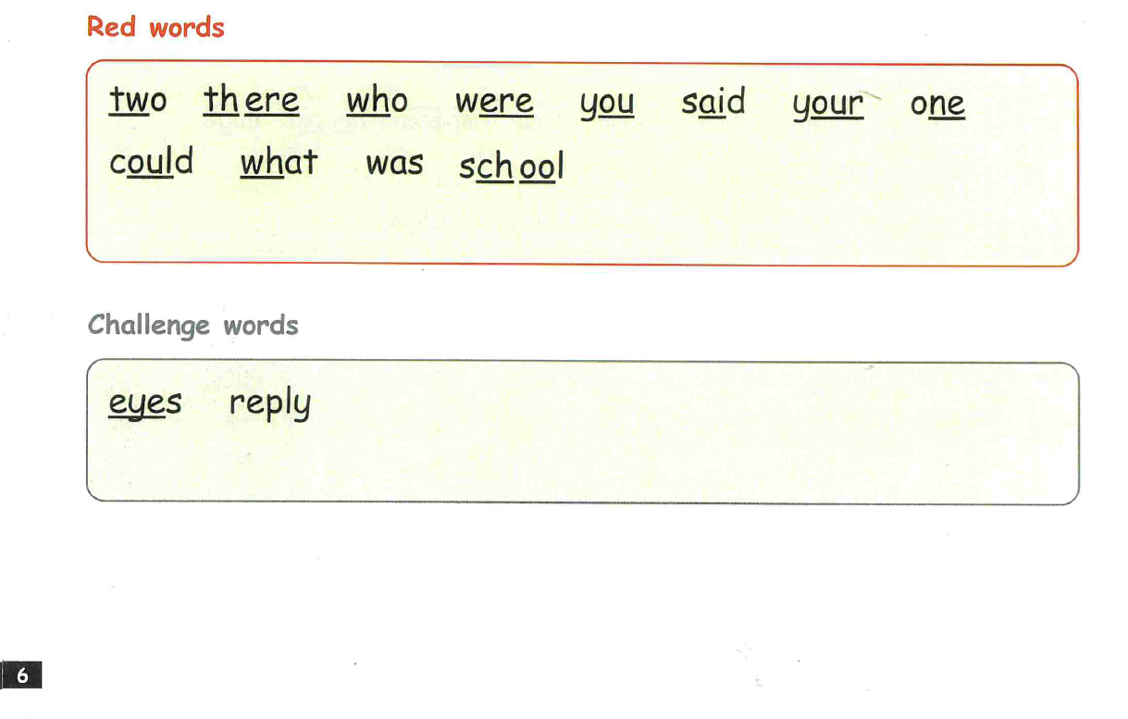

Slide 5
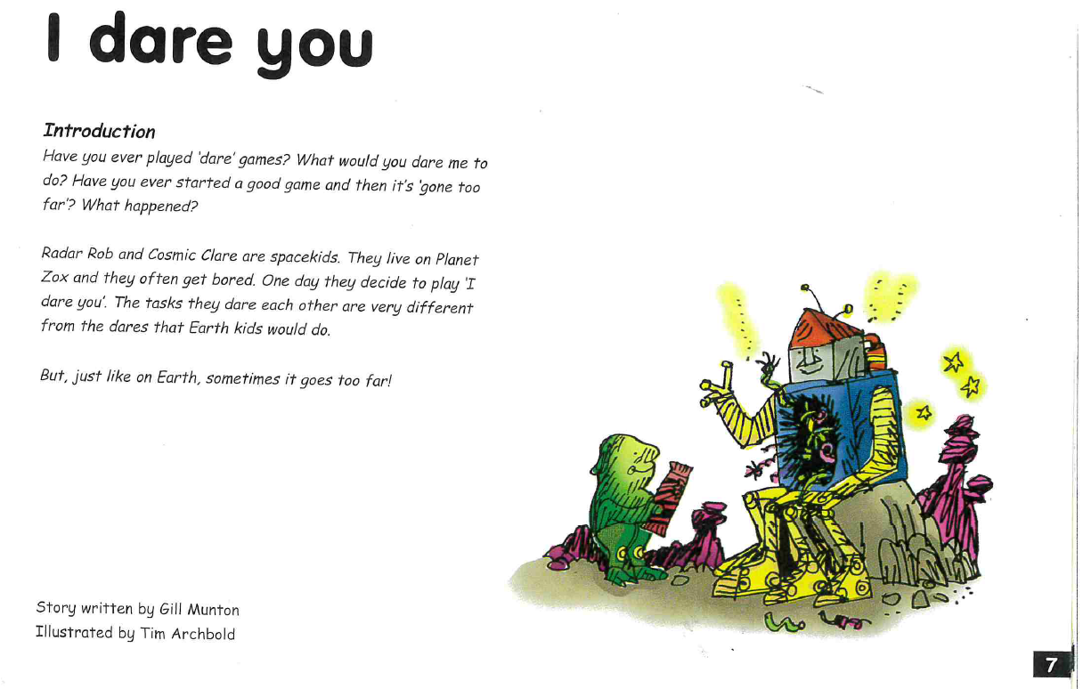

Slide 6
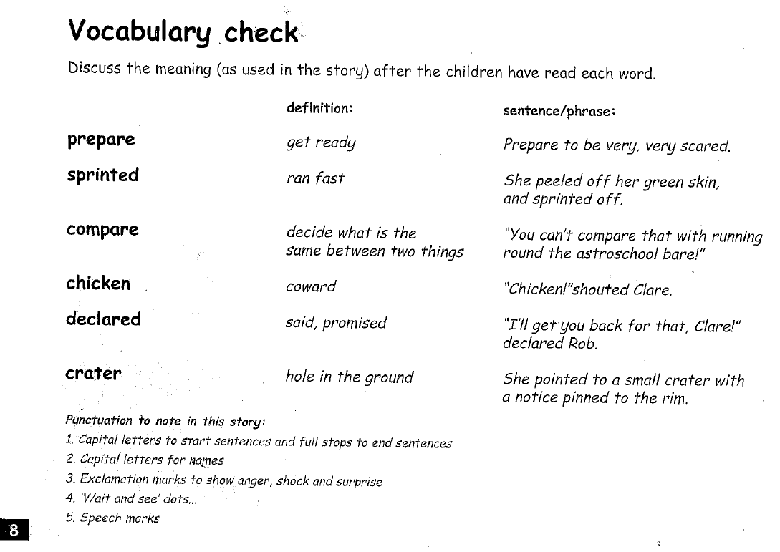

Slide 7
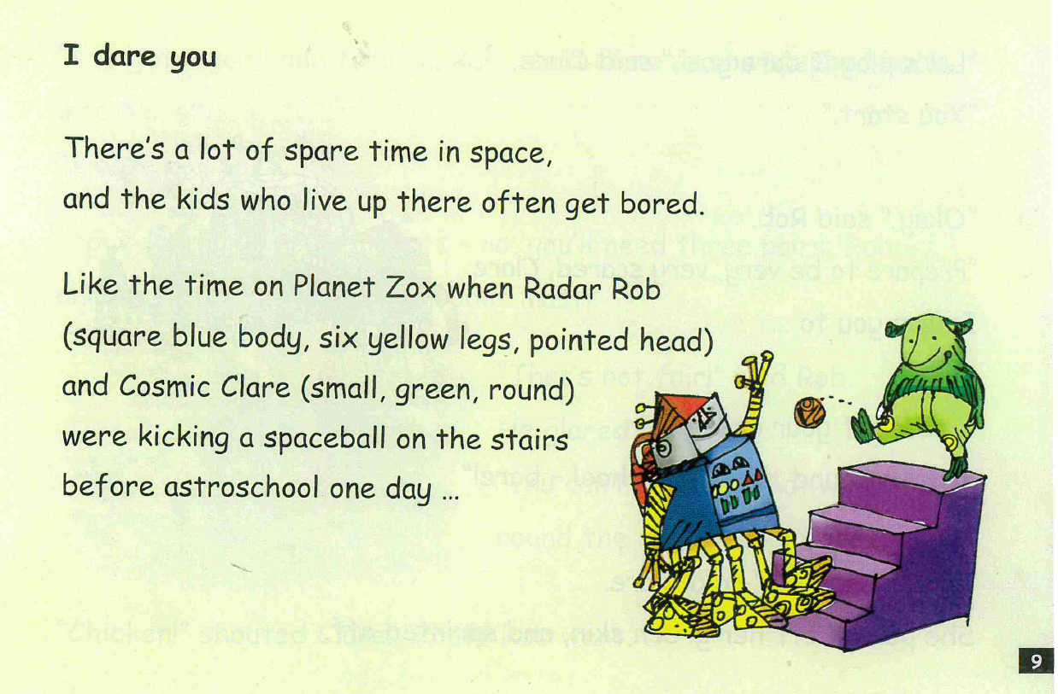

Slide 8
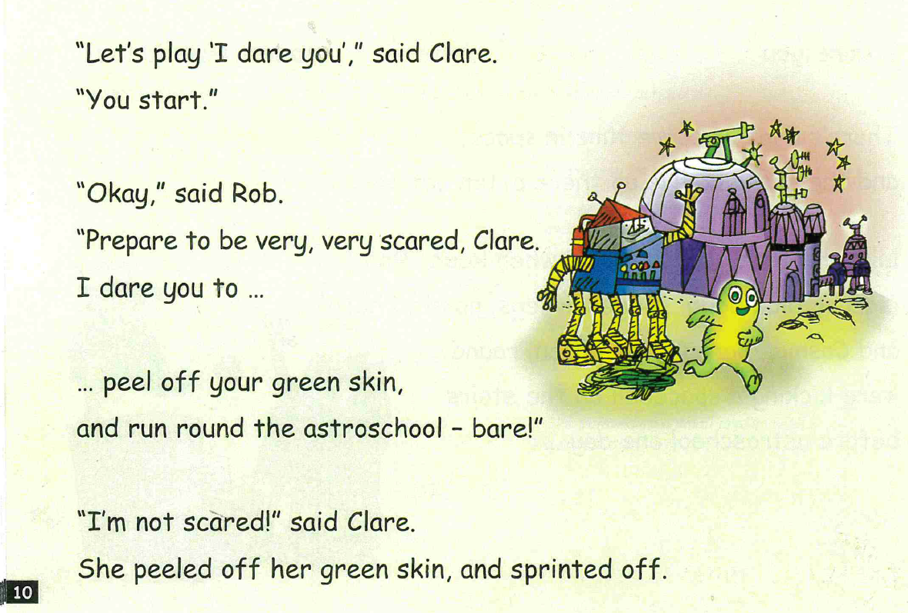

Slide 9
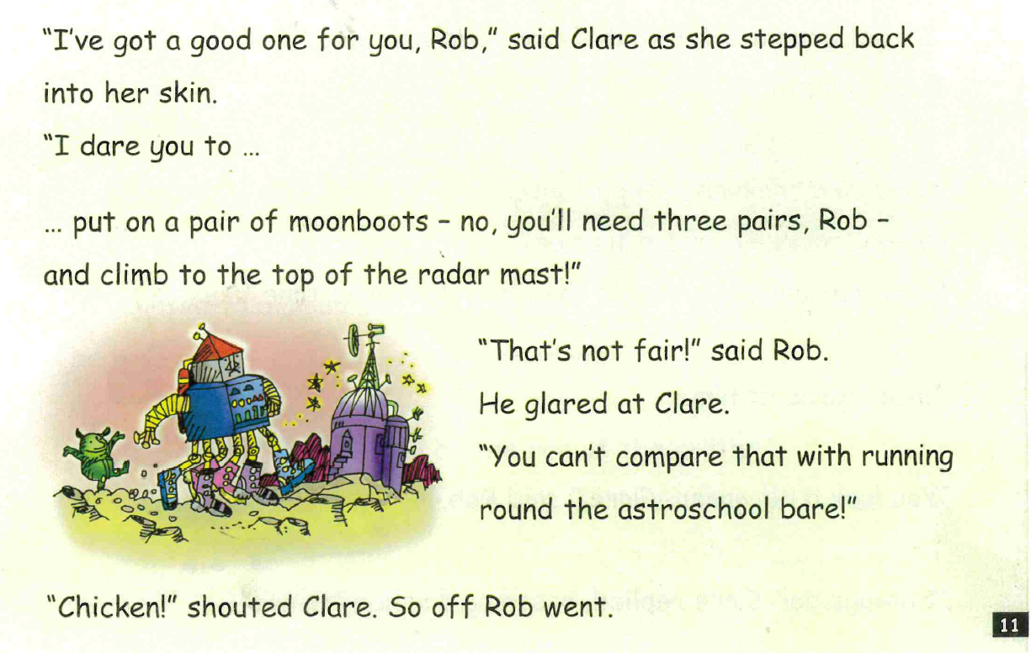

Slide 10
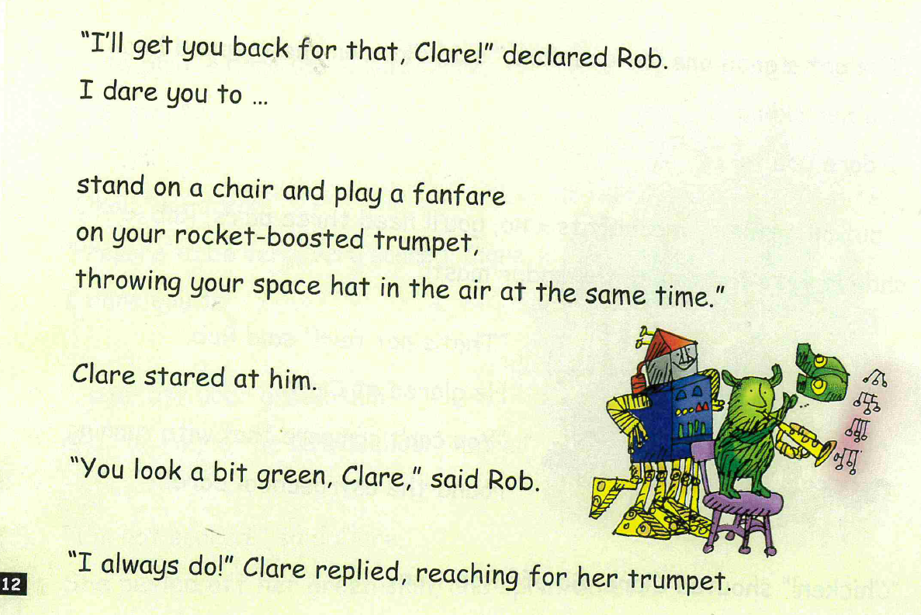

Slide 11
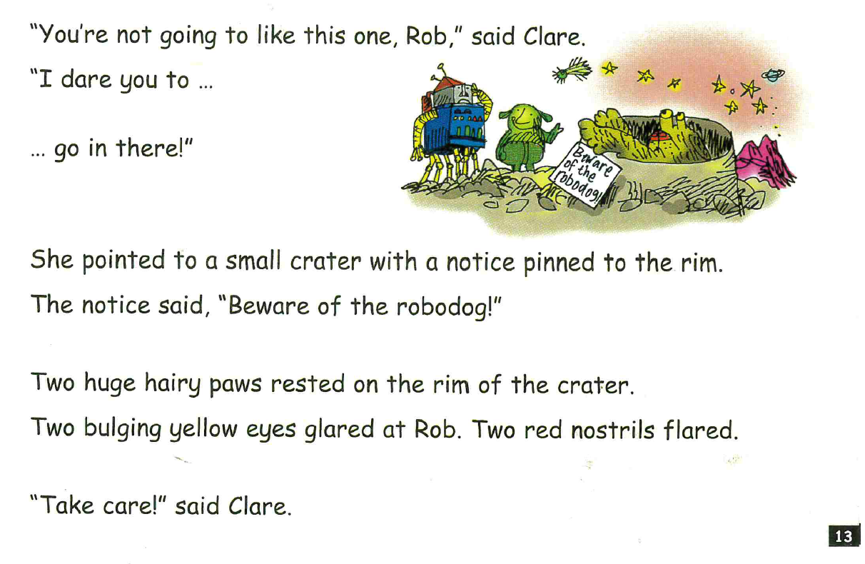

Slide 12
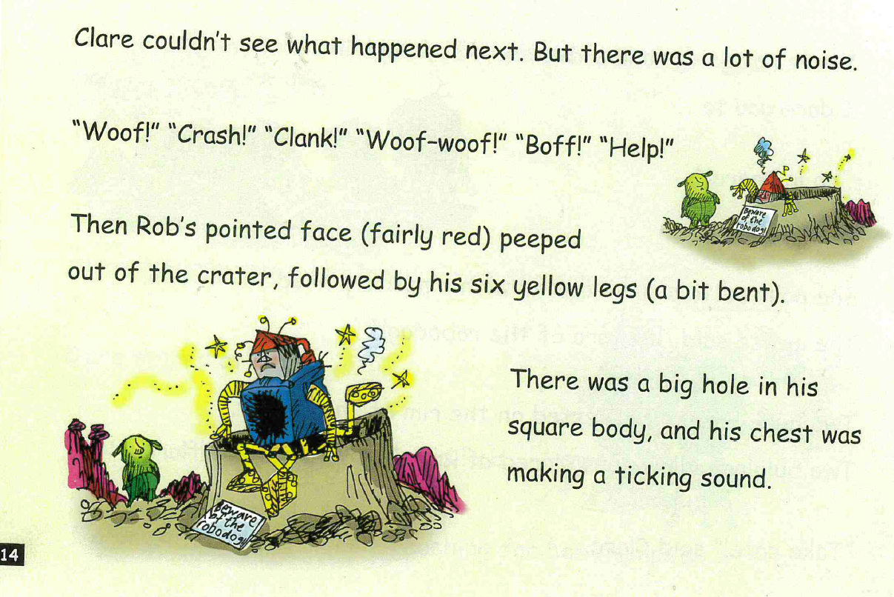

Slide 13
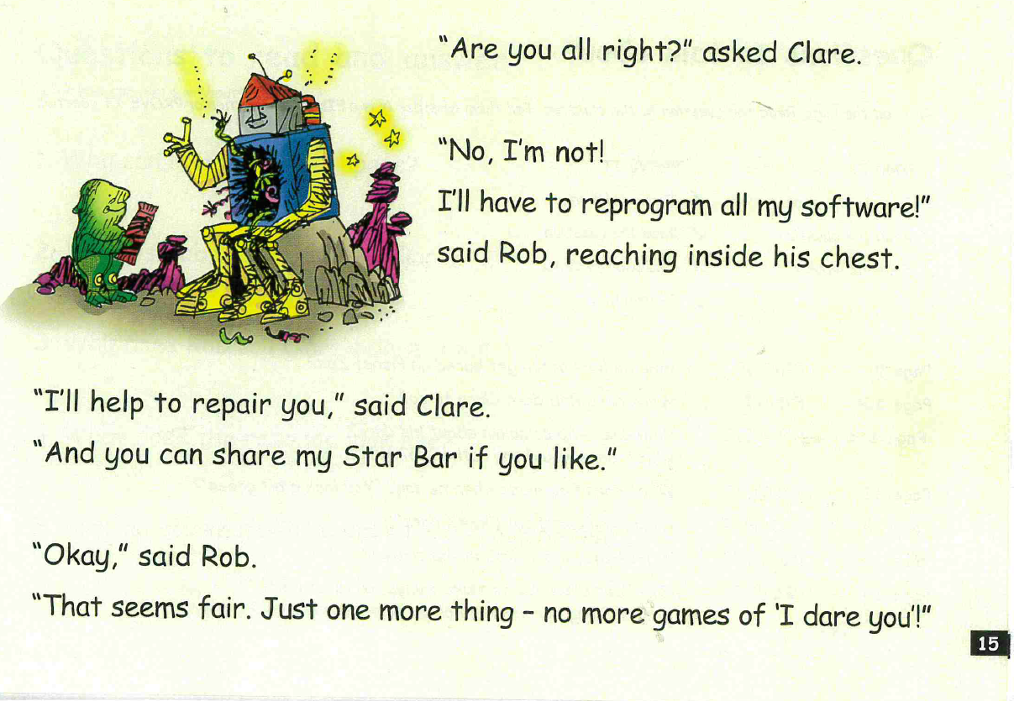

Slide 14
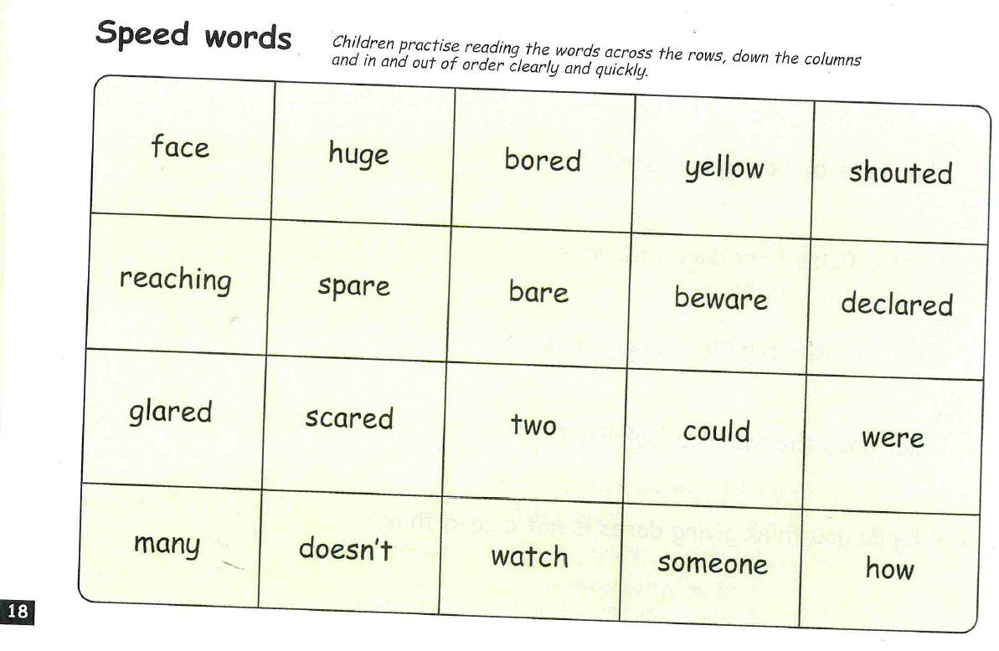

Slide 15



Edit a Sentence
2. Build a Sentence
The worksheet can be found on website or follow the PowerPoint and
write in a book or on handwriting paper.

Slide 16
Edit a sentence
Can you rewrite the below sentence for me please correcting all the mistakes. The correct sentence is on the following slide. No peaking until you have finished!
There are 2 capital letters missing
2 spelling mistakes
2 full stops missing
Two huge hungry pores rested on the rim of the cratur to bulging yellow eyes glared at rob
Then mark it using the correct sentence on the next slide.

Slide 17
Two huge hungry paws rested on the rim of the crater. Two bulging yellow eyes glared at Rob.

Slide 18

Build a sentence
Your word for today is - crammed
What does it mean? Can you find out?
Your job is to write a really creative sentence using this power word.
Can you include:
‘wow’ vocabulary
Add a conjunction to extend your sentence – and, or, but, so, if, because, when, that
Remember the 3 golden rules – capital letters, full stops and your sentence must make sense
Don’t forget to use your headphones to say your sentence out loud before writing it down.
E.g. My pens were crammed so tightly into my pencil case that they all popped out when I opened up the zip.

Slide 19


