Slide 1
Science
Over the next 2 or 3 weeks, we will be finishing off our topic on light.
So far we have investigated sources of light, reflectors and how light travels through some materials. Watch the following clips to remind you about some of the vocabulary we have discussed before in class.
https://www.bbc.co.uk/programmes/p06skhwf
A ‘get up and move’ song
https://www.bbc.co.uk/bitesize/clips/zg6r82p
Sources of light
https://www.bbc.co.uk/bitesize/clips/zb3s34j
Seeing in the dark

Slide 2
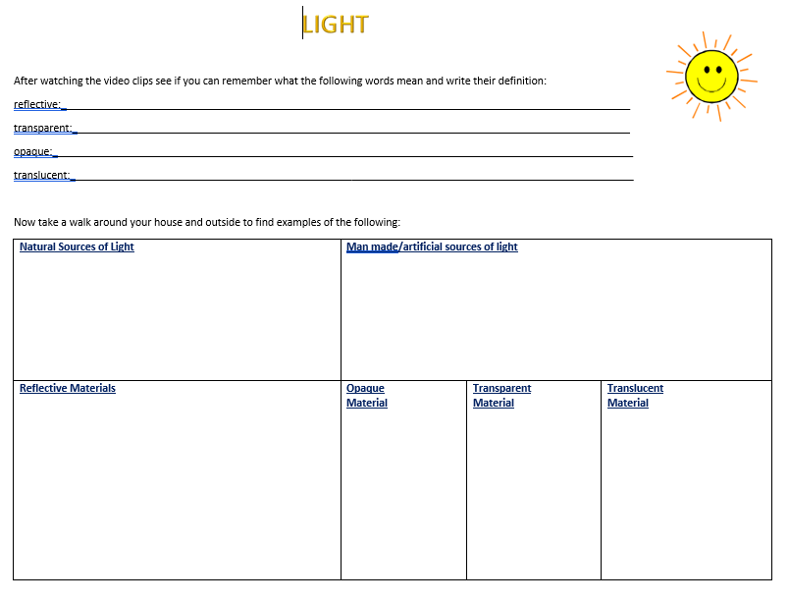

Slide 3

Follow the link for Today’s Worship
This can be found in the
‘Whole School’ folder.

