Slide 1
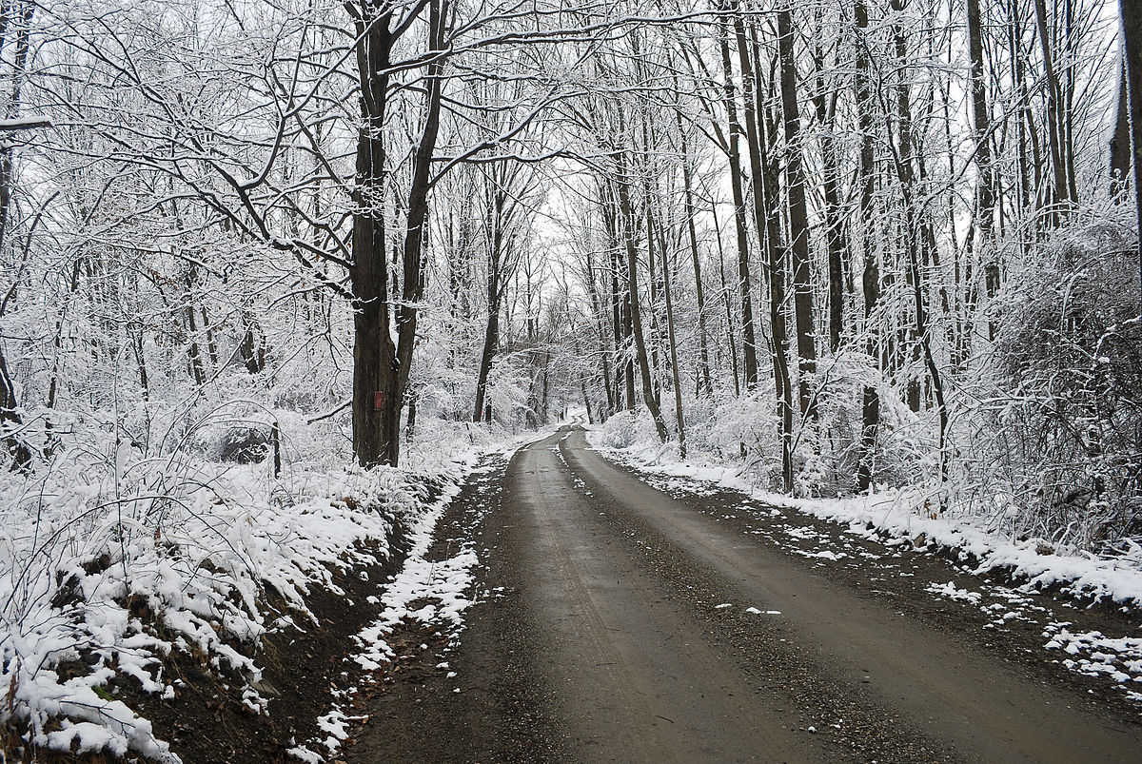
Topic
This week we are looking at winter in the United Kingdom.
Talk to someone about what you can see during winter. Now look at this link to see if you mentioned any of these things: https://www.youtube.com/watch?v=X0Bv6hchrg0

Slide 2
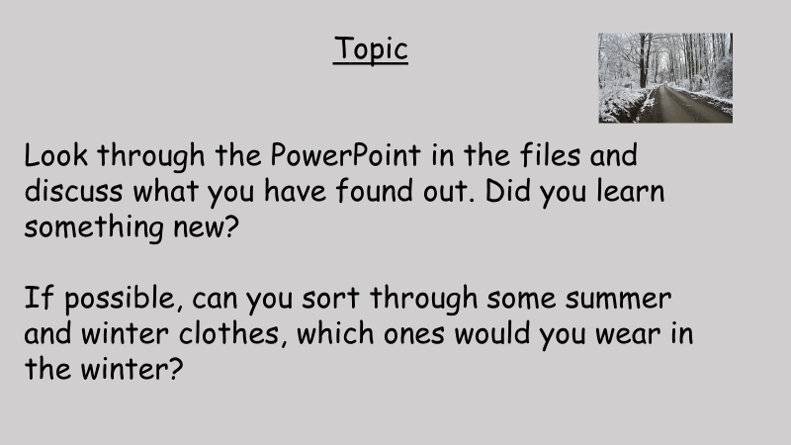

Slide 3
Topic
In your book write the date
Tuesday 12th January
and title
Winter Clothes

Slide 4


