Slide 1
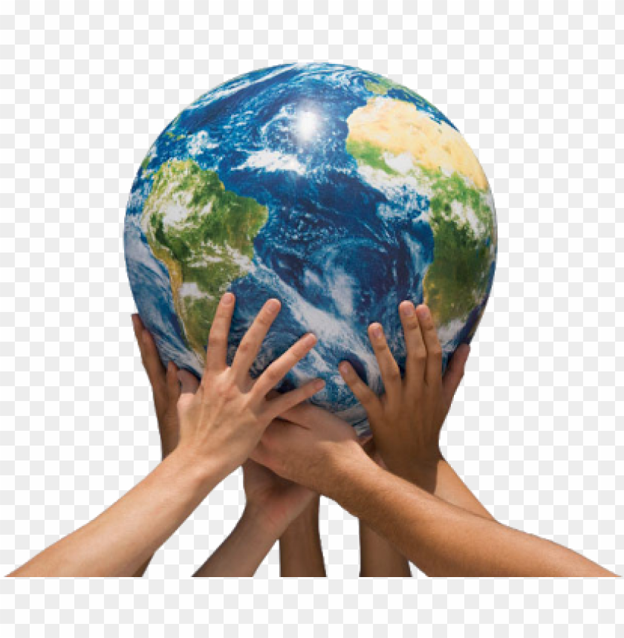
This term we will be looking at Climate Change and Our Fragile Earth
First we need to find out what the
difference is between :
The Weather and Climate

Slide 2
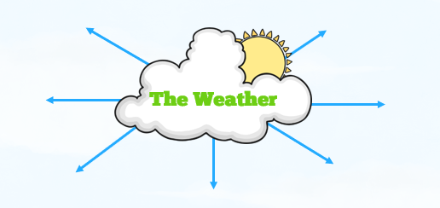
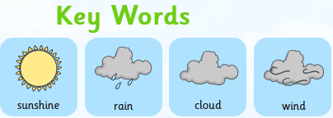
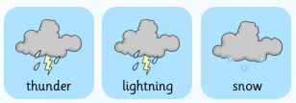
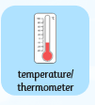
Weather and Climate
Take a quick walk outside and then come back in and give some key words to describe the weather today.

Slide 3
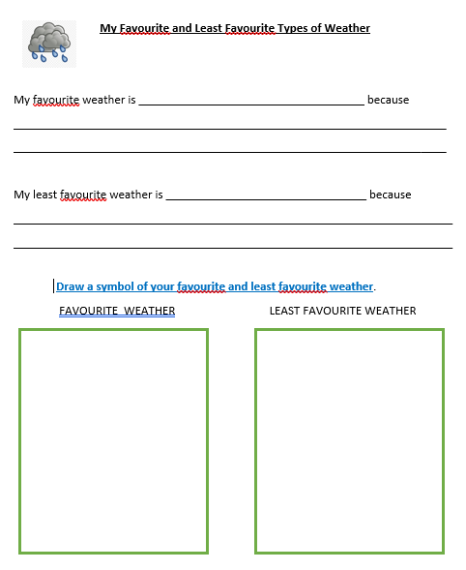
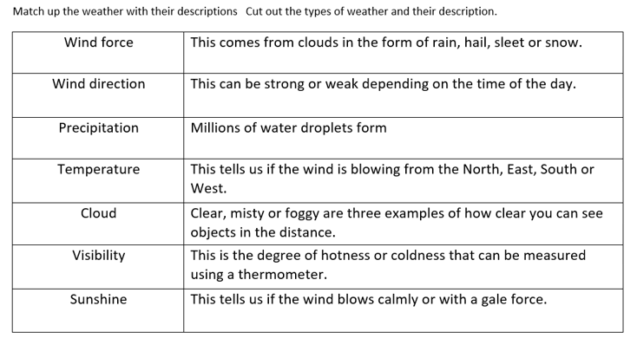
Watch the BBC clip and then complete the activities in today’s folder:
Cut up and match the vocabulary to the definition about weather
Complete the sentences and draw the symbols
https://www.bbc.co.uk/bitesize/topics/z849q6f/articles/z7dkhbk

Slide 4

Follow the link for Today’s Worship
Live on TEAMS with
Mr Debenham

