Slide 1
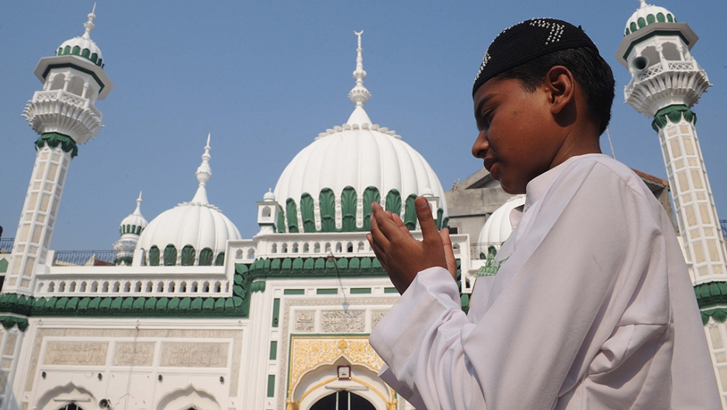
During RE we will be looking at the Muslim Faith, their festivals and worship.

Slide 2

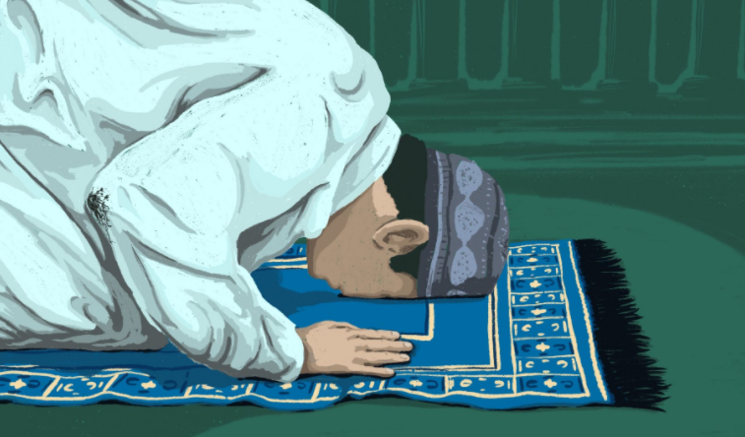
To start, we need to remind ourselves about what we already know and some of the key words we have learnt about previously.
Watch this video before doing the task.
https://www.bbc.co.uk/programmes/p02mwkxn

Slide 3
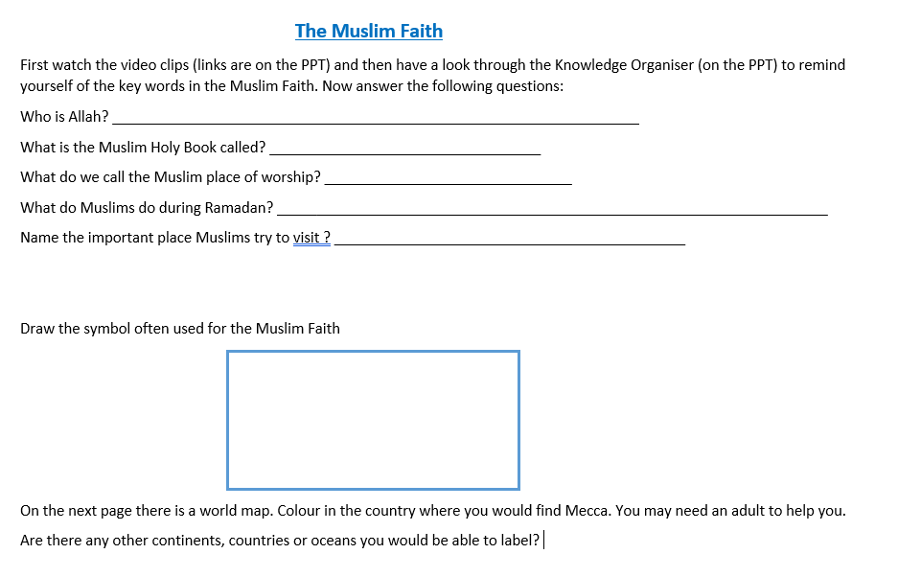

Slide 4
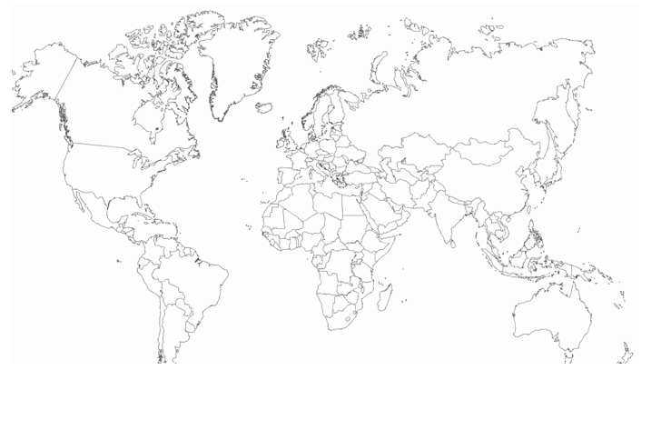

Slide 5
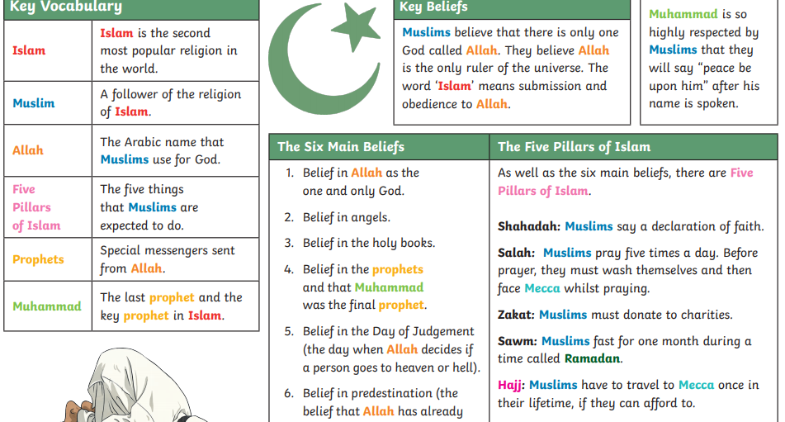

Slide 6
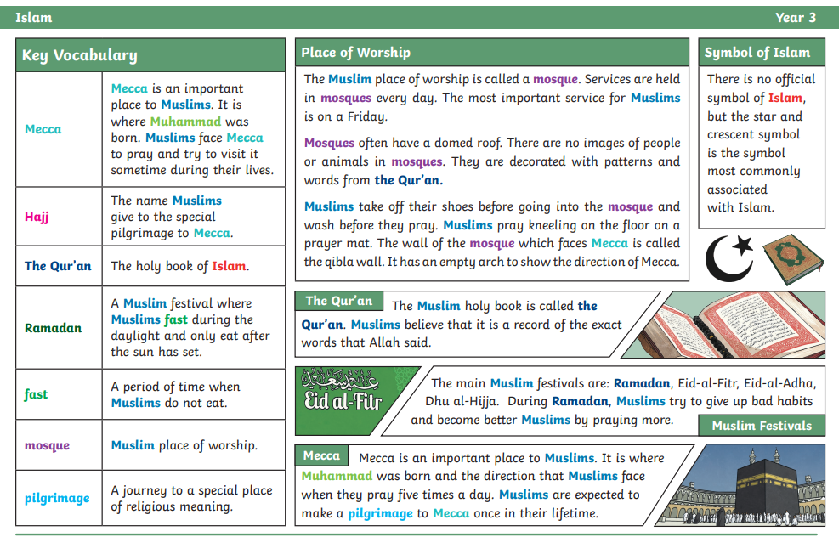

Slide 7

Follow the link for Today’s Worship
In the Whole School Folder

Slide 8
Have a super day, give of your best and please send me an e mail this afternoon with examples of your work.
teacher@kingslandengland.hereford.sch.uk
In the subject line could you have :
Year 3 and name of your child
Please only send one email a day with either attachments or a photo of work completed.

