Slide 1



Home Learning
Thursday 7th January

Slide 2

Start with a story

Slide 3
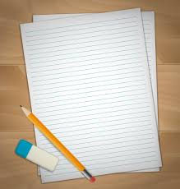
English
What was your favourite day of the holidays?
For this activity you will need paper, a pencil and rubber.
I would like you to write about your favourite day of the
holidays. On the website is a plan and example to help
you write about your favourite day of the holiday.

Slide 4

Take a break!

Slide 5
Maths
To start with we are going to look at some winter math problems. We are going to look at:
Day 1 – Do you want to build a snow man?
and
Day 2 – Snowflakes, snowflakes all around
Please click on the link for the website videos and click on the correct video.
https://whiterosemaths.com/homelearning/year-2/activity-week/
There are no worksheets for these videos that is why there are 2 to do today. Be prepared you may need to pause the video at certain points.

Slide 6

Have another break!

Slide 7
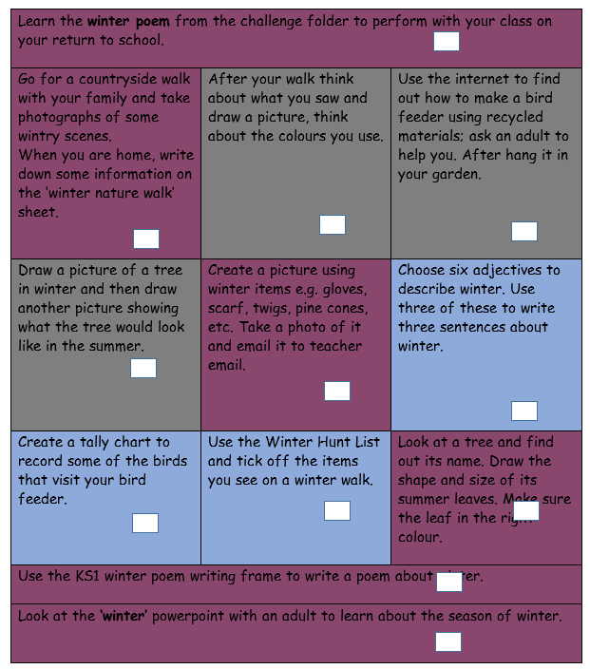
Winter Activity Challenge
For today, Thursday 7th January, and tomorrow, Friday 8th January I would like to have a go at some of the winter challenges.
A folder can be found on the website which has resources to help you complete some of the tasks.

Slide 8

Reading
We would like you to find 15-20 minutes during your day to share a book with an adult or family member.
Remember it not just you reading to an adult but also an adult reading to you.

Slide 9

Worship Time
Links to each day’s worship can be found in the whole school folder on the school website.

Slide 10

At the end of your day
Please could you please send an email to
teacher@kingslandengland.hereford.sch.uk
showing a selection of your work and I will be able to reply with a comment / feedback.
Please keep this to one email a day. If you want to include multiple attachments that will be fine.

Slide 11

Any problems
If you have any problems at all then please feel free to email me and I’ll do my best to help. Remember we are in this together and we will learn as we go along.
teacher@kingslandengland.hereford.sch.uk

