Slide 1


Friday 5th March 2021
For maths you need to be able to see or have a copy of the Subtraction Revision grid and worksheet. For RWI you need the red words to spell sheet and lines for spelling words.
 | phonics | RWI |  | maths – White Rose Vimeo link and worksheet |  | afternoon | 2:45 assembly via email | time to share a book
9am On-line registration | Rainbow Group practice green /red words Sunshine Group practice green /red words | Puppets Jim’s House -Speed Sounds -Red and Green words -Read story -Big Write | BREAK | Measure Length https://vimeo.com/508439670 | LUNCH | PE and Golden Time | Big Joe | Reading Time

Slide 2




RWI
Each day for RWI you will need:
Rainbow Group Sunshine Group
Puppets Jim’s House book book
‘Weekly Writing sheet’ RWI (from your pack)

Slide 3
Rainbow Group
Today we are going to have a very brief start to our phonic session to read through the green words and spell some words.

Slide 4
Sunshine Group
Today we are going to have a very brief start to our phonic session to read through the green words and spell some words.

Slide 5
Sunshine and Rainbow Groups
Yesterday we had the Spelling Quiz.
I would like you to look back at your quiz and see which words (if any) you found a challenge.
I would like you to practise these words so you are able to spell them with ease.

Slide 6
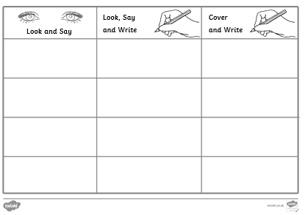
Sunshine and Rainbow Groups
In the Friday file are the red (tricky) words that you have been reading in your RWI book this week.
I would now like you to try to learn how to spell these words so you are able to spell them with ease.

Slide 7
Sunshine and Rainbow Groups
Look at the words in the Look and Say column. You need to take your time to look at each word, say the letters out loud, look at the shape of the word and try to write it in the air. Remember you can do this outside, if you prefer.
Once you think you know how to spell them, have a go in the second column.
In the final column, cover the words up and write them.

Slide 8
Sunshine and Rainbow Groups
If you have time, write two different sentences using these words.
Use the handwriting lines to help you to keep it neat.

Slide 9


Continue with RWI
Begin by reading the Speed Sounds to an adult, as you did yesterday.

Slide 10

Continue with RWI
After that, you are ready to read through the Speed Words (on page 15 of your book) to an adult.

Slide 11
Continue with RWI
Now you are ready to read the book to an adult. You have been working on this story all week so you should be getting very confident!
Remember to think about your expression to make it interesting to listen to and pausing for punctuation.

Slide 12

Today we are not going to do our Big Write as I want you to have time to talk to your adult and to think about next week. Below is a link to the story
‘The Huge Bag of Worries’ written by Virginia Ironside
https://www.youtube.com/watch?v=CDrnuPj7xfs

Slide 13
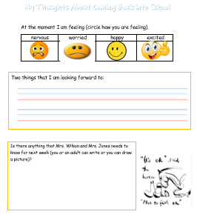
Spend your time talking through the story that you have just heard.
Now look at the sheet below and discuss with your adult.

Slide 14

Stick your sentence on the next page at the front of your purple book.
Thank you for working hard.
Now have a break and a snack.

Slide 15


White Rose Maths
Measuring Length
You will need:
Measuring Length worksheet
Subtraction Revision grid

Slide 16
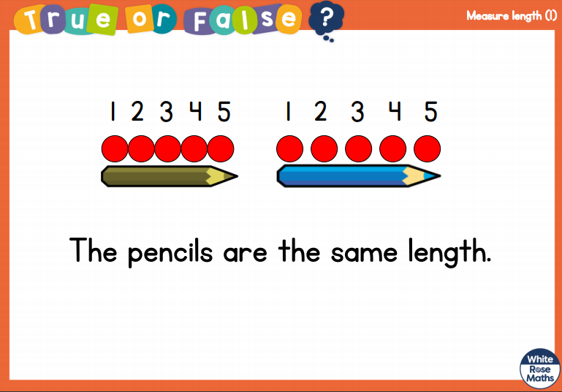
White Rose Maths
Is this true or false? (answer on slide 17)

Slide 17
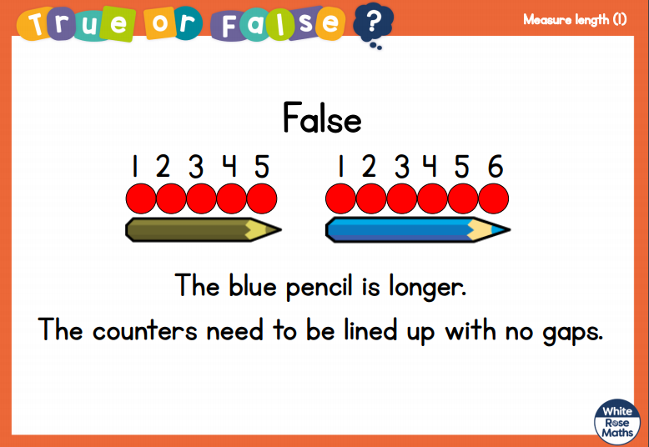
White Rose Maths

Slide 18
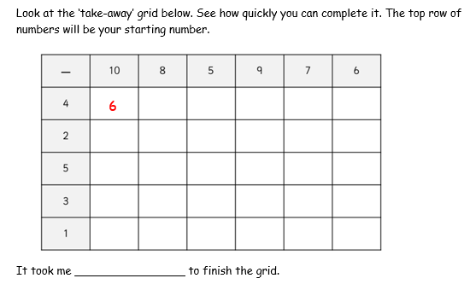
White Rose Maths
Have a look in files for the Subtraction Revision Grid that you have been looking at these past few days. I would like you to have another go and see how quickly you can fill it in today.

Slide 19
White Rose Maths
Use this video link https://vimeo.com/508439670 and have a go at the ‘questions to think about’ slide.
Work through the video, feel free to pause it to explain any of the teaching.
Now you are ready to have a go at the worksheet.
Remember you can write your answers in your blue maths book to save printing it out.

Slide 20

If you have used a sheet, stick it into the front of your blue maths book.
I think it is time for lunch and a break from your work.
.
This afternoon there is a PE session
and after that it is Golden Time.
First of all go and enjoy your lunch.

Slide 21

Worship Time:
Today is the World Day of Prayer, celebrated around the world.
As such, a special Worship Time has been created by Helen Webb, Chair of Governors, Rev Julie Read and Wendy Maddocks, Foundation Governor.
Children should bring a stone or Lego / Duplo brick to the Worship Time.
Please follow this link: https://youtu.be/rdbSv-A7zH0

Slide 22

Please make sure your reading record is up to date before bringing your books and bookbag into school on Monday.
I have found another story for you to listen
to this afternoon.
https://www.youtube.com/watch?v=i9dXoz9z4R0
Thank you all for your amazing hard work over the
past 8 weeks. See you on Monday for the next
chapter of our story!
For the last time, please send an email containing the completed work to teacher@kingslandengland.hereford.sch.uk

