Slide 1


Slide 2


Thursday 4th March 2021
For RWI you will need to be able to see a copy of the words for the Spelling Quiz. For maths you need to be able to see a copy of the subtraction grid and the measuring sheet.
 | phonics | RWI |  | maths – White Rose Vimeo link and worksheet |  | afternoon | 2:45 assembly via email | time to share a book
9am On-line registration | Rainbow Group spelling quiz Sunshine Group spelling quiz | Puppets Jim’s House -Speed Sounds -Red and Green words -Read story -Build a Sentence | BREAK | Measure Length Activity https://vimeo.com/507969952 practical | LUNCH | World Book Day Challenge | Mark Harrington | Reading Time

Slide 3


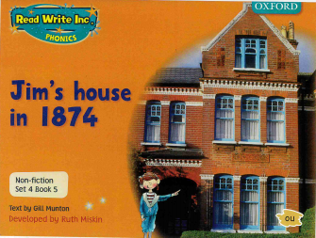

RWI
Each day for RWI you will need:
Rainbow Group Sunshine Group
Puppets Jim’s House book book
‘Weekly Writing sheet’ RWI (from your pack)

Slide 4
Rainbow Group oi – spoil the boy
Today we are going to start our phonic session by reading through the graphemes and green words and then we read the book. After that, it will be our Spelling Quiz. The words for the quiz are in Thursday’s file.

Slide 5
Sunshine Group oa – goat in a boat
Today we are going to start our phonic session by reading through the graphemes and green words and then we read the book. After that, it will be our Spelling Quiz. The words for the quiz are in Thursday’s file.

Slide 6


Continue with RWI
Begin by reading the Speed Sounds to an adult, as you did yesterday.

Slide 7

Continue with RWI
After that, you are ready to read through the Speed Words (on page 15 of your book) to an adult.

Slide 8
Continue with RWI
Once you have read the speed sounds and Speed Words you are ready to read the book to an adult. Remember to think about your expression to make it interesting to listen to.

Slide 9
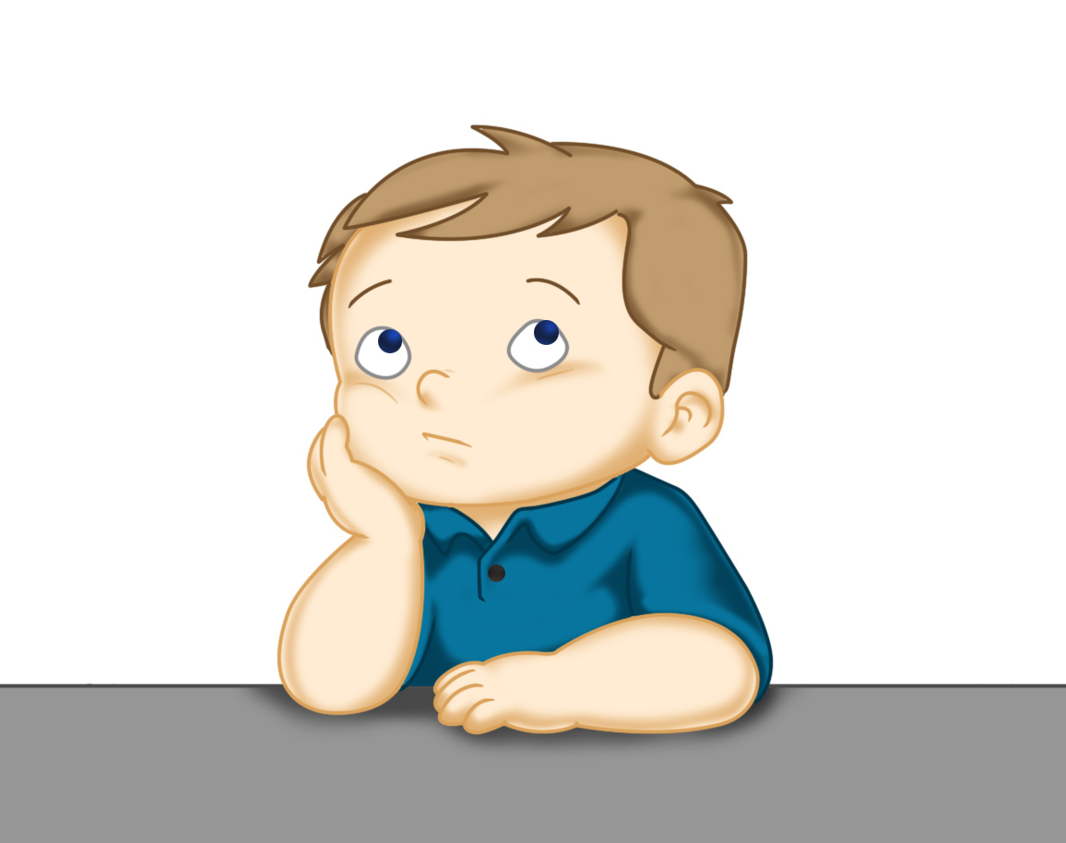
Our Structure for RWI
Build a Sentence
The aim of this task is to help to build (improve) your vocabulary.
On the next slide there are some words that I would like you to discuss with your adult. Make sure you know what they mean, think of other words that mean the same (synonyms).
Now think of an exciting sentence for each of these words.
This Photo by Unknown Author is licensed under CC BY

Slide 10

Build a Sentence
fasten join brilliant
You may like to think about:
When will it be done? After I have finished my work
Who is going to do it? I am going to….
How are you going to do it? fasten
What are you doing it to? the silvery tongue of my snake into his mouth.
This afternoon I am going to fasten the silvery tongue of my snake puppet into his mouth.
Write out 2 of your sentences using capital letters and full stops.

Slide 11
Build a Sentence
different servants scullery mangle
I would like you to write 2 sentences using 2 of the above words. You could either give me the definition of the word, or use them in a sentence.
The servant was tired out after washing the dirty clothes and then using the mangle to try to get the water out.
Write out 2 of your sentences using capital letters and full stops.

Slide 12

Stick your sentence on the next page at the front of your purple book.
Thank you for working hard.
Now have a break and a snack.

Slide 13


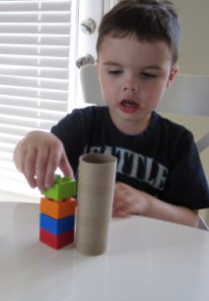


White Rose Maths
Measuring Length a practical activity
You will need:
Measuring Length worksheet
Subtraction Revision grid
Objects to measure with (paper clips or Lego bricks etc.)

Slide 14
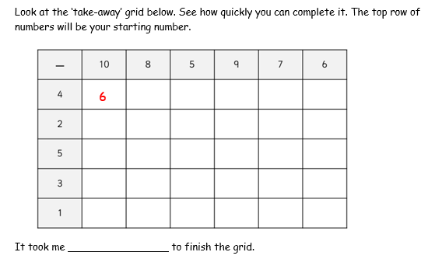
White Rose Maths
Have a look in files for the Subtraction Revision Grid that you have been looking at these past few days. I would like you to have another go and see how quickly you can fill it in today.

Slide 15
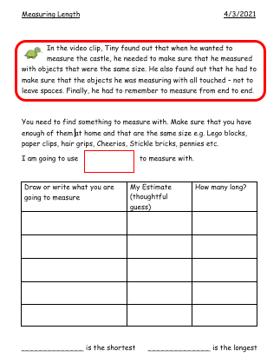
White Rose Maths
Use this video link https://vimeo.com/507969952.
Work through the video, feel free to pause it to explain any of the teaching. Don’t stop for the final activity on the video as you won’t have the blocks at home to measure cutlery.
Now you are ready to have a go at the worksheet.
Remember you can write your answers in your blue maths book to save printing it out.

Slide 16
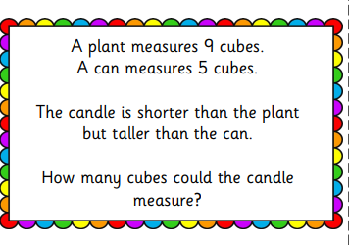
White Rose Maths
Deeper Thinking

Slide 17


If you have used a sheet, stick it into your blue maths book.
Tomorrow will be the last day of White Rose learning from home.
.
This afternoon there are some activities
for you to chose from on the World Book
Day Challenges but first of all go and have
a break and enjoy your lunch.

Slide 18
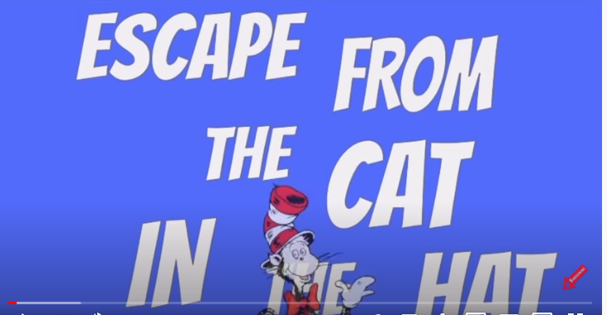
https://www.youtube.com/watch?v=hd-AIWhVINM

Slide 19

Worship Time:
Mark Harrington
https://www.youtube.com/watch?v=VLU4joFTQ2E&feature=youtu.be

Slide 20

Most importantly encourage your child to read a suitable book to you. Later on it would be great if you could read a bedtime story to them.
Please remember to send an email containing the completed work to teacher@kingslandengland.hereford.sch.uk

