Slide 1


Wednesday 3rd March 2021
For RWI you will need access to the Roll and Read sheet, a dice and the Edit a Sentence. For maths you need to be able to see a copy of the addition grid and worksheet.
 | phonics | RWI |  | maths – White Rose Vimeo link and worksheet |  | afternoon | 2:45 assembly via email | time to share a book
9am On-line registration | Rainbow Group oi – spoil the boy Roll and Read Sunshine Group oa – goat in the boat Roll and Read | Puppets Jim’s House -Speed Sounds -Red and Green words -Read story -Edit a Sentence | BREAK | Compare lengths and heights https://vimeo.com/507943851 worksheet | LUNCH | Science | I Sing Pop | Reading Time

Slide 2


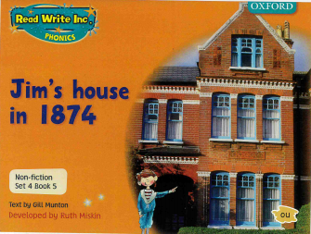

RWI
Each day for RWI you will need:
Rainbow Group Sunshine Group
Puppets Jim’s House book book
‘Weekly Writing sheet’ RWI (from your pack)

Slide 3
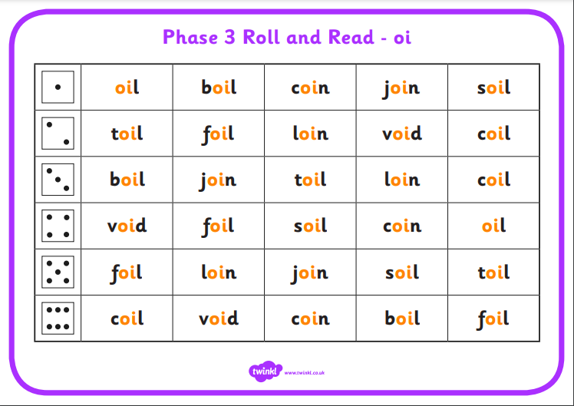
Rainbow Group oi – spoil the boy
After a brief phonic session can you complete this game that is in Wednesday’s folder. You don’t necessarily have to print it.
Once finished, it can be stuck into the front of your purple book.

Slide 4
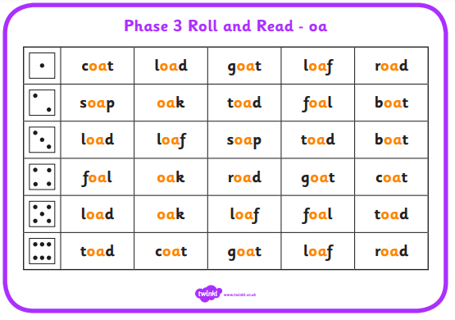
Sunshine Group oa – goat in a boat
After a brief phonic session can you complete this game that is in Wednesday’s folder. You don’t necessarily have to print it.
Once finished, it can be stuck into the front of your purple book.

Slide 5
How to Play Roll and Read
You can either: print this off and tick or colour in the words your child has read; or leave it on the screen to read.
Roll the dice and read the first word in that row, keep on rolling the dice and reading the words until you fill a complete row.

Slide 6


Continue with RWI
Begin by reading the Speed Sounds to an adult, as you did yesterday.

Slide 7

Continue with RWI
After that, you are ready to read through the Green and Red Words to an adult like you did yesterday.

Slide 8
Continue with RWI
Once you have read the speed sounds, green and red words, you are now ready to read the book. Remember to pause at the full stops.

Slide 9
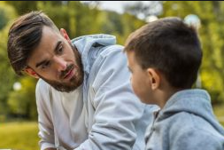
Our Structure for RWI
Today we have two activities to do:
Questions to Answer (a verbal activity, no writing!) - see page 14 of your reading book.
Get an adult ask you the questions. Don’t
forget to turn to the correct page to help
you to find the answer.
Remember to answer in full sentences.

Slide 10

Our Structure for RWI
2. Edit a Sentence.
On the following pages there is a sentence, one for each group to read.
We do this every week in class so they know that there are some mistakes and their job is to look carefully at the sentence to try to spot all of the errors.
Once they have done this they circle them and then copy the corrected sentence onto the Wednesday section of the Weekly Handout Sheet.

Slide 11

Edit a Sentence the hands and logs have strings. pull the string
There are 4 mistakes
2 capital letters (T and P) 1 spelling mistakes
1 full stop
Once you have found the mistakes, circle them and then look at the next slide to check that you have found them all.

Slide 12
Edit a Sentence
the hands and logs have strings. pull the string
Now copy it up neatly (correct sentence on slide 15).
Did you spot the missing full stop and capital letter?

Slide 13
Edit a Sentence the mous rins around it is on the couch
There are 6 mistakes:
2 capital letters 2 spelling mistakes
2 full stops
Once you have found the mistakes, circle them and then look at the next slide to check that you have found them all.

Slide 14

Edit a Sentence
the mous rins around it is on the couch
Now copy it up neatly (correct sentence on slide 15).
Did you spot all of the mistakes?

Slide 15
Edit a Sentence – correct sentences
The hands and legs have strings. Pull the string.
The mouse runs around. It is on the couch.

Slide 16

Stick your sheet in the front of your purple book.
Thank you for working hard.
Now have a break and a snack.

Slide 17


White Rose Maths
Compare length and height
You will need:
-Addition Revision Grid
White Rose sheet

Slide 18
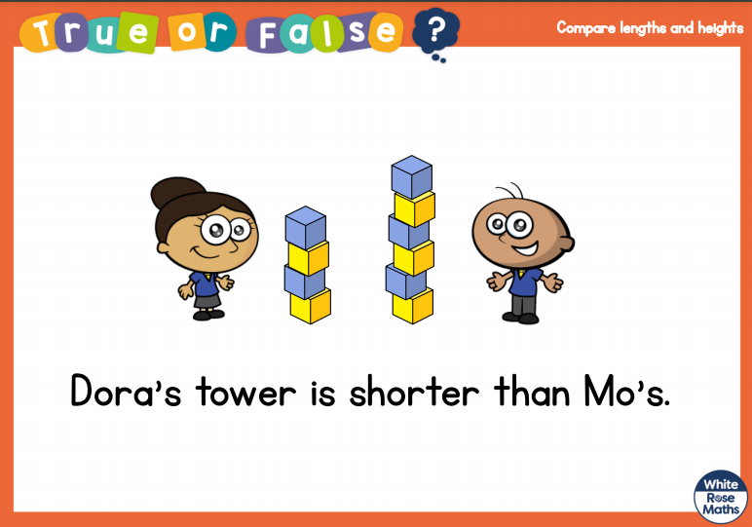
White Rose Maths
Is this true or false? (answer on slide 19)
.
Talk it through with an adult using full sentences. Use vocabulary: taller/tallest and shorter/shortest.

Slide 19
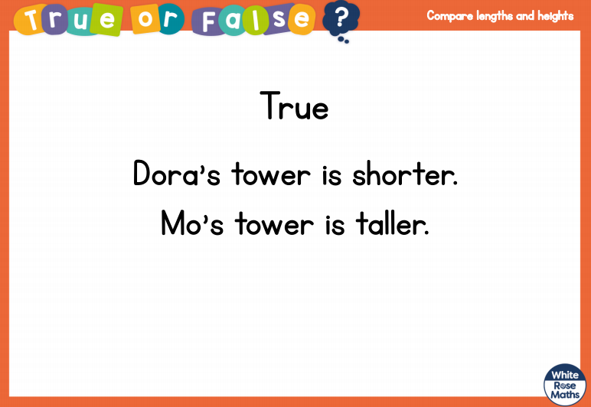
White Rose Maths

Slide 20
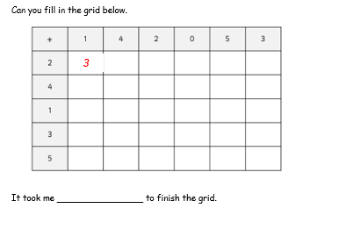
White Rose Maths
Have a look in files for Addition Revision. You have worked hard on this before half term. I would like you to see how quickly you can fill in this addition grid.

Slide 21
White Rose Maths
Use this video link https://vimeo.com/507943851 and have a go at the ‘questions to think about’ slide.
Work through the video, feel free to pause it to explain any of the teaching.
Now you are ready to have a go at the worksheet.
Remember you can write your answers in your blue maths book to save printing it out.

Slide 22
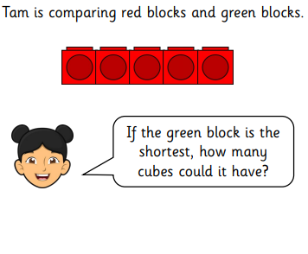
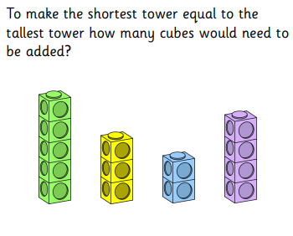
White Rose Maths
How about having a go at these deeper thinking questions?
.

Slide 23
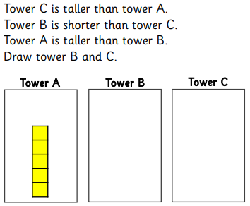
White Rose Maths
This is a tricky deeper thinking question. Do you think you can solve this?
.

Slide 24

If you have used a sheet, stick it into the front of your blue maths book.
We will continue with some White Rose teaching again tomorrow.
I think it is time for lunch and a break from your work.
There is a science session this
afternoon but enjoy your lunch
first.

Slide 25

Worship Time:
I Sing Pop
https://vimeo.com/497680868/3016fb6b28

Slide 26

Don’t forget that tomorrow is World Book Day and, if you want to, you can come to our Teams session dressed as your favourite book character. Please remember to bring your favourite book to show your friends.
Please remember to send an email containing the work that they have done to teacher@kingslandengland.hereford.sch.uk

