Slide 1


Slide 2
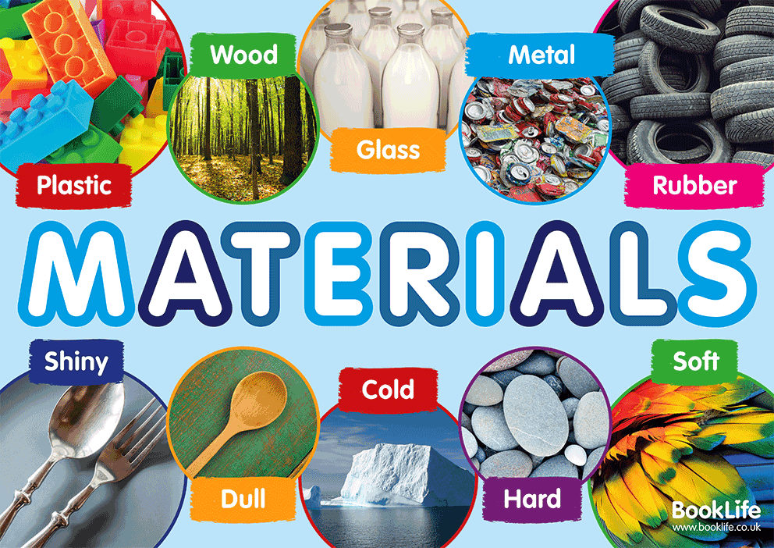

Slide 3
How can the shape of solid objects be changed?
In this lesson, we will be learning about solid objects.
You will be investigating how you can change the shape of solid objects using items in your home.

Slide 4

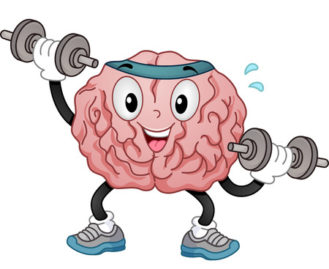
To complete today’s lesson you will need:
a piece of paper
a pencil
some household objects
your brain

Slide 5
Today you will look at shapes of solid objects can be changed
Here is the link to the video of the lesson.
https://classroom.thenational.academy/lessons/how-can-the-shape-of-solid-objects-be-changed-74uk2c?step=2&activity=video

Slide 6
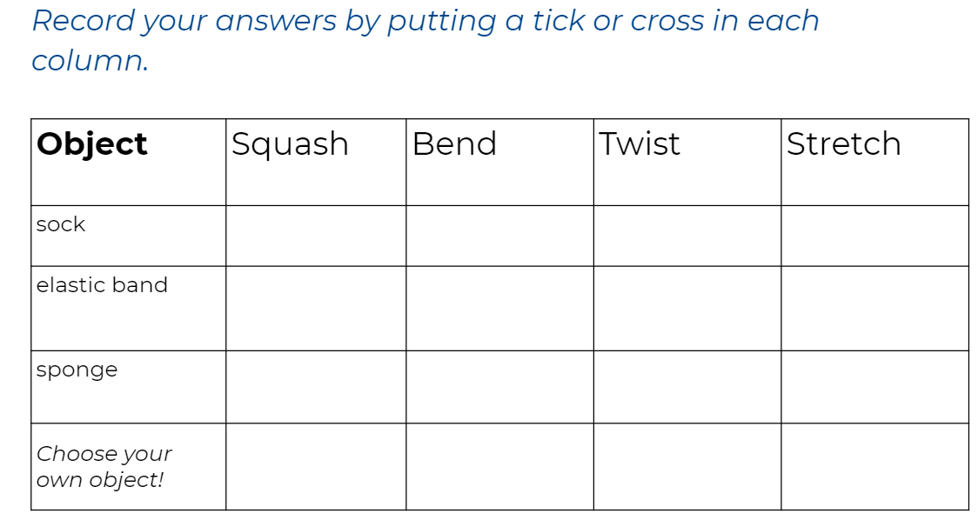
The worksheet, which is on the website, can be printed. If you don’t have the facilities to print please complete it on a separate sheet of paper.

Slide 7

Here is the end of lesson quiz (4 questions this week)
https://classroom.thenational.academy/lessons/how-can-the-shape-of-solid-objects-be-changed-74uk2c?step=4&activity=exit_quiz

Slide 8


