Slide 1


Tuesday 2nd March 2021
For RWI you will need the sounds sheet oi(Rainbow Group) oa(Sunshine Group).
For maths you will need access to the Addition revision sheet and the length and height sheet in files.
 | phonics | RWI |  | maths – White Rose Vimeo link and worksheet |  | afternoon | 2:45 assembly via email | time to share a book
9am On-line registration | Rainbow Group oi – spoil the boy Sunshine Group oa – goat in a boat | Puppets Jim’s House -Speed Sounds -Red and Green words -Read story -Hold a Sentence | BREAK | Compare both length and height https://vimeo.com/507433257 https://vimeo.com/507433540 | LUNCH | Geography The oceans of the world | Mr Debenham | Reading Time

Slide 2


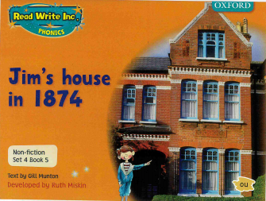

RWI
Each day for RWI you will need:
Rainbow Group Sunshine Group
Puppets Jim’s House book book
‘Weekly Writing sheet’ RWI (from your pack)
Could you please download the relevant book for your child as we will continue to read it throughout the week.

Slide 3
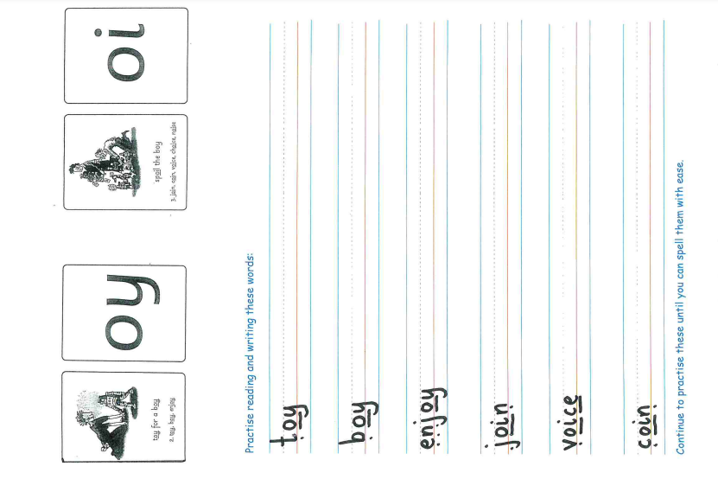
Rainbow Group oi – spoil the boy
Today, I would like you to complete this phonic sheet that is in the folder.
Once you have finished it, it can be stuck into your green home-learning book.

Slide 4
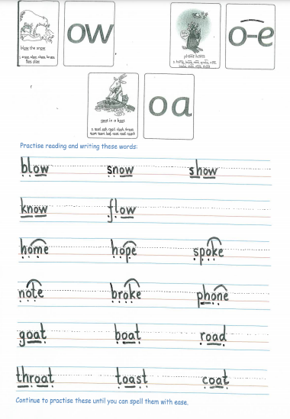
Sunshine Group oa – goat in a boat
Today, I would like you to complete this phonic sheet that is in the folder.
Once you have finished it, it can be stuck into your green home-learning book.

Slide 5


Continue with RWI
Begin by reading the Speed Sounds to an adult, as you did yesterday.

Slide 6

Continue with RWI
After that, you are ready to read through the Green and Red Words to an adult like you did yesterday.

Slide 7
Continue with RWI
Once you have read the speed sounds, green and red words, you are now ready to read the book to an adult. Remember to pause at the full stops.

Slide 8

Our Structure for RWI
Now you are ready for the second Hold a Sentence (see next slide for the sentence for each group)
Get your Weekly Writing Sheet for Tuesday and listen to your adult say the sentence out loud to you. Remember to do the actions for capital letter and full stop. Repeat at least 3 times before you write it down.

Slide 9

Rainbow Group
Today’s Hold a Sentence is:
The puppet will run and jump.
remember:
pp
Sunshine Group
Tricky word:
all
Today’s Hold a Sentence is:
We will sit on the hard couch.

Slide 10
Our Structure for RWI
Now you are ready to write the Hold a Sentence down on your paper.
Don’t forget to use
a capital letter
a full stop
finger spaces
neat handwriting.
Look at slide 11 so you can check your Hold a Sentence.

Slide 11
Time to check
Rainbow Group
The puppet will run and jump.
Sunshine Group
We will sit on the hard couch.

Slide 12

Stick your sheet in the front of your purple book.
Thank you for working hard.
Now have a break and a snack.

Slide 13


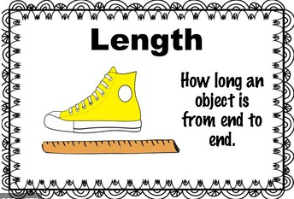
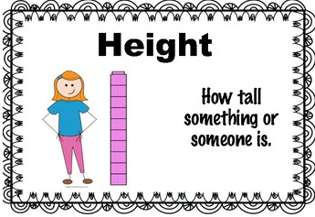
White Rose Maths
Compare length and compare height
You will need:
Addition grid
Worksheet to fill in
Dessert spoon

Slide 14

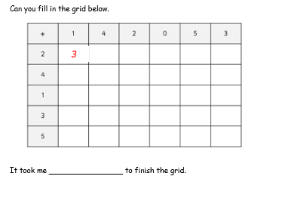
White Rose Maths
Have a look in files for Addition Revision. You have worked hard on this before half term. I would like you to see how quickly you can fill in this addition grid.

Slide 15
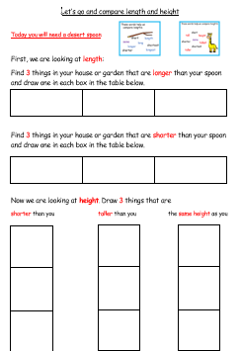
White Rose Maths
Today we are using 2 White Rose clips for our learning https://vimeo.com/507433257
https://vimeo.com/507433540
After that we are going to be looking
at a practical task based on length and
height that is included in Tuesday’s files.
Remember you can write your answers in your blue maths book or use the ppt link to save printing it.

Slide 16

If you have used a sheet, stick it into the front of your blue maths book.
We will continue with some White Rose teaching again tomorrow.
I think it is time for lunch and a break from your work.
There is a topic session in files for
this afternoon but enjoy your
lunch first.

Slide 17

Worship Time with:
Mr Debenham

Slide 18

Most importantly encourage your child to read a suitable book to you. Later on it would be great if you could read a bedtime story to them.
Please remember to send an email containing the work that they have done to teacher@kingslandengland.hereford.sch.uk

