Slide 1


Slide 2

Monday 1st March 2021
For maths you will need a copy of the subtraction revision sheet and one maths paper from the levelled worksheet.
For RWI you will need a copy of Puppets or Jim’s House book.
 | phonics | RWI |  | maths – White Rose Vimeo link and worksheet |  | afternoon | 2:45 assembly via email | time to share a book
9am On-line registration continue the story | Rainbow Group oi – spoil the boy Sunshine Group oa – goat in a boat | Puppets Jim’s House -Speed Sounds -Red and Green words -Read story -Hold a Sentence | BREAK | Compare Number Sentence https://vimeo.com/497920660 | LUNCH | RE The Qur’an Music Rhythm – lesson 2 | Rev. Julie | Reading Time

Slide 3


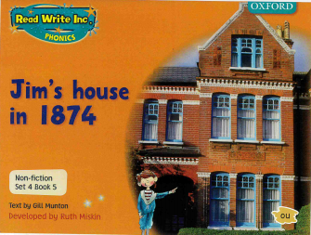

RWI
Each day for RWI you will need:
Rainbow Group Sunshine Group
Puppets Jim’s House book book
‘Weekly Writing sheet’ RWI (from your pack)
Could you please download the relevant book for your child as we will continue to read it throughout the week.

Slide 4

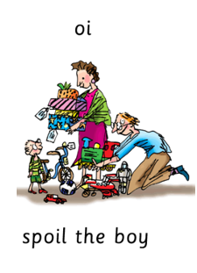
Rainbow Group
Our new sound for this week: oi – spoil the boy

Slide 5

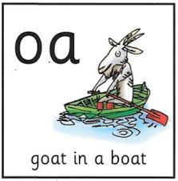
Sunshine Group
Our new sound for this week: oa – goat in a boat

Slide 6


Our Structure for RWI
Begin by reading the Speed Sounds to an adult.

Slide 7

Our Structure for RWI
After that you are ready to read through the Green and Red Words to an adult.

Slide 8
Our Structure for RWI
Adults could you look at the vocabulary list and make sure that your child knows what each word means. Then you are ready to talk through the introduction with your child.

Slide 9
Our Structure for RWI
You are now ready to read your book to an adult. Remember to pause at a full stop.

Slide 10

Our Structure for RWI
Once you have completed this, then you are ready to work on the Hold a Sentence (see next slide for the sentence for each group)
Get your Weekly Writing Sheet for Monday and listen to your adult say the sentence out loud to you. Remember to do the actions for capital letter and full stop. Repeat at least 3 times before you write it down.

Slide 11

Rainbow Group
Today’s Hold a Sentence is:
A string puppet is fun.
tricky word:
pp
Sunshine Group
Today’s Hold a Sentence is:
The cat has found a mouse.
tricky grapheme:
ss

Slide 12
Our Structure for RWI
Now you are ready to write the Hold a Sentence down on your paper.
Don’t forget to use
a capital letter
a full stop
finger spaces
neat handwriting.
Look at slide 12 so you can check your Hold a Sentence.

Slide 13
Time to check
Rainbow Group
A string puppet is fun.
Sunshine Group
The cat has found a mouse.

Slide 14

Stick your sheet in the front of your purple book.
Thank you for working hard.
Now have a break and a snack.

Slide 15


White Rose Maths
Comparing Number Sentences
You will need:
worksheet
Addition Revision Grid

Slide 16
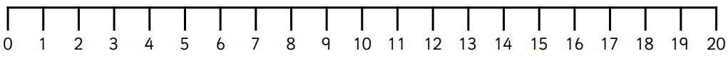
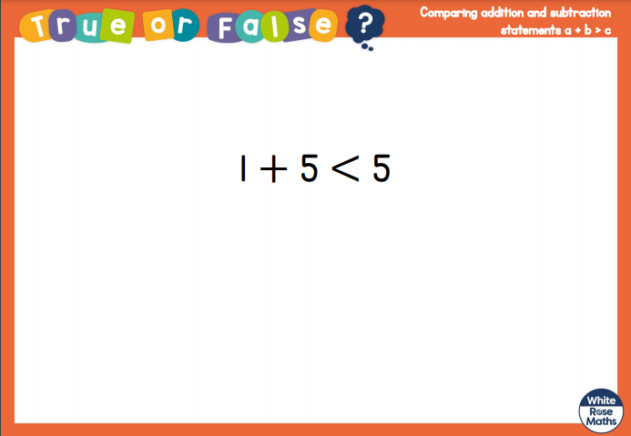
White Rose Maths

Slide 17
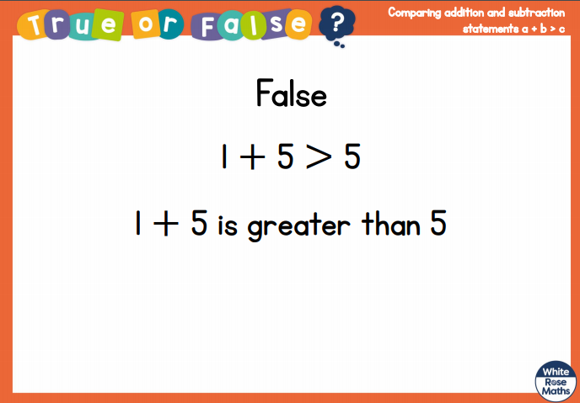
White Rose Maths

Slide 18
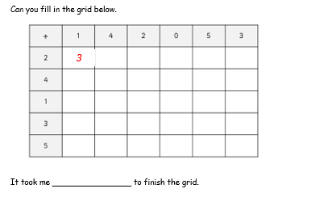
White Rose Maths
Have a look in files for Addition Revision. You have worked hard on this before half term. I would like you to see how quickly you can fill in this addition grid.

Slide 19
White Rose Maths
Use this video link https://vimeo.com/497920660 and have a go at the ‘questions to think about’ slide.
Work through the video, feel free to pause it to explain any of the teaching.
Once you have watched the video you are then ready to have a go at the worksheet.
Please can you write your answers in your blue maths book.

Slide 20


We will continue with some White Rose teaching again tomorrow.
I think it is time for lunch and a break from your work.
This afternoon I would like you to
complete the R.E session, find the
Power Point in the files. Then follow
the link for music (also in files) but
enjoy your lunch first.

Slide 21

Worship Time with:
Rev Julie

Slide 22
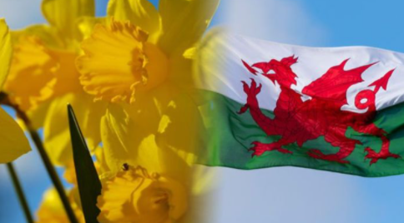
Most importantly encourage your child to read a suitable book to you.
If your child would like to find out some more about St David’s Day then follow the link below.
https://www.bbc.co.uk/cbeebies/watch/lets-celebrate-st-davids-day
Please remember to send an email containing the work that they have done to teacher@kingslandengland.hereford.sch.uk

