Slide 1

Religious Education
What can people learn from Muslim holy words?

Slide 2
Religious Education
Can you remember the Shahadah? What words have been covered up? Check on page 3 to see if you are right.
There is no god except Allah;
Muhammad is the messenger
of Allah.

Slide 3
Religious Education
The Shahadah says:
There is no god except Allah;
Muhammad is the messenger
of Allah.

Slide 4
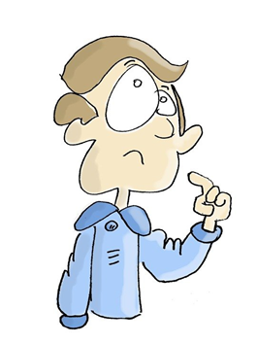
Religious Education
Who is the person who Muslims believe is a messenger from God?
Prophet Muhammad (PBUH)

Slide 5

Religious Education
Look at this picture. Talk to your partner – what do you notice?
This book is called the Qur’an. It is the Muslim special book.

Slide 6

Religious Education
Why do you think that it is on a stand?
It is on the stand because it is so special to Muslims.

Slide 7
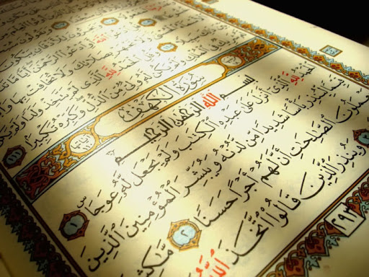
Religious Education
The Qur’an is written
in a language called
Arabic.

Slide 8
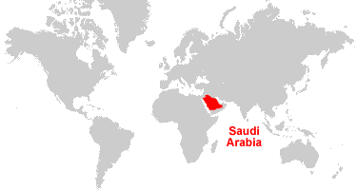
Religious Education
What is the connection between the Prophet Muhammad(PBUH) and the Qur’an?
Muhammad (PBUH) was born in a city called Mecca which is in a country called Saudi Arabia. He was born nearly 1500 years ago, in AD 570. He worked as a merchant, a type of shopkeeper, and became known for his honesty.

Slide 9
Religious Education
One day he was meditating in a cave on Mount Hira when an angel called Jibril (Gabriel) appeared to him.
Jibril spoke to him and said the word ‘Allah’ and Muhammad began to recite words which he believed came straight from God.
Muhammad wrote this information down in the Muslim special book known as the Qur’an.
https://www.bbc.co.uk/bitesize/clips/zympvcw

Slide 10
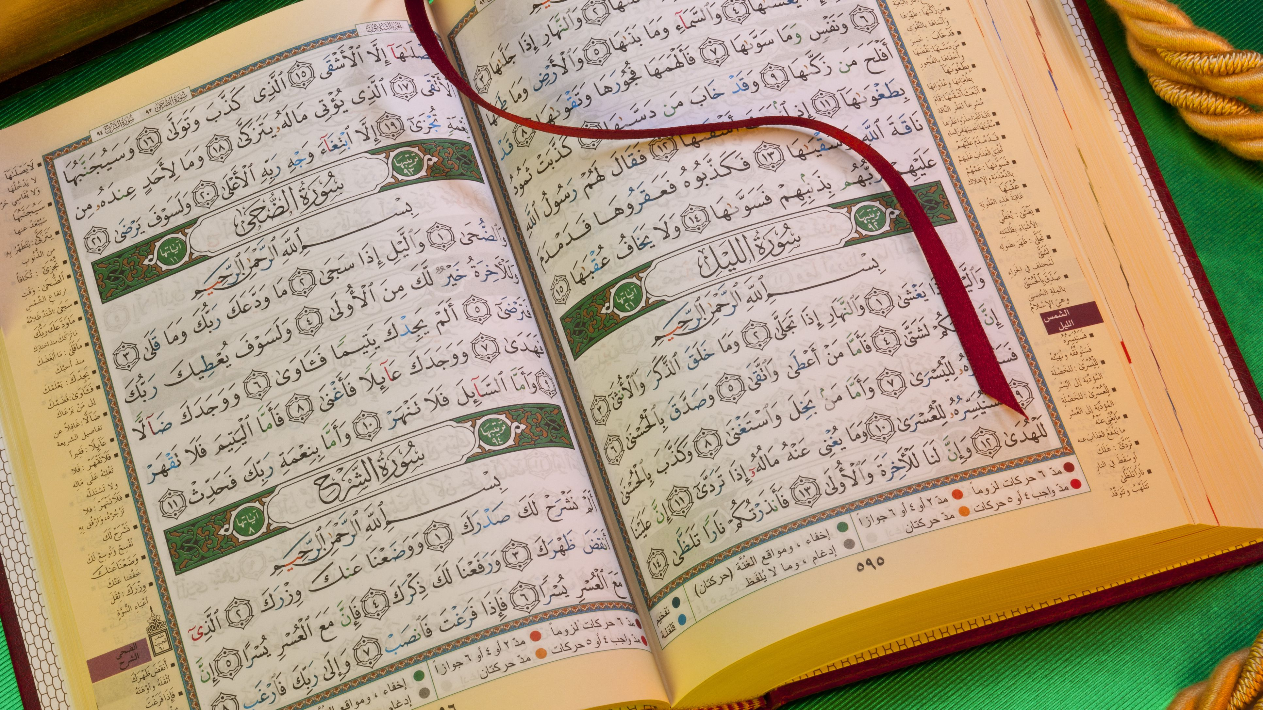
Religious Education
The Qur’an teaches Muslims how to live a good life.
Here are just a few rules which Muslims must live by:
Worship only one God
Pray 5 times a day
Give to charity
Show respect and love to your parents
Show forgiveness to others

Slide 11
Religious Education
Muslim people read and study the Qur’an.
Muslim children often learn a language called Arabic so they can read the Qur’an.
All Muslims treat their copy of the Qur’an with care.
They wash their hands before touching the Qur’an.

Slide 12
Religious Education
The Qur’an is placed on a stand rather than on a table.
It is never kept on the floor.
When it isn’t being used it is kept up high to show
that they believe that it is more special than all
other books.

Slide 13
Religious Education
Write the date:
Monday 1st March
Write the title:
How Muslims Look After the Qur’an
Ask an adult to split your page in half and write
True False

Slide 14
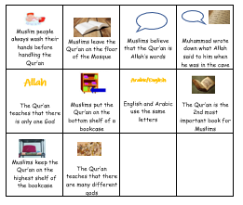
Religious Education
Look at the worksheet ‘Facts About the Qur’an and cut carefully along the lines to cut out the statements and picture boxes. Read through the statements and sort into true or false(if you need help, look at pages 11 and 12)

