Slide 1
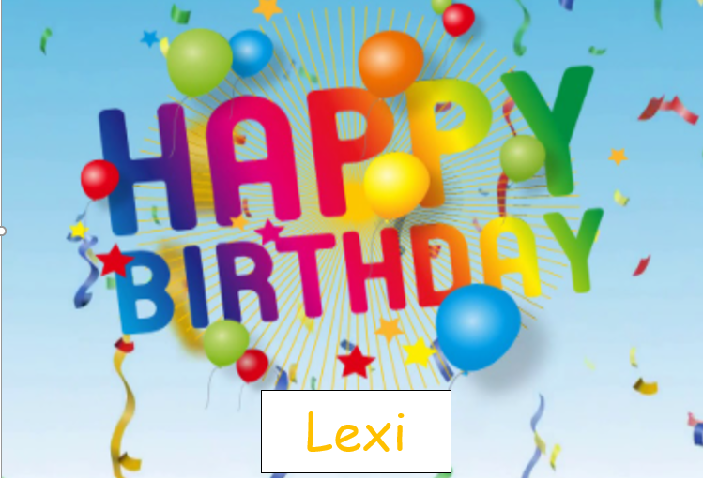

Slide 2


Friday 24th February 2021
For maths you need to be able to see or have a copy of the Subtraction Revision grid and worksheet. For RWI you need the red words to spell sheet and lines for spelling words.
 | phonics | RWI |  | maths – White Rose Vimeo link and worksheet |  | afternoon | 2:45 assembly via email | time to share a book
9am On-line registration | Rainbow Group practice green /red words Sunshine Group practice green /red words | Tag Follow Me! -Speed Sounds -Red and Green words -Read story -Big Write | BREAK | Fact Families using bar model worksheet | LUNCH | PE and Golden Time | Big Joe | Reading Time

Slide 3




RWI
Each day for RWI you will need:
Rainbow Group Sunshine Group
Tag Follow Me! book book
‘Weekly Writing sheet’

Slide 4
Rainbow Group
Today we are going to have a very brief start to our phonic session to read through the green words and spell some words.

Slide 5
Sunshine Group
Today we are going to have a very brief start to our phonic session to read through the green words and spell some words.

Slide 6
Sunshine and Rainbow Groups
Yesterday we had the Spelling Quiz.
I would like you to look back at your quiz and see which words (if any) you found a challenge.
I would like you to practise these words so you are able to spell them with ease.

Slide 7
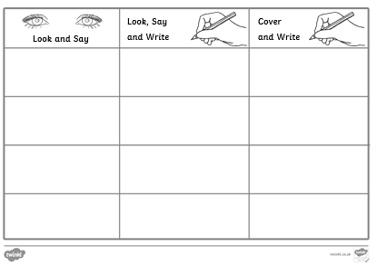
Sunshine and Rainbow Groups
In the Friday file are the red (tricky) words that you have been reading in your RWI book this week.
I would now like you to try to learn how to spell these words so you are able to spell them with ease.

Slide 8
Sunshine and Rainbow Groups
Look at the words in the Look and Say column. You need to take your time to look at each word, say the letters out loud, look at the shape of the word and try to write it in the air. Remember you can do this outside, if you prefer.
Once you think you know how to spell them, have a go in the second column.
In the final column, cover the words up and write them.

Slide 9
Sunshine and Rainbow Groups
If you have time, write two different sentences using these words.
Use the handwriting lines to help you to keep it neat.

Slide 10


Continue with RWI
Begin by reading the Speed Sounds to an adult, as you did yesterday.

Slide 11

Continue with RWI
After that, you are ready to read through the Speed Words (on page 15 of your book) to an adult.

Slide 12
Continue with RWI
Now you are ready to read the book to an adult. You have been working on this story all week so you should be getting very confident!
Remember to think about your expression to make it interesting to listen to and pausing for punctuation.

Slide 13
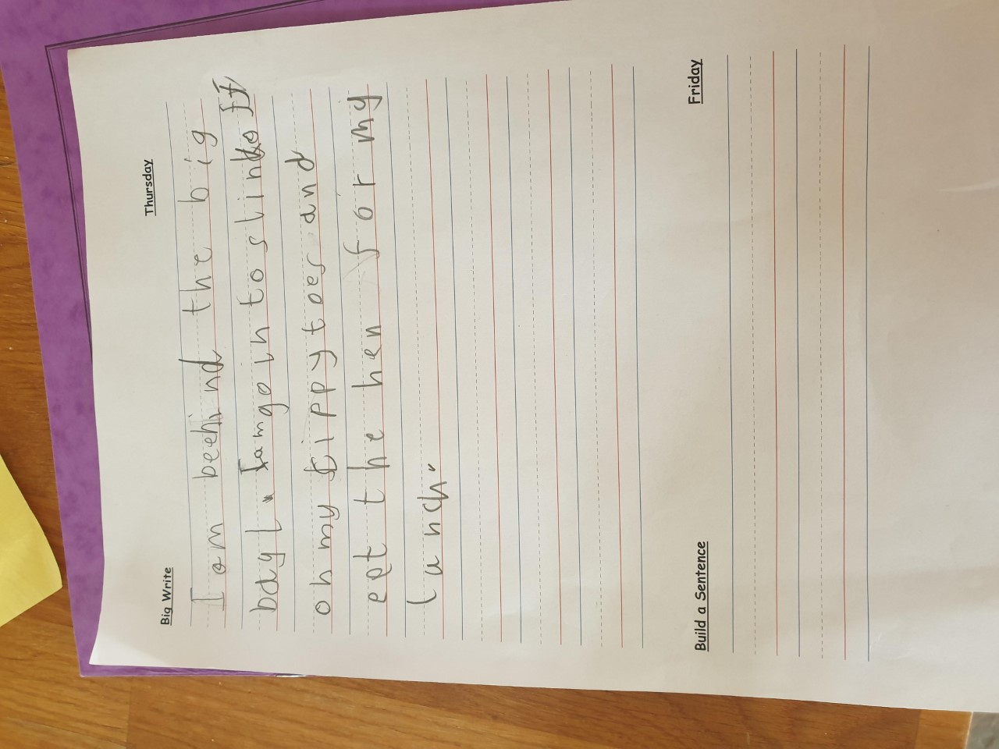

Star Big Write Work
Wilf

Slide 14
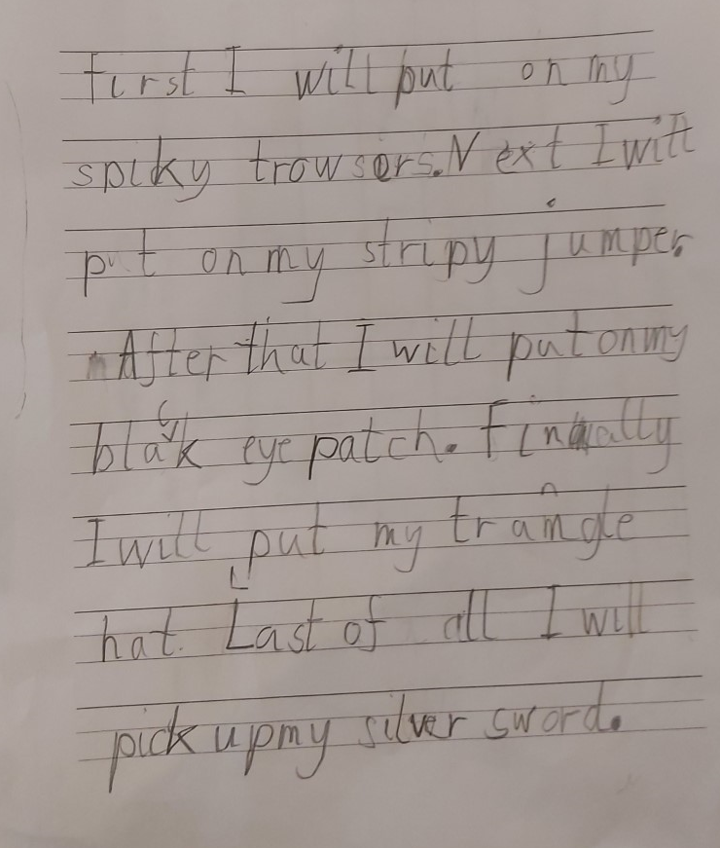
Star Big Write Work
Aidan

Slide 15
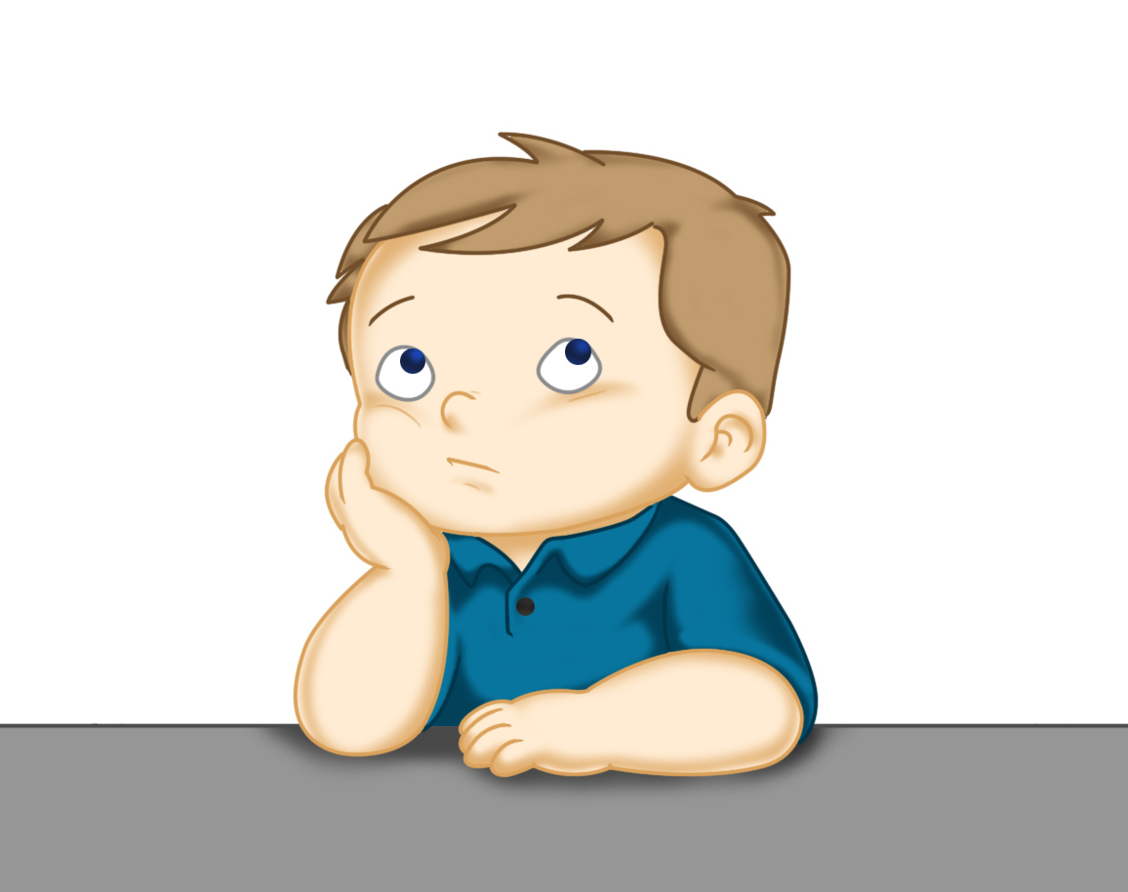
Our Structure for RWI
Today is the final day of RWI for the week.
This is when we do our Big Write. We base this around the book that we have been reading in RWI.
This Photo by Unknown Author is licensed under CC BY

Slide 16
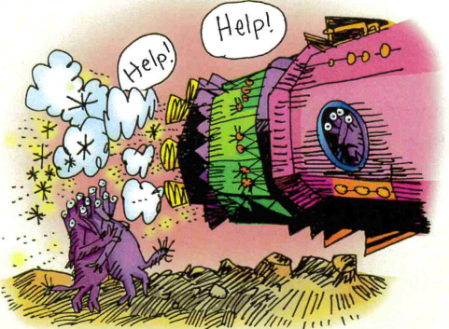
Rainbow Group - Big Write
Today I want you to imagine that you are Tip inside the rocket as it blasts off. I want you to write about how you are feeling and what you are thinking as the rockets zooms off into space.
How is the rocket moving?
What can you hear?
How is it making you feel?

Slide 17
Rainbow Group - Big Write
I would like you and your adult to think of some words to help you with your writing:
1. What is happening inside the rocket? (Think about the sounds and the movement of the rocket)
2. How are you feeling?

Slide 18
Rainbow Group - Big Write
Here is an example of my sentence.
I was playing with my friends and I hid inside a shiny rocket. Suddenly I felt it begin to move and shake. There was a terrible clatter and a very loud noise. I was terrified. I was worried that I may never see Pip and Zip again.
Don’t forget to use adjectives (describing words) and the wow words from yesterday’s Build a Sentence.

Slide 19
Big Write
Sunshine Group - Big Write
Today we are going to think about how Duckling 3 in the story Follow Me!.
Where was he?
What was he doing?
How was he feeling at the start?
What happened next?
How did he feel in the end and why?
Don’t forget to use details/adjectives to make your writing interesting. Think about how you start your sentences.

Slide 20
Sunshine Group - Big Write
Use these ideas to write about your playday. Here is an example of what I would do.
Yesterday I was so glum sitting on the grassy bank of the pond. I could see my brothers and sisters having so much fun. The problem is that I couldn’t swim until the thoughtful crow came to help me. Now I am overjoyed because I can join in with the others.

Slide 21

Big Write
You are ready to think about how you can use these words in some super sentences.
Talk through your sentences with an adult, one sentence at a time. When you are happy with your sentence, ‘put your headphones on’ say it again and then write it down.
I will look forward to reading your finished pieces of writing.
Don’t forget to use neat handwriting, finger spaces, capital letters and full stops.

Slide 22

Stick your sentence on the next page at the front of your purple book.
Thank you for working hard.
Now have a break and a snack.

Slide 23
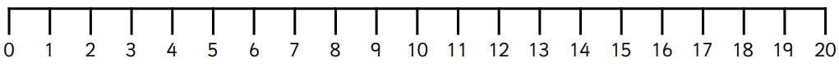

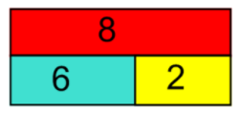
White Rose Maths
Subtraction crossing 10
You will need:
Subtraction Revision grid
Bar Models and Related Facts

Slide 24
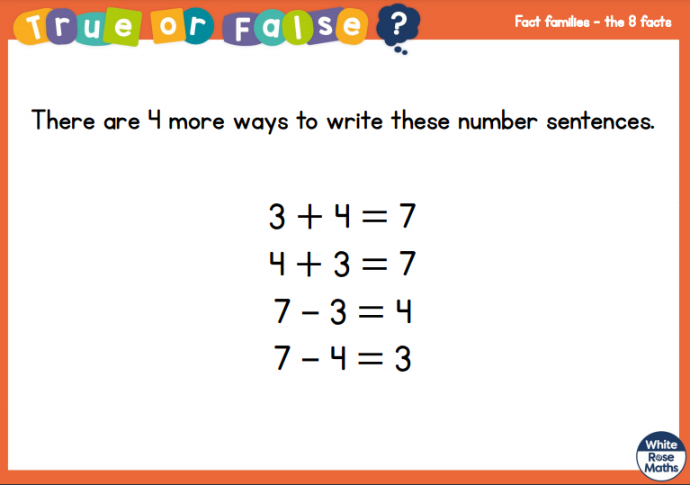
White Rose Maths
Is this true or false? (answer on slide 14)
Think about…can you have the = at the beginning?.

Slide 25
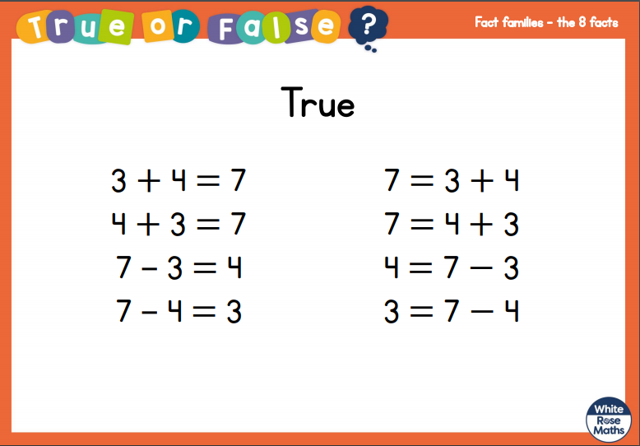
White Rose Maths

Slide 26
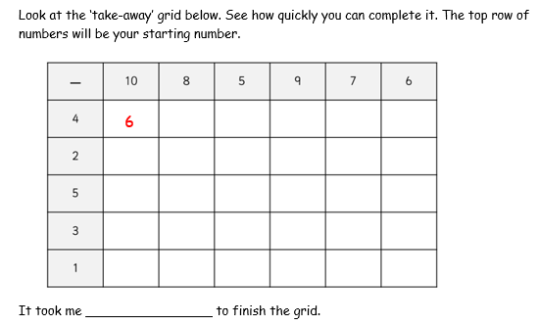
White Rose Maths
Have a look in files for the Subtraction Revision Grid that you have been looking at these past few days. I would like you to have another go and see how quickly you can fill it in today.

Slide 27
White Rose Maths
We are not going to use a video today We are going to go over what we were doing yesterday – related number facts.
Today we are looking at bar models instead of whole/part/part models. I would like you to work out the related facts.
I have also put in a deeper thinking sheet for those of you who want to have a bit of a challenge.

Slide 28

If you have used a sheet, stick it into the front of your blue maths book.
We will continue with some White Rose teaching again tomorrow.
I think it is time for lunch and a break from your work.
.
This afternoon there is 100 days
at school session and after that it
is Golden Time. First of all go and
enjoy your lunch.

Slide 29

Worship Time:
Big Joe
https://www.youtube.com/watch?v=rC6vih99Fnc&feature=youtu.be

Slide 30
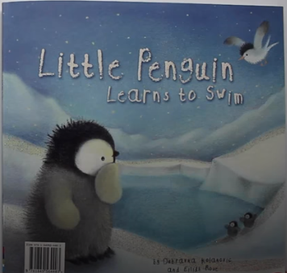
Most importantly encourage your child to read a suitable book to you. Later on it would be great if you let them listen to a story called Little Penguin.
https://www.youtube.com/watch?v=i9dXoz9z4R0
Please remember to send an email containing the completed work to teacher@kingslandengland.hereford.sch.uk

