Slide 1


Thursday 25th February 2021
For RWI you will need to be able to see a copy of the words for the Spelling Quiz. For maths you need to be able to see a copy of the subtraction grid and related facts part/part/whole model sheet.
 | phonics | RWI |  | maths – White Rose Vimeo link and worksheet |  | afternoon | 2:45 assembly via email | time to share a book
9am On-line registration | Rainbow Group spelling quiz Sunshine Group spelling quiz | Tag Follow Me! -Speed Sounds -Red and Green words -Read story -Build a Sentence | BREAK | Related Facts Part/part/whole model sheet | LUNCH | ICT coding PE | Mark Harrington | Reading Time

Slide 2




RWI
Each day for RWI you will need:
Rainbow Group Sunshine Group
Tag Follow Me! book book
‘Weekly Writing sheet’

Slide 3
Rainbow Group ea- cup of tea
Today we are going to start our phonic session by reading through the graphemes and green words and then we read the book. After that, it will be our Spelling Quiz. The words for the quiz are in Thursday’s file.

Slide 4
Sunshine Group ai – snail in the rain
Today we are going to start our phonic session by reading through the graphemes and green words and then we read the book. After that, it will be our Spelling Quiz. The words for the quiz are in Thursday’s file.

Slide 5


Continue with RWI
Begin by reading the Speed Sounds to an adult, as you did yesterday.

Slide 6

Continue with RWI
After that, you are ready to read through the Speed Words (on page 15 of your book) to an adult.

Slide 7
Continue with RWI
Once you have read the speed sounds and Speed Words you are ready to read the story to an adult. Remember to think about your expression to make it interesting to listen to.

Slide 8
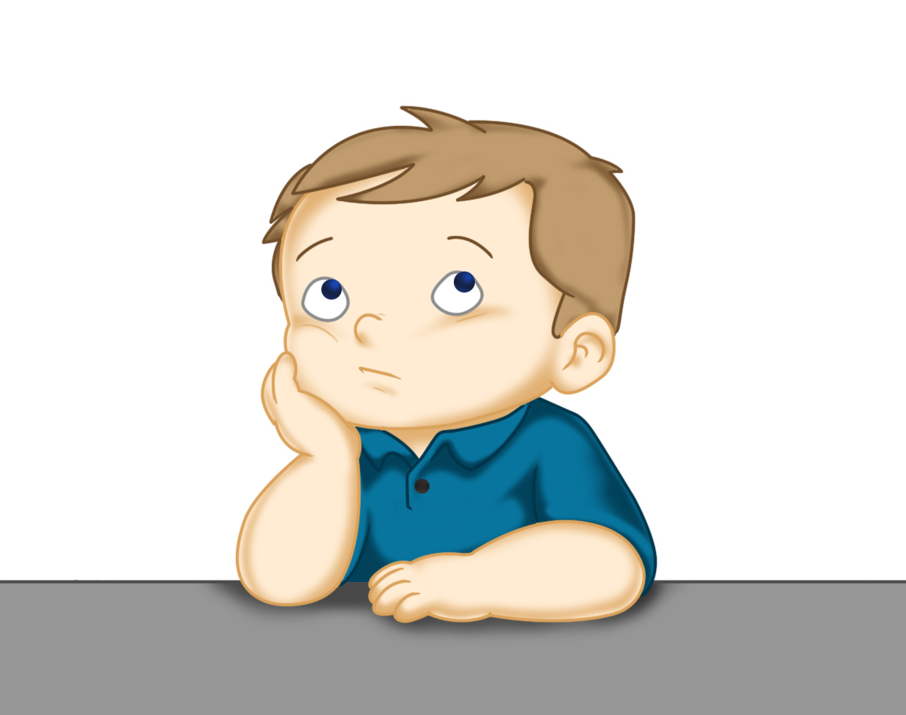
Our Structure for RWI
Build a Sentence
The aim of this task is to help to build (improve) your vocabulary.
On the next slide there are some words that I would like you to discuss with your adult. Make sure you know what they mean, think of other words that mean the same (synonyms).
Now think of an exciting sentence for each of these words.
This Photo by Unknown Author is licensed under CC BY

Slide 9

Build a Sentence
blasted off zoomed horrified shook like a leaf
You may like to think about:
What was it? The rocket…the shiny rocket…
How did it move? blasted off…
Where did it go? it zoomed through outer space…
Where are they? they landed on the rocky surface of Mars
The shiny rocket blasted off and zoomed through outer space until it landed on the rocky surface of Mars.
Write out 2 of your sentences using capital letters and full stops.

Slide 10
Build a Sentence
thoughtful glum overjoyed
You may like to think about:
When did it happen? Last week…
Who are you talking about? my little brother...
What were they doing? was very thoughtful…
What happened? when he shared his snack with me.
Last week my little brother was very thoughtful when he shared his favourite snack with me.
Write out 2 of your sentences using capital letters and full stops.

Slide 11

Stick your sentence on the next page at the front of your purple book.
Thank you for working hard.
Now have a break and a snack.

Slide 12
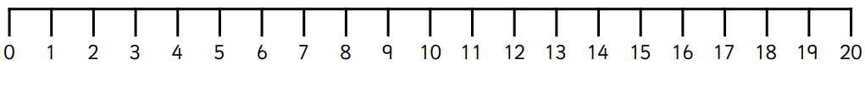

White Rose Maths
Related Facts
You will need:
Related facts part/part/whole model sheet
Subtraction Revision grid

Slide 13
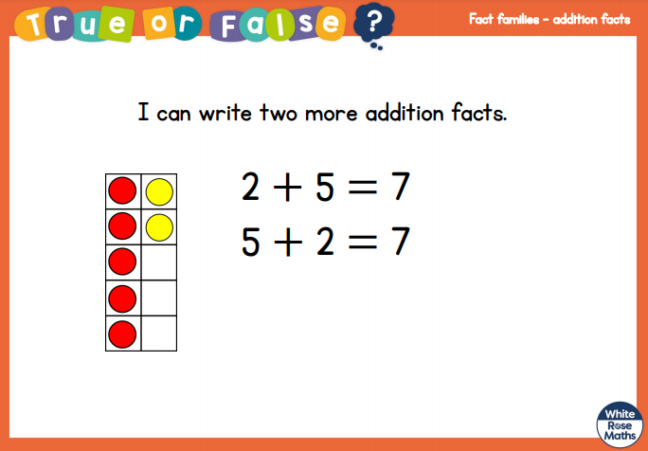
White Rose Maths
Is this true or false? (answer on slide 14)
Think about…can you have the = at the beginning?.

Slide 14
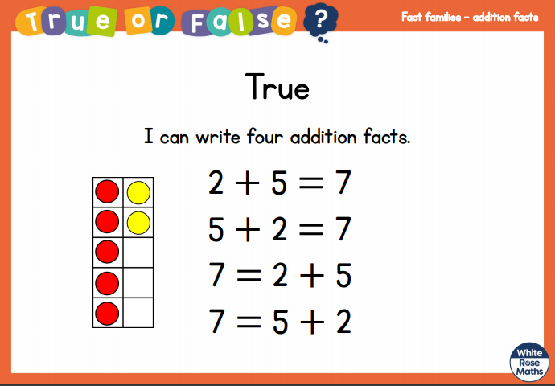
White Rose Maths

Slide 15
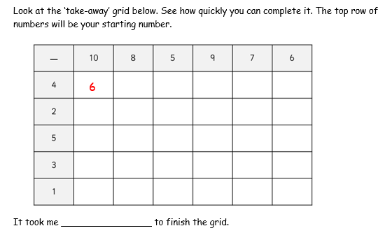
White Rose Maths
Have a look in files for the Subtraction Revision Grid that you have been looking at these past few days. I would like you to have another go and see how quickly you can fill it in today.

Slide 16
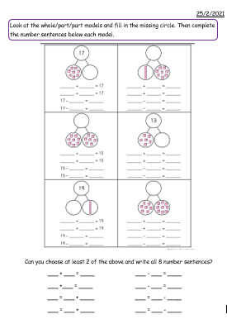
White Rose Maths
Today, we are having another day without using a White Rose video clip. We are building upon what we have been working on this week.
8 + 4 = 12 – 8 =
4 + 8 = 12 – 4 =
12 = 8 + 4 8 = 12 - 4
12 = 4 + 8 4 = 12 - 8

Slide 17
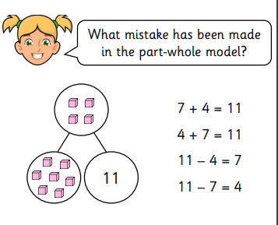
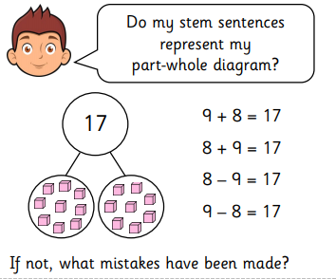
White Rose Maths
Deeper Thinking

Slide 18

If you have used a sheet, stick it into the front of your blue maths book.
We will continue with some White Rose teaching again tomorrow.
I think it is time for lunch and a break from your work.
.
This afternoon there is an ICT
lesson and a PE session. First of all
enjoy your lunch.

Slide 19

Worship Time:
Mark Harrington
https://www.youtube.com/watch?v=_aIeaG1xXho&feature=youtu.be

Slide 20

Most importantly encourage your child to read a suitable book to you. Later on it would be great if you could read a bedtime story to them.
Please remember to send an email containing the completed work to teacher@kingslandengland.hereford.sch.uk

