Slide 1


Slide 2
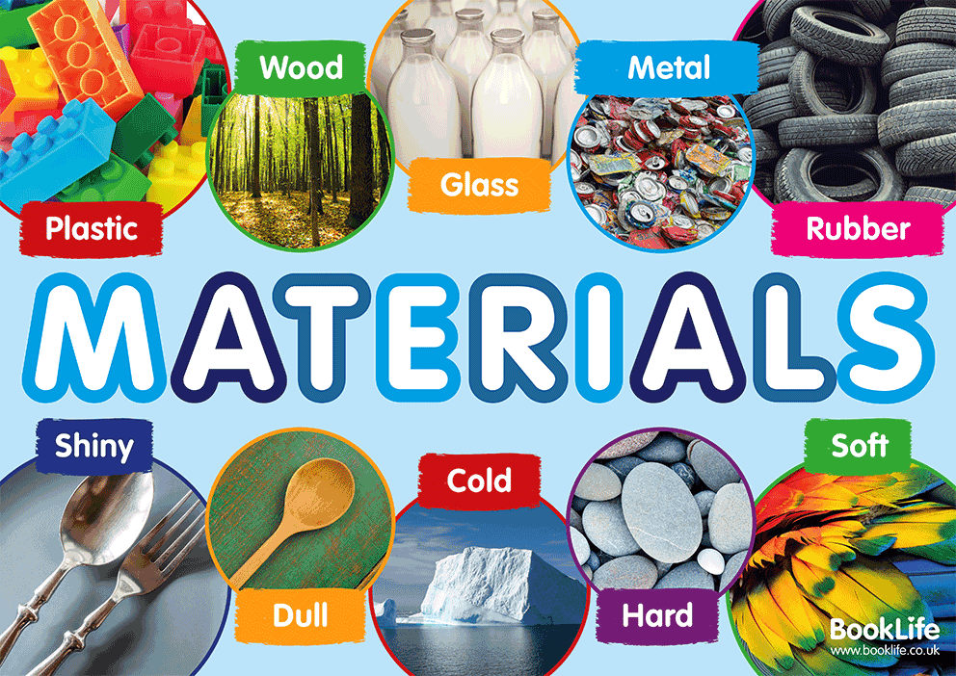

Slide 3
Which material is best for different objects?
In this lesson, we will be learning about materials and their properties. We will also learn why certain materials are used for specific purposes because of their properties.

Slide 4
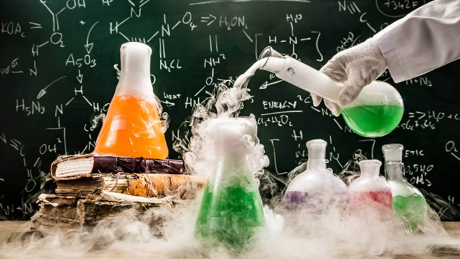
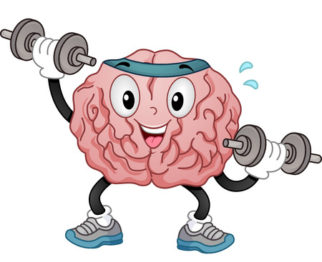
To complete today’s lesson you will need:
a piece of paper
a pencil
a coloured pencil
and your brain!

Slide 5
Today you will look at why we use certain materials to perform specific jobs.
Here is the link to the video of the lesson.
https://classroom.thenational.academy/lessons/which-material-is-best-for-different-objects-60vkar?step=2&activity=video

Slide 6
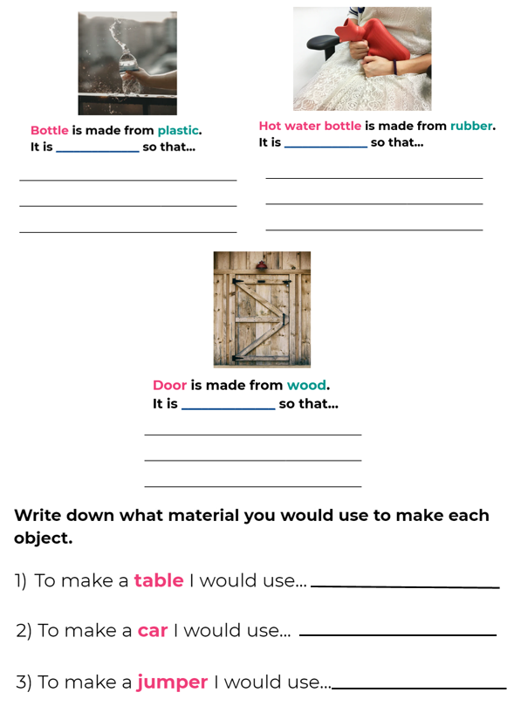
The worksheet, which is on the website, can be printed. If you don’t have the facilities to print please complete it on a separate sheet of paper.

Slide 7

Here is the end of lesson quiz (4 questions this week)
https://classroom.thenational.academy/lessons/which-material-is-best-for-different-objects-60vkar?step=4&activity=exit_quiz

Slide 8


