Slide 1


Tuesday 23rd February 2021
For RWI you will need the sounds sheet ea(Rainbow Group) ai(Sunshine Group).
For maths you will need access to the Subtraction revision sheet and the tens frame model and stem sentence sheet.
 | phonics | RWI |  | maths – White Rose Vimeo link and worksheet |  | afternoon | 2:45 assembly via email | time to share a book
9am On-line registration | Rainbow Group ea – cup of tea Sunshine Group ai – snail in the rain | A Bad Fox A Bad Fright -Speed Sounds -Red and Green words -Read story -Hold a Sentence | BREAK | Maths Practical work on fact families | LUNCH | Geography The continents of the world | Mr Debenham | Reading Time

Slide 2




RWI
Each day for RWI you will need:
Rainbow Group Sunshine Group
Tag Follow Me! book book
‘Weekly Writing sheet’ RWI (from your pack)

Slide 3
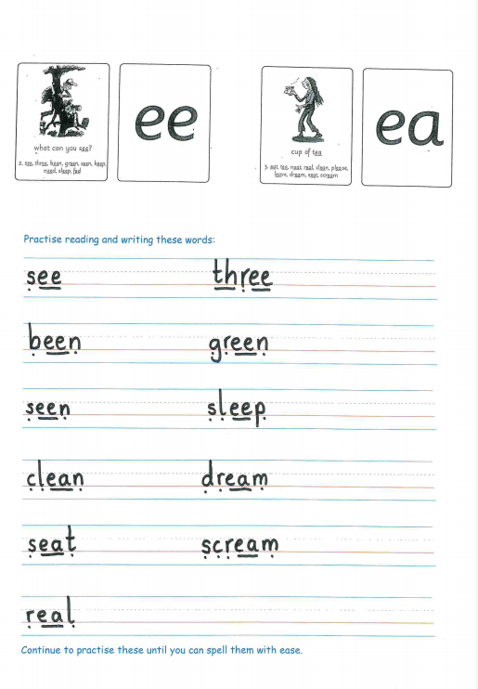
Rainbow Group ea – cup of tea
Today, I would like you to complete this phonic sheet that is in the folder.
Once you have finished it, it can be stuck into your green home-learning book.

Slide 4
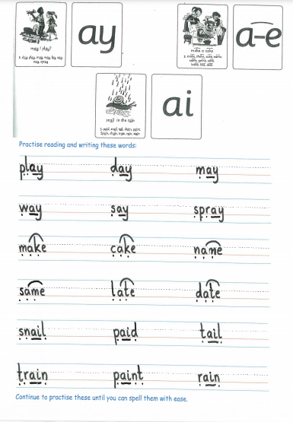
Sunshine Group ai – snail in the rain
Today, I would like you to complete this phonic sheet that is in the folder.
Once you have finished it, it can be stuck into your green home-learning book.

Slide 5


Continue with RWI
Begin by reading the Speed Sounds to an adult, as you did yesterday.

Slide 6

Continue with RWI
After that, you are ready to read through the Green and Red Words to an adult like you did yesterday.

Slide 7
Continue with RWI
Once you have read the speed sounds, green and red words, you are now ready to read the book to an adult. Remember to pause at the full stops.

Slide 8

Our Structure for RWI
Now you are ready for the second Hold a Sentence (see next slide for the sentence for each group)
Get your Weekly Writing Sheet for Tuesday and listen to your adult say the sentence out loud to you. Remember to do the actions for capital letter and full stop. Repeat at least 3 times before you write it down.

Slide 9

Rainbow Group
Today’s Hold a Sentence is:
I am in the rocket.
remember:
ck
Sunshine Group
Tricky word:
all
Today’s Hold a Sentence is:
They all sat in a row on the bank.

Slide 10
Our Structure for RWI
Now you are ready to write the Hold a Sentence down on your paper.
Don’t forget to use
a capital letter
a full stop
finger spaces
neat handwriting.
Look at slide 11 so you can check your Hold a Sentence.

Slide 11
Time to check
Rainbow Group
I am in the rocket.
Sunshine Group
They all sat in a row on the bank.

Slide 12

Stick your sheet in the front of your purple book.
Thank you for working hard.
Now have a break and a snack.

Slide 13
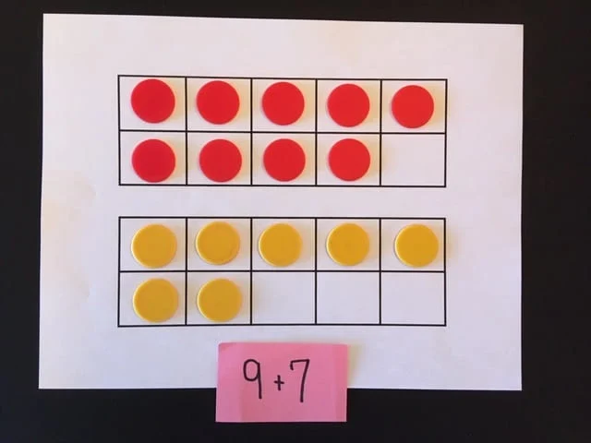

White Rose Maths
Subtraction – related facts
You will need:
Subtraction grid
Tens frame model and stem sentences sheets
Counters to use on the tens frame

Slide 14
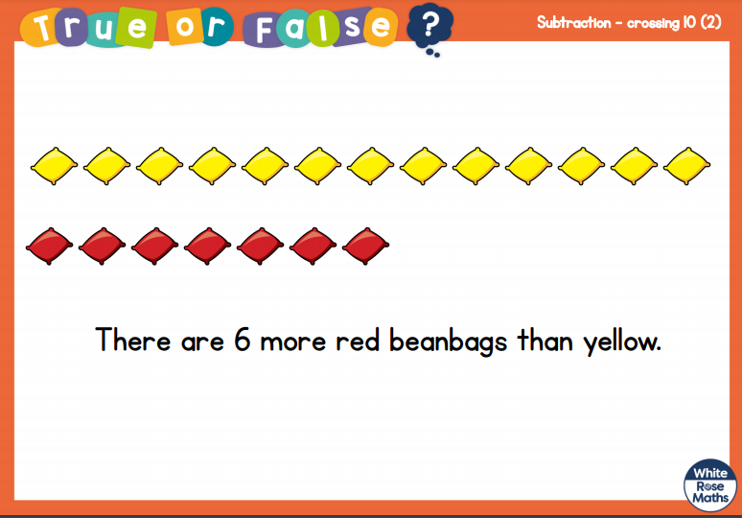
White Rose Maths
Is this true or false?
Talk to your adult to explain your thinking.

Slide 15
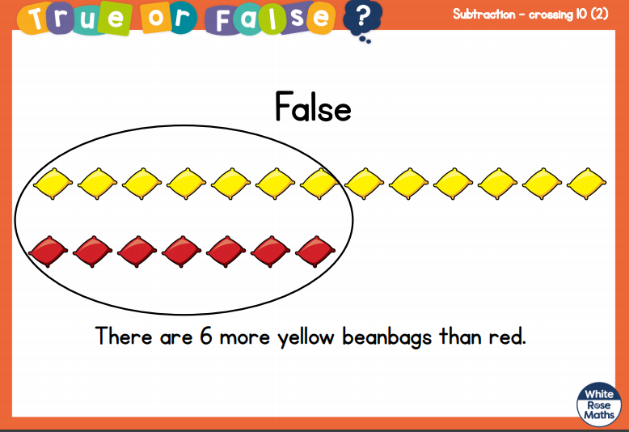
White Rose Maths

Slide 16
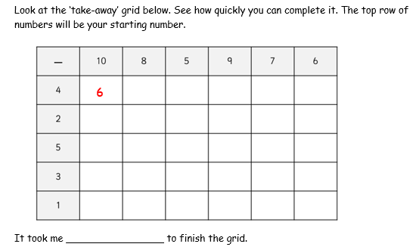
White Rose Maths
Have a look in files for the Subtraction Revision Grid that you looked at yesterday. I would like you to have another go and see how quickly you can fill in today.

Slide 17
White Rose Maths
Today we are not looking at a white rose clip for our learning.
Instead we are going to be looking at a practical task that is included in Tuesday’s files.
We are looking at ‘fact families’.
Remember you can write your answers in your blue maths book or use the ppt link to save printing it.

Slide 18
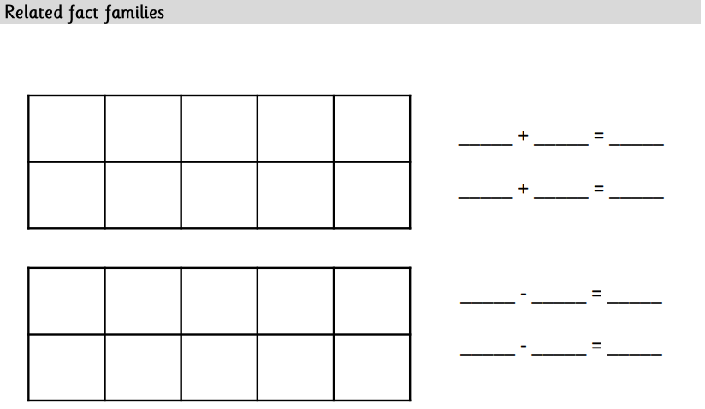
Fact Families

Slide 19
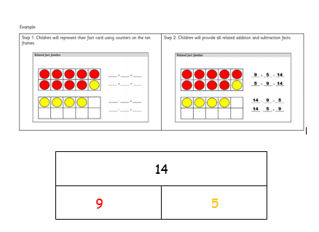
Look at this:

Slide 20
____ + ____ = ____ ____ - ____ = ____
____ + ____ = ____ ____ - ____ = ____

Slide 21

If you have used a sheet, stick it into the front of your blue maths book.
We will continue with some White Rose teaching again tomorrow.
I think it is time for lunch and a break from your work.
There is a topic session in files for
this afternoon but enjoy your
lunch first.

Slide 22

Most importantly encourage your child to read a suitable book to you. Later on it would be great if you could read a bedtime story to them.
Please remember to send an email containing the work that they have done to teacher@kingslandengland.hereford.sch.uk

Slide 23

Worship Time with:
Mr Debenham

