Slide 1


Slide 2


Friday 12th February 2021
For maths you need to be able to see or have a copy of the Subtraction Revision grid. For RWI you need the red words to spell sheet and lines for spelling words.
 | phonics | RWI |  | maths – White Rose Vimeo link and worksheet |  | afternoon | 2:45 assembly via email | time to share a book
9am On-line registration | Rainbow Group air, ir, ou, oy Sunshine Group ow – brown cow | A Bad Fox A Bad Fright -Speed Sounds -Red and Green words -Read story -Big Write | BREAK | Ssubtraction crossing 10 https://vimeo.com/497919464 worksheet | LUNCH | PE and Golden Time | Big Joe | Reading Time

Slide 3




RWI
Each day for RWI you will need:
Rainbow Group Sunshine Group
A Bad Fox A Bad Fright book book
‘Weekly Writing sheet’ RWI (from your pack)
Could you please download the relevant book for your child as we will continue to read it throughout the week.

Slide 4
Rainbow Group
Today we are going to have a very brief start to our phonic session to read through the green words and spell some words.

Slide 5
Sunshine Group
Today we are going to have a very brief start to our phonic session to read through the green words and spell some words.

Slide 6
Sunshine and Rainbow Groups
Yesterday we had the Spelling Quiz.
I would like you to look back at your quiz and see which words (if any) you found a challenge.
I would like you to practise these words so you are able to spell them with ease.

Slide 7
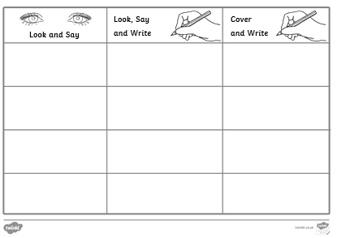
Sunshine and Rainbow Groups
In the Friday file are the red (tricky) words that you have been reading in your RWI book this week.
I would now like you to try to learn how to spell these words so you are able to spell them with ease.

Slide 8
Sunshine and Rainbow Groups
Look at the words in the Look and Say column. You need to take your time to look at each word, say the letters out loud, look at the shape of the word and try to write it in the air. Remember you can do this outside, if you prefer.
Once you think you know how to spell them, have a go in the second column.
In the final column, cover the words up and write them.

Slide 9
Sunshine and Rainbow Groups
If you have time, write two different sentences using these words.
Use the handwriting lines to help you to keep it neat.

Slide 10


Continue with RWI
Begin by reading the Speed Sounds to an adult, as you did yesterday.

Slide 11

Continue with RWI
After that, you are ready to read through the Speed Words (on page 15 of your book) to an adult.

Slide 12
Continue with RWI
Now you are ready to read the book to an adult. You have been working on this story all week so you should be getting very confident!
Remember to think about your expression to make it interesting to listen to and pausing for punctuation.

Slide 13
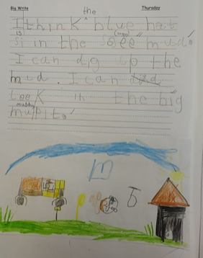

Star Big Write Work
Ethan

Slide 14
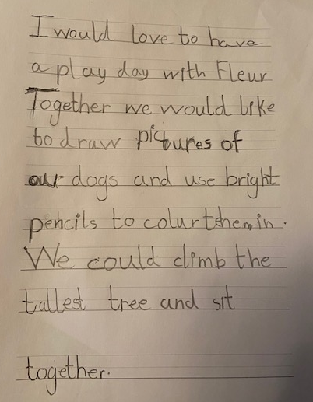
Star Big Write Work
Martha

Slide 15
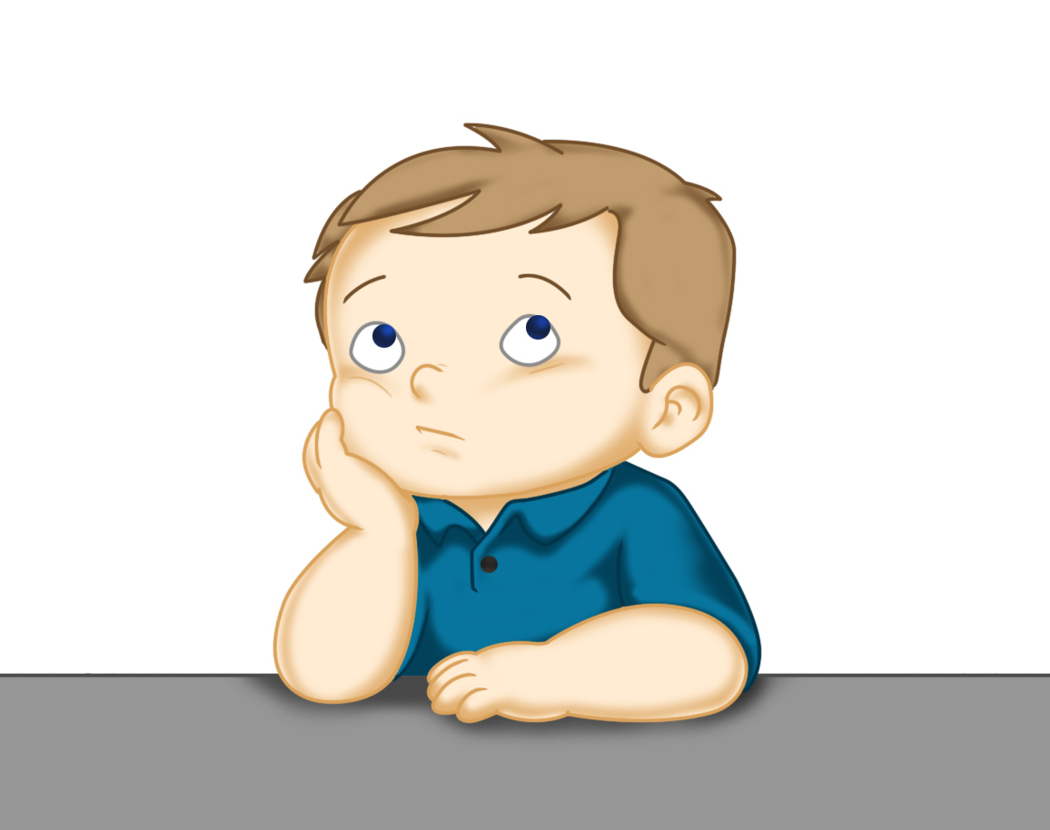
Our Structure for RWI
Today is the final day of RWI for the week.
This is when we do our Big Write. We base this around the book that we have been reading in RWI.
This Photo by Unknown Author is licensed under CC BY

Slide 16

Rainbow Group - Big Write
To start with, we are thinking about the fox sneaking up on the hen. I want you to imagine that you are the fox and you are thinking about what you are going to do.
What do you want to do?
Where are you going to be?
How will you move?

Slide 17
Rainbow Group - Big Write
I would like you and your adult to think of some words to help you with your writing:
1. Where you are?
2. How are you going to move?

Slide 18
Rainbow Group - Big Write
Here is an example of my sentence.
I am hiding behind the water butt at the back of the old shed. My mouth is watering as I am planning to sneak up on the delicious looking hen and gobble her up.
Don’t forget to use adjectives (describing words) and the wow words from yesterday’s Build a Sentence.

Slide 19
Big Write
Sunshine Group - Big Write
Today we are going to write about a dressing up.
I would like you to think about what you would wear if you were going to a fancy dress day. Draw a picture if that helps you.
What different clothes would you wear?
What adjectives could you use to describe them?
In what order would you put the items on? (First, next, after that, then, finally)
Don’t forget to use details/adjectives to make your writing interesting. Think about how you start your sentences.

Slide 20
Sunshine Group - Big Write
Use these ideas to write about your playday. Here is an example of what I would do.
Tomorrow I am going to go to have a fancy dress day. First of all I am going to put on some brightly coloured striped trousers. After that I am going to wear a blond curly wig with a small red pointed hat on top. Finally I am going to paint my face with a big happy smile. Can you guess what I am going to be?

Slide 21

Big Write
You are ready to think about how you can use these words in some super sentences.
Talk through your sentences with an adult, one sentence at a time. When you are happy with your sentence, ‘put your headphones on’ say it again and then write it down.
I will look forward to reading your finished pieces of writing.
Don’t forget to use neat handwriting, finger spaces, capital letters and full stops.

Slide 22

Stick your sentence on the next page at the front of your purple book.
Thank you for working hard.
Now have a break and a snack.

Slide 23
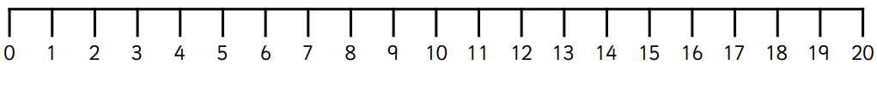

White Rose Maths
Subtraction crossing 10
You will need:
Subtraction Revision grid
Subtraction Frame
Subtraction Crossing 10 - levelled sheets

Slide 24
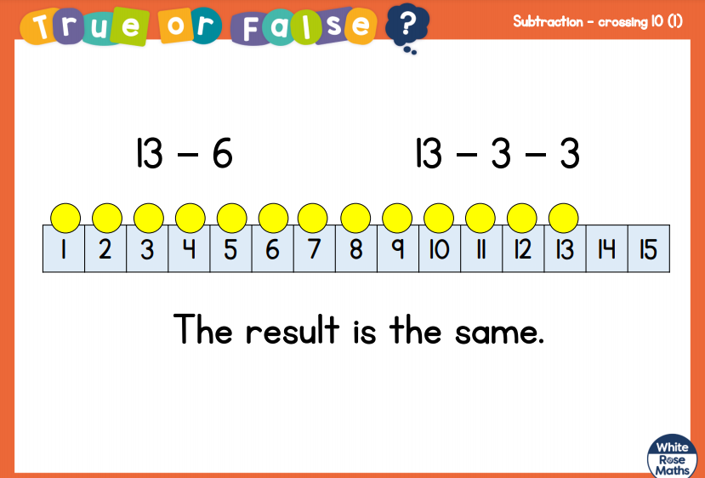
White Rose Maths
Show your thinking on a tens frame or a number line.

Slide 25
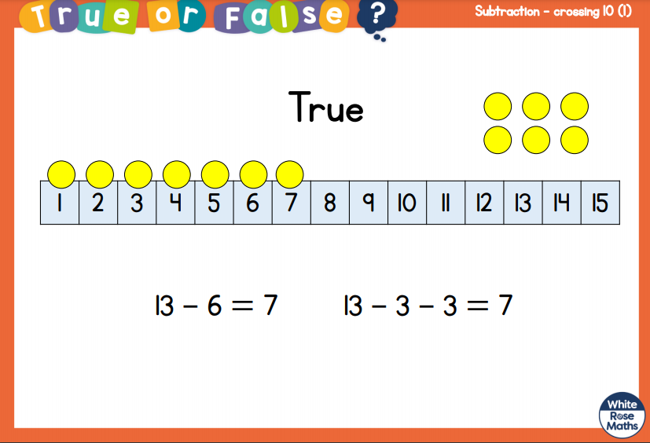
White Rose Maths

Slide 26
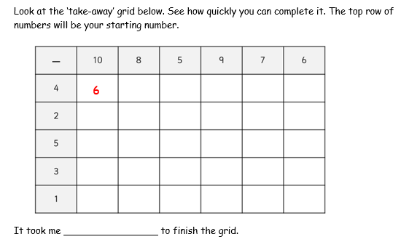
White Rose Maths
Have a look in files for the Subtraction Revision Grid that you have been looking at these past few days. I would like you to have another go and see how quickly you can fill it in today.

Slide 27
White Rose Maths
We are not going to use a video today(unless you think your child needs to be reminded how to jump back to 10 https://vimeo.com/497919464 ). We are going to go over what we were doing yesterday - subtracting by finding 10 and then counting back.
Chose the level that you think would suit your child:
*
**
***
from the work called Subtraction Crossing 10.

Slide 28

If you have used a sheet, stick it into the front of your blue maths book.
We will continue with some White Rose teaching again tomorrow.
I think it is time for lunch and a break from your work.
.
This afternoon there is 100 days
at school session and after that it
is Golden Time. First of all go and
enjoy your lunch.

Slide 29

Worship Time:
Big Joe
https://youtu.be/jxNJ-iXNcds

Slide 30

Most importantly encourage your child to read a suitable book to you. Later on it would be great if you let them listen to Boogie Bear by David Walliams, recommended by Imogen.
https://www.youtube.com/watch?v=I1XAVlur-y0
Please remember to send an email containing the completed work to teacher@kingslandengland.hereford.sch.uk

