Slide 1

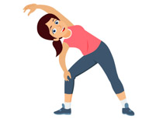
PE
If you can get outdoors please do. You could try these activities to keep active:
Go for a long brisk walk
Ride your bike or scooter
Play some football or just kick a ball around
Play on outdoor equipment
If you can’t get out, follow the link on the slide for a workout, dance or gymnastic session.

Slide 2
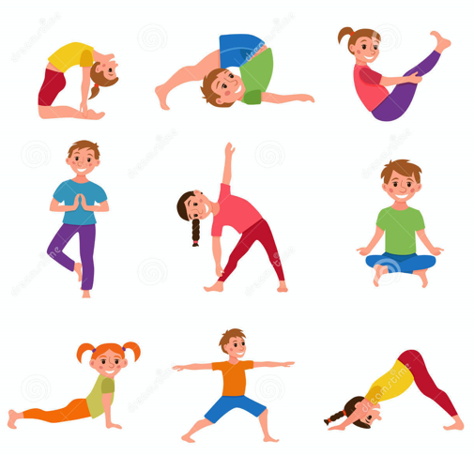
12.2.21
Today we are going to follow the Oak Academy PE Video
This lesson 3 is about exploring different rolls and balances.
make sure you are comfortably dressed
you have a safe space to move in
follow the link and instructions below
https://classroom.thenational.academy/lessons/exploring-linking-rolls-and-balances-cdgkad

Slide 3
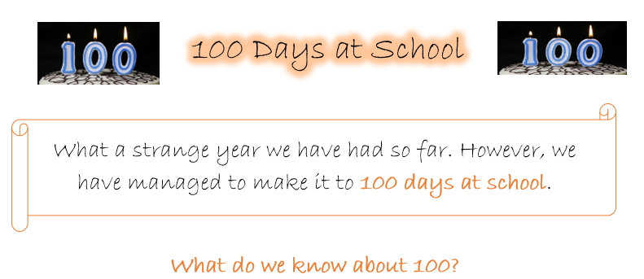
12.2.21
Follow the PDF in the folder with activities all linked to 100.

Slide 4


https://www.youtube.com/watch?v=0TgLtF3PMOc-
Get Physical to 100!

