Slide 1
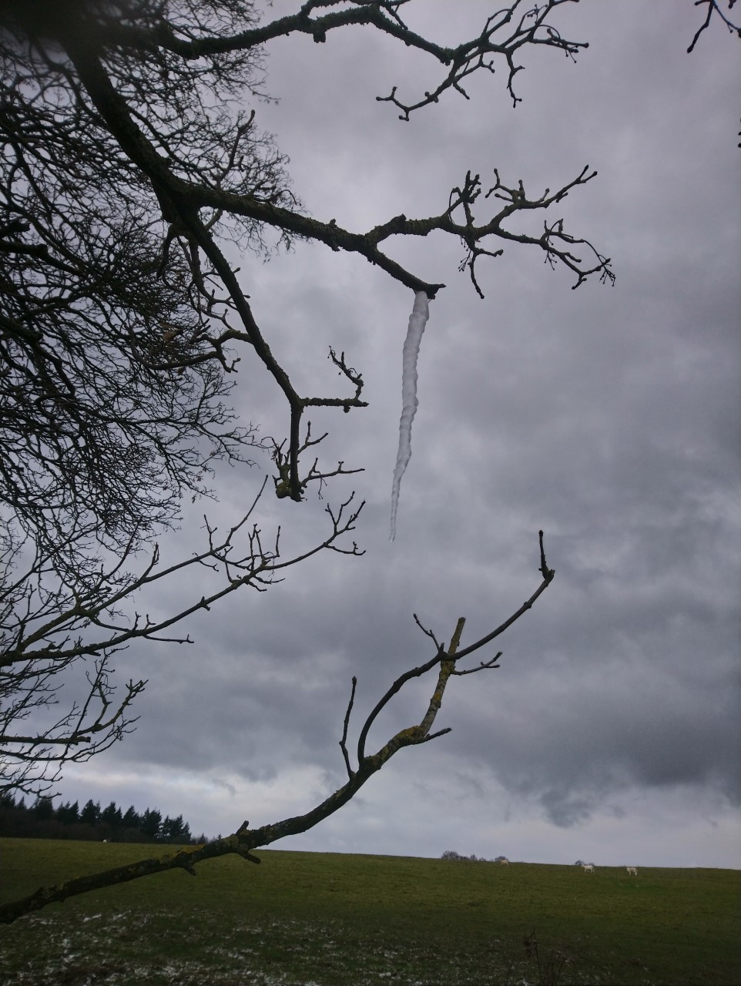
Thursday 11th February 2021

Slide 2


Thursday 11th February 2021
For RWI you will need to be able to see a copy of the words for the Spelling Quiz. For maths you need to be able to see a copy of the White Rose worksheet and the subtraction grid.
 | phonics | RWI |  | maths – White Rose Vimeo link and worksheet |  | afternoon | 2:45 assembly via email | time to share a book
9am On-line registration | Rainbow Group air, ir, ou and oy Sunshine Group ow – brown cow | A Bad Fox A Bad Fright -Speed Sounds -Red and Green words -Read story -Build a Sentence | BREAK | Subtraction crossing 10 https://vimeo.com/497919464 worksheet | LUNCH | ICT coding PE | Mark Harrington | Reading Time

Slide 3


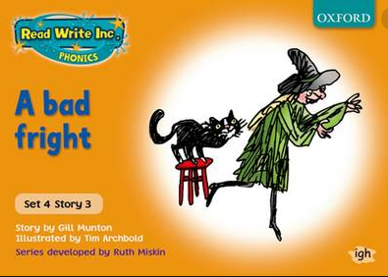

RWI
Each day for RWI you will need:
Rainbow Group Sunshine Group
A Bad Fox A Bad Fright book book
‘Weekly Writing sheet’ RWI (from your pack)
Could you please download the relevant book for your child as we will continue to read it throughout the week.

Slide 4
Rainbow Group air, ir, ou and oy
Today we are going to have a very brief start to our phonic session to read through the graphemes and then we will move onto our Spelling Quiz. The words for the quiz are in Thursday’s file.

Slide 5
Sunshine Group ow – brown cow
Today we are going to have a very brief start to our phonic session to read through the graphemes and then we will move onto our Spelling Quiz. The words for the quiz are in Thursday’s file.

Slide 6


Continue with RWI
Begin by reading the Speed Sounds to an adult, as you did yesterday.

Slide 7

Continue with RWI
After that, you are ready to read through the Speed Words (on page 15 of your book) to an adult.

Slide 8
Continue with RWI
Once you have read the speed sounds and Speed Words you are ready to read the story to an adult. Remember to think about your expression to make it interesting to listen to.

Slide 9
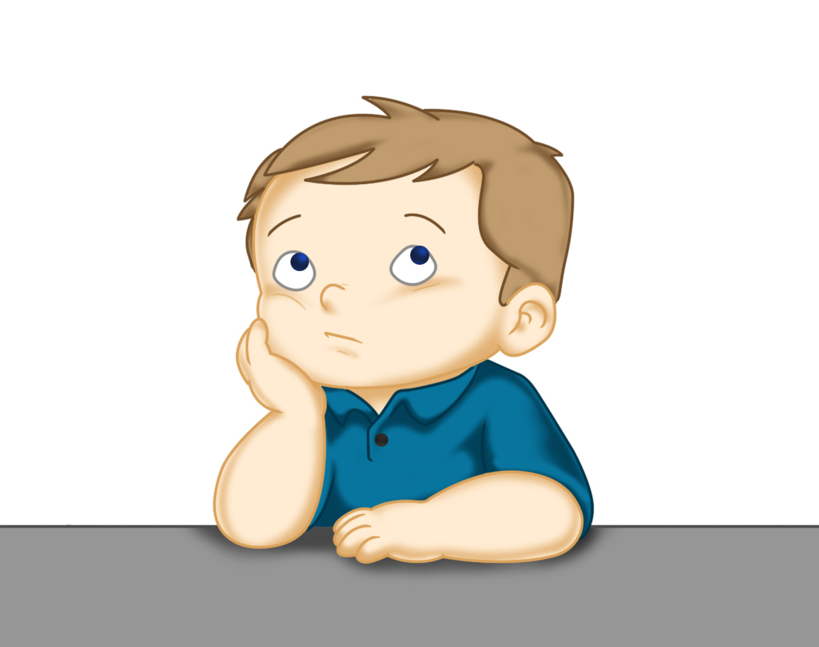
Our Structure for RWI
Build a Sentence
The aim of this task is to help to build (improve) your vocabulary.
On the next slide there are some words that I would like you to discuss with your adult. Make sure you know what they mean, think of other words that mean the same (synonyms).
Now think of an exciting sentence for each of these words.
This Photo by Unknown Author is licensed under CC BY

Slide 10

Build a Sentence
slink off sneak away soaking drenched
You may like to think about:
When did it happen?
Who are you talking about?
Why are they like that/moving like that?
Where are they?
At the end the sly fox was soaking after being tipped into the murky pond.
Write out 2 of your sentences using capital letters and full stops.

Slide 11
Build a Sentence
foul horrid ghastly up to tricks
You may like to think about:
Who you are writing about?
What are they doing?
Who are they doing it to?
I am a ghastly witch with sticky cobwebs in my hair. I am going to play a horrid trick on my big brother.
Write out 2 of your sentences using capital letters and full stops.

Slide 12

Stick your sentence on the next page at the front of your purple book.
Thank you for working hard.
Now have a break and a snack.

Slide 13
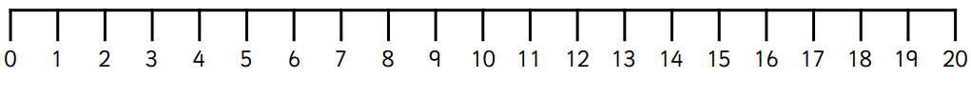

White Rose Maths
Subtraction crossing 10
You will need:
White Rose maths sheet from Thursday’s file
Subtraction Revision grid
Subtraction Frame
Subtraction Practice

Slide 14
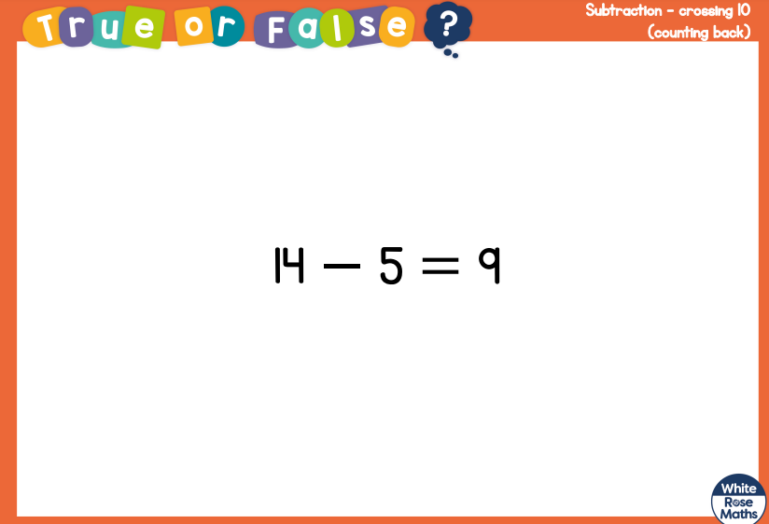
White Rose Maths
Is this true or false? (answer on slide 14)
Use a number line to show your thinking.

Slide 15
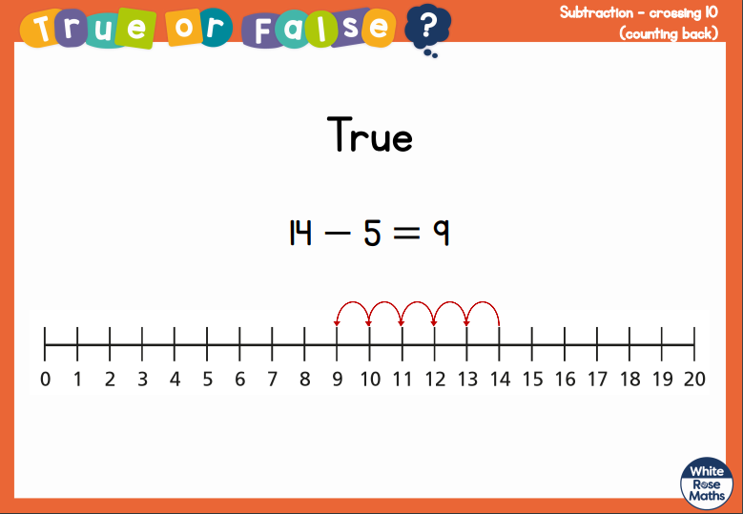
White Rose Maths

Slide 16
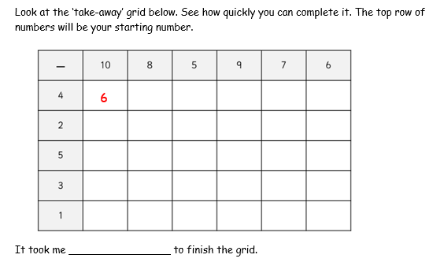
White Rose Maths
Have a look in files for the Subtraction Revision Grid that you have been looking at these past few days. I would like you to have another go and see how quickly you can fill it in today.

Slide 17
White Rose Maths
Use this video link https://vimeo.com/497919464
and have a go at the ‘questions to think about’ slide.
Work through the video, feel free to pause it to explain any of the teaching.
Now you are ready to have a go at the White Rose maths sheet.
Remember you can write your answers in your blue maths book to save printing it out.

Slide 18
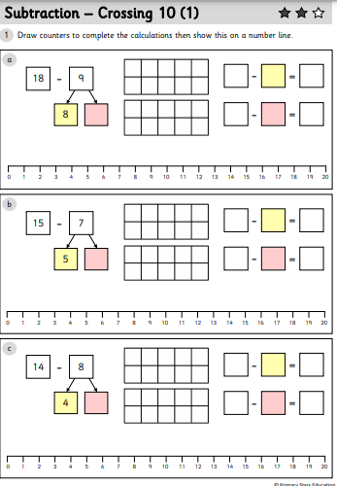
White Rose Maths
Complete this sheet in today’s file. If you need to, please can you carry on practising until you are feeling more confident with this new method.

Slide 19

If you have used a sheet, stick it into the front of your blue maths book.
We will continue with some White Rose teaching again tomorrow.
I think it is time for lunch and a break from your work.
.
This afternoon there is an ICT
lesson and a PE session. First of all
enjoy your lunch.

Slide 20

Worship Time:
Mark Harrington
https://www.youtube.com/watch?v=RPae2IUbSYM&feature=youtu.be

Slide 21

Most importantly encourage your child to read a suitable book to you. Later on it would be great if you could read a bedtime story to them.
Please remember to send an email containing the completed work to teacher@kingslandengland.hereford.sch.uk

