Slide 1


Wednesday 10th February 2021
For RWI you will need access to the Roll and Read sheet, a dice and the Edit a Sentence. For maths you need to be able to see a copy of subtraction grid and worksheet.
 | phonics | RWI |  | maths – White Rose Vimeo link and worksheet |  | afternoon | 2:45 assembly via email | time to share a book
9am On-line registration | Rainbow Group air, ir, ou and oy Roll and Read Sunshine Group ow – brown cow Roll and Read | A Bad Fox A Bad Fright -Speed Sounds -Red and Green words -Read story -Edit a Sentence | BREAK | Subtraction - counting back https://vimeo.com/497563367 worksheet | LUNCH | Science | I Sing Pop | Reading Time

Slide 2




RWI
Each day for RWI you will need:
Rainbow Group Sunshine Group
A Bad Fox A Bad Fright book book
‘Weekly Writing sheet’ RWI (from your pack)
Could you please download the relevant book for your child as we will continue to read it throughout the week.

Slide 3




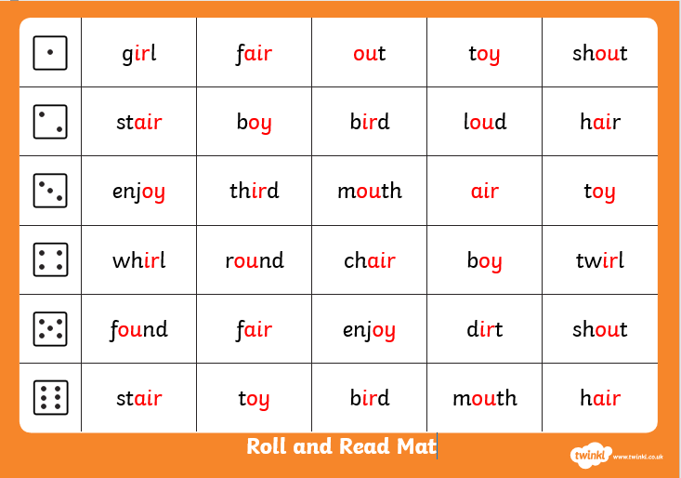
Rainbow Group air, ir, ou, oy
After a brief phonic session can you complete this game that is in Wednesday’s folder. You don’t necessarily have to print it.
Once finished, it can be stuck into the front of your purple book.

Slide 4
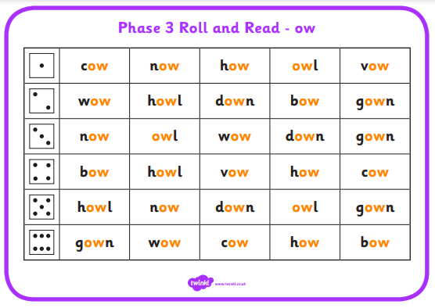
Sunshine Group ow – brown cow
After a brief phonic session can you complete this game that is in Wednesday’s folder. You don’t necessarily have to print it.
Once finished, it can be stuck into the front of your purple book.

Slide 5
How to Play Roll and Read
You can either: print this off and tick or colour in the words your child has read; or leave it on the screen to read.
Roll the dice and read the first word in that row, keep on rolling the dice and reading the words until you fill a complete row.

Slide 6


Continue with RWI
Begin by reading the Speed Sounds to an adult, as you did yesterday.

Slide 7

Continue with RWI
After that, you are ready to read through the Green and Red Words to an adult like you did yesterday.

Slide 8
Continue with RWI
Once you have read the speed sounds, green and red words, you are now ready to read the story. Remember to pause at the full stops.

Slide 9
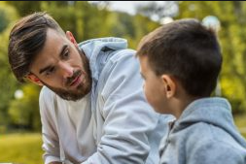
Our Structure for RWI
Today we have two activities to do:
Questions to Answer (a verbal activity, no writing!) - see page 14 of your reading book.
Get an adult ask you the questions. Don’t
forget to turn to the correct page to help
you to find the answer.
Remember to answer in full sentences.

Slide 10

Our Structure for RWI
2. Edit a Sentence.
On the following pages there is a sentence, one for each group to read.
We do this every week in class so they know that there are some mistakes and their job is to look carefully at the sentence to try to spot all of the errors.
Once they have done this they circle them and then copy the corrected sentence onto the Wednesday section of the Weekly Handout Sheet.

Slide 11

Edit a Sentence the man gets the bad fix and puts hem in a bag
There are 4 mistakes:
1 capital letter 2 spelling mistakes
1 full stop
Once you have found the mistakes, circle them and then look at the next slide to check that you have found them all.

Slide 12
Edit a Sentence
the man gets the bad fix and puts hem in a bag
Now copy it up neatly (correct sentence on slide 15).
Did you spot all of the mistakes?

Slide 13
Edit a Sentence i crip up to my mum i give her a frit
There are 6 mistakes:
2 capital letters 2 spelling mistakes
2 full stops
Once you have found the mistakes, circle them and then look at the next slide to check that you have found them all.

Slide 14

Edit a Sentence
i crip up to my mum i give her a frit
Now copy it up neatly (correct sentence on slide 15).
Did you spot all of the mistakes?

Slide 15
Edit a Sentence – correct sentences
The man gets the bad fox and puts him in a bag.
I creep up to my mum. I give her a fright.

Slide 16

Stick your sheet in the front of your purple book.
Thank you for working hard.
Now have a break and a snack.

Slide 17
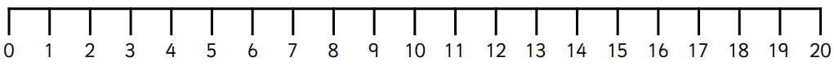

White Rose Maths
Subtraction – crossing 10 (counting back)
You will need:
White Rose sheet
Number line 0-20
Subtraction Revision Grid

Slide 18
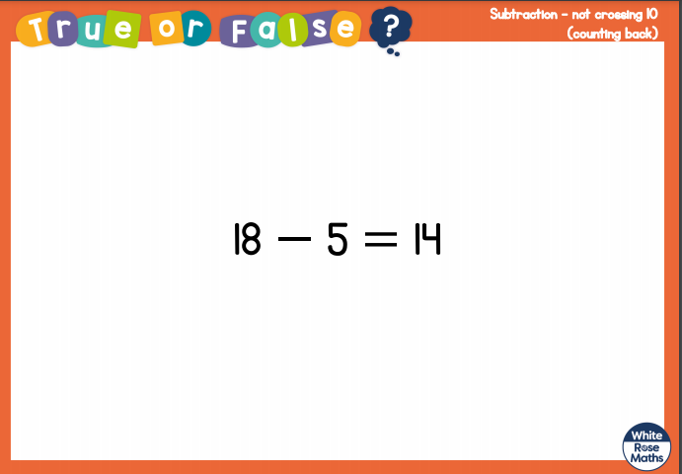
White Rose Maths
Is this true or false? (answer on slide 19)
.
Show your thinking on a number line.

Slide 19
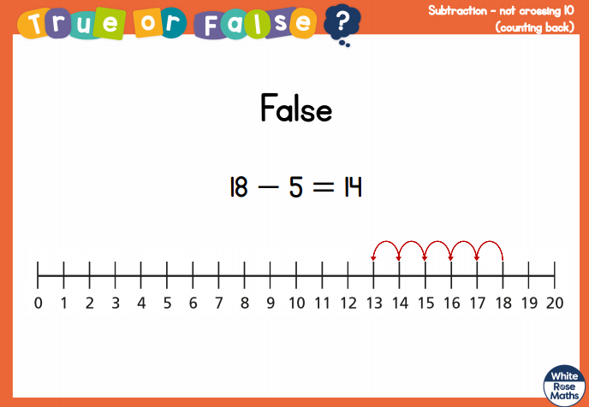
White Rose Maths

Slide 20
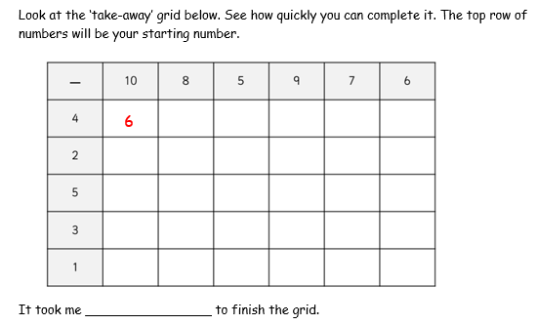
White Rose Maths
Have a look in files for the Subtraction Revision Grid that you have been looking at these past few days. I would like you to have another go and see how quickly you can fill it in today.

Slide 21
White Rose Maths
Use this video link https://vimeo.com/497563367 and have a go at the ‘questions to think about’ slide.
Work through the video, feel free to pause it to explain any of the teaching.
Now you are ready to have a go at the worksheet.
Remember you can write your answers in your blue maths book to save printing it out.

Slide 22
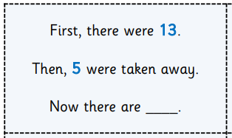
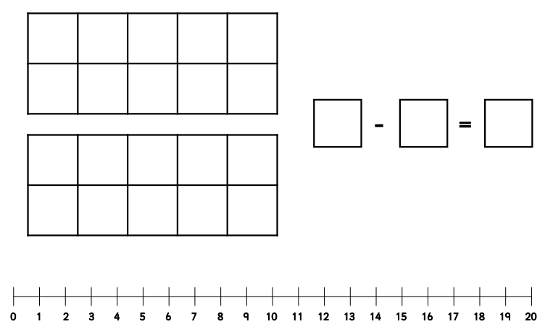
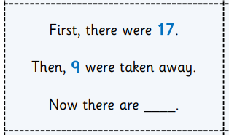
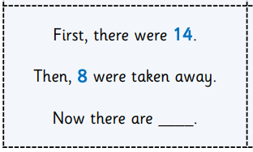
White Rose Maths
Now use the tens frames, number line and stem sentence model to work out the 3 word problems on this page.
.

Slide 23

If you have used a sheet, stick it into the front of your blue maths book.
We will continue with some White Rose teaching again tomorrow.
I think it is time for lunch and a break from your work.
There is a science session this
afternoon but enjoy your lunch
first.

Slide 24

Worship Time:
I Sing Pop
https://vimeo.com/487175458/fb36b412d8 password: Spring

Slide 25

Most importantly encourage your child to read a suitable book to you. Later on it would be great if you could read a bedtime story to them.
Please remember to send an email containing the work that they have done to teacher@kingslandengland.hereford.sch.uk

