Slide 1


Slide 2
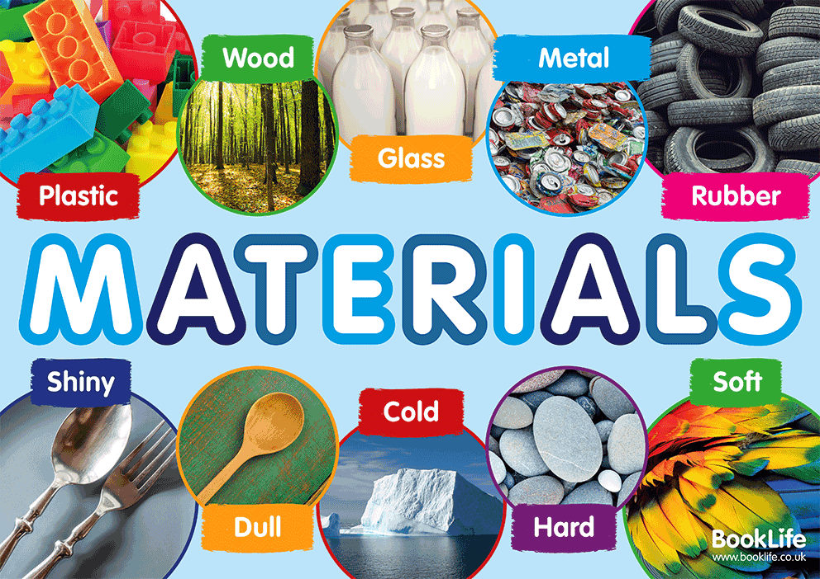

Slide 3
Which materials are absorbent?
In this lesson, we will be learning about absorbency. We will test and compare the absorbency of a variety of household materials.

Slide 4

To complete today’s lesson you will need:
a piece of paper
and a pencil
For the experiment, if you would like to take part, you will need:
a sponge or cloth
plastic bag or cup
foil
cardboard or paper
cotton wool or tissue.
If you do not have these materials, you can watch Miss Harris complete the experiment while observing the outcomes.

Slide 5
You can watch the video and take part alongside Miss Harris. Otherwise, you can watch Miss Harris conduct the experiment while observing the outcomes.
Link to the video
https://classroom.thenational.academy/lessons/which-materials-are-absorbent-6tk3er?step=2&activity=video

Slide 6
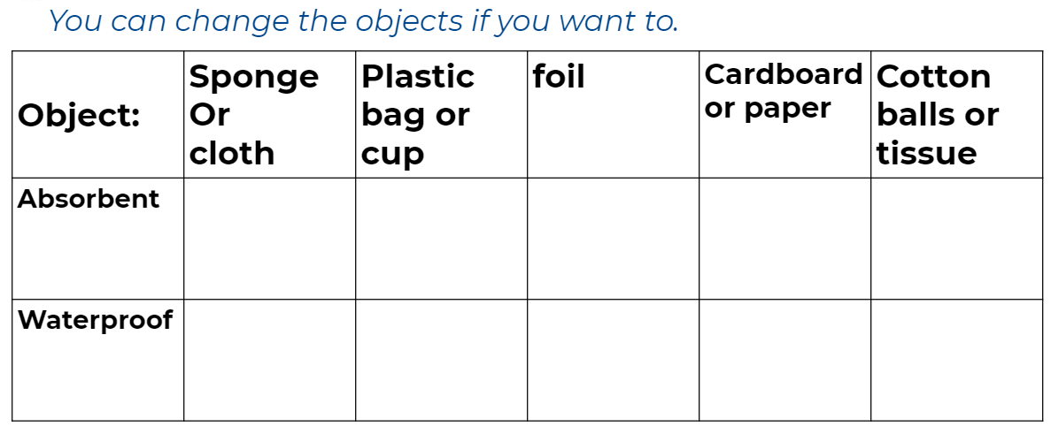

The worksheet, which is on the website, can be printed. If you don’t have the facilities to print please draw the table on another sheet of paper.
Here is the end of lesson quiz (3 multiple choice questions)
https://classroom.thenational.academy/lessons/which-materials-are-absorbent-6tk3er?step=4&activity=exit_quiz

Slide 7


