Slide 1


Tuesday 9th February 2021
For RWI you will need the sounds sheet ow(sunshine group).
For maths you will need access to the Subtraction revision sheet and White Rose worksheet in Tuesday’s file.
 | phonics | RWI |  | maths – White Rose Vimeo link and worksheet |  | afternoon | 2:45 assembly via email | time to share a book
9am On-line registration | Rainbow Group Revision air, ir, ou, oy Sunshine Group ow – brown cow | A Bad Fox A Bad Fright -Speed Sounds -Red and Green words -Read story -Hold a Sentence | BREAK | Subtraction Counting back https://vimeo.com/492198226 worksheet | LUNCH | Safer Internet Day | Safer Internet Day | Reading Time

Slide 2


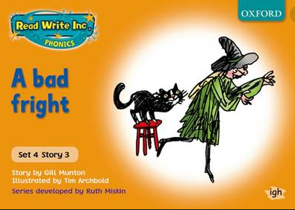

RWI
Each day for RWI you will need:
Rainbow Group Sunshine Group
A Bad Fox A Bad Fright book book
‘Weekly Writing sheet’ RWI (from your pack)

Slide 3

Rainbow Group
After a brief phonic session can you work on spelling: stair
bird
found
boy
all
you.

Slide 4
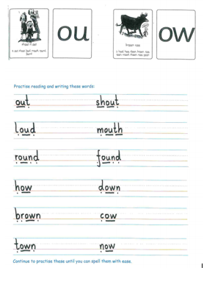
Sunshine Group ow is our sound for this week
After a brief phonic session can you complete this phonic sheet that is
in the folder.
Once you have finished it, it can be stuck into your green home-learning book.

Slide 5


Continue with RWI
Begin by reading the Speed Sounds to an adult, as you did yesterday.

Slide 6

Continue with RWI
After that, you are ready to read through the Green and Red Words to an adult like you did yesterday.

Slide 7
Continue with RWI
Once you have read the speed sounds, green and red words, you are now ready to read the book to an adult. Remember to pause at the full stops.

Slide 8

Our Structure for RWI
Now you are ready for the second Hold a Sentence (see next slide for the sentence for each group)
Get your Weekly Writing Sheet for Tuesday and listen to your adult say the sentence out loud to you. Remember to do the actions for capital letter and full stop. Repeat at least 3 times before you write it down.

Slide 9

Rainbow Group
Today’s Hold a Sentence is:
The man has got a big bag.
remember:
Sunshine Group
remember:
Today’s Hold a Sentence is:
Mum did not get a bad fright.

Slide 10
Our Structure for RWI
Now you are ready to write the Hold a Sentence down on your paper.
Don’t forget to use
a capital letter
a full stop
finger spaces
neat handwriting.
Look at slide 11 so you can check your Hold a Sentence.

Slide 11
Time to check
Rainbow Group
The man has got a big bag.
Sunshine Group
Mum did not get a bad fright.

Slide 12

Stick your sheet in the front of your purple book.
Thank you for working hard.
Now have a break and a snack.

Slide 13
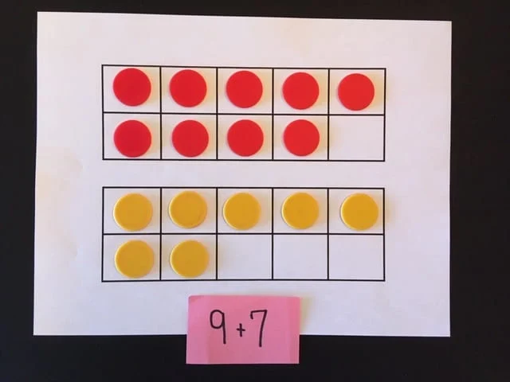

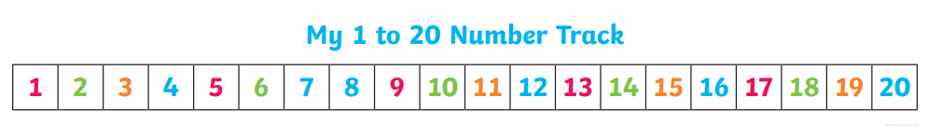
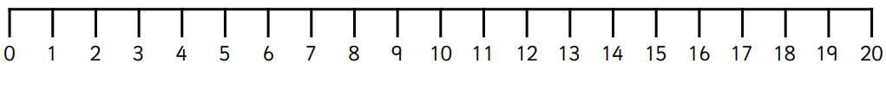
White Rose Maths
Subtraction - counting back
You will need:
maths sheets from Tuesday’s file
Number track 0-20
0-20 number line

Slide 14
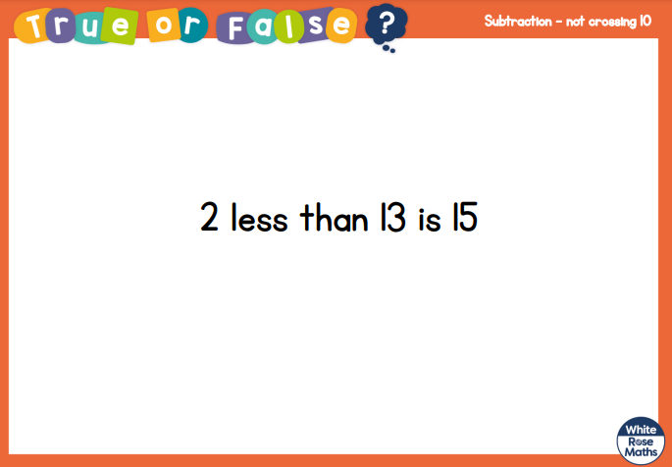
White Rose Maths
Is this true or false?
Use a tens frame to show your thinking.

Slide 15
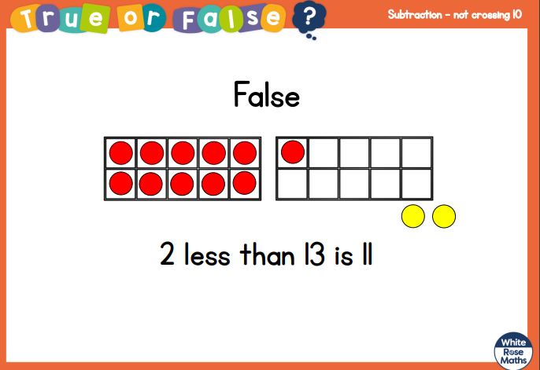
White Rose Maths

Slide 16
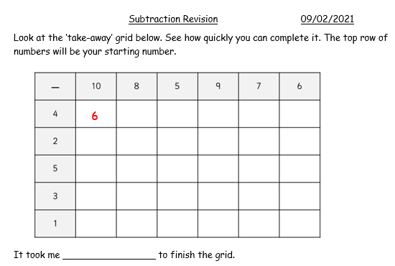
White Rose Maths
Have a look in files for the Subtraction Revision Grid that you looked at yesterday. I would like you to have another go and see how quickly you can fill in today.

Slide 17
White Rose Maths
Use this video link https://vimeo.com/492198226 and have a go at the ‘questions to think about’ slide.
Work through the video, feel free to pause it to explain any of the teaching.
Now you are ready to have a go at the worksheet.
Remember you can write your answers in your blue maths book or use the ppt link to save printing it.

Slide 18
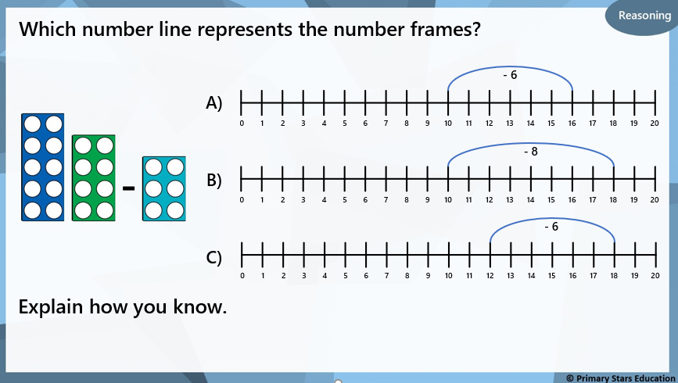
Would you like to have a go at the ‘Deeper Thinking’ question?

Slide 19

If you have used a sheet, stick it into the front of your blue maths book.
We will continue with some White Rose teaching again tomorrow.
I think it is time for lunch and a break from your work.
There is a topic session in files for
this afternoon but enjoy your
lunch first.

Slide 20

Most importantly encourage your child to read a suitable book to you. Later on it would be great if you could read a bedtime story to them.
Please remember to send an email containing the work that they have done to teacher@kingslandengland.hereford.sch.uk

Slide 21

Worship Time with:
Safer Internet Day
: https://www.saferinternet.org.uk/detective-digiduck-virtual-assembly-3-7s

