Slide 1
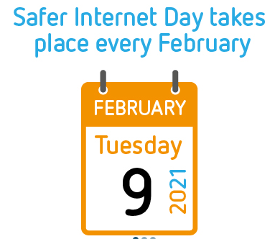
Today we are looking at the question:
‘Can we trust all that we read on the Internet?’

Slide 2
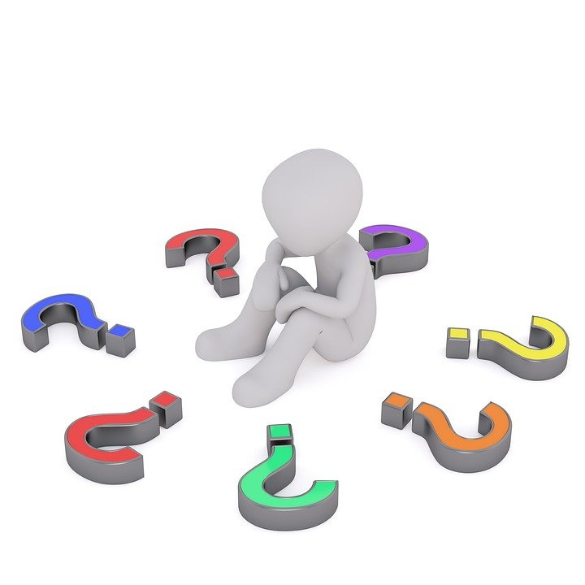
Talk to an adult and see if you can think about what we use the Internet for.

Slide 3
Use this link to watch today’s assembly
https://www.saferinternet.org.uk/detective-digiduck-virtual-assembly-3-7s

Slide 4
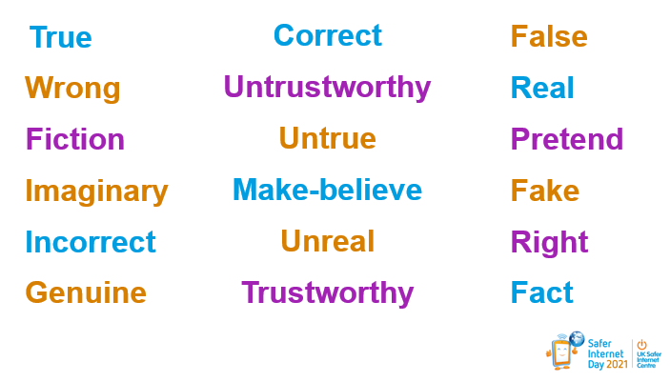
How many words can you find that mean true?
How many words can you find that mean false?

Slide 5
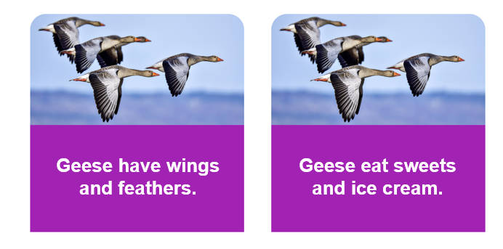
On the Internet there are lots of facts and information. However not all of these are true. Which fact is true and which is false?

Slide 6
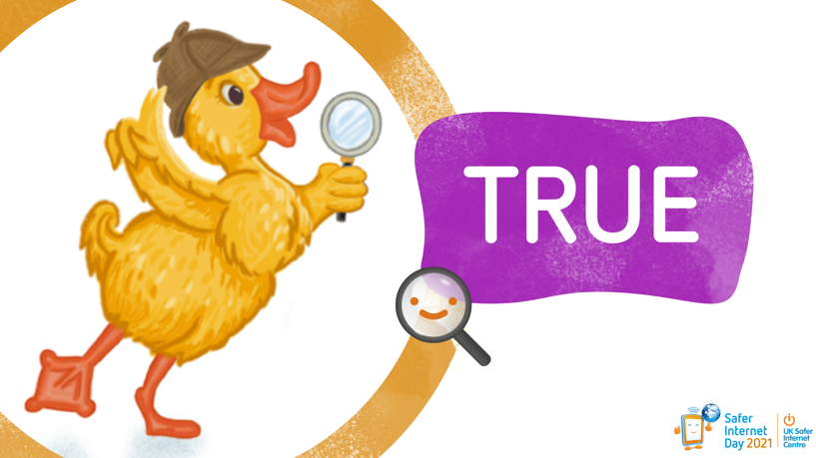
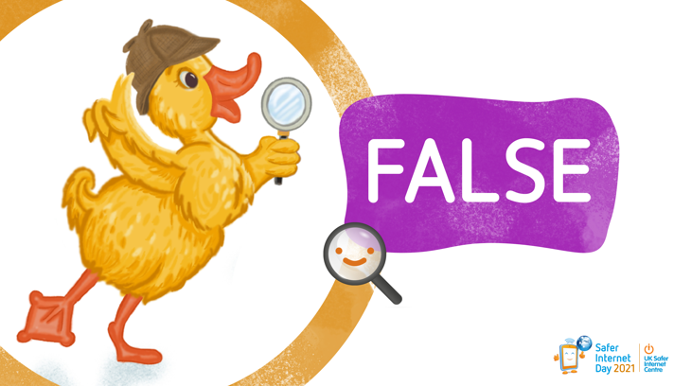
What things can you trust online?
What things can’t you trust online?

Slide 7
Some examples:
BBC News
BBC Bitesize
Some wildlife programme e.g. David Attenborough
Newsround

Slide 8
Some examples:
Fake competitions
People who you don’t know asking to be friends
Some adverts
Wikipedia

Slide 9
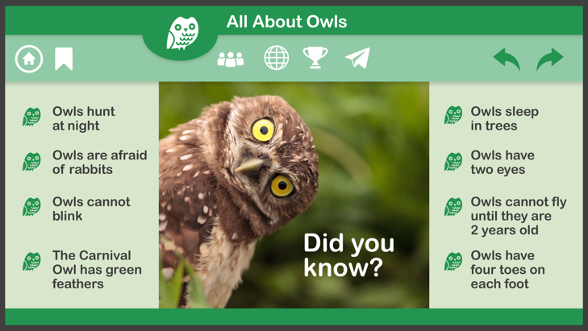
Are all of these facts correct about owls?
or

Slide 10
Today I want you to think about the Arctic animal that you wrote about last week in Topic.
Can you think about 2 facts that are true?
Then think about 2 facts that are false.
Using these facts I would like you to make a Did you know? page about your animal. Once you have finished it, show it to another person and see if they can work out which the facts are true and which are false.

Slide 11


