Slide 1


Friday 5th February 2021
For maths you need to be able to see or have a copy of Add by making 10 sheet. For RWI you need the red words to spell sheet and lines for spelling words.
 | phonics | RWI |  | maths – White Rose Vimeo link and worksheet |  | afternoon | 2:45 assembly via email | time to share a book
9am On-line registration | Rainbow Group oy – toy for a boy Sunshine Group er – better letter | Ken’s Cap Playday -Speed Sounds -Red and Green words -Read story -Big Write | BREAK | Find and make number bonds | LUNCH | PE and Golden Time | Big Joe | Reading Time

Slide 2

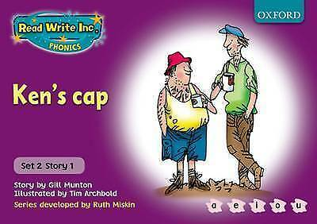


RWI
Each day for RWI you will need:
Rainbow Group Sunshine Group
Ken’s Cap Playday book book
‘Weekly Writing sheet’ RWI (from your pack)

Slide 3
Rainbow Group oy – toy for a boy
Today we are going to have a very brief start to our phonic session to read through the green words and spell some words.

Slide 4
Sunshine Group
er – better letter
Today we are going to have a very brief start to our phonic session to read through the green words and spell some words.

Slide 5
Sunshine and Rainbow Groups
Yesterday we had the Spelling Quiz.
I would like you to look back at your quiz and see which words (if any) you found a challenge.
I would like you to practise these words so you are able to spell them with ease.

Slide 6
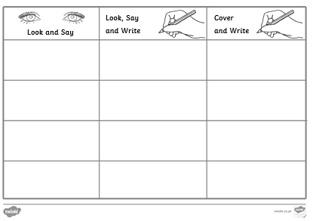
Sunshine and Rainbow Groups
In the Friday file are the red (tricky) words that you have been reading in your RWI book this week.
I would now like you to try to learn how to spell these words so you are able to spell them with ease.

Slide 7
Sunshine and Rainbow Groups
Look at the words in the Look and Say column. You need to take your time to look at each word, say the letters out loud, look at the shape of the word and try to write it in the air. Remember you can do this outside, if you prefer.
Once you think you know how to spell them, have a go in the second column.
In the final column, cover the words up and write them.

Slide 8
Sunshine and Rainbow Groups
If you have time, write two different sentences using these words.
Use the handwriting lines to help you to keep it neat.

Slide 9


Continue with RWI
Begin by reading the Speed Sounds to an adult, as you did yesterday.

Slide 10

Continue with RWI
After that, you are ready to read through the Speed Words (on page 15 of your book) to an adult.

Slide 11
Continue with RWI
Now you are ready to read the book to an adult. You have been working on this story all week so you should be getting very confident!
Remember to think about your expression to make it interesting to listen to and pausing for punctuation.

Slide 12
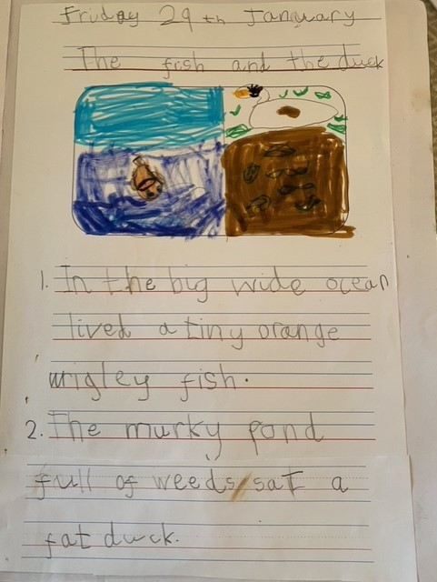

Star Big Write Work

Slide 13
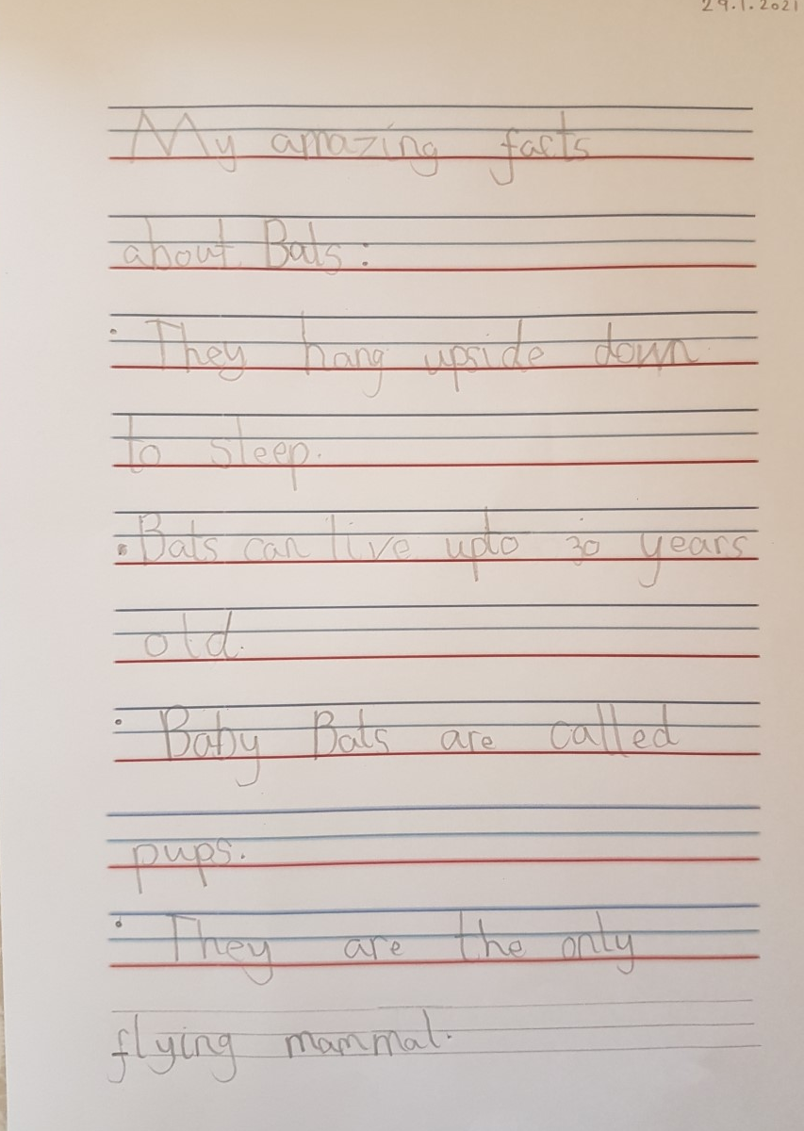
Star Big Write Work

Slide 14
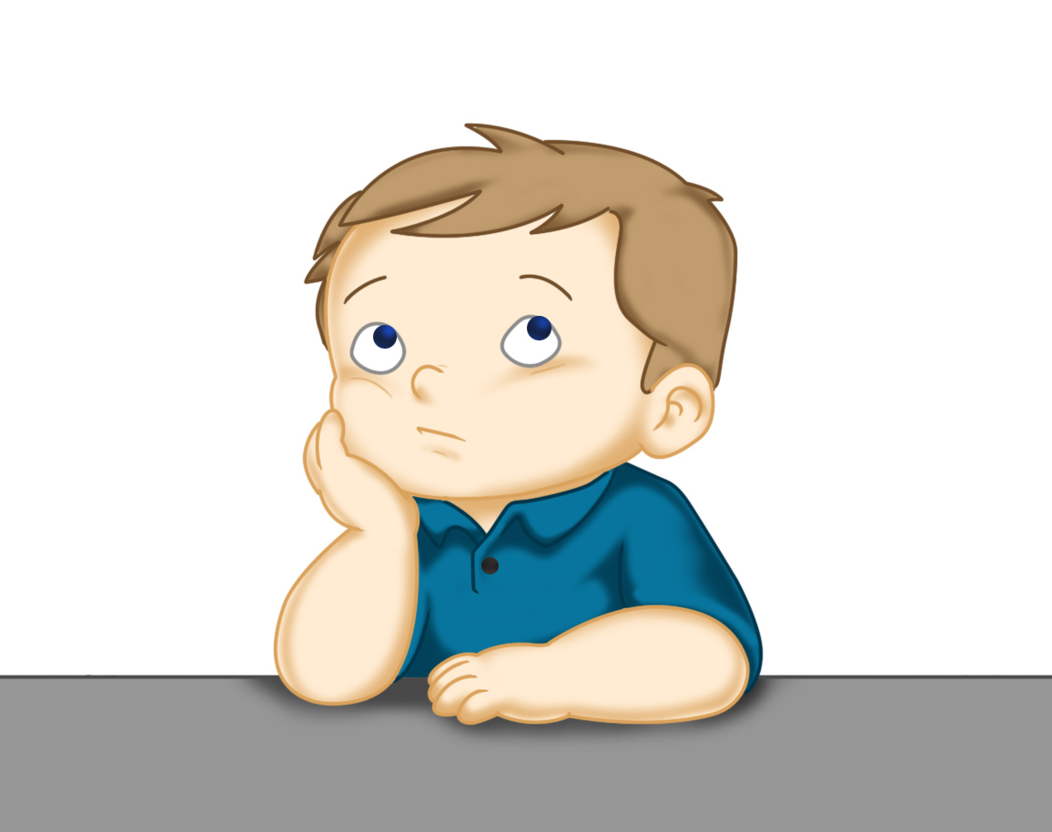
Our Structure for RWI
Today is the final day of RWI for the week.
This is when we do our Big Write. We base this around the book that we have been reading in RWI.
This Photo by Unknown Author is licensed under CC BY

Slide 15
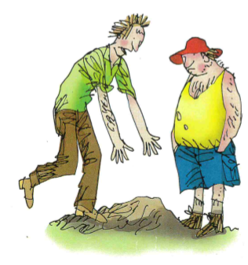
Rainbow Group - Big Write
To start with, we are thinking about Ken’s cap. I want you to imagine that you are Dan and Ken has just told you that he has lost his cap.
Where did he lose it?
What could you say/do to help him?

Slide 16
Rainbow Group - Big Write
I would like you and your adult to think of some words to help you with your writing:
1. Think about how to describe where Ken lost the cap.
2. What could you do to help?

Slide 17
Rainbow Group - Big Write
Here is an example of my sentence.
I think your favourite hat is in that massive pit. I can get my digger and help you to dig it out.
Using the stem sentences I think
I can
Don’t forget to use adjectives (describing words) and the wow words from yesterday’s Build a Sentence.

Slide 18
Big Write
Sunshine Group - Big Write
Today we are going to write about a playday.
Wouldn’t it be great if you could have a playday today?
If you could have a playday think about:
Who would you play with?
What would you do?
Don’t forget to use details/adjectives to make your writing interesting. Think about how you start your sentences.

Slide 19
Sunshine Group - Big Write
Use these ideas to write about your playday. Here is an example of what I would do.
I want to have a playday with my friend Sam.
We could play in the sand and build an enormous sandcastle with a flag on the top. After that we could go outside and jump for joy on the brand new trampoline.

Slide 20

Big Write
You are ready to think about how you can use these words in some super sentences.
Talk through your sentences with an adult, one sentence at a time. When you are happy with your sentence, ‘put your headphones on’ say it again and then write it down.
I will look forward to reading your finished pieces of writing.
Don’t forget to use neat handwriting, finger spaces, capital letters and full stops.

Slide 21

Stick your sentence on the next page at the front of your purple book.
Thank you for working hard.
Now have a break and a snack.

Slide 22
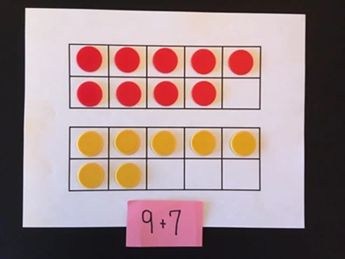

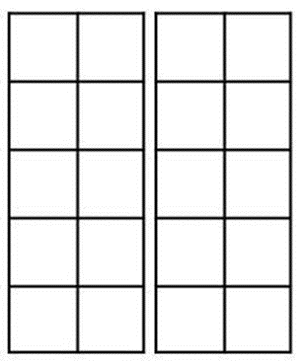
White Rose Maths
Add by making 10
You will need:
White Rose maths sheet from Thursday’s file
2 tens frames and counters
Have a Go! sheet

Slide 23
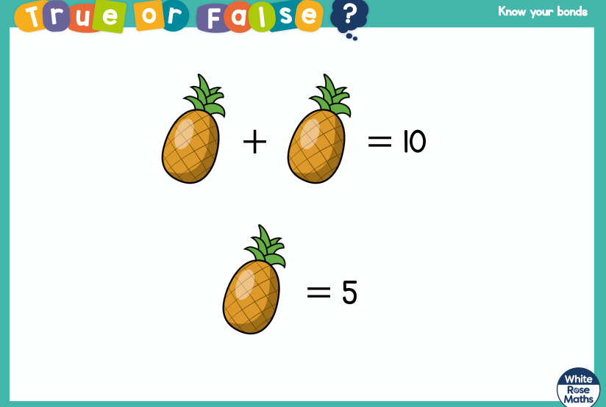
White Rose Maths
Talk about this to your adult.

Slide 24
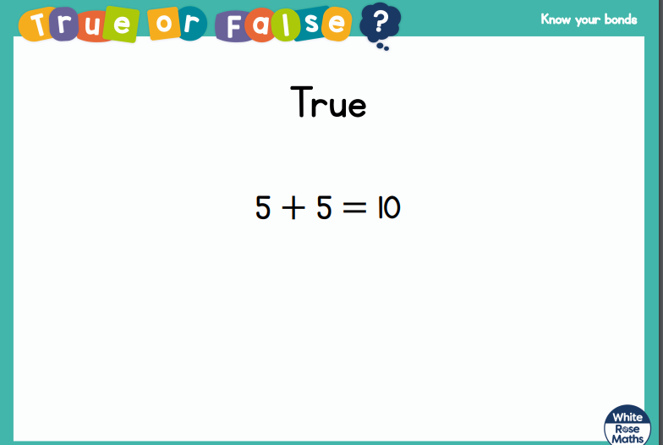
White Rose Maths

Slide 25

White Rose Maths
https://www.google.com/search?q=jack+hartman+number+bonds+to+10&ie=&oe=
Watch this Jack Hartman clip on number bonds to 10. Remember to get up and join in with the actions and try to learn the words of the song so you can sing along with him.

Slide 26
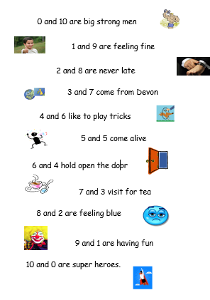
White Rose Maths
In today’s maths file there is a poem that I would like you to try and learn over the coming weeks.
This poem is all about the number bonds
that make 10. If you learn this poem,
it will help you to remember those key Instant Recall Facts (KIRFs) that we practise in our maths lessons.

Slide 27
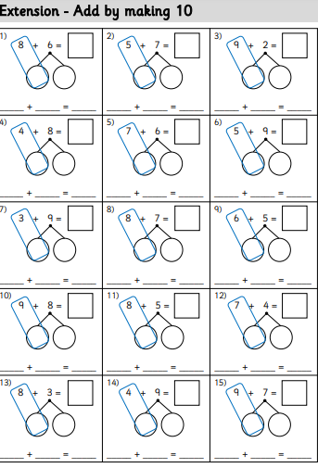
White Rose Maths
We are not going to use a video today as you have already done your two number bonds activities. I would like you to complete this sheet Add by making 10. You can either fill in
the boxes as shown on
the sheet or use your tens
frames to work out the
answers.

Slide 28

If you have used a sheet, stick it into the front of your blue maths book.
We will continue with some White Rose teaching again tomorrow.
I think it is time for lunch and a break from your work.
.
This afternoon there is a PE session
and after that it is Golden Time.
First of all go and enjoy your lunch.

Slide 29

Worship Time:
Big Joe

Slide 30

Most importantly encourage your child to read a suitable book to you. Later on it would be great if you could read a bedtime story to them.
Please remember to send an email containing the completed work to teacher@kingslandengland.hereford.sch.uk

