Slide 1

Thursday 4th February 2021
Arthur

Slide 2


Thursday 4th February 2021
For RWI you will need to be able to see a copy of the words for the Spelling Quiz. For maths you need to be able to see a copy of the White Rose worksheet, 2 tens frames and counters and the Have a Go! sheet.
 | phonics | RWI |  | maths – White Rose Vimeo link and worksheet |  | afternoon | 2:45 assembly via email | time to share a book
9am On-line registration | Rainbow Group oy – toy for a boy Sunshine Group er – better letter | Ken’s Cap Playday -Speed Sounds -Red and Green words -Read story -Build a Sentence | BREAK | Add by Making 10 https://vimeo.com/492195871 worksheet | LUNCH | Screen Free Afternoon Screen free activities | Mark Harrington | Reading Time

Slide 3




RWI
Each day for RWI you will need:
Rainbow Group Sunshine Group
Ken’s Cap Playday book book
‘Weekly Writing sheet’ RWI (from your pack)

Slide 4
Rainbow Group oy – toy for a boy
Today we are going to have a very brief start to our phonic session to read through the graphemes and then we will move onto our Spelling Quiz. The words for the quiz are in Thursday’s file.

Slide 5
Sunshine Group er – better letter
Today we are going to have a very brief start to our phonic session to read through the graphemes and then we will move onto our Spelling Quiz. The words for the quiz are in Thursday’s file.

Slide 6


Continue with RWI
Begin by reading the Speed Sounds to an adult, as you did yesterday.

Slide 7

Continue with RWI
After that, you are ready to read through the Speed Words (on page 15 of your book) to an adult.

Slide 8
Continue with RWI
Once you have read the speed sounds and Speed Words you are ready to read the story to an adult. Remember to think about your expression to make it interesting to listen to.

Slide 9
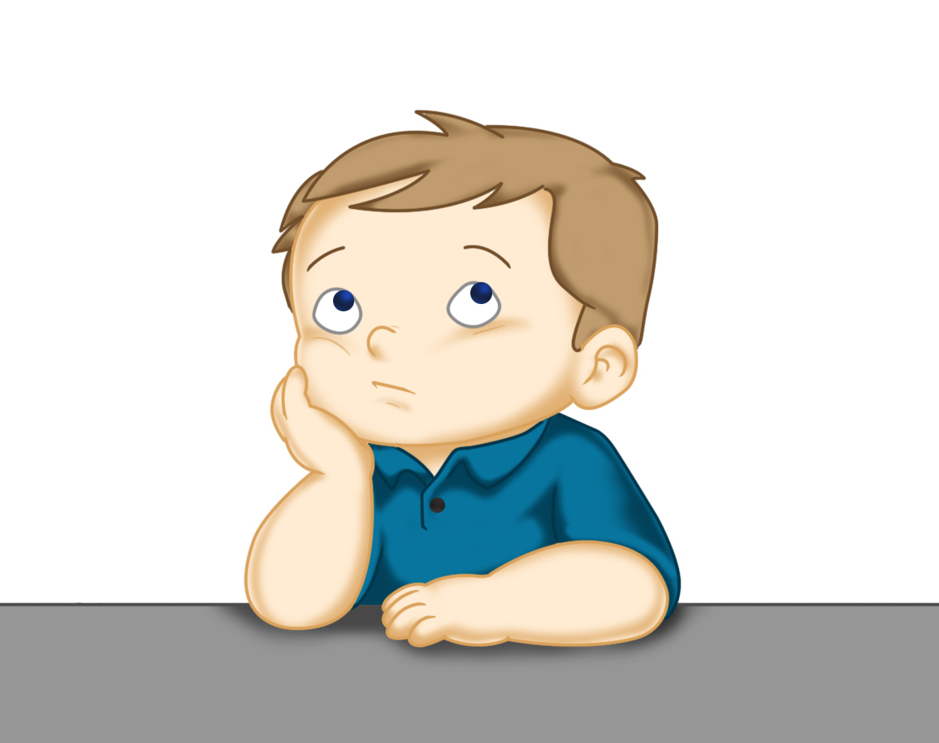
Our Structure for RWI
Build a Sentence
The aim of this task is to help to build (improve) your vocabulary.
On the next slide there are some words that I would like you to discuss with your adult. Make sure you know what they mean, think of other words that mean the same (synonyms).
Now think of an exciting sentence for each of these words.
This Photo by Unknown Author is licensed under CC BY

Slide 10

Build a Sentence
enormous vast massive stylish
You may like to think about:
What are you talking about?
What colour is it?
Where is it?
to help you to build an exciting sentence.
Write out 2 of your sentences using capital letters and full stops.

Slide 11
Build a Sentence
jump for joy bounce about delighted surprise
You may like to think about:
When it happened?
Who did it happened to?
Why were they feeling like that?
to help you to build an exciting sentence.
Write out 2 of your sentences using capital letters and full stops.

Slide 12

Stick your sentence on the next page at the front of your purple book.
Thank you for working hard.
Now have a break and a snack.

Slide 13
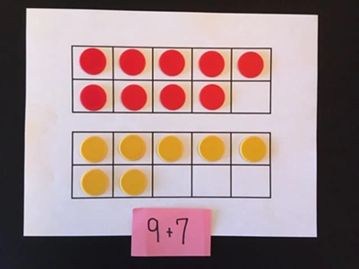

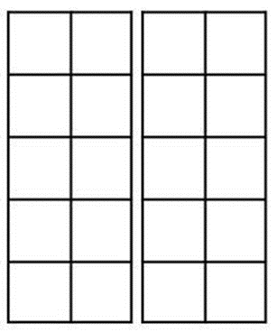
White Rose Maths
Add by making 10
You will need:
White Rose maths sheet from Thursday’s file
2 tens frames and counters
Have a Go! sheet

Slide 14
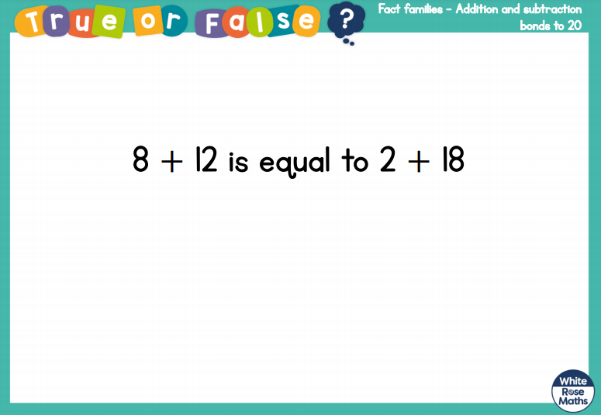
White Rose Maths
Is this true or false? (answer on slide 19)
Use a tens frame to show your thinking.

Slide 15
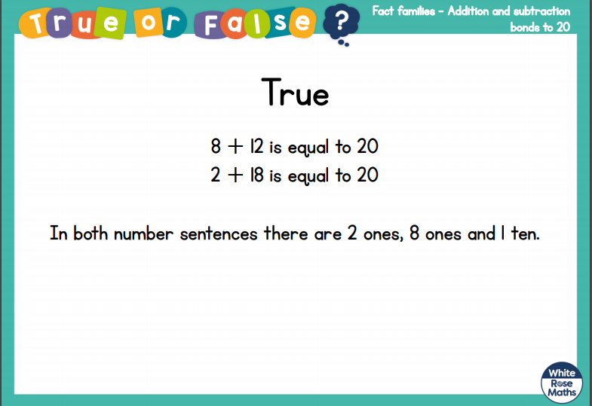
White Rose Maths

Slide 16
White Rose Maths
Use this video link https://vimeo.com/492195871 and have a go at the ‘questions to think about’ slide.
Work through the video, feel free to pause it to explain any of the teaching.
Now you are ready to have a go at the White Rose maths sheet.
Remember you can write your answers in your blue maths book to save printing it out.

Slide 17


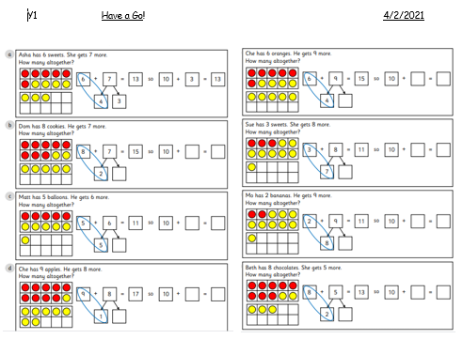
White Rose Maths
To finish with, I would like you to complete the ‘Have a Go!’ sheet from the maths file.

Slide 18

If you have used a sheet, stick it into the front of your blue maths book.
We will continue with some White Rose teaching again tomorrow.
I think it is time for lunch and a break from your work.
.
This afternoon it is a Screen Free
afternoon. You will find a link of
suggested activities on the school
website – see slide 20.

Slide 19

Afternoon Lessons
Have a screen free afternoon!

Slide 20
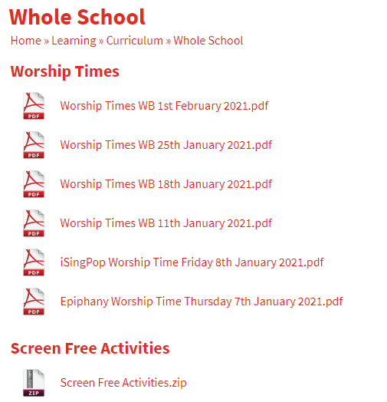

On the school website is a list of suggested activities.

Slide 21

Most importantly encourage your child to read a suitable book to you. Later on it would be great if you could read a bedtime story to them.
Please remember to send an email containing the completed work to teacher@kingslandengland.hereford.sch.uk

