Slide 1


Wednesday 3rd February 2021
Below is the timetable for today.
It is here to give you a guide on today’s work.
For RWI you will need access to the Roll and Read sheet, a dice and the Edit a Sentence. For maths you need to be able to see a copy of the Add by making 10 sheets.
 | phonics | RWI |  | maths – White Rose Vimeo link and worksheet |  | afternoon | 2:45 assembly via email | time to share a book
9am On-line registration | Rainbow Group oy- toy for a boy Roll and Read Sunshine Group er – better letter Roll and Read | Ken’s Cap Playday -Speed Sounds -Red and Green words -Read story -Edit a Sentence | BREAK | Add by making 10 https://vimeo.com/492195871 | LUNCH | Science | I Sing Pop | Reading Time

Slide 2




RWI
Each day for RWI you will need:
Rainbow Group Sunshine Group
Ken’s Cap Playday book book
‘Weekly Writing sheet’ RWI (from your pack)

Slide 3
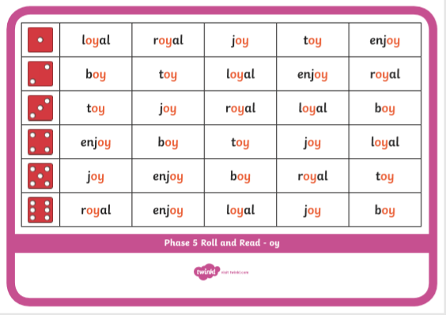
Rainbow Group oy – toy for a boy
After a brief phonic session can you complete this game that is in Wednesday’s folder. You don’t necessarily have to print it.
Once finished, it can be stuck into the front of your purple book.

Slide 4
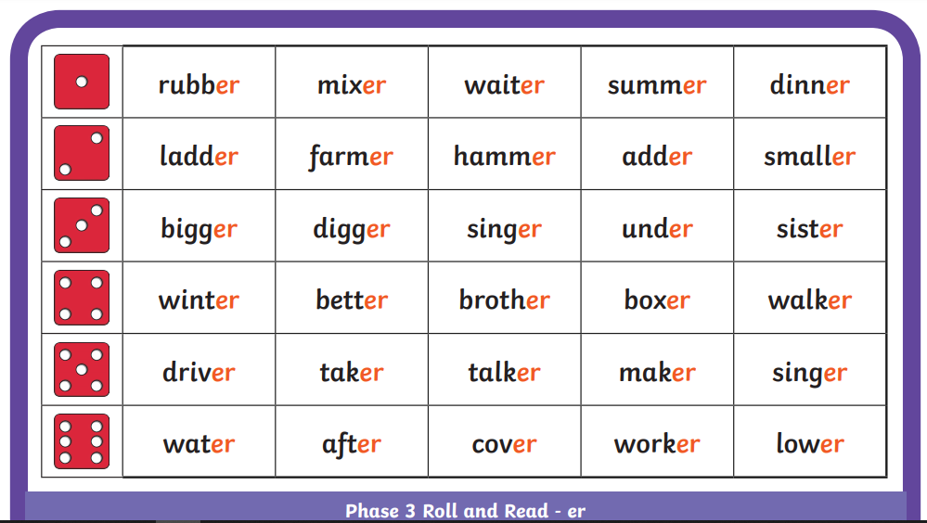
Sunshine Group er – better letter
After a brief phonic session can you complete this game that is in Wednesday’s folder. You don’t necessarily have to print it.
Once finished, it can be stuck into the front of your purple book.

Slide 5
How to Play Roll and Read
You can either: print this off and tick or colour in the words your child has read; or leave it on the screen to read.
Roll the dice and read the first word in that row, keep on rolling the dice and reading the words until you fill a complete row.

Slide 6


Continue with RWI
Begin by reading the Speed Sounds to an adult, as you did yesterday.

Slide 7

Continue with RWI
After that, you are ready to read through the Green and Red Words to an adult like you did yesterday.

Slide 8
Continue with RWI
Once you have read the speed sounds, green and red words, you are now ready to read the non-fiction text to an adult. Remember to pause at the full stops.

Slide 9
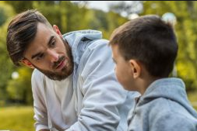
Our Structure for RWI
Today we have two activities to do:
Questions to Answer (a verbal activity, no writing!) - see page 14 of your reading book.
Get an adult ask you the questions. Don’t
forget to turn to the correct page to help
you to find the answer.
Remember to answer in full sentences.

Slide 10

Our Structure for RWI
2. Edit a Sentence.
On the following pages there is a sentence, one for each group to read.
We do this every week in class so they know that there are some mistakes and their job is to look carefully at the sentence to try to spot all of the errors.
Once they have done this they circle them and then copy the corrected sentence onto the Wednesday section of the Weekly Handout Sheet.

Slide 11

Edit a Sentence he has lost his cip. it is in the pit
There are 4 mistakes:
2 capital letters 1 spelling mistake
1 full stop
Once you have found the mistakes, circle them and then look at the next slide to check that you have found them all.

Slide 12
Edit a Sentence
he has lost his cip. it is in the pit
Now copy it up neatly (correct sentence on slide 15).
Did you spot all of the mistakes?

Slide 13
Edit a Sentence he went to play in the sand she went to play wiv the clay
There are 5 mistakes:
2 capital letters 1 spelling mistake
2 full stops
Once you have found the mistakes, circle them and then look at the next slide to check that you have found them all.

Slide 14

Edit a Sentence
he went to play in the sand she went to play wiv the clay
Now copy it up neatly (correct sentence on slide 15).
Did you spot all of the mistakes?

Slide 15
Edit a Sentence – correct sentences
He has lost his cap. It is in the pit.
He went to play in the sand. She went to play with the clay.

Slide 16

Stick your sheet in the front of your purple book.
Thank you for working hard.
Now have a break and a snack.

Slide 17
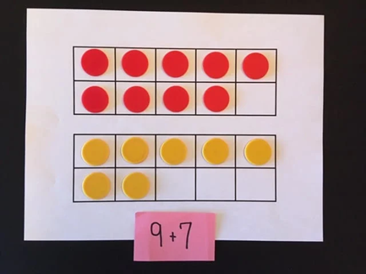

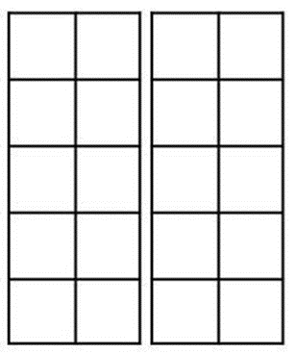
White Rose Maths
Add ones by using number bonds
You will need:
Add by Making 10 - calculations (2)
Add by making 10 calculation sheet
tens frames to make 20 and counters

Slide 18
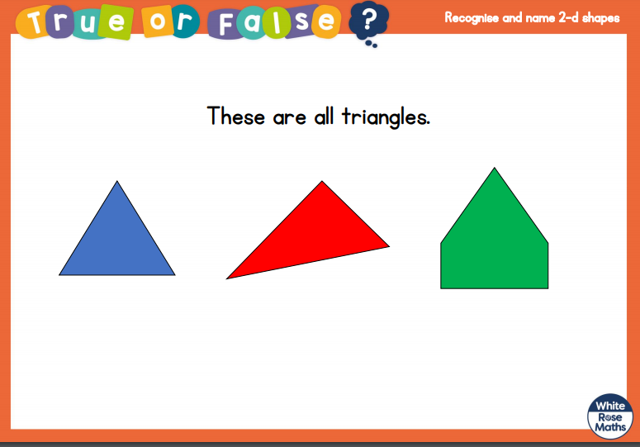
White Rose Maths
Is this true or false? (answer on slide 19)
.

Slide 19
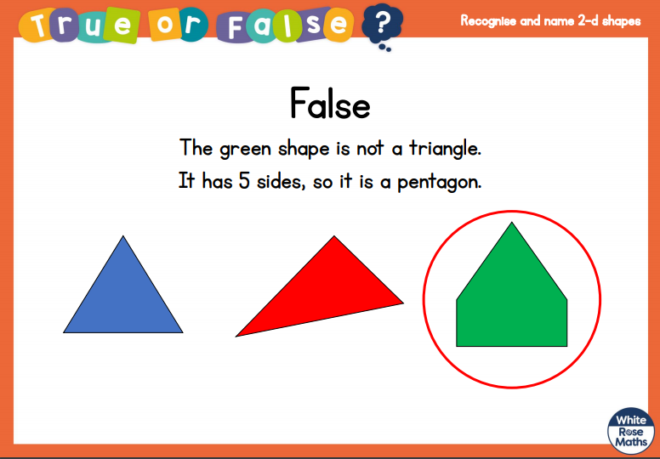
White Rose Maths

Slide 20

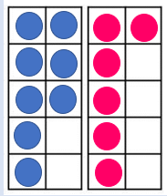
White Rose Maths
8 + 6 so 10 + 4 = 14
Remind yourself of yesterday’s teaching and activity.
Try these using your 10s frame and counters:
5 + 8 = 8 + 7 = 4 + 9 =
Don’t forget to write what you did: __ + __ so 10 + __ = __

Slide 21
White Rose Maths
Use this video link https://vimeo.com/492195871 and have a go at the ‘questions to think about’ slide.
Work through the video, feel free to pause it to explain any of the teaching.
Now you are ready to have a go at the worksheet.
Remember you can write your answers in your blue maths book to save printing it out.

Slide 22
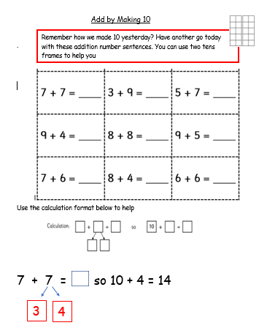
White Rose Maths
Now have
a go at
these number
sentences.
Some of you could have a go at writing it out as I have shown you at the bottom of this sheet. There is a sheet for you to fill in for this method.

Slide 23

If you have used a sheet, stick it into the front of your blue maths book.
We will continue with some White Rose teaching again tomorrow.
I think it is time for lunch and a break from your work.
There is a science session this
afternoon but enjoy your lunch
first.

Slide 24

Worship Time:
I Sing Pop
https://vimeo.com/487171013/2b85542e6d You will be asked to type in a password which is ‘spring’

Slide 25

Most importantly encourage your child to read a suitable book to you. Later on it would be great if you could read a bedtime story to them.
Please remember to send an email containing the work that they have done to teacher@kingslandengland.hereford.sch.uk

