Slide 1


Tuesday 2nd February 2021
Below is the timetable for today.
It is here to give you a guide on today’s work.
For RWI you will need the sounds sheet oy/er. For maths you will need access to the Add by making 10 calculations and Add by making 10 tens frame.
 | phonics | RWI |  | maths – White Rose Vimeo link and worksheet |  | afternoon | 2:45 assembly via email | time to share a book
9am On-line registration | Rainbow Group oy – toy for a boy Sunshine Group er – better letter | Ken’s Cap Playday -Speed Sounds -Red and Green words -Read story -Hold a Sentence | BREAK | Add by Making 10 https://vimeo.com/492195871 worksheet | LUNCH | Topic Arctic Animals | Mr Debenham | Reading Time

Slide 2

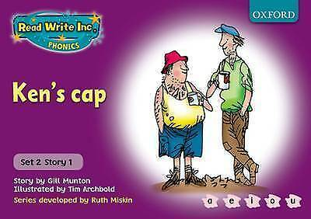


RWI
Each day for RWI you will need:
Rainbow Group Sunshine Group
Ken’s Cap Playday book book
‘Weekly Writing sheet’ RWI (from your pack)

Slide 3
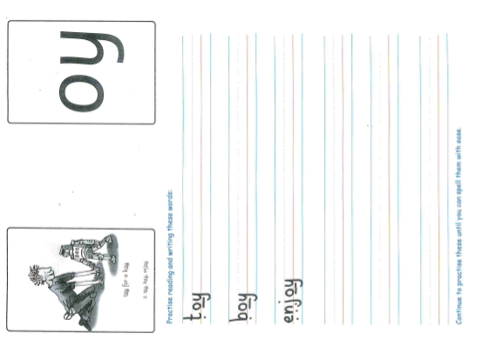
Rainbow Group oy is our sound for this week
After a brief phonic session can you complete this phonic sheet that is
in the folder.
Once you have finished it, it can be stuck into your green home-learning book.

Slide 4
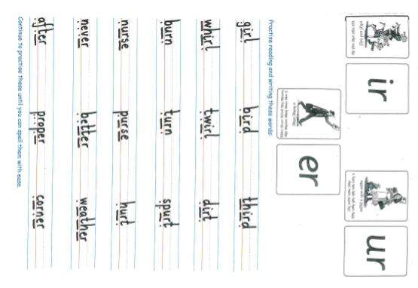
Sunshine Group er is our sound for this week
After a brief phonic session can you complete this phonic sheet that is
in the folder.
Once you have finished it, it can be stuck into your green home-learning book.

Slide 5


Continue with RWI
Begin by reading the Speed Sounds to an adult, as you did yesterday.

Slide 6

Continue with RWI
After that, you are ready to read through the Green and Red Words to an adult like you did yesterday.

Slide 7
Continue with RWI
Once you have read the speed sounds, green and red words, you are now ready to read the book to an adult. Remember to pause at the full stops.

Slide 8

Our Structure for RWI
Now you are ready for the second Hold a Sentence (see next slide for the sentence for each group)
Get your Weekly Writing Sheet for Tuesday and listen to your adult say the sentence out loud to you. Remember to do the actions for capital letter and full stop. Repeat at least 3 times before you write it down.

Slide 9

Rainbow Group
Today’s Hold a Sentence is:
The mud is in the big pit.
remember:
Sunshine Group
remember:
Today’s Hold a Sentence is:
I will play with the wet sand.

Slide 10
Our Structure for RWI
Now you are ready to write the Hold a Sentence down on your paper.
Don’t forget to use
a capital letter
a full stop
finger spaces
neat handwriting.
Look at slide 11 so you can check your Hold a Sentence.

Slide 11
Time to check
Rainbow Group
The mud is in the big pit.
Sunshine Group
I will play with the wet sand.

Slide 12

Stick your sheet in the front of your purple book.
Thank you for working hard.
Now have a break and a snack.

Slide 13
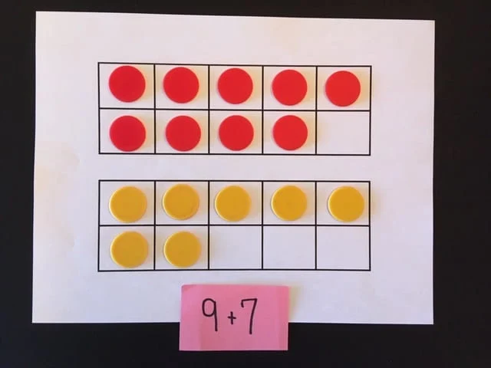

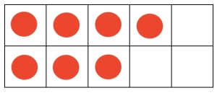
White Rose Maths
Add by making 10
You will need:
maths sheets from Tuesday’s file
20 ‘counters’

Slide 14
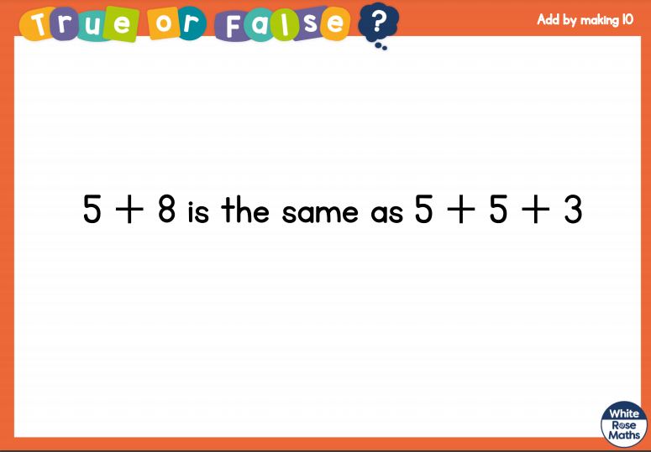
White Rose Maths
Is this true or false?

Slide 15
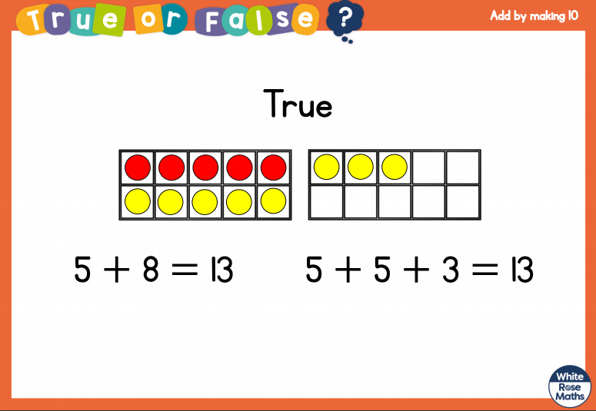
White Rose Maths

Slide 16
White Rose Maths
Use this video link https://vimeo.com/492195041 and have a go at the ‘questions to think about’ slide.
Work through the video, feel free to pause it to explain any of the teaching.
Now you are ready to have a go at the worksheet.
Remember you can write your answers in your blue maths book or use the ppt link to save printing it.

Slide 17
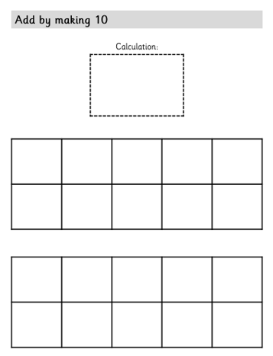
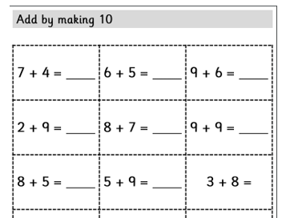
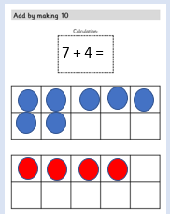
Using the sheets below:
place counters representing the larger number on the first tens frame and place other counters on second tens frame.
So 7 + 4 =

Slide 18
Move counters from second tens frame to fill the first tens frame. So you have 10 + 1 = 11.
7 + 4 so 10 + 1 = 11
7 + 4 =

Slide 19

If you have used a sheet, stick it into the front of your blue maths book.
We will continue with some White Rose teaching again tomorrow.
I think it is time for lunch and a break from your work.
There is a topic session in files for
this afternoon but enjoy your
lunch first.

Slide 20

Most importantly encourage your child to read a suitable book to you. Later on it would be great if you could read a bedtime story to them.
Please remember to send an email containing the work that they have done to teacher@kingslandengland.hereford.sch.uk

Slide 21

Worship Time with:
Mr. Debenham

