Slide 1
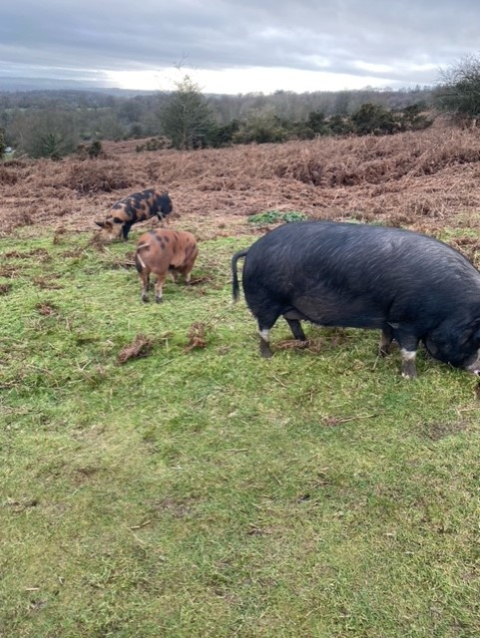
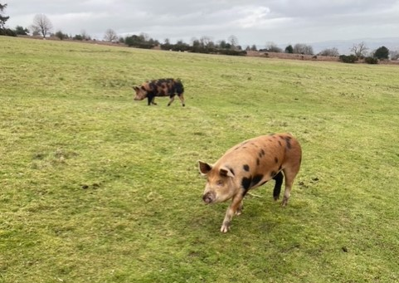
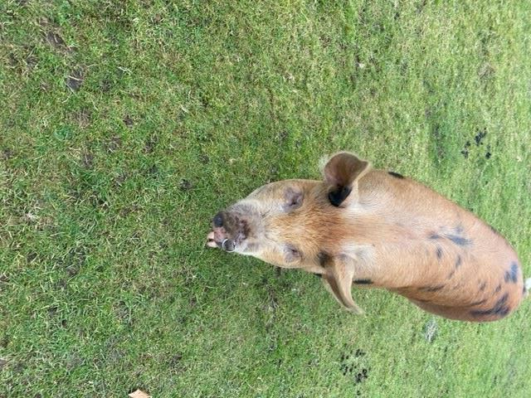
Monday 1st February 2021
Somebody has spotted us again up on Bircher Common.

Slide 2

Monday 1st February 2021
For maths you will need a 0 – 10 cards and a copy of the add on to make 10 sheet in the file.
For RWI you will need a copy of the Ken’s Cap or Playdays book.
 | phonics | RWI |  | maths – White Rose Vimeo link and worksheet |  | afternoon | 2:45 assembly via email | time to share a book
9am On-line registration Story | Rainbow Group oy – toy for a boy Sunshine Group er – better letter | Ken’s Cap Playday -Speed Sounds -Red and Green words -Read story -Hold a Sentence | BREAK | Add by making 10 https://vimeo.com/492195871 Add by Making 10 sheet | LUNCH | RE 99 names of Allah Music Pulse – lesson 2 | Rev Julie | Reading Time

Slide 3




RWI
Each day for RWI you will need:
Rainbow Group Sunshine Group
Ken’s Cap Playday book book
‘Weekly Writing sheet’ RWI (from your pack)
Could you please download the relevant book for your child as we will continue to read it throughout the week.

Slide 4


Rainbow Group
Our new sound for this week: oy

Slide 5
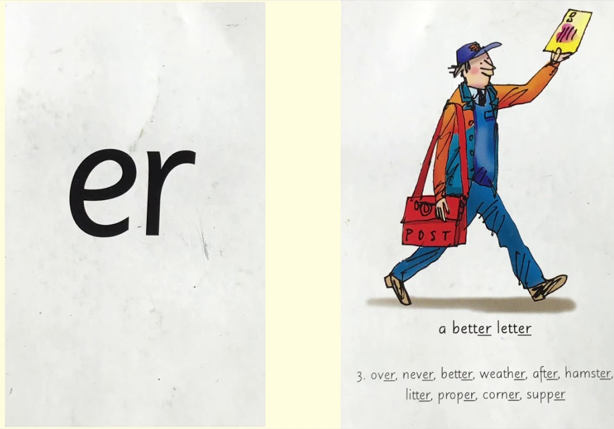
Sunshine Group
Our new sound for this week: er

Slide 6


Our Structure for RWI
Begin by reading the Speed Sounds to an adult (just like we do in class).

Slide 7

Our Structure for RWI
After that you are ready to read through the Green and Red Words to an adult (just like we do in class).

Slide 8
Our Structure for RWI
Adults could you look at the vocabulary list and make sure that your child knows what each word means. Then you are ready to talk through the introduction with your child.

Slide 9
Our Structure for RWI
You are now ready to read your book to an adult. Remember to pause at a full stop.

Slide 10

Our Structure for RWI
Once you have completed this, then you are ready to work on the Hold a Sentence (see next slide for the sentence for each group)
Get your Weekly Writing Sheet for Monday and listen to your adult say the sentence out loud to you. Remember to do the actions for capital letter and full stop. Repeat at least 3 times before you write it down.

Slide 11

Rainbow Group
Today’s Hold a Sentence is:
The truck is full of mud.
tricky word:
of
Sunshine Group
Today’s Hold a Sentence is:
You may play with the clay.
tricky word: you

Slide 12
Our Structure for RWI
Now you are ready to write the Hold a Sentence down on your paper.
Don’t forget to use
a capital letter
a full stop
finger spaces
neat handwriting.
Look at slide 12 so you can check your Hold a Sentence.

Slide 13
Time to check
Rainbow Group
The truck is full of mud.
Sunshine Group
You may play with the clay.

Slide 14

Stick your sheet in the front of your purple book.
Thank you for working hard.
Now have a break and a snack.

Slide 15

White Rose Maths
Add by counting on (practical)
You will need:
0 - 10 number cards (written on squares of paper)
Add by Making 10 sheet
tens frames and counters

Slide 16
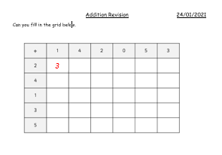
White Rose Maths
Have a look in files for Addition Revision. You looked at this last week and again, I would like you to see how quickly you can fill in the addition grid.

Slide 17
White Rose Maths
Use this video link https://vimeo.com/492195041
and have a go at the ‘questions to think about’ slide.
Work through the video, feel free to pause it to explain any of the teaching.
Play the first game that Amir and Eva played. After watching the video complete the Add by Making 10.
Please can you write your answers in your blue maths book.

Slide 18


We will continue with some White Rose teaching again tomorrow.
I think it is time for lunch and a break from your work.
This afternoon I would like you to
complete the R.E session, find the
Power Point in the files. Then follow
the link for music (also in files); but
enjoy your lunch first.

Slide 19

Worship Time with:
Rev. Julie

Slide 20

Most importantly encourage your child to read a suitable book to you. Later on it would be great if you could read a bedtime story to them.
Please remember to send an email containing the work that they have done to teacher@kingslandengland.hereford.sch.uk

