Slide 1


Friday 29th January 2021
Below is the timetable for today.
It is here to give you a guide on today’s work.
For maths you need to be able to see or have a copy of the worksheet and game. For RWI you need the red words to spell sheet.
 | phonics | RWI |  | maths – White Rose Vimeo link and worksheet |  | afternoon | 2:45 assembly via email | time to share a book
9am On-line registration | Rainbow Group ou – shout it out Sunshine Group ur – nurse with a purse | We can all swim Bats -Speed Sounds -Red and Green words -Read story -Big Write | BREAK | Find and make number bonds https://vimeo.com/490882337 worksheet | LUNCH | PE and Golden Time | Big Joe | Reading Time

Slide 2

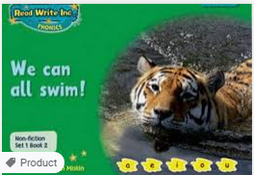


RWI
You will need:
Rainbow Group Sunshine Group
We can all swim! Bats book book
‘Weekly Writing sheet’ RWI (from your pack)

Slide 3
Rainbow Group ou – shout it out
Today we are going to have a very brief start to our phonic session to read through the green words.

Slide 4
Sunshine Group
ur – nurse with a purse
Today we are going to have a very brief start to our phonic session to read through the green words.

Slide 5
Sunshine and Rainbow Groups
Yesterday we had the Spelling Quiz.
I would like you to look back at your quiz and see which words (if any) you found a challenge.
I would like you to practise these words so you are able to spell them with ease.

Slide 6
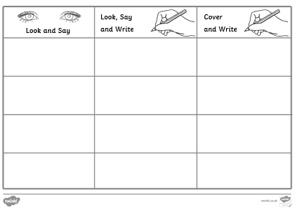
Sunshine and Rainbow Groups
In the Friday file are the red (tricky) words that you have been reading in your RWI book this week.
I would now like you to try to learn how to spell these words so you are able to spell them with ease.

Slide 7
Sunshine and Rainbow Groups
Look at the words in the Look and Say column. You need to take your time to look at each word, say the letters out loud, look at the shape of the word and try to write it in the air.
Once you think you know how to spell them, have a go in the second column.
In the final column, cover the words up and write them.

Slide 8
Sunshine and Rainbow Groups
If you have time, write two different sentences using these words.
Use the handwriting lines to help you to keep it neat.

Slide 9


Continue with RWI
Begin by reading the Speed Sounds to an adult, as you did yesterday.

Slide 10

Continue with RWI
After that, you are ready to read through the Speed Words (on page 15 of your book) to an adult.

Slide 11
Continue with RWI
Now you are ready to read the book to an adult. You have been working on this story all week so you should be getting very confident!
Remember to think about your expression to make it interesting to listen to and pausing for punctuation.

Slide 12

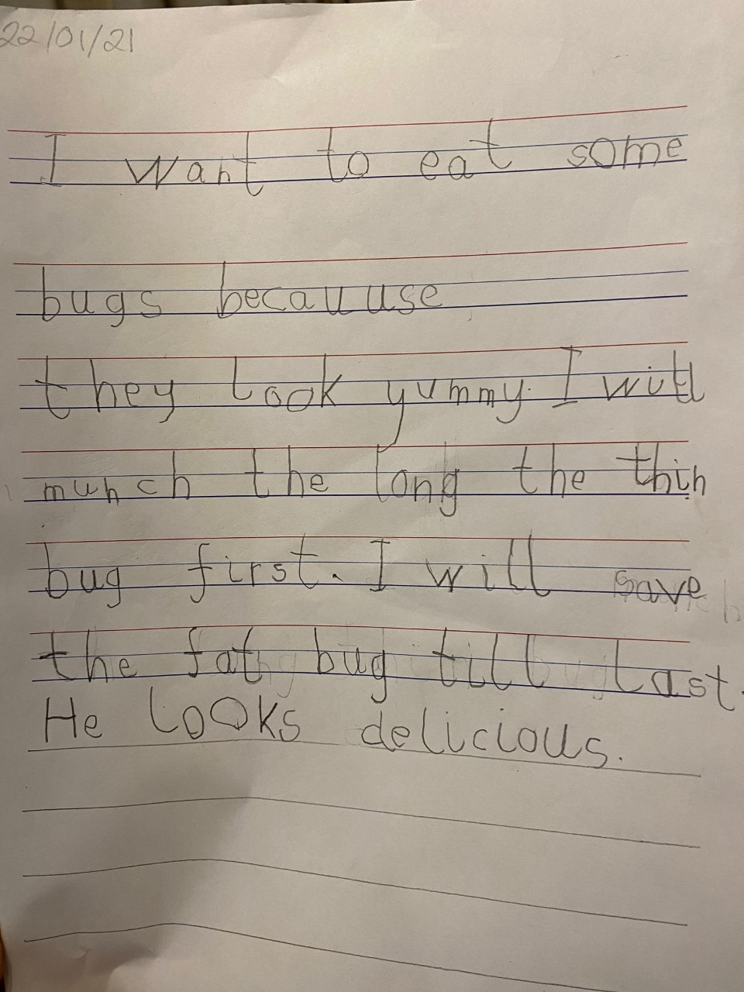
Star Big Write Work

Slide 13
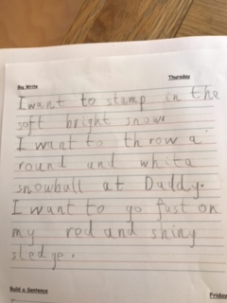
Star Big Write Work

Slide 14

Our Structure for RWI
Today is the final day of RWI for the week.
This is when we do our Big Write. We base this around the book that we have been reading in RWI. This week we are writing non-fiction texts.
This Photo by Unknown Author is licensed under CC BY

Slide 15
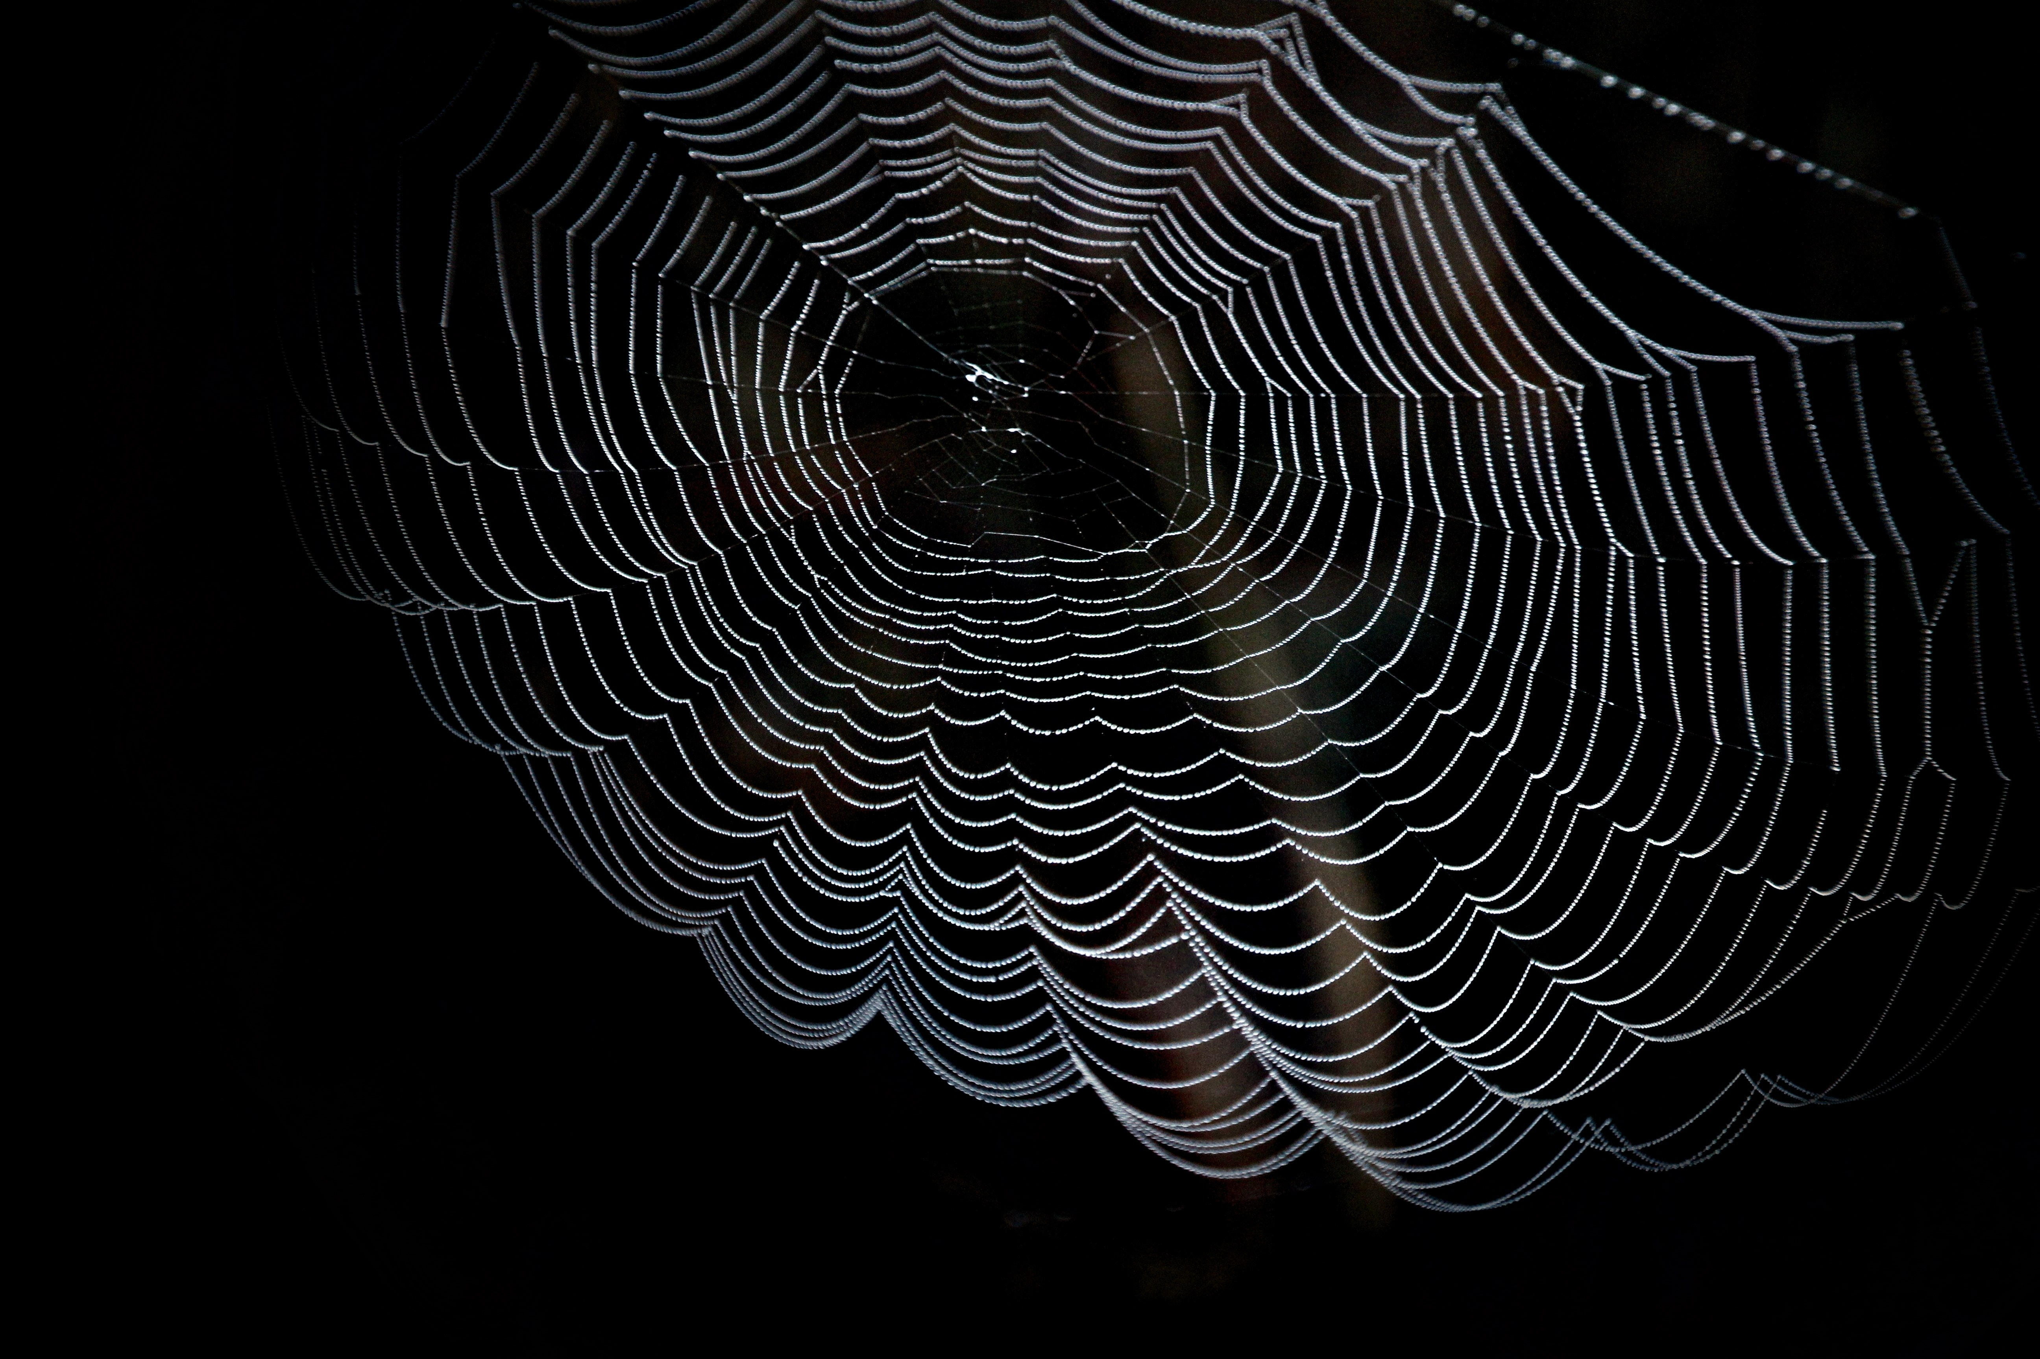
Rainbow Group - Big Write
To start with, we are thinking about the fish. Think about where he is and what is with him?
The fish…
Now think about the duck. Where is he?
What is around him?
The duck…

Slide 16
Rainbow Group - Big Write
I would like you and your adult to think of some words to help you with your writing:
1. Think about where the fish is.
2. How is he moving?
3. What is in there with him?
Now do the same for the duck and use this to help you with your writing.

Slide 17
Rainbow Group - Big Write
Here is an example of my sentence.
The tiny fish is darting around the weeds in the brightly lit tank.
Using the stem sentences The fish
The duck
Think of a sentence for the fish and one for the duck. Don’t forget to use adjectives (describing words) and the wow words from yesterday’s Build a Sentence.

Slide 18
Big Write
Sunshine Group - Big Write
Today we are going to write some bat facts.
1. Talk to your adult about some different facts that you have found out about bats.
2. Now watch one of the clips below and talk to your adult about some new facts that you have learnt today. https://www.youtube.com/watch?v=9FVoTMOorXA https://www.youtube.com/watch?v=2Mii45v85YY
3. Decide on at least 4 facts that you want to write about. Say the sentence out loud to an adult.

Slide 19
Sunshine Group - Big Write
Use these ideas to write an information text. I have started my writing below.
Bats sleep in the day and come out at night.
They are timid mammals.
Each new point begins with a bullet point and I have varied how I have started my sentences.

Slide 20

Big Write
You are ready to think about how you can use these words in some super sentences.
Talk through your sentences with an adult, one sentence at a time. When you are happy with your sentence, ‘put your headphones on’ say it again and then write it down.
I will look forward to reading your finished pieces of writing.
Don’t forget to use neat handwriting, finger spaces, capital letters and full stops.

Slide 21

Stick your sentence on the next page at the front of your purple book.
Thank you for working hard.
Now have a break and a snack.

Slide 22

White Rose Maths
Find and make number bonds
You will need:
Friday’s worksheet found in the files
to be able to see a copy of the number bonds to 10 poem
number bonds to 10 maths game

Slide 23

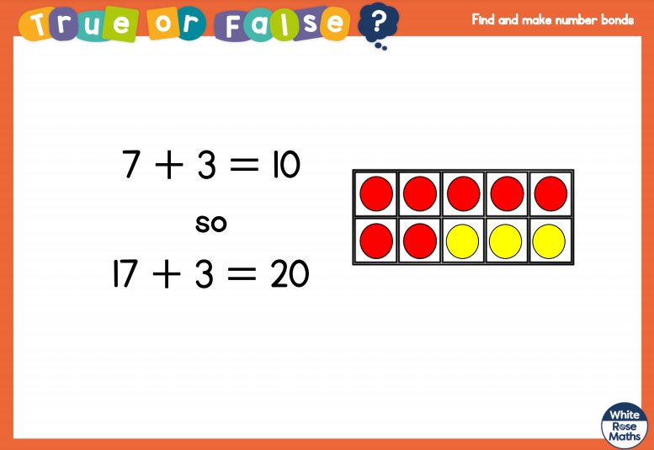
White Rose Maths
Talk about this to your adult.

Slide 24
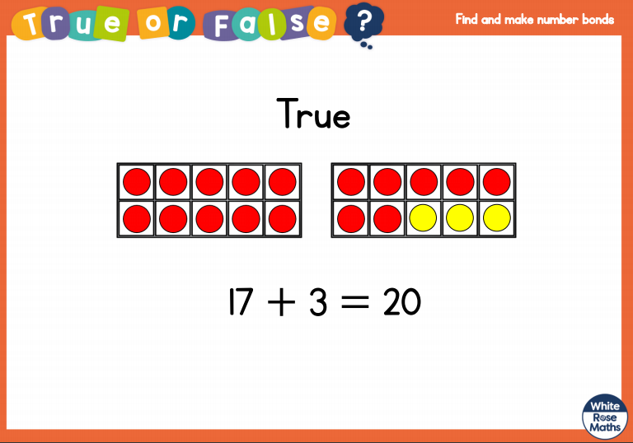
White Rose Maths

Slide 25
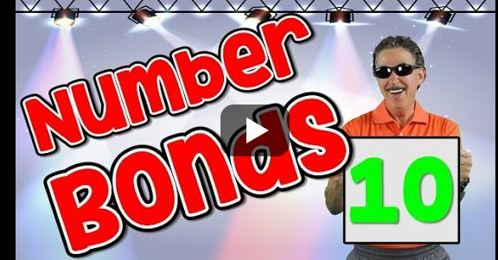
White Rose Maths
https://www.google.com/search?q=jack+hartman+number+bonds+to+10&ie=&oe=
Watch this Jack Hartman clip on number bonds to 10. Remember to get up and join in with the actions and try to learn the words of the song so you can sing along with him.

Slide 26
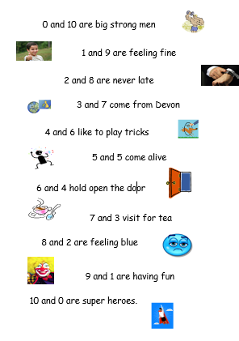
White Rose Maths
In today’s maths file there is a poem that I would like you to try and learn over the coming weeks.
This poem is all about the number bonds
that make 10. If you learn this poem,
it will help you to remember those key Instant Recall Facts (KIRFs) that we practise in our maths lessons.

Slide 27
White Rose Maths
Use this video link https://vimeo.com/490882337 and have a go at the ‘questions to think about’ slide.
Work through the video, feel free to pause it to explain any of the teaching.
Now you are ready to have a go at the White Rose maths worksheet.
Remember you can write your answers in your blue maths book to save printing it out.

Slide 28

If you have used a sheet, stick it into the front of your blue maths book.
We will continue with some White Rose teaching again tomorrow.
I think it is time for lunch and a break from your work.
.
This afternoon there is a PE session
and after that it is Golden Time.
First of all go and enjoy your lunch.

Slide 29

Worship Time:
Big Joe
https://youtu.be/i-oyAw3nVKs

Slide 30

Most importantly encourage your child to read a suitable book to you. Later on it would be great if you could read a bedtime story to them.
Please remember to send an email containing the completed work to teacher@kingslandengland.hereford.sch.uk

