Slide 1

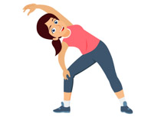
PE
If you can get outdoors please do. You could try these activities to keep active:
Go for a long brisk walk
Ride your bike or scooter
Play some football or just kick a ball around
Play on outdoor equipment
If you can’t get out, follow the link on the slide for a workout, dance or gymnastic session.

Slide 2
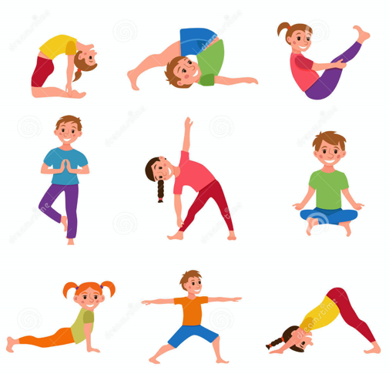
Today we are going to follow the Oak Academy PE Video
This lesson is about different balances.
make sure you are comfortably dressed
you have a safe space to move in
follow the link and instructions below
https://classroom.thenational.academy/lessons/an-introduction-to-basic-balance-ccwk2d?activity=video&step=1

Slide 3
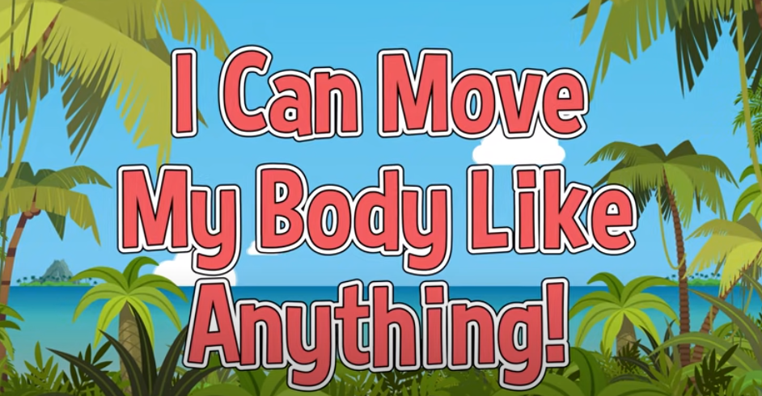
Follow the Link to Get Moving
https://www.youtube.com/watch?v=uzAl5gHD5-I

