Slide 1


Thursday 28th January 2021
Below is the timetable for today.
It is here to give you a guide on today’s work.
For RWI you will need to be able to see a copy of the words for the Spelling Quiz. For maths you need to be able to see a copy of the second part of the worksheet and number cards from 0-10.
 | phonics | RWI |  | maths – White Rose Vimeo link and worksheet |  | afternoon | 2:45 assembly via email | time to share a book
9am On-line registration | Rainbow Group ou – shout it out Sunshine Group ur – nurse with a purse | We can all swim! Bats -Speed Sounds -Red and Green words -Read story -Build a Sentence | BREAK | Add ones by using number bonds https://vimeo.com/490880277 | LUNCH | ICT and PE | Mark Harrington | Reading Time

Slide 2




RWI
You will need:
Rainbow Group Sunshine Group
We can all swim! Bats book book
‘Weekly Writing sheet’ RWI (from your pack)

Slide 3
Rainbow Group ou – shout it out
Today we are going to have a very brief start to our phonic session to read through the graphemes and then we will move onto our Spelling Quiz. The words for the quiz are in Thursday’s file.

Slide 4
Sunshine Group ur – nurse with a purse
Today we are going to have a very brief start to our phonic session to read through the graphemes and then we will move onto our Spelling Quiz. The words for the quiz are in Thursday’s file.

Slide 5


Continue with RWI
Begin by reading the Speed Sounds to an adult, as you did yesterday.

Slide 6

Continue with RWI
After that, you are ready to read through the Speed Words (on page 15 of your book) to an adult.

Slide 7
Continue with RWI
Once you have read the speed sounds and Speed Words you are ready to read the book to an adult. Remember to think about your expression to make it interesting to listen to.

Slide 8
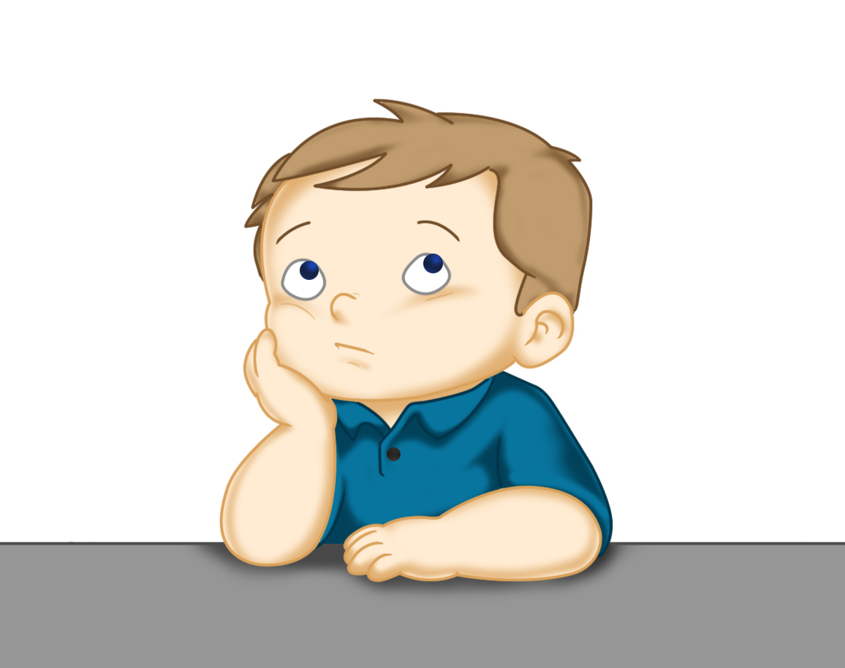
Our Structure for RWI
Build a Sentence
The aim of this task is to help to build (improve) your vocabulary.
On the next slide there are some words that I would like you to discuss with your adult. Make sure you know what they mean, think of other words that mean the same (synonyms).
Now think of an exciting sentence for each of these words.
This Photo by Unknown Author is licensed under CC BY

Slide 9

Build a Sentence
glide paddle gracefully
You may like to think about:
When it happened?
What or who did this?
Where did it happened?
to help you to build an exciting sentence.
Write out 2 of your sentences using capital letters and full stops.

Slide 10
Build a Sentence
timid shy frightening alarming
You may like to think about:
When it happened?
Who did it happened to?
Where did it happened?
What happened?
to help you to build an exciting sentence.
Write out 2 of your sentences using capital letters and full stops.

Slide 11

Stick your sentence on the next page at the front of your purple book.
Thank you for working hard.
Now have a break and a snack.

Slide 12


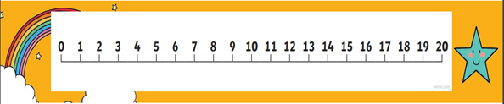
White Rose Maths
Add ones by using number bonds
You will need:
maths sheet from Thursday’s file

Slide 13
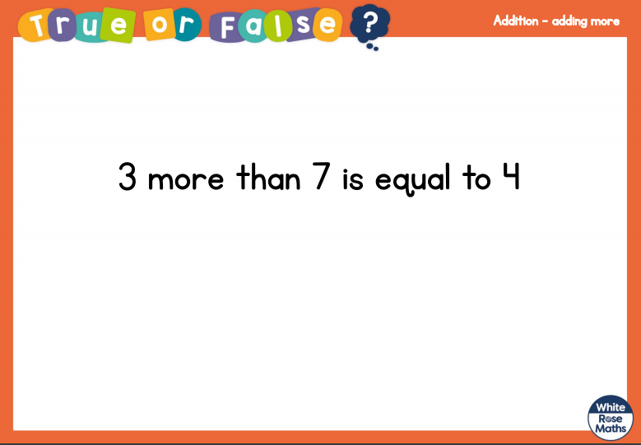
White Rose Maths
Is this true or false? (answer on slide 19)

Slide 14
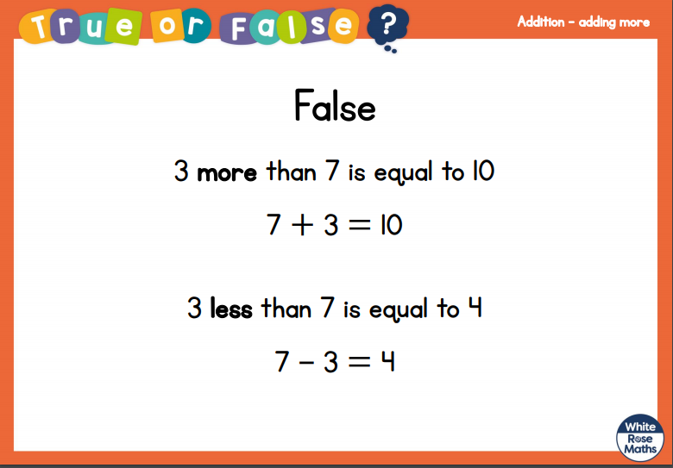
White Rose Maths

Slide 15

White Rose Maths
Today I would like your child to have some numbers from 0-10 written on cards.
They pick a number (part) and tell you the ‘partner number’ to make 10 (whole).
Show in a part, part, whole model. If they find this tricky, use the counting on method like we have already been working on by either using fingers, counters, the number line or tens frames.
2
10
2
8

Slide 16
White Rose Maths
Use this video link https://vimeo.com/490880277 and have a go at the ‘questions to think about’ slide.
Work through the video, feel free to pause it to explain any of the teaching.
Now you are ready to have a go at the maths sheet – it isn’t a White Rose worksheet today.
Remember you can write your answers in your blue maths book to save printing it out.

Slide 17

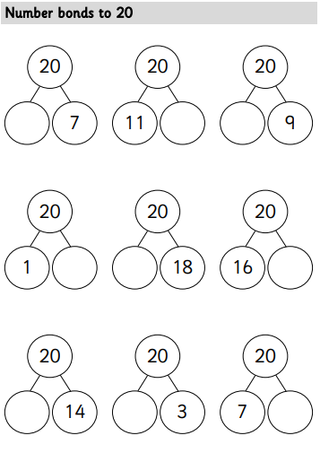
White Rose Maths
Challenge – to complete these

Slide 18

If you have used a sheet, stick it into the front of your blue maths book.
We will continue with some White Rose teaching again tomorrow.
I think it is time for lunch and a break from your work.
.
This afternoon there is an ICT
lesson and a PE session. First of all
enjoy your lunch.

Slide 19

Worship Time:
Mark Harrington
https://youtu.be/NlSDvQ6bYdM password: spring

Slide 20

Most importantly encourage your child to read a suitable book to you. Later on it would be great if you could read a bedtime story to them.
Please remember to send an email containing the completed work to teacher@kingslandengland.hereford.sch.uk

