Slide 1


Slide 2

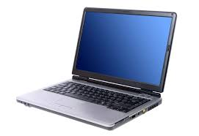
Here are the next 2 lessons on Digital Literacy

Slide 3
Lesson 5: How can you use the internet?
https://www.bbc.co.uk/bitesize/topics/zymykqt/articles/zgqfyrd
You can click on the items to discover the uses of the internet.

Slide 4
Lesson 6: How to take care of your personal information?
https://www.bbc.co.uk/bitesize/topics/zymykqt/articles/zwbq7ty
Again, you click on the items to find out more about personal information.

Slide 5

On the website, it asks a question.
Mouse wants to play a game, but has forgotten his password. He asks Hedgehog to tell him her password. What should Hedgehog do?

